Slide 1
Security-n-Compliance: is Hard!
(Lets make it easy!)

Slide 2
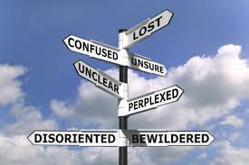
Security-n-Compliance (Project Proposal)
Problem: Security and compliance are complex and difficult for small business entities to address. Many businesses but don’t have the resources either technical or financial to meet them. Many security and compliance lapses result in business failures due to fines and legal issues. Hiring security professionals is expensive.
Solution: Develop a web based portal to support to small business security and compliance needs. Put the knowledge of an expert in the portal. Build in examples of what the requirements are about, and provide automated reminders to business when they need to complete specific tasks to maintain security and compliance.

Slide 3
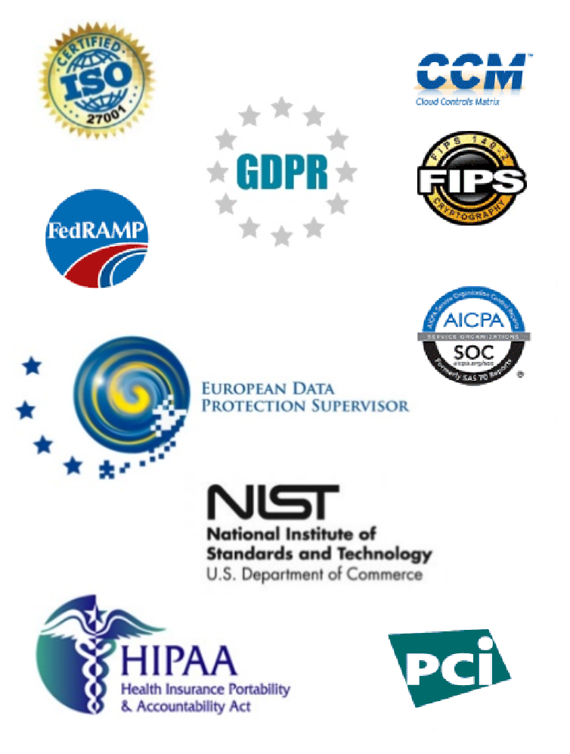
Security-n-Compliance (Project Proposal)
Ok there are lots of security and compliance standards!
(THIS is the SHORT LIST!)
Where does one start?

Slide 4
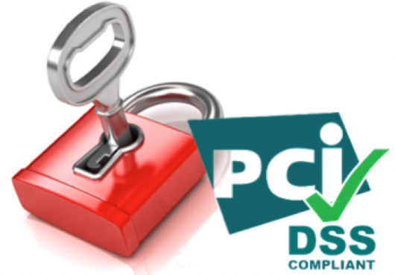
Security-n-Compliance (Project Proposal)
Where to start? PCI Compliance!
What is PCI Compliance? Payment Card Industry (Credit Card Security)
Why? Well defined and mature security standard.
Standard form based questionnaires
Basic Responses (YES, Yes w/CCW, No, NA)
Supporting documentation can be PDF/DOC’s
Global Standard
Impacts companies large & small! (Target/HomeDepot/Marriot)
Who Can Help? Your Project Sponsor!
10year + Veteran of PCI, PCI-ISA, CISA, CISSP, CRISC
On campus everyday!

Slide 5
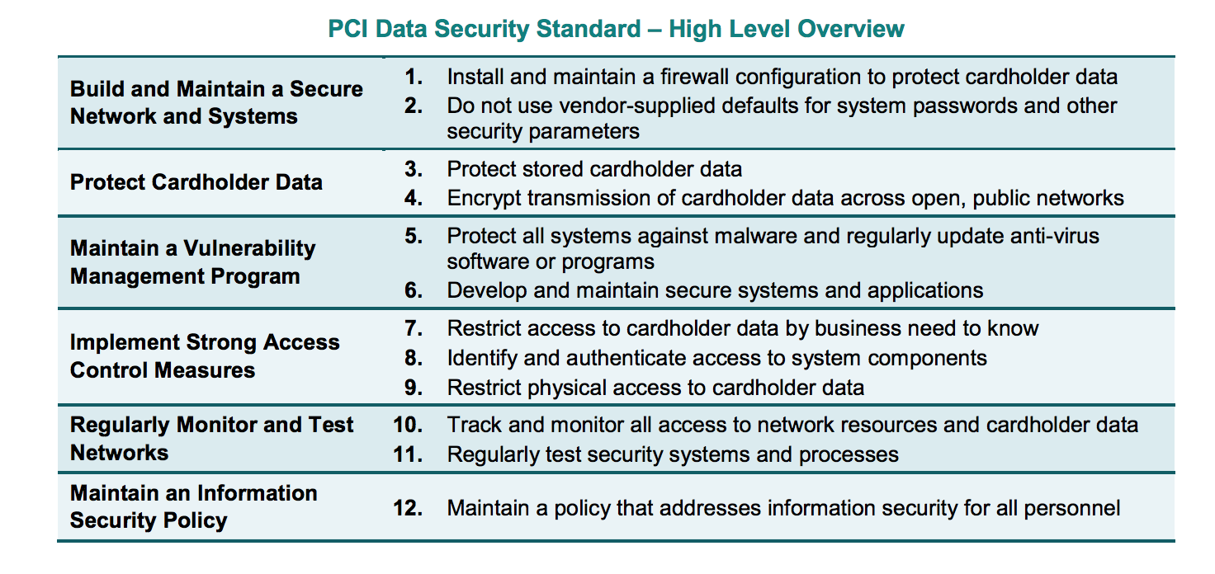
Security-n-Compliance (Project Proposal)
PCI is straight forward!

Slide 6
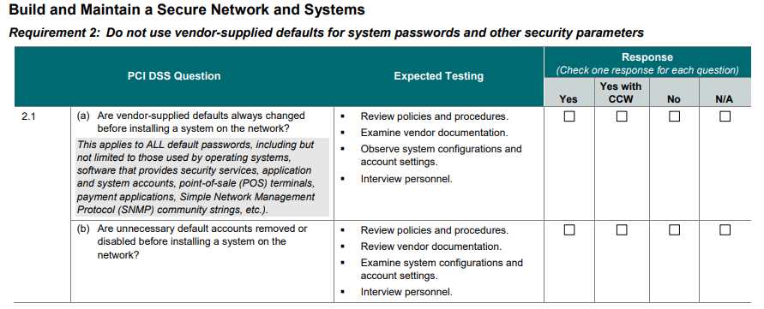
Security-n-Compliance (Project Proposal)
The actual requirements are not overly technical, but this can be made SUPER EASY!
The web app forms will be made to look like PCI Forms, with links to expert tips & examples!
The web app forms will support attached supporting documents and reminders

Slide 7
Security-n-Compliance (Project Proposal)
What skills are needed?
Database Design
Web Design
Data Integration
Cloud Services
Test / Development
CAN DO ATTITUDE!

Slide 8
Security-n-Compliance (Project Proposal)
So what do you think?

