Slide 1
BEDSIDE SICU PHARMACY Mobile App
Dr. John Yoon
Dr. Oyshik Banerjee

Slide 2
The Big PICTURE
There are thousand of medications that are given on a daily basis in the Surgical Intensive Care Unit (SICU)
Knowing the indications is only one part of deciding to give a certain medication
Giving care for a patient in the intensive care unit requires a team of doctors, nurses, pharmacists, therapists, and technicians.
Major hospitals are able to provide elite level of care because of these resources

Slide 3
The ICU
Critically Ill
Acuity
Organ Systems
Patients require multiple medications and quickly deteriorate
When patients are “crashing”, physicians need to make quick decisions
Each medication has a side effect affecting other organs
Physicians need to make immediate life saving decisions

Slide 4
The Problem
Resources
Cost
Trust
Accuracy
Audience
Being able to memorize important facts are difficult
Mobile apps cost money and smaller hospitals do not have access to pharmacists
Numerous sources on the internet that cloud the important information
Current mobile apps do not reference to studies
Apps need to focus on the providers

Slide 5
Solution
Create a mobile app that is targeted for ICU physicians
Easy to navigate
Intuitive and easy to use
Allow providers to make educated decisions
Create an ICU provider community
Free

Slide 6
Scenario
Severely withdrawing patient
Clinician wants to use a benzodiazepine
Would like fastest acting one NOW, preferably short acting
Bedside SICU Pharmacy
Urgent
Dynamic
Collaborative
Now need a longer acting agent to schedule
Bedside SICU Pharmacy

Slide 7
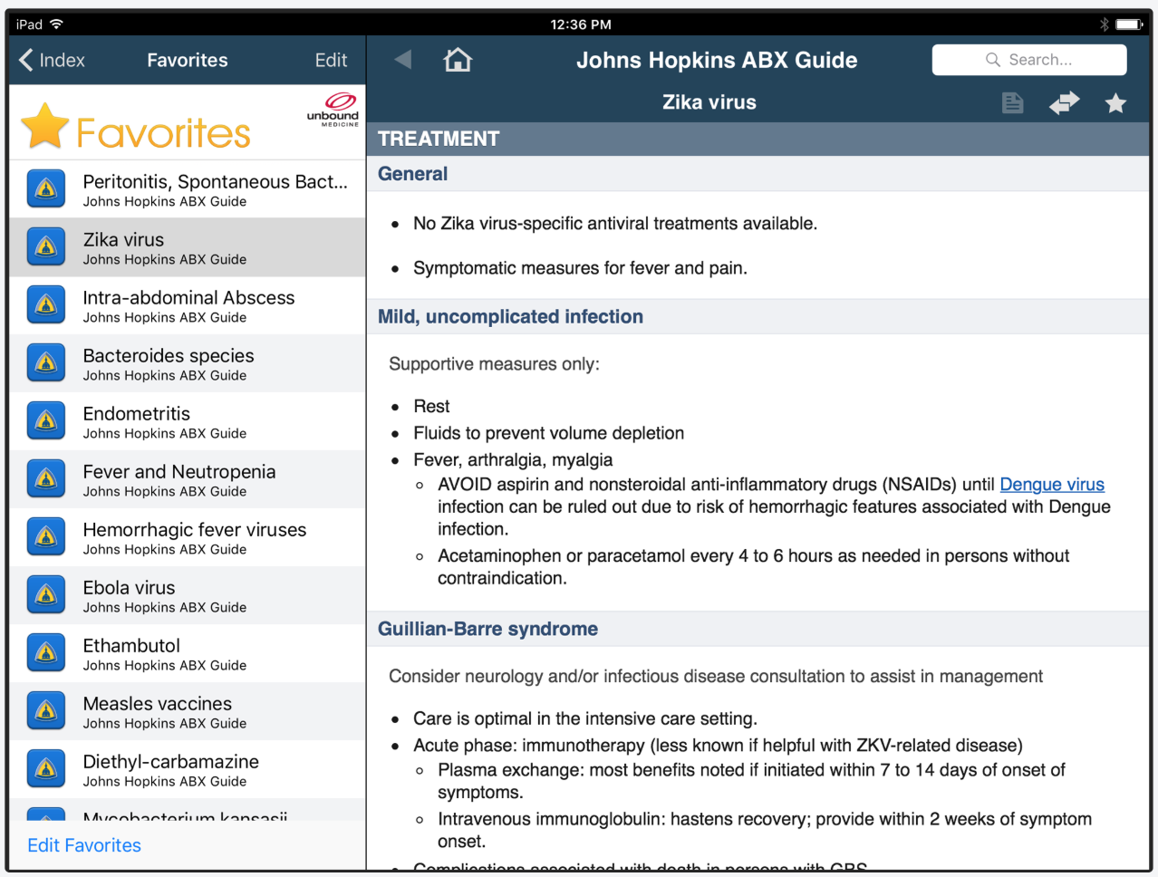
Product
Consider:
Succinct
Organized
Intuitive

Slide 8
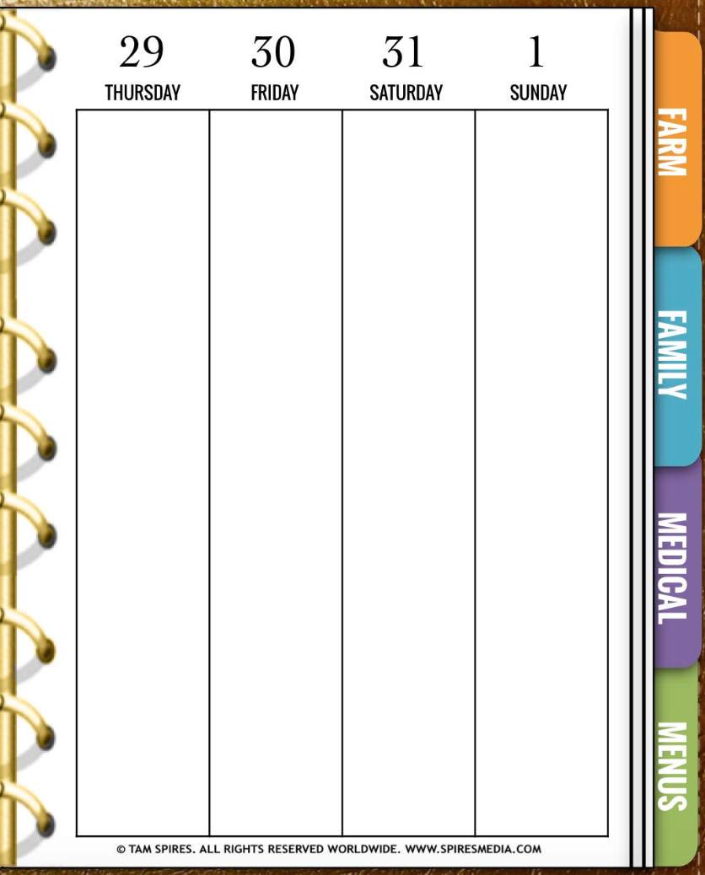
Notecard Feel
BENZODIAZIPINES
Alprazolam (Xanax)
Chlordiazepoxide (Librium)
Diazepam (Valium)
Lorazepam (Ativan)
Midazolam (Versed)
Dose
Kinetics
Metabolism/Excretion
Contraindications/Warnings
Temazepam (Restoril)
Pharmaceutical classes
Succinct
Organized
Intuitive
Bedside
Rounds
Dynamic dose calculator

Slide 9
Dynamic Components
Up to date ticker for new evidence
Discussion board

Slide 10
Thank You
Dr. John Yoon and Dr. Oyshik Banerjee
310-402-8093
johnyoon08@gmail.com
https://www.med.unc.edu/surgery/trauma/

