Slide 1
WeatherWays
Mapping Application integrating current Weather/Events

Slide 2
Application Overview
Concept combines Route Mapping, Weather and Traffic Patterns
- Predictively models Optimal Route accounting for:
- Anticipated Weather
- Anticipated Traffic
- Road Construction
- Current event (Sports, Concerts, VIP visit, news worthy, ..)
- Any incidentals which may occur during travel (newly developed conditions
- Multi – route calculation
- Target market
- Transportation Carriers
- Business Travelers
- Casual travelers
- Changing condition alerts as traveling
- New data influencing route efficiency
- iPhone and Android UX delivery, web secondary

Slide 3
Integrations
Google Maps API
- Integrates Picture views for trouble areas with current views
- Shows projected traffic issues based on traffic volume at projected time
Weather API
- Integrates current alerts that may impact travel at project time in the area
Enables SMS alerts to centralized numbers (delivery destination)
Already own URL – www.weatherways.com

Slide 4
Revenue Model
In application Advertising (like Weather Underground)
Fee based model to transportation businesses
Subscription Service

Slide 5
Google Mapping API

Slide 6
Notes:
https://www.wunderground.com/weather/api (fee service)

Slide 7
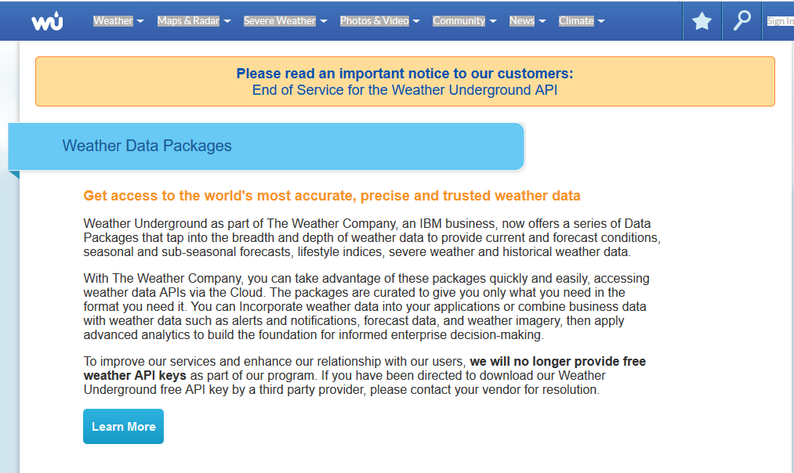
Notes:
https://www.wunderground.com/weather/api (fee service)

