Slide 1
ITK Performance Visualization
UNC COMP 523 Projects
Matt McCormick, PhD, Kitware, Inc
January 16th, 2019

Slide 2
The Insight Toolkit (ITK)
The Insight Segmentation and Registration Toolkit (ITK) is an open-source, freely available, cross-platform system for N-dimensional image analysis
Extensive suite of algorithms for processing, registering, segmenting, analyzing, and quantifying scientific data.
https://itk.org/

Slide 3
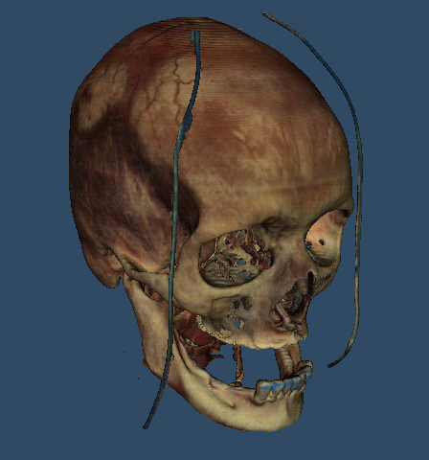
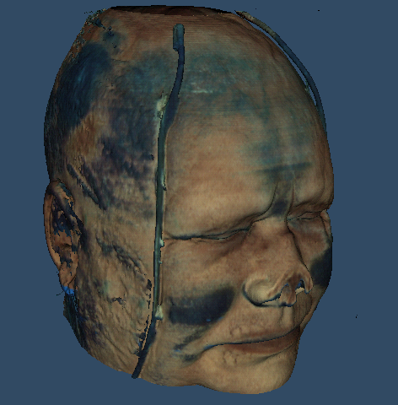
Insight into images

Slide 4
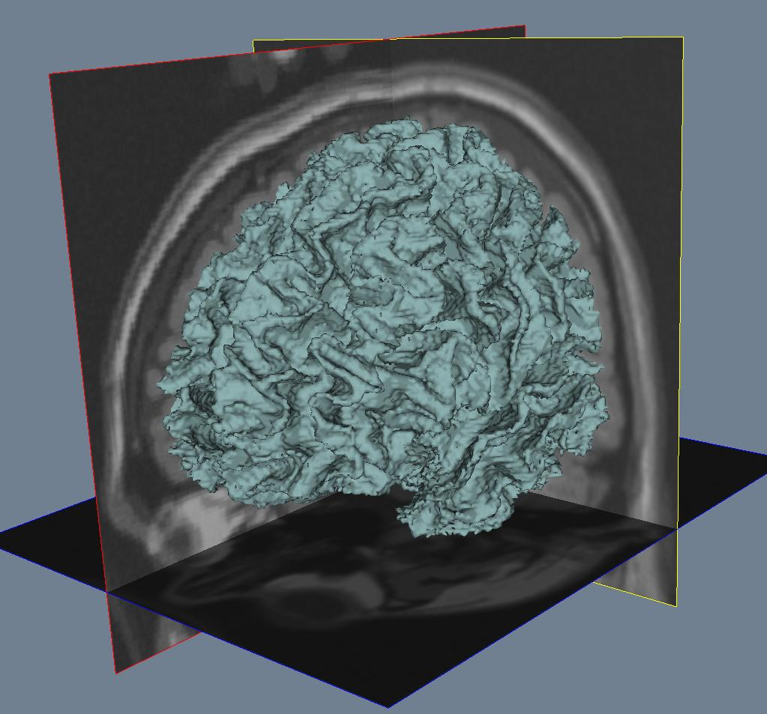
Segmentation

Slide 5
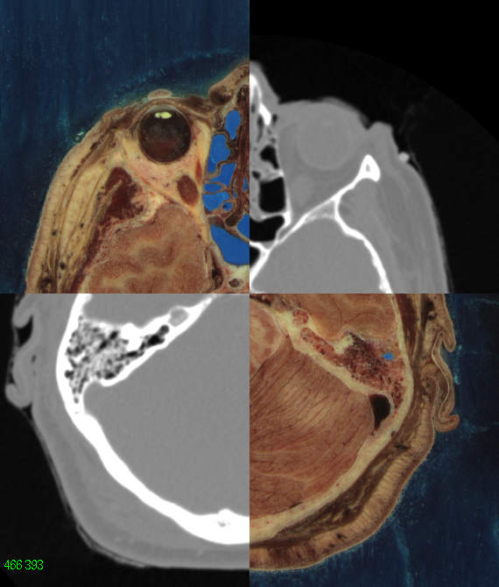
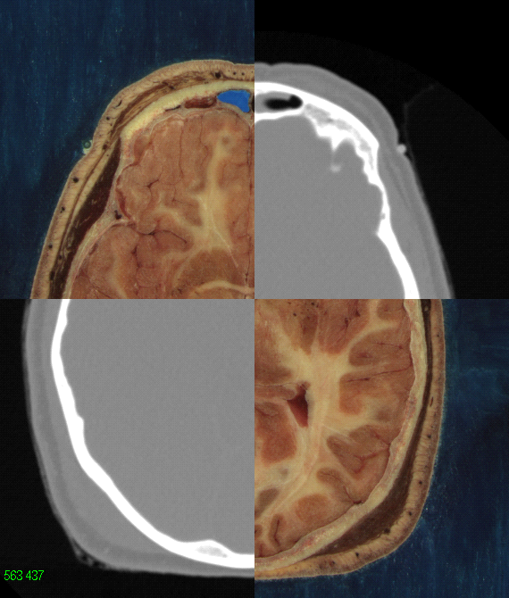
Registration

Slide 6
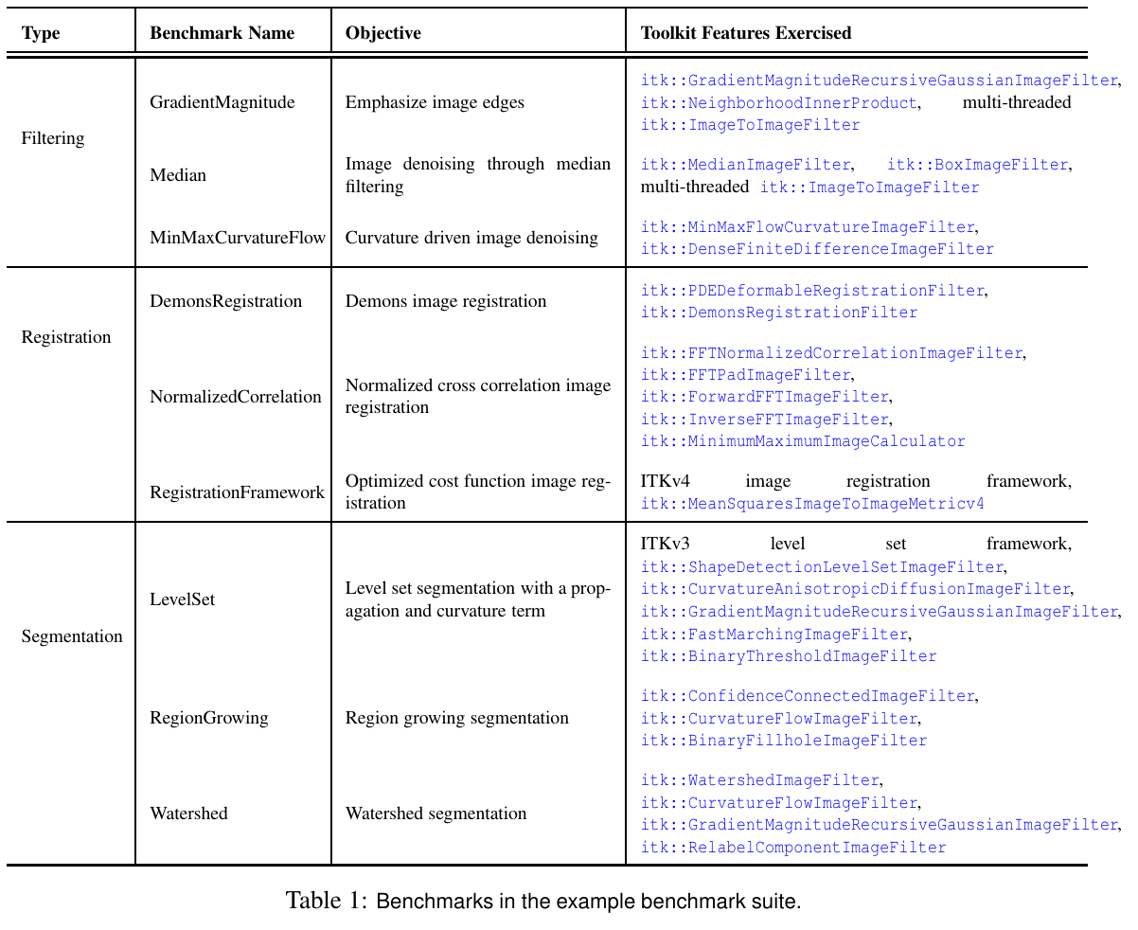
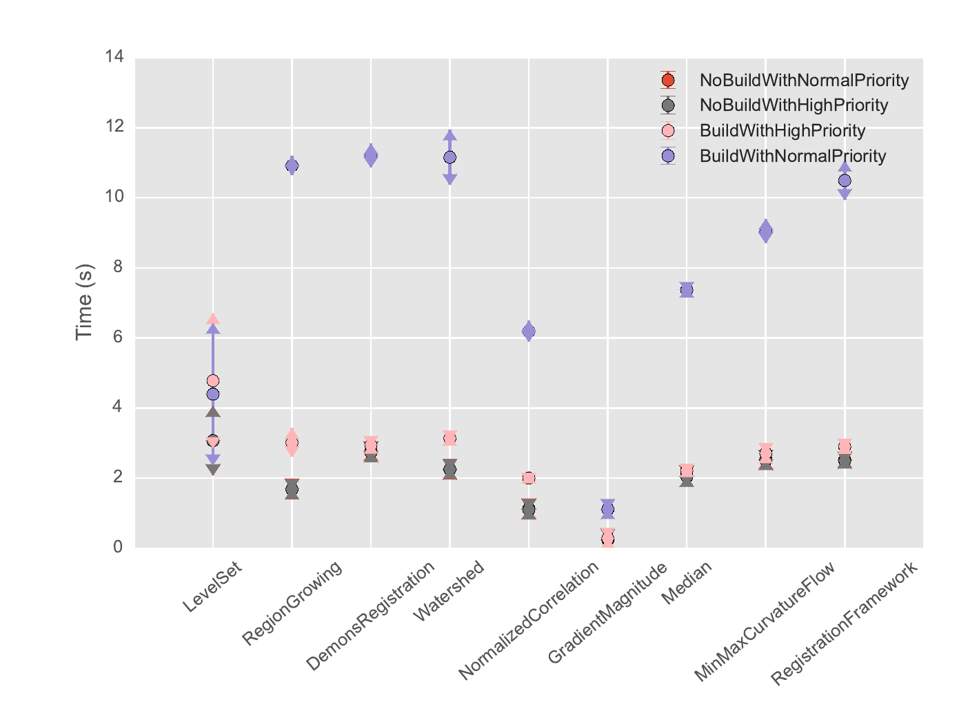
Performance Benchmarks
Performance Benchmarking the Insight Toolkit, http://hdl.handle.net/10380/3557

Slide 7
Questions to answer
Over the project's history, when did commits introduce a performance regression / improvement?
How does a proposed change affect performance?
How does performance change across platforms?
How does performance change with build settings?
How does performance scale with the number of threads used?

Slide 8
The Challenge
Develop an interactive visualization tool to understand ITK performance
Develop a JAMStack (client-side JavaScript) web application
Deploys on free, static website hosting services
Has regression testing
Use the performance benchmarks: https://github.com/InsightSoftwareConsortium/ITKPerformanceBenchmarking
Read from benchmark outputs stored in JSON: https://data.kitware.com/#collection/57b5c9e58d777f126827f5a1/folder/5af50c818d777f06857985e3
Example visualizations: https://github.com/jhlegarreta/ITKPerformancePlot
View modes: Historical, Commit-to-Commit, Thread Scalability
Selection of: metric, system, compiler, compiler flags, operating system, threads

