Slide 1
UNC’s Comprehensive Cancer Support Program’s Oncology Nutrition App
Meredith Moyers MS, RD, CSO, LDN
Meredith.Moyers@unchealth.unc.edu
984-974-8232

Slide 2
Restrictions: Must be iOS
Description of the idea: UNC is the state’s healthcare system and serves every county in North Carolina. Unfortunately, a board-certified oncology dietitian is only available at Main Campus in Chapel Hill or at Rex Healthcare in Raleigh. This leaves a huge gap in nutrition care for patients who are experiencing eating challenges during their cancer journey at our UNC Affiliated sites across the state. My idea is to create an app that can provide nutrition education routinely provided, in person in Chapel Hill, to all our cancer patients and their caregivers throughout the state. All cancer patients should have access to reliable and accurate nutrition information which the app will provide.

Slide 3
Goal #1- A section that provides eating tips for managing nutrition impact symptoms (nausea, vomiting, diarrhea, constipation, mouth sores, difficulty swallowing, taste and smell changes)
It would also have recipes patients patients/caregivers click on that are good for each nutrition impact symptom (i.e. under the mouth sores section, we could have recipes for various smoothies and soft foods). I would like it if the patient could check mark certain ingredients in the recipe and it automatically adds them to a “shopping list” for them. Furthermore, the patient could email/share the recipe to a caregiver directly from the app

Slide 4
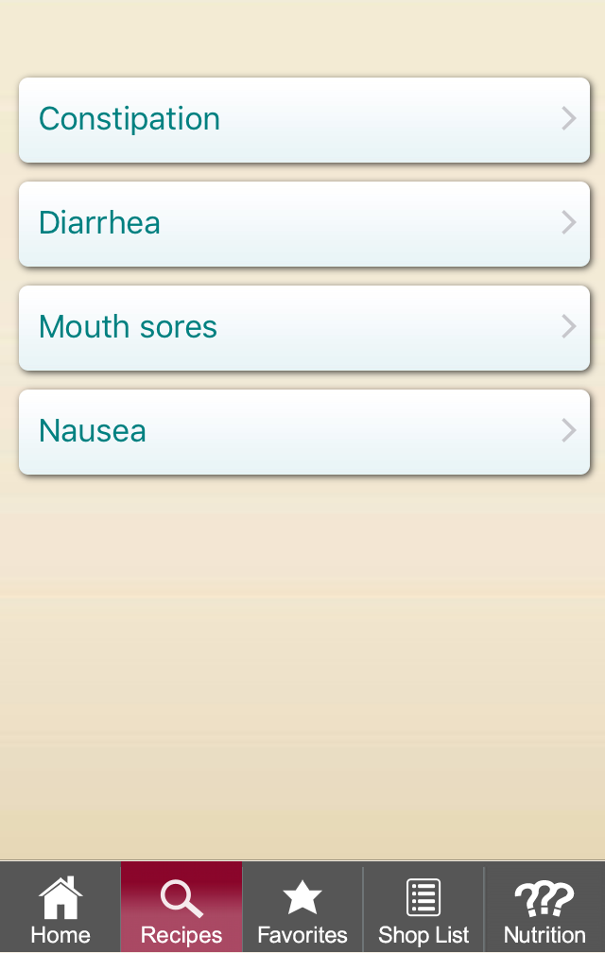
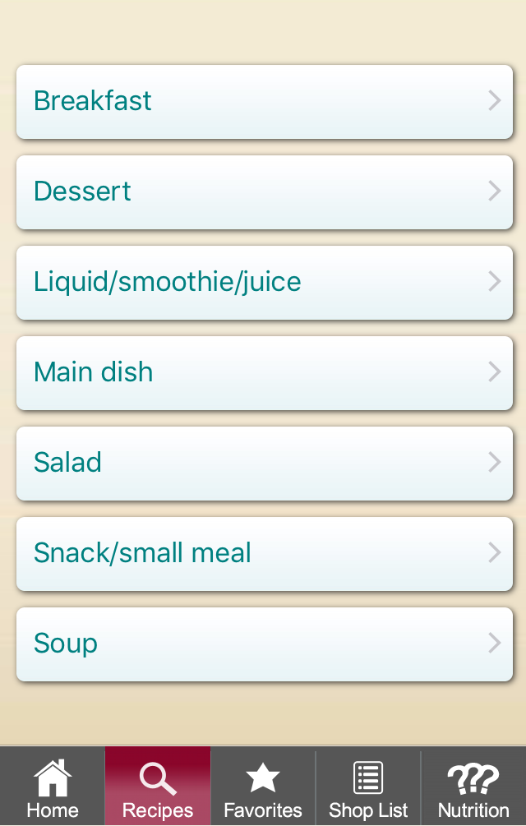
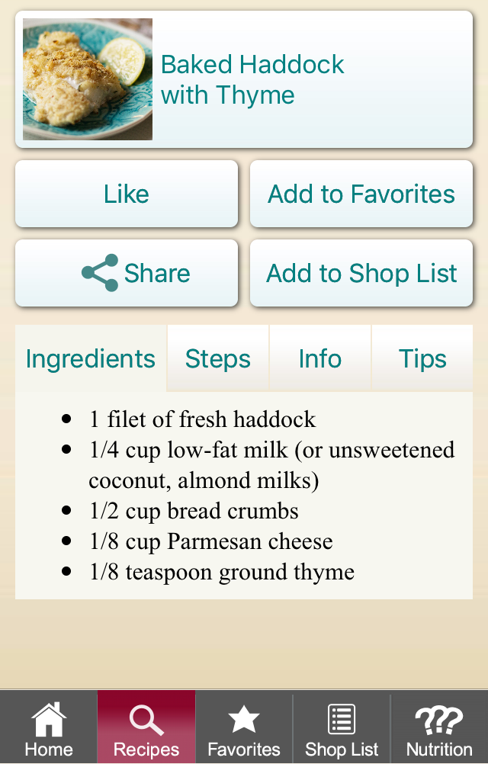
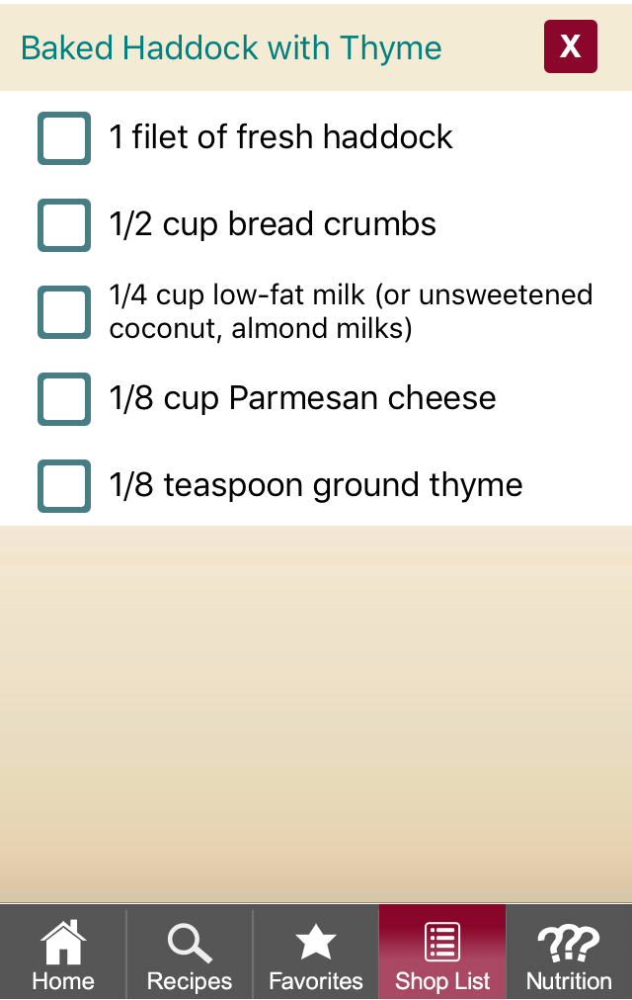

Slide 5
Goals #2 and #3
A section that provides info on common diet changes (food safety, gastrectomy, tube feed, bowel obstructions, survivorship)
A FAQ section that lists answers to common diet questions we get (i.e. sugar feeds cancer, ketogenic diet, alkaline water, dairy and cancer, etc…)

Slide 6
Goal #4
16 oz
32 oz
64 oz
A section where the patient could track their fluid intake (dehydration is a common problem among cancer patients). It would be nice if they could “check off” something every time they drank 8 oz of fluids and there could be a progress bar that changes color as the patient gets closer to the goal of 64 oz. Once the patient hits 64 oz, some sort of celebration could take place.

Slide 7
Nice to Have Functions
Something similar to the fluid tracking but for our patients who have to administer their tube feed, in which they could either journal when they gave themselves their tube feed or have a progress bar that shows they hit their goal for number of tube feeds/day they administered (this would be a different amount for each patient, unlike the fluid intake would be automatically 64 oz for everyone).
A journaling section where the patient could journal their nutrition impact symptoms for the day. i.e. they could document which days they experienced nausea, how intense was it, duration, etc…this will help them remember to share it with their providers when they are in clinic for follow up visits.
We would like the ability to have authorized people go back in the app and make edits as needed. Such as when we have a new recipe we would like to add or with the addition of new FAQ.

