Slide 1
MLDY MUSIC
COMP 523
Muhmad Alzpair

Slide 2
What is MLDY Music?

Slide 3
ABOUT US
Connecting musicians together.
The aim of MLDY Music is to connect artists with producers and other artists through a social media platform. MLDY Music is also going to be a platform to showcase music, users can register a “reviewer account” which would allow them to listen to music and give their opinions and criticisms.

Slide 4
WHY?
A Solution to the Problem in Todays Music Collaboration
Collaboration today is extremely strenuous
Attaining a solid fan base for upcoming musicians is difficult and nearly impossible without the backing of a label
Having clear feedback on your music from your listeners gives you a better understanding of how your music affects others and what you can do to improve upon that

Slide 5
SOLUTION
An easy-to-use web application, so the musicians can have more time to work on and listen to music
A search feature to allow musicians to look for other musicians based on their attributes and musicianship
A profile page where you can introduce yourself, what you do, and your content
Instant messaging feature that would be able to handle the sending of video and music files as well as being able to host multiple users for extended collaboration

Slide 6
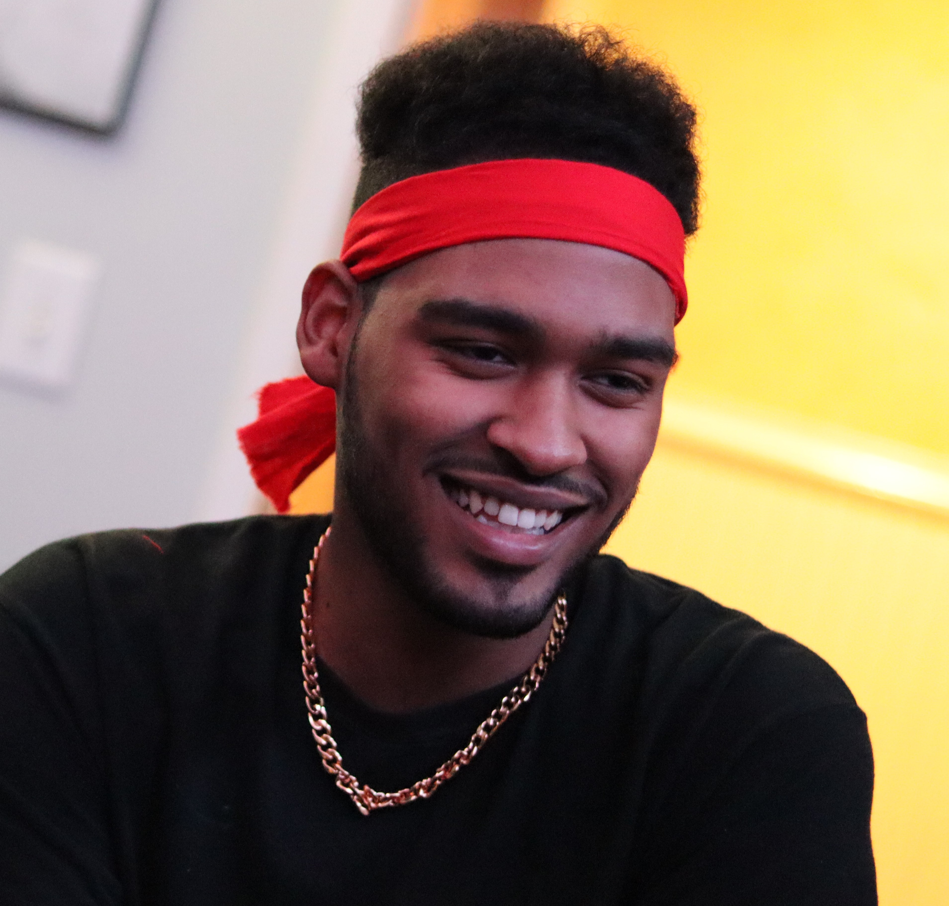
WHO AM I?
I am a fellow student at Carolina, Go Heels! I am currently a quantitative finance and biology major and a music minor. I’ve always been interested in music and music industry. After working on music for myself, one of the bigger problems my music colleagues and I faced was looking for someone who specialized in our specific needs for the piece of music we were constructing. Also, we needed a platform to streamline the collaboration process. I searched for platforms, but none had the specific needs we needed as musicians. That’s what lead to the creation of MLDY Music.
Muhmad Alzpair
Muhmad@live.unc.edu
704-533-4575

