Slide 1
Building patients voices into dashboards to improve quality of maternal healthcare in Kenya

Slide 2
Jacaranda’s Mission and Approach
1
We design better systems for delivering quality maternity care
We test and improve them in our own centers of excellence
We spread these innovations at scale through public and private partners
2
3

Slide 3
Jacaranda Maternity: highest quality maternity care for less than $150/delivery
57%
Postpartum family planning
90%
exclusive breastfeeding at 6 months postpartum
66%
fewer maternal complications than nearby public hospitals
External Accreditation & Recognition
Our hospital scored as SafeCare level 5 - the highest-scored hospital in East Africa.

Slide 7
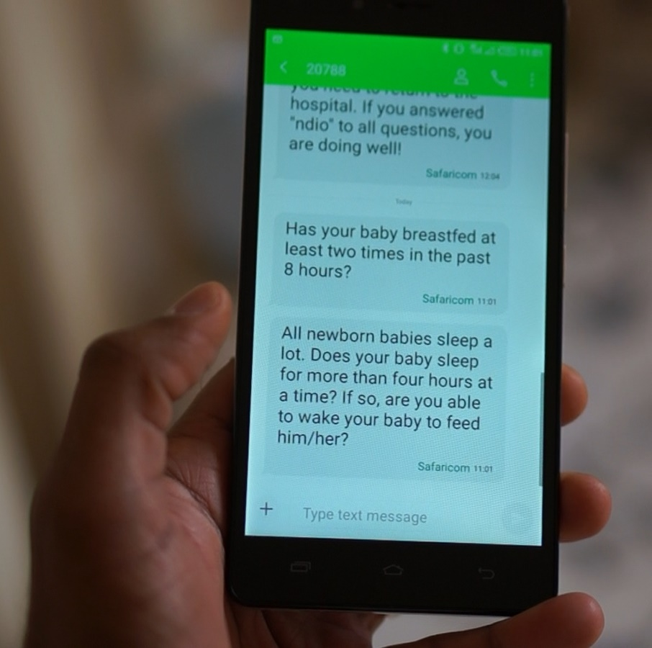
Our Public Sector Strategy
mHealth program: SMS messages that change behavior
Can ask questions via a helpdesk service
1
Pregnant women see posters
2
Receive SMS messages
3
ANTENATAL CARE
Tips
Danger signs
Pregnancy nutrition
POSTPARTUM
Checklists of information
maternal and newborn danger signs
Family planning tips
19 msgs
26 msgs

Slide 8
Our Public Sector Strategy
Current status: Rapid enrollment across public facilities
In six months, 60 facilities have used the service. Our enrollment rate is now 1,000 mothers/month, with a 95% retention rate in the program.
5 facilities
13 facilities
40 facilities
Total enrollment (mothers)
Key metrics
5000+ women enrolled to date
Adding ~1,000 new mothers/month
June
# weeks since rollout
September

Slide 9
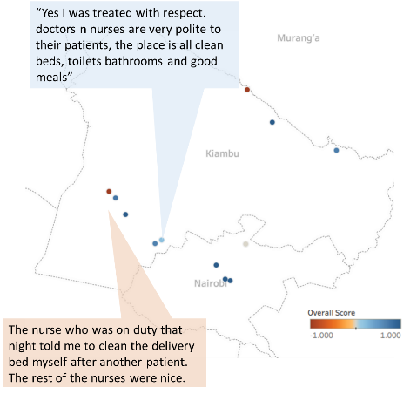
Dashboards for partner facilities accountability
Hospital dashboards will be compiled from publicly available clinical outcomes (online DHIS2 data), client feedback from our SMS database, provider performance data.
Patient feedback
# of Complaints | <10/ month | >15/month |  | 2 | 2 | 3 | 5 | 11
Avg patient rating | >=8 | <6 |  | 8.9 | 9 | 7.5 | 9.1 | 5.9

Slide 10
Where we need your help…
4
NLP for sentiment analysis of patient messaging responses
Route patient queries to help connect urgent request to clinicians
(Freshdesk)
1
Design and build database for SMS and dashboard of key indicators
API to integrate with analytics tools (e.g. Tableau) to scrape data for dashboard
2
3

