Slide 1
Detection of Programming Difficulties
Nils Erik Persson
University of North Carolina at Chapel Hill
npersson@cs.unc.edu
Advisor: Prasun Dewan

Slide 2
Motivation
As programmers, we experience difficulty constantly
We seek assistance from the internet, colleagues, superiors, etc.
Search time and energy is a barrier to all of these

Slide 3
Vision
Create a difficulty recommendation system that can:
Detect user difficulty
Determine the current task
Provide reasonable assistance
Notes:
Give video of difficulty
Make it concrete, why save time?

Slide 4
Project Goal
Develop the framework to support classification and assistance

Slide 5
Task Overview
Capture all words in user’s code
Determine keywords
Capture searches in browser logs
Store/update keyword -> search mappings in a database
Recommend searches based on keywords to the user

Slide 6
What You’ll Learn
Eclipse plugin development
Chrome extension development
Database creation and management
Distributed systems (centralized server with multiple clients)
Machine learning (classification)

Slide 7
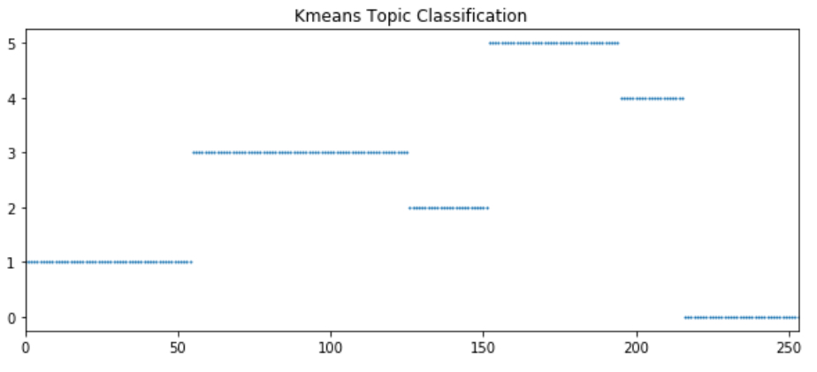
Classification Example
Count of words created from underlying code over time
Document states clustered based on the counts
Cluster/
Topic
Document state word counts

Slide 8
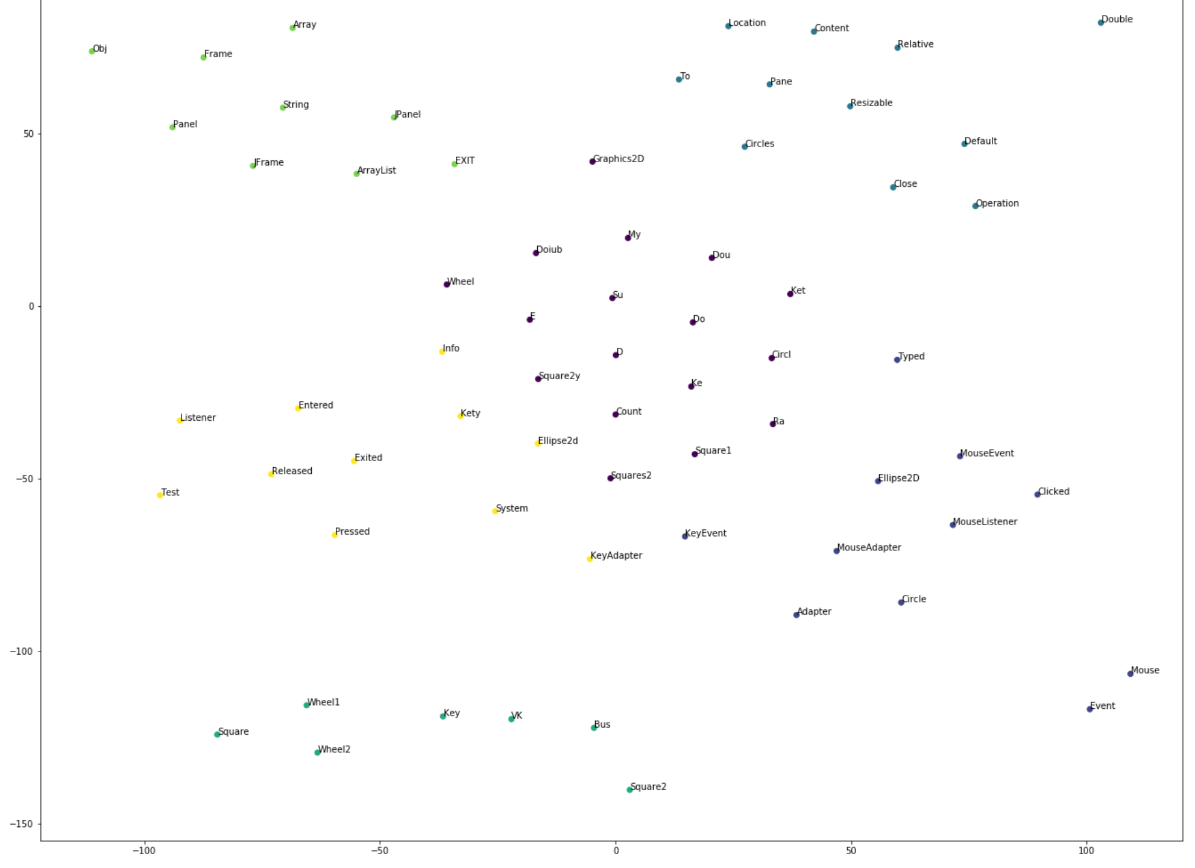
Classification Example
Determine which words are important for each cluster
Look at relative weights of each word on classification
Label topics with these words!

Slide 9
Questions?

