Slide 1
GUI Application For Object Detector(s)
Phil Ammirato
Computer Vision Grad Student

Slide 2
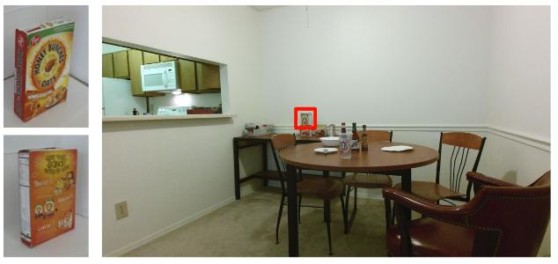
Object Detection
Computer Vision
Machine Learning

Slide 3
GUI
?

Slide 4
GUI
Get images from camera
Get images from an object library
Display detections
…

Slide 5
Technologies
Detection code: Python
GUI: Your choice? (but needs to call python code)
Web: -Call detection code over network
-web based gui

Slide 6
What you need
laptop?
cameras provided
detection code can be simulated

Slide 7
What it’s for
Live Demos
we have hundreds of people come through for demos
Public Use (research community)
will attach to the detection project page and github, with credit

Slide 8
GUI Application For Object Detector(s)
Phil Ammirato

