Slide 1
Bloodborne Pathogens (BBP) Exposure Control Plan
For Housekeeping Services
at UNC Chapel Hill
Erika England
Biosafety Specialist
Environment, Health & Safety

Slide 2
Learning Objectives
What are Bloodborne pathogens?
What is an Occupational Exposure?
How to Prevent Exposures
Post-Exposure Procedures
Exercises

Slide 3
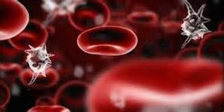
1. What are Bloodborne Pathogens?
Bloodborne pathogen definition
The big three
Hepatitis B
Hepatitis C
Human Immunodeficency Virus (HIV)

Slide 4
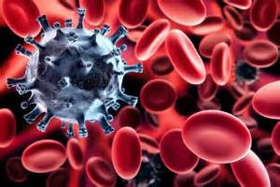
Definition
OSHA defines bloodborne pathogens as:
Pathogenic microorganisms that are present in human blood that can cause disease in humans

Slide 5
Transmission
Sex with an infected partner
Sharing needles, syringes, or other drug-injection equipment
Direct contact with the blood or open sores of an infected person
Exposure to blood from needlesticks or other sharp instruments
Birth (spread from an infected mother to her baby during birth)
Sharing items such as razors or toothbrushes with an infected person
Notes:
Hepatitis B is spread when blood, semen, or other body fluid infected with the Hepatitis B virus enters the body of a person who is not infected
Many people with chronic Hepatitis B virus infection do not know they are infected since they do not feel or look sick. However, they still can spread the virus to others and are at risk of serious health problems themselves
Unlike Hepatitis A, it is not spread routinely through food or water
Hepatitis B virus is not spread by sharing eating utensils, breastfeeding, hugging, kissing, holding hands, coughing, or sneezing

Slide 6
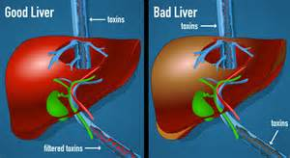
Viral Hepatitis
Hepatitis means inflammation of the liver
Your liver helps your body digest food, store energy, and get rid of poisons. It acts as a filtration system for your body
As the filter begins to fail, impurities build up in your body and symptoms can occur such as:
Jaundice Abdominal pain
Dark urine Extreme fatigue
Anorexia Nausea
Joint pain Rash
Fever

Slide 7
Viral Hepatitis
 | Hep A | Hep B | Hep C | Hep D | Hep E
Source of Virus | Feces | Blood/Body fluids | Blood/Body fluids | Blood/Body fluids | Feces
Route of Transmission | Fecal-oral | Broken skin, mucous membrane, sexual contact | Broken skin, mucous membrane | Broken skin, mucous membrane | Fecal-oral
Chronic Infection | No | Yes | Yes | Yes | No
Prevention | Vaccine | Vaccine | Modified behavior, blood screening | Modified behavior, HBV vaccine | Ensure safe drinking water
Notes:
Comparison chart of the 5 types of Hepatitis

Slide 8
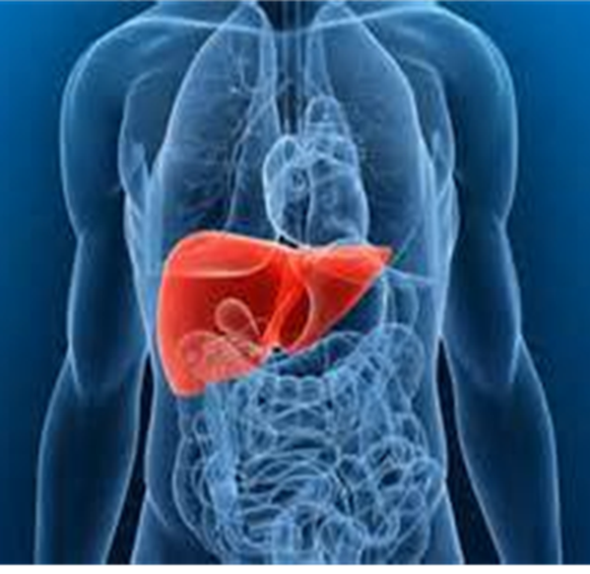
Hepatitis B statistics
In 2014, approximately 19,200 new cases of Hep B in the US
Estimated 1.2 million in US and 350 million chronic cases worldwide
Hepatitis B virus can survive outside the body at least 7 days
Symptoms appear between 6 weeks to 6 months
90% adults will get rid of the virus from their bodies after a few months (acute hepatitis B)
10% adults will never get rid of it (chronic hepatitis B)
15-20% with chronic hepatitis develop liver disease
Notes:
There were and estimated 19,200 new cases of Hep B in the US in 2014. However, the actual number of cases reported was much lower. Many people do not show symptoms so they don’t know they are infected or seek medical treatment.
The likelihood depends upon the age at which someone becomes infected. The younger a person is when infected with Hepatitis B virus, the greater his or her chance of developing chronic Hepatitis B.
Approximately 90% of infected infants will develop chronic infection. The risk goes down as a child gets older.
Approximately 25%–50% of children infected between the ages of 1 and 5 years will develop chronic hepatitis.
The risk drops to 6%–10% when a person is infected over 5 years of age.
Worldwide, most people with chronic Hepatitis B were infected at birth or during early childhood.

Slide 9
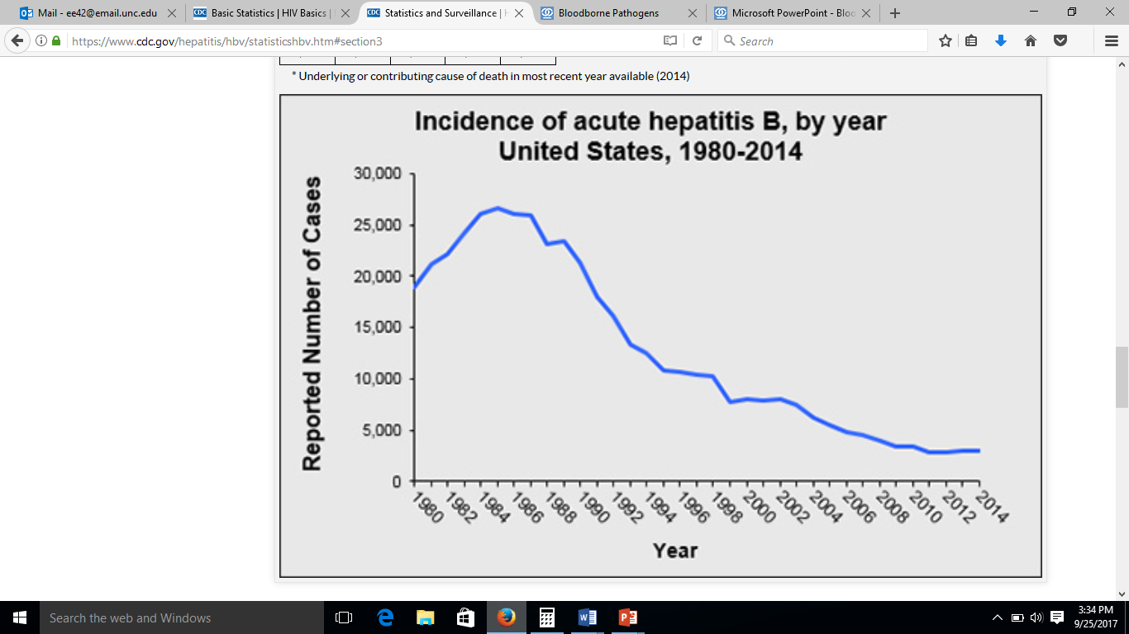
Hepatitis B
Notes:
Rates of acute Hepatitis B in the United States have declined by approximately 82% since 1991. At that time, routine Hepatitis B vaccination of children was implemented and has dramatically decreased the rates of the disease in the United States, particularly among children.

Slide 10
Hepatitis B Treatment
Contact your health provider
There is no medication available to treat acute Hepatitis B
During this short-term infection, doctors usually recommend rest, adequate nutrition, and fluids, although some people may need to be hospitalized.
If a person who has been exposed to Hepatitis B virus gets the Hepatitis B vaccine and/or a shot called “HBIG” (Hepatitis B immune globulin) within 24 hours, Hepatitis B infection may be prevented.

Slide 11
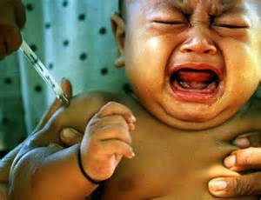
Hepatitis B Vaccination
Hepatitis B can be prevented!
A safe and effective vaccine to prevent Hepatitis B has been available since 1982
Employees who have reasonably anticipated exposure to bloodborne pathogens will be offered the vaccine for free
Series of 3 shots: Initial, 1 month, 6 month
Only need the series once in a lifetime
Notes:
The best way to prevent Hepatitis B is by getting the Hepatitis B vaccine. The Hepatitis B vaccine is safe and effective and is usually given as 3-4 shots over a 6-month period
Hepatitis B vaccine is very effective at preventing Hepatitis B virus infection. After receiving all three doses, Hepatitis B vaccine provides greater than 90% protection to infants, children, and adults immunized before being exposed to the virus
(I’m not sure what the protective rate is for people that only have 1 or 2 of the series)

Slide 12
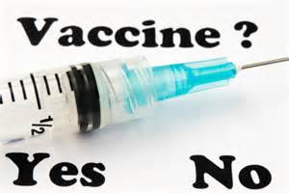
Hepatitis B Declination
Any employee may decline the vaccination series by signing the Hepatitis B Vaccine Declination form
You can change your mind at any time and receive the vaccine free of charge
Notes:
The best way to prevent Hepatitis B is by getting the Hepatitis B vaccine. The Hepatitis B vaccine is safe and effective and is usually given as 3-4 shots over a 6-month period
Hepatitis B vaccine is very effective at preventing Hepatitis B virus infection. After receiving all three doses, Hepatitis B vaccine provides greater than 90% protection to infants, children, and adults immunized before being exposed to the virus
(I’m not sure what the protective rate is for people that only have 1 or 2 of the series)

Slide 13
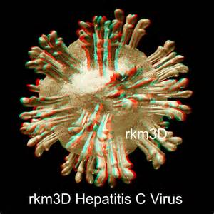
Hepatitis C Statistics
There is no vaccine yet to prevent hepatitis C
Hepatitis C virus is the most frequently occurring bloodborne pathogen infection
70-85% of people infected with HCV become chronically infected
Chronic liver disease develops in an average of 67%
An estimated 2.7-3.9 million people in the United States have chronic hepatitis C
The Hepatitis C virus can survive outside the body at room temperature, on environmental surfaces, for up to 3 weeks
Notes:
Research is still being conducted to find a vaccine to prevent Hepatitis C
Bleach solutions are effective at killing the virus

Slide 14
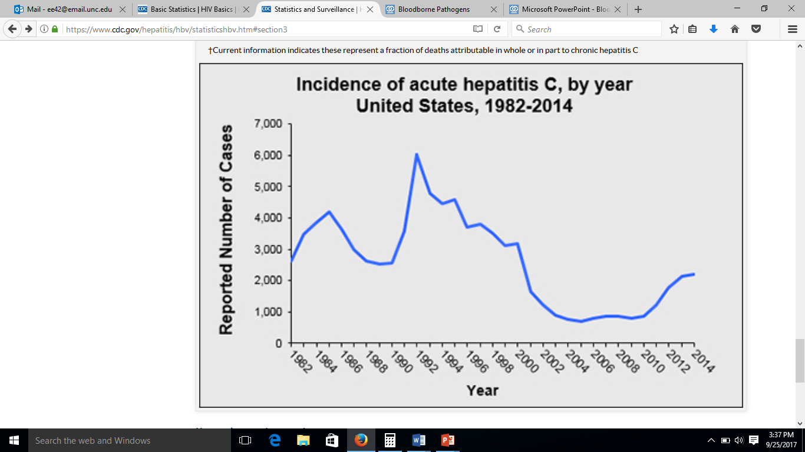
Hepatitis C
Notes:
Since there is no vaccine for Hepatitis C, prevention must be obtained through behavioral changes and medical screenings

Slide 15
Hepatitis C Treatment
Vaccine: no vaccine on the market yet
Preventative: best way to prevent Hepatitis C is by avoiding behaviors that can spread the disease, especially injecting drugs
Treatment: There are several medications available to treat chronic Hepatitis C
Cure: Daily pill taken for 12 weeks has a 98% effective cure rate
Notes:
approximately 15%–25% of people who get Hepatitis C will clear the virus from their bodies without treatment and will not develop chronic infection. Experts do not fully understand why this happens for some people
Research into the development of a Hepatitis C vaccine is under way
There are multiple drug therapies available to treat Hepatitis C. (They all have complicated names so I didn’t list them)

Slide 16
Hepatitis C

Slide 17
HIV and AIDS Statistics
HIV is the virus that causes AIDS (the final stage of HIV infection)
AIDS means that the virus has weakened the immune system to the point at which the body has a difficult time fighting infection
It can take years for an infected person with HIV to reach this stage
The risk of infection from needles is less than 0.5%
HIV does not survive long outside the human body on surfaces
Estimated 1.1 million people are living with HIV in the United States
In 2014, there were an estimated 37,600 new HIV infections

Slide 18
HIV and AIDS Treatment
Vaccine: no vaccine on the market yet
Preventative: Pre-exposure Prophylaxis (PrEP) to help protect people who are at substantial risk for HIV infection. Best way is by avoiding risky behaviors that can spread the disease.
Treatment: Taking antiretroviral medicines (ART) after being potentially exposed to HIV to prevent becoming infected.
Cure: No known cure
Notes:
With the drug therapies available, a person can live a normal life span if the drugs are taken correctly every day (Magic Johnson is still alive). However, medication is expensive even with insurance coverage.

Slide 19
Recap: What are Bloodborne Pathogens?
Bloodborne pathogen definition
The big three
Hepatitis B
Hepatitis C
Human Immunodeficency Virus (HIV)

Slide 20
2. What is an Occupational Exposure
Definition
Who is at risk?

Slide 21
Exposure
The OSHA BBP Standard Definition:
“A specific eye, mouth, other mucous membrane, non-intact skin or parenteral contact with blood or OPIM that results from the performance of an employee’s duties”
OPIM: Other Potentially Infectious Material such as most human body fluids, experimental human material, products made from human blood, human cells lines
Notes:
When potentially infectious material enter an unprotected break in your skin such as an open wound, acne, rash, etc
When this material splashes or otherwise gets into your eyes, nose, or mouth
If you are cut or stuck by an object (breaks the skin) that is contaminated with this material

Slide 22
Who is at Risk?
You may have occupational exposure if:
The job duties of the housekeeping staff member require them to otherwise come into contact with blood or other potentially infectious materials.
The housekeeping staff member works as part of a spill clean-up crew responsible for responding to spills of blood or other potentially infectious materials
You work at the following buildings

Slide 23
Who is at Risk?
Zone 1: Davie Hall, Howell Hall
Zone 7: Caudill Labs, Chapman Hall, Kenan Labs, Phillips Hall
Zone 8: Lineberger Cancer Res Center, Thurston-Bowles, Mary Ellen Jones
Zone 10: Brinkous-Bullitt, Burnett-Womack, MacNider Hall
Zone 11: Hooker, Kerr Hall, McGavran-Greenburg, Rosenau
Zone 15: Brauer Hall, First Dental, Koury Oral Health, Tarrson Hall

Slide 24
Who is at Risk?
Zone 16: Med Research B, MBRB, Glaxo, Neuroscience Res Bldg, Taylor Hall
Zone 17: All buildings
Zone 19: Genome Sciences, Med School Wings
Zone 22: Aycock Family Medicine
Zone 25: Carrington Hall, Fordham Hall, Wilson Hall
Zone 26: Genetic Medicine Res Bldg, Marsico Hall

Slide 25
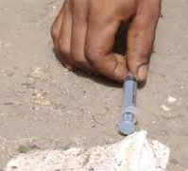
Who is at Risk?
Picking up sharps
Notes:
Discuss these hazards if they have not already been talked about in the previous slide

Slide 26
Who is at Risk?
Picking up sharps
Notes:
Discuss these hazards if they have not already been talked about in the previous slide

Slide 27
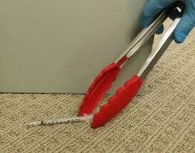
Who is at Risk?
Picking up sharps
Notes:
Discuss these hazards if they have not already been talked about in the previous slide

Slide 28
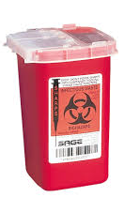
Who is at Risk?
Picking up sharps
Notes:
Discuss these hazards if they have not already been talked about in the previous slide

Slide 29
Who is at Risk?
Picking up sharps
Notes:
Discuss these hazards if they have not already been talked about in the previous slide

Slide 30
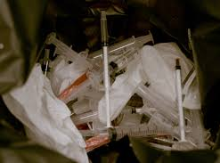
Who is at Risk?
Improper disposal of needles
Needles in biohazard or regular trash
Notes:
Discuss these hazards if they have not already been talked about in the previous slide

Slide 31
Who is at Risk?
Improper disposal of needles
Notes:
Discuss these hazards if they have not already been talked about in the previous slide

Slide 32
Who is at Risk?
Improper disposal of needles
Do NOT take out trash with needles
Take a picture (if possible)
Contact Supervisor
Supervisor contacts EHS for investigation
Notes:
Discuss these hazards if they have not already been talked about in the previous slide

Slide 33
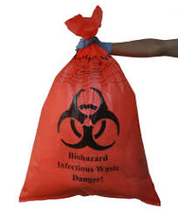
Who is at Risk?
Autoclaved waste
What is this bag missing?
Notes:
Discuss these hazards if they have not already been talked about in the previous slide

Slide 34
Who is at Risk?
Autoclaved waste
Notes:
Discuss these hazards if they have not already been talked about in the previous slide

Slide 35
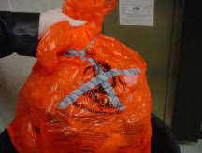
Who is at Risk?
Autoclaved waste
Notes:
Discuss these hazards if they have not already been talked about in the previous slide

Slide 36
Who is at Risk?
Autoclaved waste
Autoclaved
Decontaminated
Notes:
Discuss these hazards if they have not already been talked about in the previous slide

Slide 37
Who is at Risk?
Autoclaved waste
Autoclaved
Decontaminated
Notes:
Discuss these hazards if they have not already been talked about in the previous slide

Slide 38
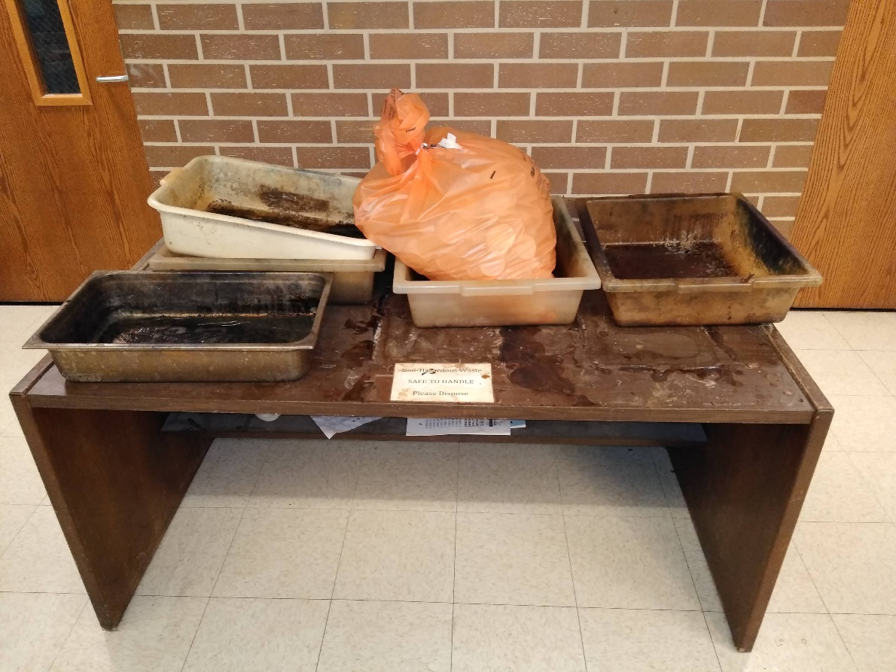
Who is at Risk?
Fordham Hall 2nd floor
Notes:
Discuss these hazards if they have not already been talked about in the previous slide

Slide 39
Who is at Risk?
Fordham Hall 2nd floor
Notes:
Discuss these hazards if they have not already been talked about in the previous slide

Slide 40
Who is at Risk?
Fordham Hall 2nd floor
Notes:
Discuss these hazards if they have not already been talked about in the previous slide

Slide 41
Who is at Risk?
Fordham Hall 2nd floor
Autoclaved
Decontaminated
Notes:
Discuss these hazards if they have not already been talked about in the previous slide

Slide 42
Who is at Risk?
Fordham Hall 2nd floor
Autoclaved
Decontaminated
Notes:
Discuss these hazards if they have not already been talked about in the previous slide

Slide 43
Who is at Risk?
Large Biological Spills
Lineberger autoclave spill in October 2018
Call EHS for Emergency Response Team
919-962-5507 (8am-5pm)
EHS emergency pager 24hr (after hours)
919-969-0785
Notes:
Discuss these hazards if they have not already been talked about in the previous slide

Slide 44
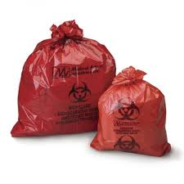
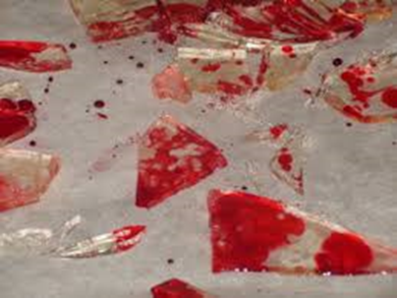
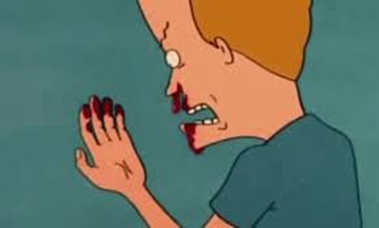
Who is at Risk?
Broken glass
Bloody nose
Biological waste
Needles
Notes:
Discuss these hazards if they have not already been talked about in the previous slide

Slide 45
Recap: Occupational Exposures
Definition
Who is at risk?

Slide 46
3. How to Prevent Exposures
Universal precautions
Communication of Hazards
Engineering controls
Work Practice Controls

Slide 47
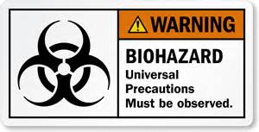
Universal Precautions
Universal Precautions is an approach to infection control that has been used by emergency and medical professional for years to prevent contact with blood or OPIM
With Universal Precautions you wear PPE when you anticipate contact with any and all human blood, body fluids, OPIM, or anything with a biohazard label on it

Slide 48
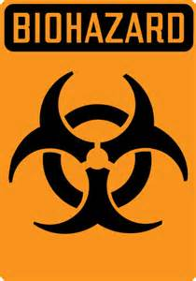
Communication of Hazards
Biohazard labels are used to alert others of the potential presence of biohazardous materials
A sign incorporating the universal biohazard symbol must be posted at the entrance to the laboratory when infectious agents are present
Labels are placed on:
Containers of biohazard waste
Refrigerators and freezers used to store BSL-2 specimens
Containers used to store, transport, and ship
Any equipment that could be potentially contaminated with blood, OPIM, and other BSL-2 materials

Slide 49
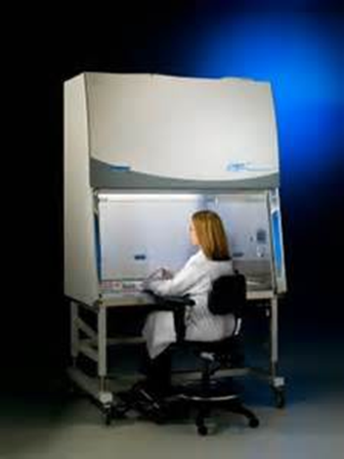
Engineering Controls
Engineering controls are equipment or devices used to control exposures
Sharps disposal containers
Biohazard material container
Safe needle devices
Biological Safety cabinets

Slide 50
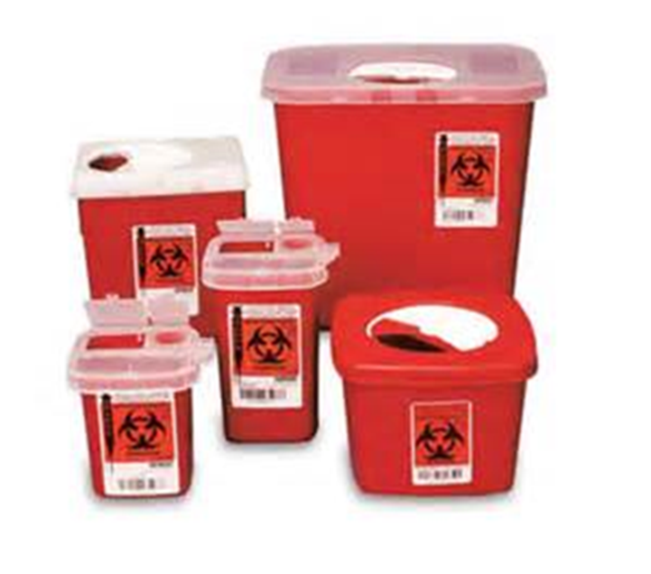
Engineering Controls
Sharps disposal containers:
Biohazard material container:
Tissue culture dishes
Solid contaminated materials
Needles
Scalpels
Razor blades
Syringes
Slides, slide covers
Broken glass

Slide 51
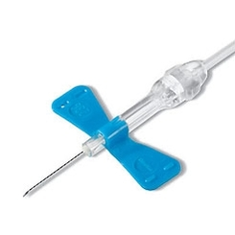
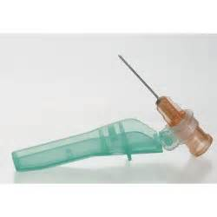
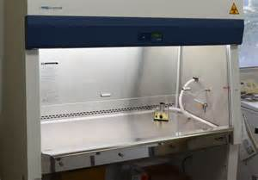
Engineering Controls
Biological Safety Cabinets:
Must be used when conducting procedures with a potential for creating aerosols or splashes of blood or OPIM (centrifuge, sonication, blending, inoculating animals
Safe needle devices

Slide 52
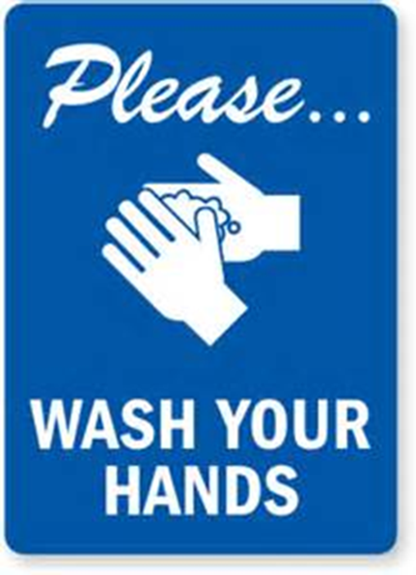
Work Practice Controls
Reduce likelihood of exposure by altering the manner in which a task is performed:
Handwashing
Sharps handling
Preventing ingestion
Minimizing splashing
Personal Protective Equipment
Laundry and Housekeeping

Slide 53
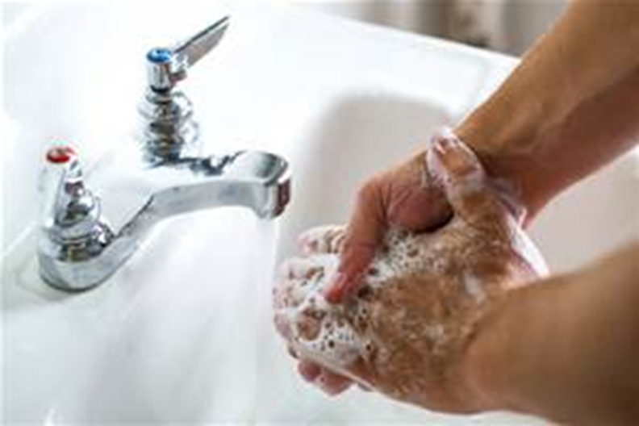
Handwashing
Persons must wash their hands after working with potentially hazardous materials and before leaving the laboratory
Make sure to use hot, soapy water
Use utility or restroom sink
Use antiseptic hand cleaner if a sink is not readily available

Slide 54
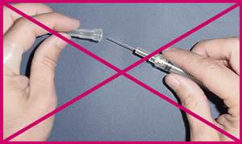
Sharps Handling
Broken glassware must not be handled directly. Instead, it must be removed using a brush and dustpan, tongs, or forceps
Used disposable needles and syringes must be carefully placed in conveniently located puncture-resistant containers used for sharps disposal
Needles must not be bent, sheared, broken, recapped, removed from disposable syringes, or otherwise manipulated by hand before disposal.

Slide 55
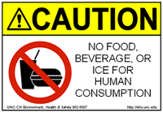
Preventing Ingestion
Eating, drinking, smoking, handling contact lenses, applying cosmetics, and storing food for human consumption must not be permitted in laboratory areas. Food must be stored outside the laboratory area in cabinets or refrigerators designated and used for this purpose.
Lab fridges and freezers
Food products used for experiments
Microwaves and fridges in food area

Slide 56
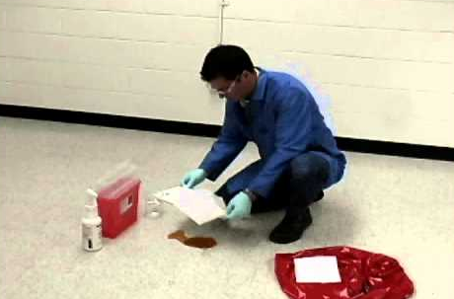
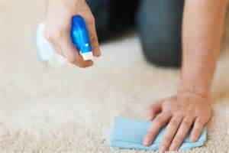
Minimizing Splashes
A good approach to cleaning a spill of material that minimizes spread by airborne droplets is to:
Place paper towels over the spill site
2. Douse area with disinfectant

Slide 57
Personal Protective Equipment
Specialized clothing or equipment worn by an employee for protection against a hazard
General work clothes (including uniforms) are NOT PPE
Change gloves when contaminated, integrity has been compromised, or when otherwise necessary.
Wear two pairs of gloves when appropriate.
Do not wash or reuse disposable gloves.
All PPE must be removed and placed in designated container
Do NOT wear gloves on elevators or open doors

Slide 58
Laundry and Housekeeping
Clothing soiled with blood or OPIM?
Minimize handling and use gloves
Place soiled uniforms in bags to prevent leakage
Do NOT take them home. Contact your zone manager for laundry arrangments

Slide 59
Recap: How to Prevent Exposures
Universal precautions
Communication of Hazards
Engineering controls
Sharps disposal containers
Biohazard material container
Safe needle devices
Biological Safety cabinets
Work Practice Controls
Handwashing
Sharps handling
Preventing ingestion
Minimizing splashes
Personal Protective Equipment
Laundry and Housekeeping

Slide 60
4. Post-Exposure Procedures
What is an exposure?
Types of Exposures:
Exposure to break in the skin
Mucous membrane exposure
Injury from contaminated object that breaks the skin
Reporting Procedures
Post-Exposure Evaluation

Slide 61
What is an Exposure
The OSHA BBP Standard Definition:
“A specific eye, mouth, other mucous membrane, non-intact skin or parenteral contact with blood or OPIM that results from the performance of an employee’s duties”
OPIM: Other Potentially Infectious Material such as most human body fluids, experimental human material, products made from human blood, human cells lines

Slide 62
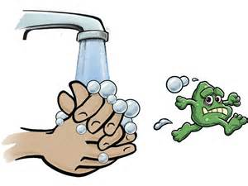
Exposure to Break in the Skin
When potentially infectious material enter an unprotected break in your skin such as an open wound, acne, rash, etc
Remove contaminated gloves and if possible, allow the wound to bleed freely for a minute
Wash the wound with soap and water for 5 minutes and apply sterile gauze or bandage
Decontaminate and remove PPE and proceed to the clinic

Slide 63
Mucous Membrane Exposure
When this material splashes or otherwise gets into your eyes, nose, or mouth
Rinse tissue surface with copious amount of water
Eyes should be irrigated for at least 5 minutes
Decontaminate and remove PPE and proceed to clinic

Slide 64
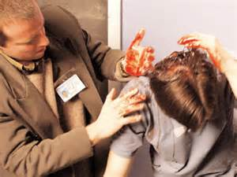
Contaminated Object Injury
If you are cut or stuck by an object (breaks the skin) that is contaminated with blood or OPIM
Remove contaminated clothing
Wash the wound with soap and water as soon as possible
Apply antiseptic, sterile gauze or bandage
Proceed to the clinic or call 911 if it is an emergency

Slide 65
Reporting Procedures
Immediately report incident to your supervisor
Report to the clinic for evaluation
During daytime hours (8:30am – 4:30pm, M-F)
919-966-9119
After hours: Call Healthlink (966-7890)
If it is an emergency: 9-911

Slide 66
Post-Exposure Evaluation
Fill out a post exposure evaluation
Document routes of exposure
Circumstances of the incident
Identifying sources of contamination
Blood tests for HIV and HBV (consent needed)
Post exposure prophylaxis and counseling
A report will be filed with EHS within 48 hours
EHS will investigate the circumstances of the exposure incident
The employee will NOT be billed for injuries/illnesses on the job

Slide 67
Recap: Post-Exposure Procedures
What is an exposure?
Types of Exposures:
Exposure to break in the skin
Mucous membrane exposure
Injury from contaminated object that breaks the skin
Reporting Procedures
Post-Exposure Evaluation

Slide 68
Exercises

Slide 69
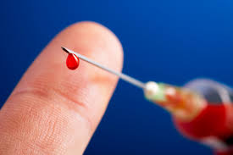
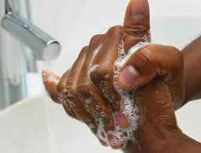
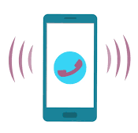
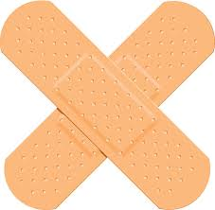
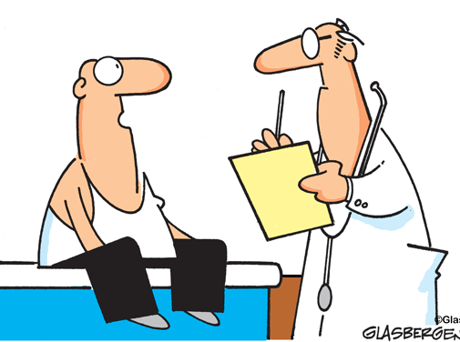
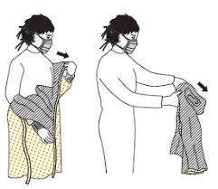
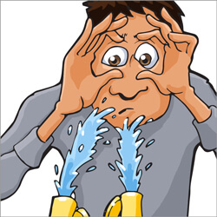
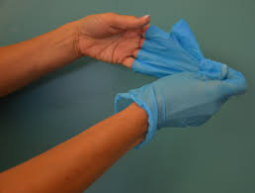
Station 1
Arrange the Post-Exposure steps in the correct order for “Splash to the Face” and “Cuts and Needlesticks”

Slide 70
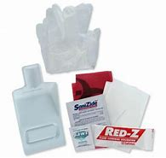
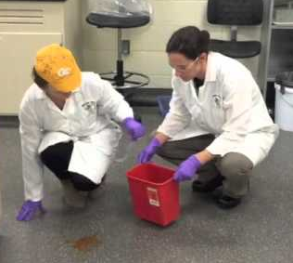
Station 2
Use the Blood Spill Clean-up kit with directions to clean up a small blood spill
One person from the group will put on the PPE and clean up the spill. The others in the group will help instruct the person of the proper clean up procedures.

Slide 71
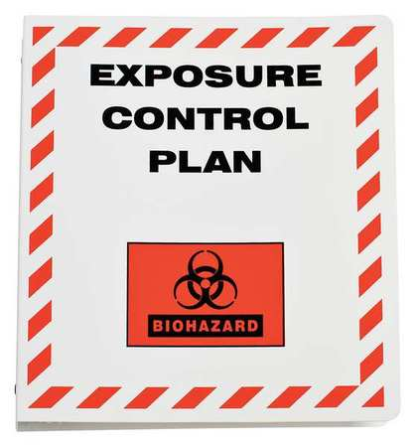
Station 3
Take ONE half sheet of questions and a pen per group. Use the Bloodborne Pathogen Exposure Control Plan for Housekeepers to answer the questions

Slide 72
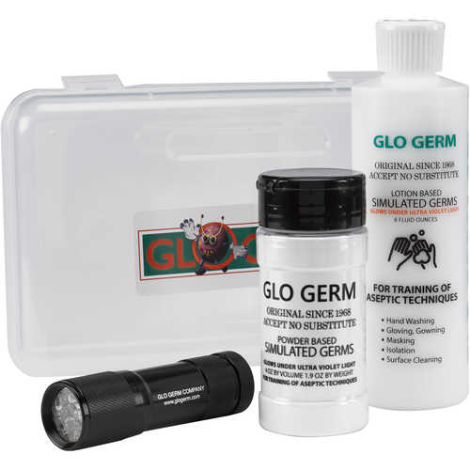
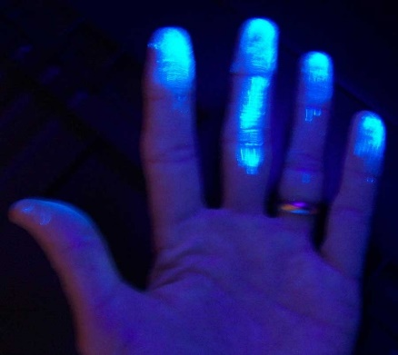
Station 4
1. Put on a pair of disposable gloves.
2. Take ONE pump of Glo Germ lotion and rub it all over the gloves with both hands.
3. Look at the gloves under the UV light to see the “germs”.
4. Remove the gloves using the instructor’s demonstration.
5. Look at bare hands under the UV light to check for any contamination.

