Slide 1
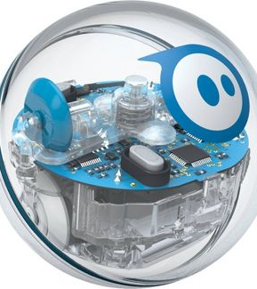
Accessible Block Coding App
Diane Brauner
Notes:
Sphero Spark + ($87)

Slide 2
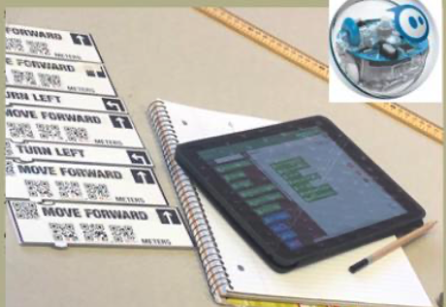
Accessibility of current intro to coding apps
Mainstream Coding Concept Apps: Fix the Factory, GoldieBlox, Sphero Edu, etc.
SAS CodeSnaps (Sphero) Modified QR codes are accessible; drag-and-drop coding blocks are not
Ballyland Code: Say Hello (Accessible)
Microsoft CodeJumper (soon to be released)
Swift Playgrounds (Accessible but complicated for emerging coder who is blind)
Notes:
Discuss need and importance of Coding! Ballyland (go thru menu to select – geared for early elementary)
Lego Minstorms

Slide 3
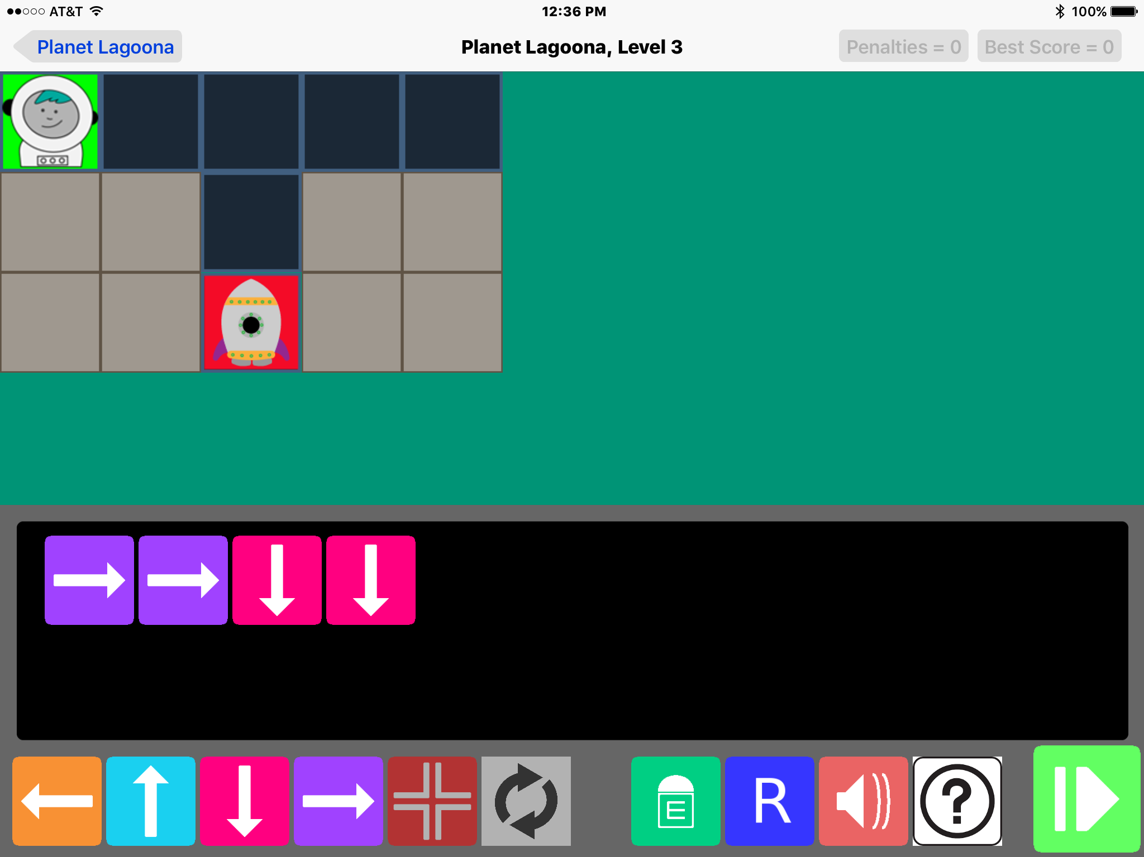
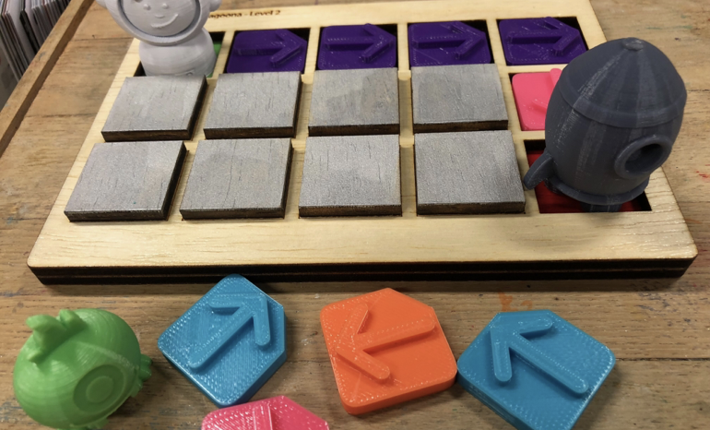
CodeQuest App
Serious Games Project (2016 – 2017)
APH Field Testing
Notes:
beginning concepts paired with 3D manipulatives. Note: P2T Posts on CodeQuest shared with developers. Proof of Concept

Slide 4
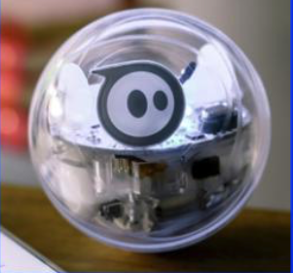
Accessible Coding Block App
Create an accessible coding block app that will bridge the gap between accessible coding concept apps and writing code.
Code blocks will control the Sphero robot through tactile obstacle courses.
App will incorporate accessible Drag-and-Drop commands to select and sequence code blocks.
Notes:
Sphero Sparks + $87

Slide 5
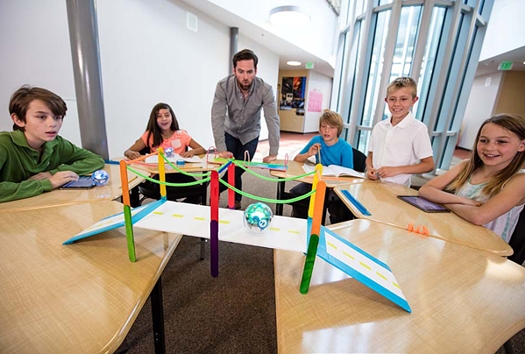
Target Audience
Elementary schoolers (Visually Impaired & Gen Ed)
Middle Schoolers (Visually Impaired & Gen Ed)
Educators (TVIs and Gen Ed)
App Developers (Proof-of-Concept)

