Slide 1
A Solution to Help Kids
Thrive on the spectrum

Slide 2
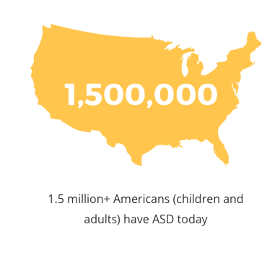
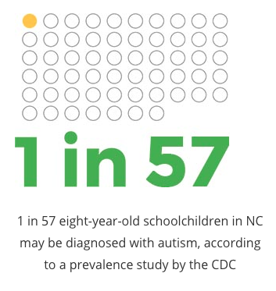
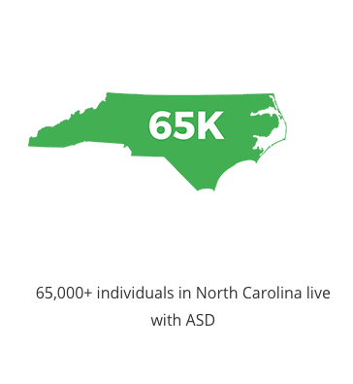
The why
Beyond
The diagnosis
When we truly thought about what we desire for these children, we want them and their parents to not be defined by a diagnosis. We want to make the experience of development special and fun.
We needed a device that was an extension of parental support outside the home that also:
Enabled a productive way to foster emotional regulation.
Provided an efficient way to support family schedules and routines.
Helped parents nurture positive reinforcement by communicating more effectively.

Slide 3
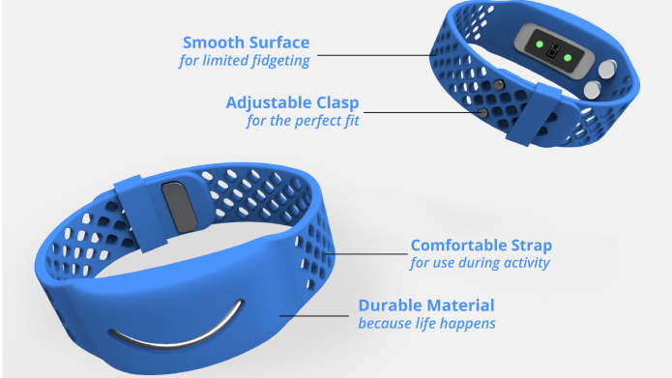
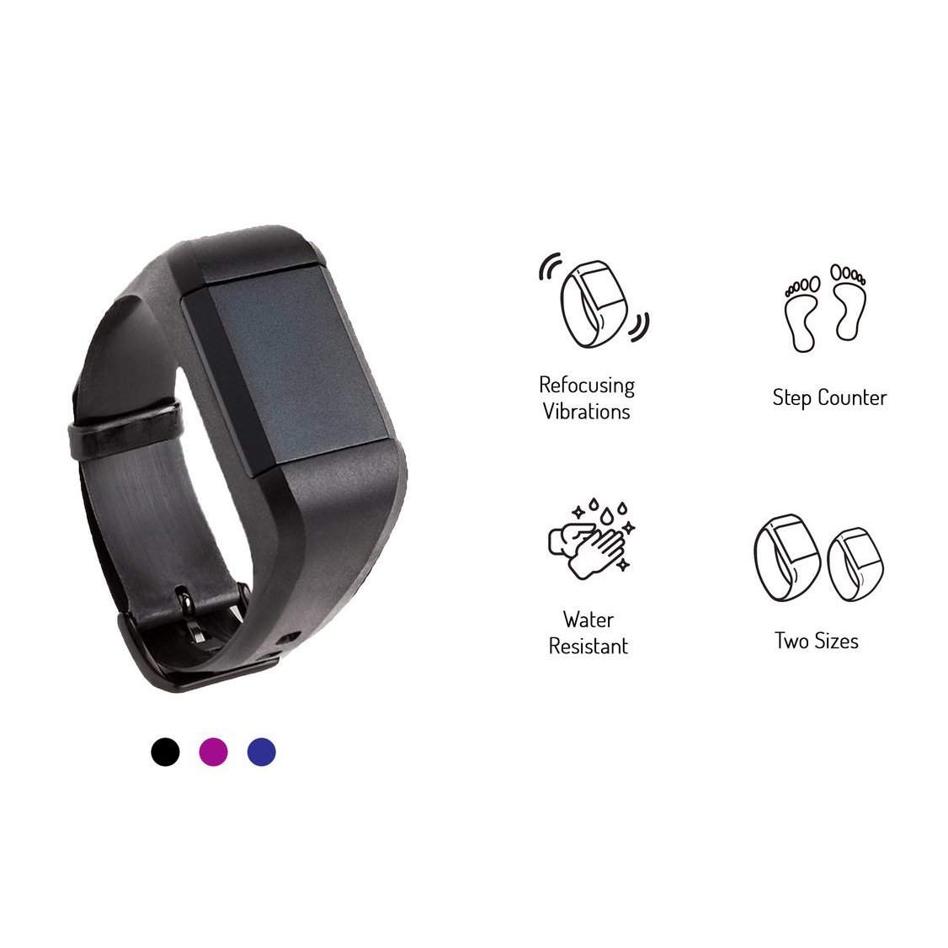
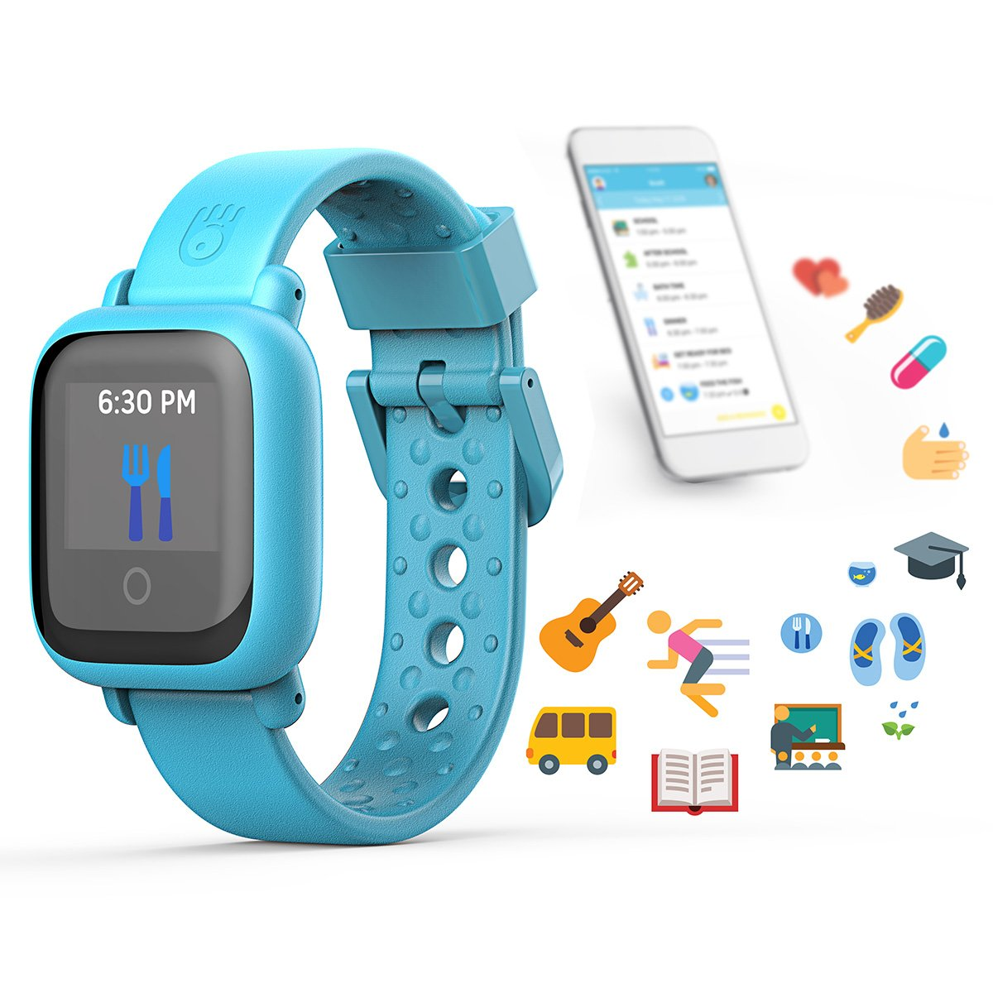
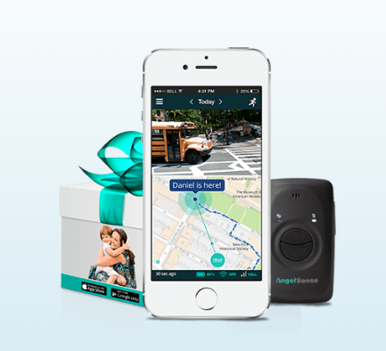
The problem
Therapy gave us direction, but we needed more
Today there is a sea of single feature assistive technologies to aid children diagnosed with Autism Spectrum Disorder BUT none of them could do what we were looking for all in one. Buying one of these devices meant sacrificing one feature for another.
Notes:
We knew our then 3 year old wasn’t going to be 3 forever and that he will need the skills not only to navigate the opportunities he faces but to be able to thrive in a world that is ever changing. That in itself is the challenge. For children with autism, the event of change (new faces, new spaces and new environments) can become a trigger for an emotional meltdown.

Slide 4
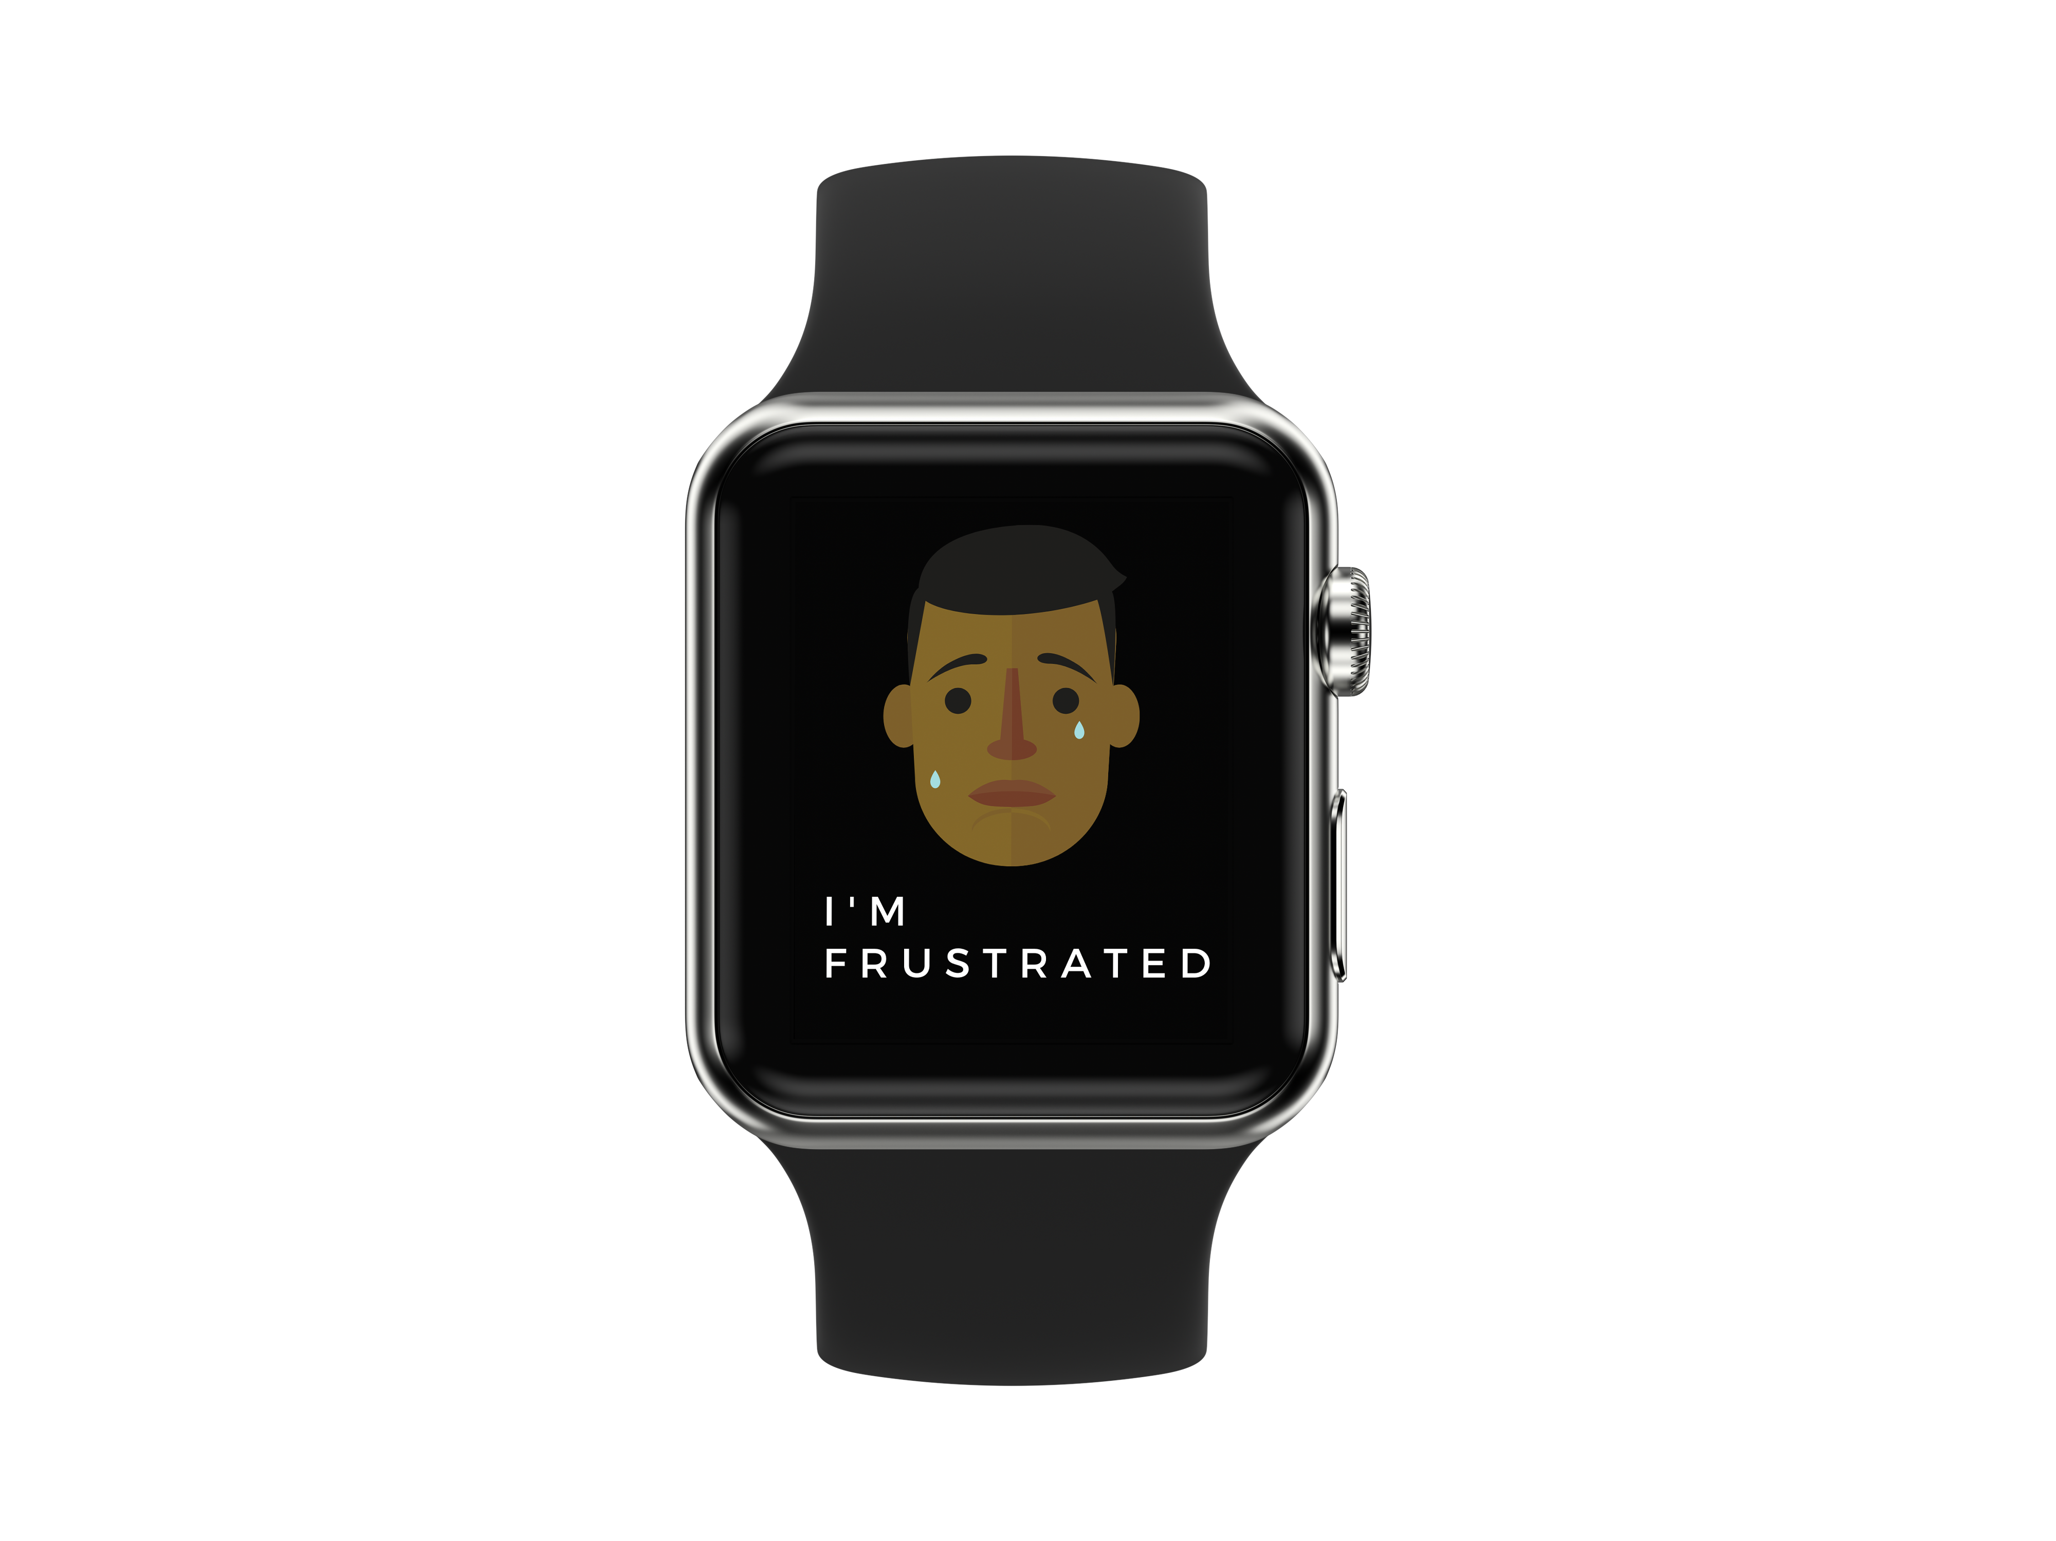
The solution
If I couldn’t find it, I would build it
The thought was to match my child’s needs with technologies that already exist. This was more critical than creating a new technology. As a parent, I knew I would feel more at ease and informed if I had a device that enables real-time feedback. A device that would:
Alert me to heightened states but help him minimize future trigger moments
Help him identify and become more aware of his emotions
Implement his schedule “on-the-go”
Help me keep track of his whereabouts
Reinforce behaviors through a positive reward system
Notes:
I thought if I am going to make another investment towards the betterment of my child’s life I’d do what it takes but I wanted it to work and I wanted it to be comprehensive. Instead of interrogated my child I wanted to have conversations. I ultimately wanted to be able to communicate better.

Slide 5
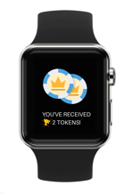
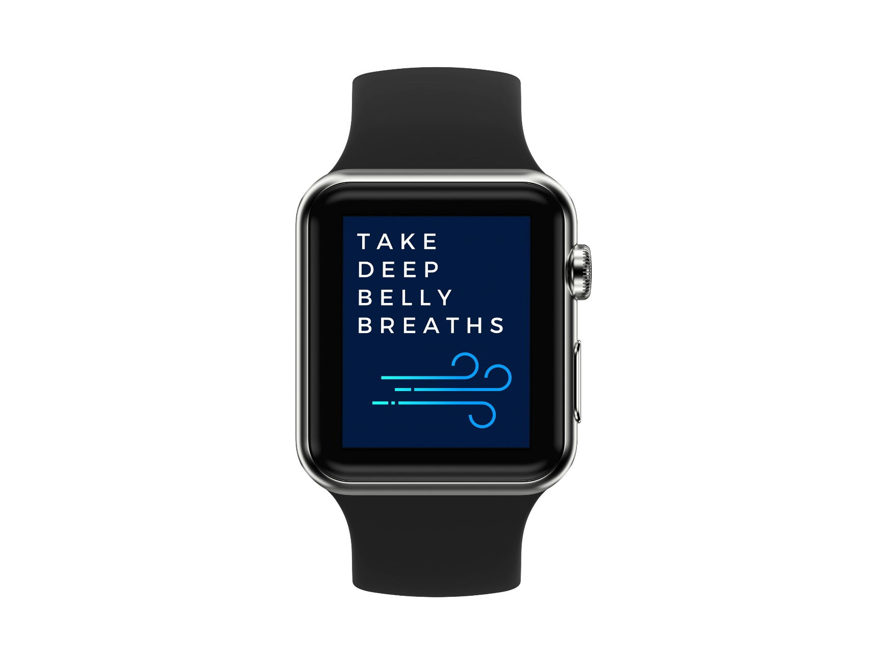
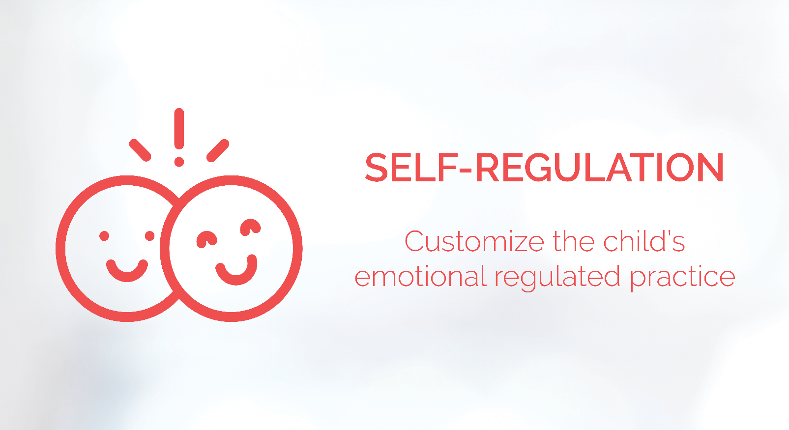
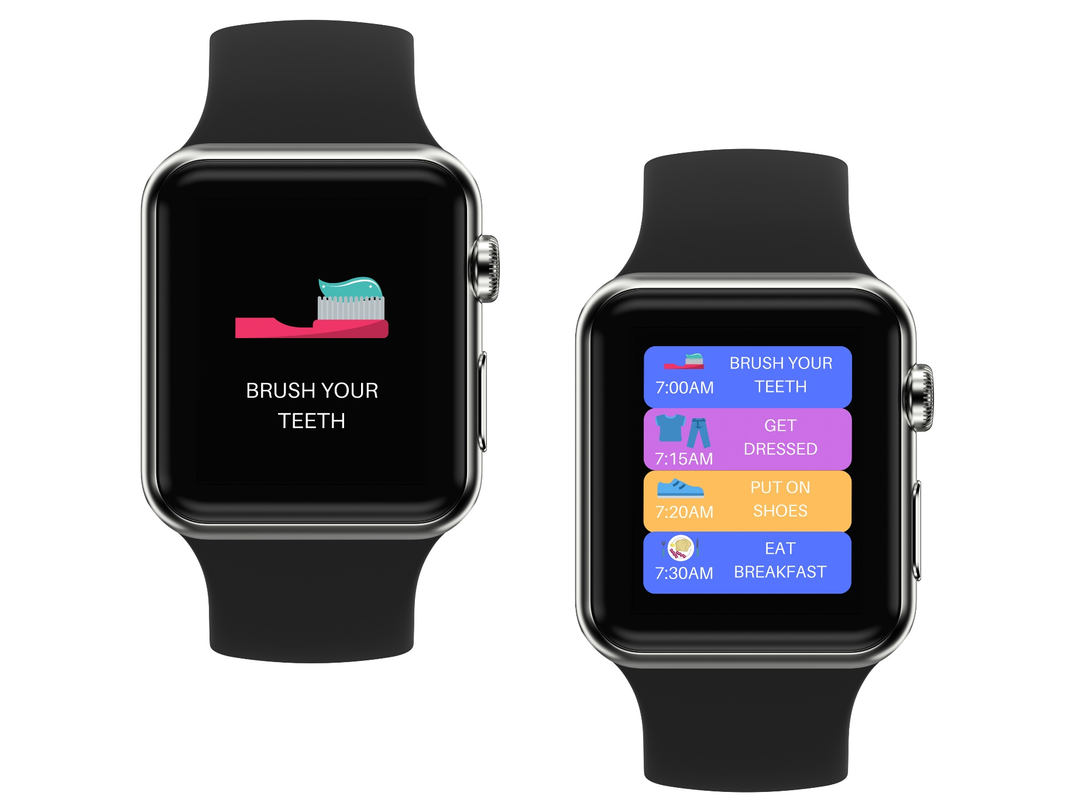
Core App Features

Slide 6
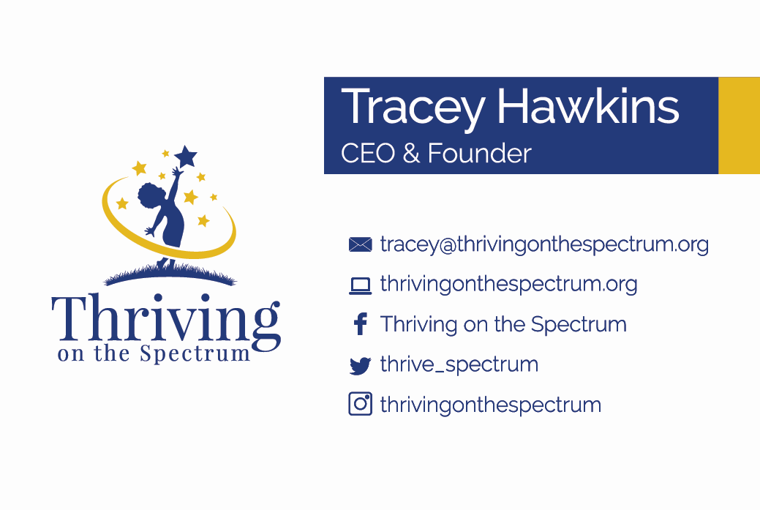
The ask
Help us build the app so we can begin our initial round of beta testing app!
Ranking of features: (1) Visual Schedule (2) Self-Regulation (3) Communication Portal
Could you create the app to be compatible for iPad and iPhone?
Notes:
I thought if I am going to make another investment towards the betterment of my child’s life I’d do what it takes but I wanted it to work and I wanted it to be comprehensive. Instead of interrogated my child I wanted to have conversations. I ultimately wanted to be able to communicate better.

