Slide 1
Revenue intelligence to support go-to-market model optimization
December 2022

Slide 2
Kinetik | Insights in Motion
Kinetik enables go-to market leaders to drive revenue growth through bold action powered by predictive analytics and proven optimization methods
‹#›

Slide 3
Go-to market models are complex
Strategy
Sales Operations
Marketing
Sales Management
Client Success
Brand
Segmentation
Positioning`
Target Accounts
Coverage Model
Incentives
Awareness
Preference
Campaigns
Tactics
Engage
Qualify
Design
Propose
Negotiate
Close
Business Partners
Product Use
NPS
Expansion
Myopic
functions
Incongruent execution windows
Three sides to every story
Static views lack causal insights
Gut feel investments
Functional leads make resource and mix decisions to optimize their functional metrics
Optimization requires end-to-end understanding of go-to market model
Marketing campaigns run for quarters; slow to adapt
Sales plans set for 6 -12 months
Sales management adapts weekly
Sales not proactively working leads
Marketing leads are not worth pursuing
Productivity and resource shifts required; better account targeting
CRM systems report sales pipeline at point in time
Understanding of resources, actions, and outcomes over time required
Need 4X pipeline
Increase seller quotas
Constantly changing account assignments
Decision windows do not support in-depth analysis

Slide 4
The reality
Strategy
Sales Operations
Design
Sales Management
Positioning
Awareness
Preference
Target Accounts
Coverage
Propose
Campaigns
Engage
Closing
Segmentation
Expansion
Value Proposition
Qualify
Negotiate
Brand
Tactics
Incentives
Client Success
Marketing
Static views lack causal insights
Gut feel investments
Myopic
functions
Incongruent execution windows
Three sides to every story
Functional leads make resource and mix decisions to optimize their functional metrics
Optimization requires end-to-end understanding of go-to market model
Sales not proactively working leads
Marketing leads are not worth pursuing
Productivity and resource shifts required; better account targeting
CRM systems report sales pipeline at point in time
Understanding of resources, actions, and outcomes over time required
Need 4X pipeline
Increase seller quotas
Constantly changing account assignments
Decision windows do not support in-depth analysis
Marketing campaigns run for quarters; slow to adapt
Sales plans set for 6 -12 months
Sales management adapts weekly
Notes:
Pipeline acts as a predictable system that can be understood and modeled through a set of historical pipeline metrics and statistics - identified leads - lead progression statistics - win rates
Stochastic modeling provides a forward-looking view of pipeline through use of pipeline statistics calculated through time series analysis
Key to understanding system is to develop a new set of pipeline velocity statistics to support advanced modeling and scenario analysis

Slide 5
Kinetik RAPPORTTM framework calibrates and optimizes go-to-market models across resources, actions, pipeline and outcomes to align actions with revenue forecasting
R
HC, Mkt$ spend, business partner programs, customer success, industry coverage. Geographic market coverage,
impressions, marketing tactics, seller coverage, product-market fit alignment Automation, internal sales, force multipliers, revenue operations tools, market dynamics
Operational metrics with leading indicators
: things you can count. impressions, leads, opportunities, progression velocity, win rate, cost / lead, cost / opportunity
Wins, Losses, Did Not Pursue (DNP), ARR, NRR, Account Expansion, New Logos Weekly, monthly, and quarterly revenue forecasts with embedded ARR, NRR, and CAC Time to implement, Time to productivity, lead qualification, sales progression cycles
Resources
A
Actions
P
Productivity
P
Pipeline
O
Outcomes
R
Revenue
T
Timing

Slide 6
Go-to Market Complexity (1.61E +09)
Massive investment in CRM Platforms
Permutations of a typical technology go-to market model

Slide 7
Three sides to every story
Sales
Marketing
Just need more ‘at bats’
Marketing leads are not worth pursuing
Need 4X pipeline in week 1 to make the quarter
Sales won’t pursue new accounts
Marketing mix maximizes responses and leads
Business partners are not following up
Static performance views lack required end-to-end context
Myopic functional view sub-optimizes mix and resource decisions
Lack of confidence in plans and projections limits investment
Truth
Notes:
Use case 1: SVP of software business unit.
Use case 2
Use case 3

Slide 8
Kinetik’s unique approach
Kinetik
Analytics Unicorns
Consultants
Deep insights into sales and marketing optimization –not just forecasting
21st century statistics and data science
Revolutionary visualization, animation and user experience
Sophisticated predictive analytics and simulation
Revenue Operations
CRM SaaS

Slide 9
Scenario Analysis Use Cases
1
2
3
Market Conditioning
Seller Productivity
Business Partner Ecosystem
What is the impact on a 10% increase in validated leads based on a 30% increase in awareness and preference in target accounts?
What is the impact on won pipeline of 30% increase in validated leads from digital demand programs
What sales communities are most productive at identifying new leads and opportunities?
What are opportunity attributes that have the highest correlation with sales productivity?
What is the expected impact of incremental sales resources across the sales cycle
What is net seller capacity given realities of seller capability, capacity, and assignments
How many business partners are required to support target revenue growth
What are opportunity or business partner attributes that drive highest and lowest business partner sales productivity?
What is the impact of increased demand generation programs and lead passing to business partners?
4
5
6
Competitive Insights
Lead generation and opportunity prioritization
New Product Launch
What opportunity attributes has the highest correlation with win and loss probability vs. key competitors
What are the opportunity attributes that have the highest impact on pipeline progression velocity and win rate?
What are number of new leads, lead progression rates, identified opportunities, opportunity progression and win rates required to attain growth targets for a new product?
How many resources are required and what is the optimal route-to-market mix

Slide 10
Simulation Use Cases
c. Pipeline root cause analysis
a. Acquisition synergies
Strategic
d. Competitive insights
b. New product launch
e. Business partner ecosystem
j. Constraining factors and R2M Optimization
f. Lead generation and opportunity prioritization
g. Seller productivity
i. Current quarter / next quarter actions
h. Market conditioning and demand generation
Tactical
Current Quarter
Annual Planning
Strategic Planning (2 -5 years)

Slide 11
Kinetik Overview
Identify tactics most impactful at addressing pipeline challenges
Understand expected outcomes from marketing tactics based on simple framing of scope and historical productivity metrics
Identify pipeline dynamics with greatest potential for business impact
Identify constraining factors
Determine root cause issues impacting growth
Tactic visualization and insights
Forecast impact of proposed go-to market model on pipeline, signings and revenue growth
Understand expected outcomes from sales and marketing tactics based on proposed resource levels and historical productivity
Systemic issues / root cause
Scenario analysis
Pipeline visualization and simulation
Segmentation / Target accounts
GTM mix optimizer
Identify sales, marketing, and business development actions that align to clients’ key issues
Build scenarios based on mapping tactics to growth objectives
Model key GTM outcomes associated with different marketing / sales mix scenarios
Evaluate trade-offs between growth, margin and cash objectives
Growth blueprint
Forecast pipeline dynamics, throughput, and revenue impact based on historical pipeline velocity metrics and defined scenarios
Overlay incremental actions on current projections to assess overall impact on pipeline and signings

Slide 12
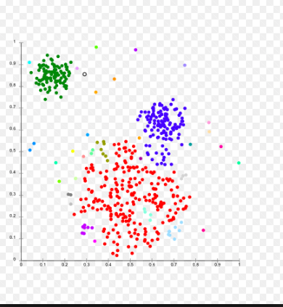
Go-to market cluster analysis
Cluster analysis @ L30 (Identified leads)
Cluster analysis @ L30 (Validated Opp progression)
Cluster based on opportunity attributes (e.g. OI Source, OO Owner type, Opportunity value $, Marketing tactic)
Menu to select portfolio / offerings , IMT, and date range
Velocity metrics calculated based on time series data (every unique opportunity should have a set of velocity metrics tagged to the opportunity
ID > Val lead velocity
VAL > QUAL velocity
New leads / month
Days in Sales Stage (VAL)

Slide 13
Pipeline velocity metrics power Kinetik’s forecasting engine
Key Design Points
Stochastic model based on historical pipeline analysis
Historical statistics calculated using weekly comparison of pipeline at opportunity level
Projections based on actual current pipeline with simulation of weekly activity
Weekly projections summed to monthly and quarterly forecasts
Average Weekly Pipeline Velocity Metrics
New leads
stall
88
5
ID 100
close
5
progress
7
43
revert
VL 50
stall
close
3
3
progress
4
19
revert
QL 25
stall
close
4
2
progress
2
stall
revert
AG 10
close
progress
revert
WN 5

Slide 14
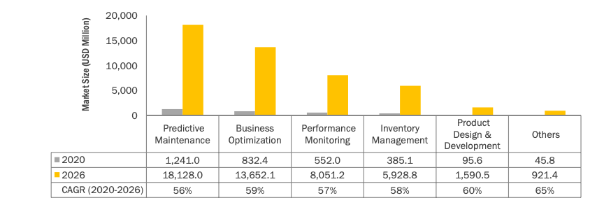
Business optimization software growing ~60% CAGR to $13.6B in 2026
Growth Drivers
Big Data / Analytics
Artificial Intelligence and Machine Learning
Augmented Reality, Virtual Reality
5G
Internet of Things
Source: Markets & Markets

Slide 15
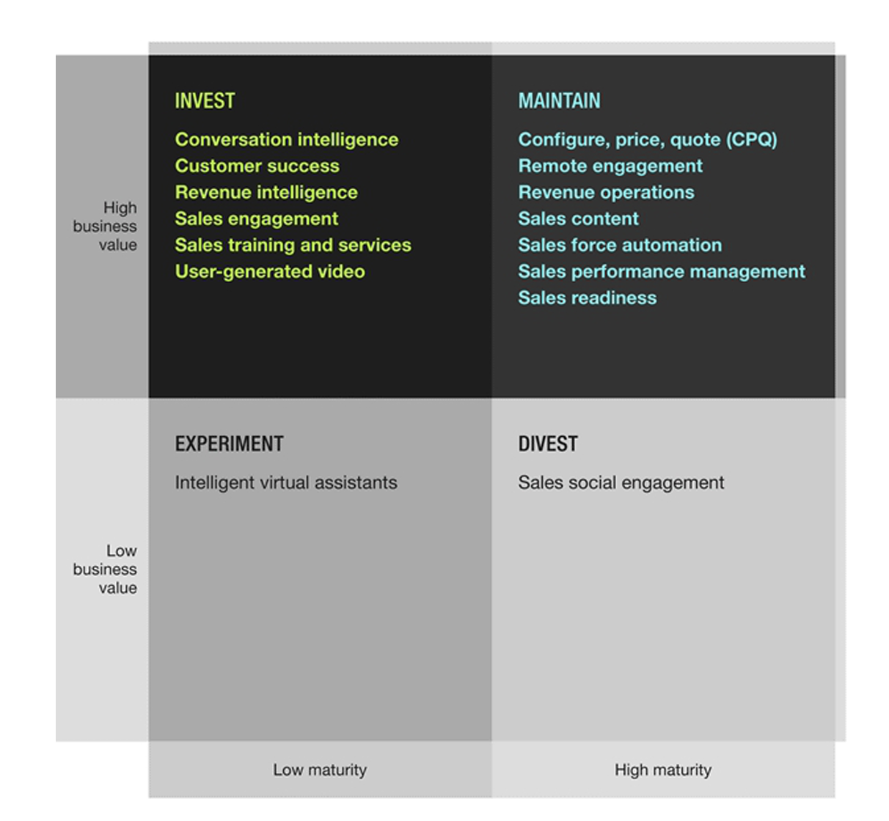
Revenue Intelligence emerging as analytics for revenue operations
Select sales technologies that offer high business value
Strategic Planning Assumptions
By 2026, 65% of B2B sales organizations will transition from intuition-based to data driven decision making, using technology that unites workflows, data and analytics.
By 2025, 70% of all B2B seller-buyer interactions will be recorded to extract competitive, deal and market insights using artificial intelligence (AI), machine learning (ML) and natural language processing (NLP)
Source: Forrester Research; The Forrester Tech Tide™: Sales Technologies, Q1 2021
Source: Gartner; Market Guide for Revenue Intelligence Platforms; Nov 2021

Slide 16
Timeline
Milestones
Seeking $1.5M investment in 1Q23 to expand product functionality and scale to 20 accounts
MVP model (September 1)
$300k Seed funding of core team
Five revenue generating proof-of-concept clients $250k (5 @ $50k) in 1Q23
Simple Website
Salesforce Integration
UX Clickable demo
On-line Demo Launch
Proof-of-concept project
1,000 Trial Users
April
May
June
July
Aug
Sept
Oct
Nov
Dec
Jan
Feb
Founder Investment$25K
Investment Round $1.5M
Seed Investment $300K
david.hughes@kinetiksimulation.com
Notes:
End of Launch Goals : End of April
1. Polished investor pitch; including a specific ask [$300k angel]
Apply to NC Idea Grant. [complete]
New Ventures Deliverable: Market Discovery [
Website launched. Landing page. [David Lapp and Web Developer]
5 Interns hired for Summer.
Vetting process. Lay out the timeline. Upwards. Fiverr. Full development team.
Class. Start-up class. Computer science 523. Software engineering lab.

Slide 17
Appendix

Slide 18
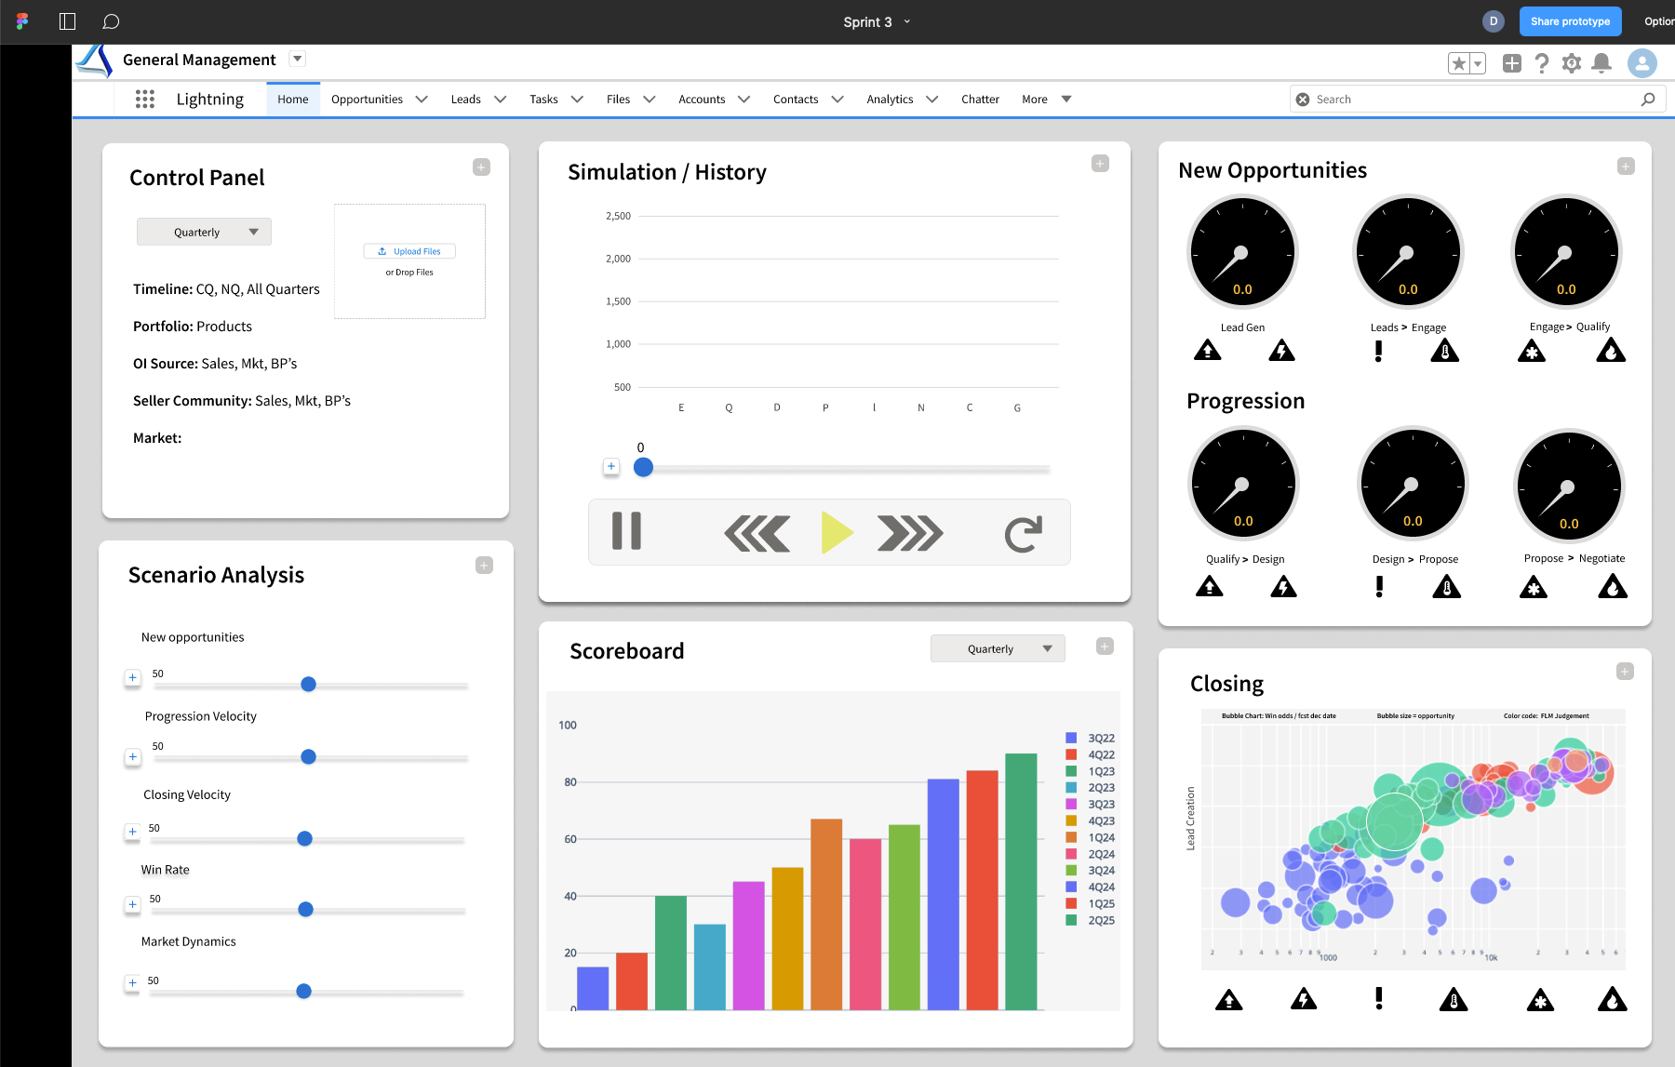

Slide 19
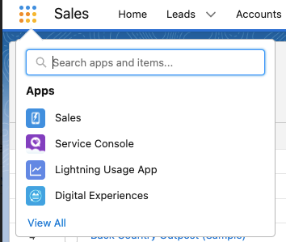
Kinetik Home Screen kinetik.solutions/home
General Manager
Forecast
Run Simulation
Scenarios
Structure Model
Visualization
Analyze Data
Upload Files
Dashboards
Replay
Understand
Forecast
Optimize
Model

Slide 20
Kinetik Home Screen kinetik.solutions/home
General Manager
Forecast
Run Simulation
Scenarios
Structure Model
Visualization
Analyze Data
Upload Files
Dashboards
Run Simulation
Structure Model
Scenarios
Discovery
Analyze Data
Upload Files
Dashboards
Slider UX
Resource levels and mix
20 minute survey
Visualize system dynamics
Calculate velocity statistics
Upload CSV
General Manager
Load top 5 scenarios
Visual g2m builder
Calculate current course and speed statistics
Simple upload: two files with dates
Chief Revenue Officer
Productivity Drivers
Replay historical performance
Update key variables
Upload files and refine (min 2)
Sales
Multiple file upload: upload from box file or drive; infer dates or tag
Operational Outcomes
Constraining factor analysis
Journey statistics for user defined tranches
Sales Operations
Detailed Assumptions
Connect CRM
Marketing
Pipeline State and key metrics
Profile user defined tranches
Channels
Route path statistics for user defined tranches
Strategy
Tranches and Velocity Statistics
AI proposed tranches and route-path statistics ($1M)

Slide 21
System Visualization
Prospecting
Qualification
Demo / Meeting
Proposal
Negotiation
Won
Lead Streams
Stall | Lost | Progress
Stall | Lost | Progress
Stall | Lost | Progress
30%
5 4 3 2 1 0
Account Rep
30% | 30% | 40%
30% | 30% | 40%
Cascading icons
120 Opps
120 Opps
3/10
Speed = leads / week
new / total
Brand Rep
20% | 50% | 30%
20% | 50% | 30%
30%
Color code = tactic
60 Opps
60 Opps
3 / 10
Conversion to opp visualized to OI source > notification
new / total
Business Partner
20%
60% | 30% | 10%
60% | 30% | 10%
20 Opps
20 Opps
1 / 5
new / total
25% | 15% | 60%
25% | 15% | 60%
0%
Specialist
18 Opps
18 Opps
0 / 9
new / total
Other
40% | 30% | 30%
40% | 30% | 30%
66%
25 Opps
25 Opps
Contacts
Leads
Opportunities
1,000
100
10
2 /3
Now
new / total
Wk Mon Qtr Yr

Slide 22
Simulation Design and Structure
Pipeline forecasting model simulation reflects how opportunities progress through the sales cycle
Key Design Points
New leads
Pipeline acts as a predictable system that can be understood and modeled through a set of historical pipeline metrics and statistics - identified leads - lead progression statistics - win rates
Stochastic modeling provides a forward-looking view of pipeline through use of pipeline statistics calculated through time series analysis
Key to understanding system is to develop a new set of pipeline velocity statistics to support advanced modeling and scenario analysis
stall
Engage
close
progress
revert
Qualify
stall
close
progress
revert
Design
stall
close
progress
stall
revert
Propose
close
progress
revert
Negotiate
Closing
Win
Loss

Slide 23
Kinetik High Level Solution Architecture
Manual Uploads
Kinetik AWS Account / AWS Amplify
2.0 Calculate Statistics
3.0 Run Simulation
4.0 Results / User Experience
CRM Software
Salesforce
Microsoft
Oracle / Siebel
Sales Force Automation Software
Marketing Software
Company APIs
AWS Amplify Resources
MVP
0.0 Foundational UX and Navigation
kinetikupload.csv
1.0 Data Ingestion
Get model design, t₀ pipeline, and historical pipeline snapshots. Validate data and pass to 2.0
Determine calculations required based on input method. Perform time series analysis and calculate mean and std dev for model variables
Run simulation model based on initial variables and pass results to UX. Pass model variables to PyMC4 get model results back via API. Accept updated model variables from UX and re-run model.
Collect information from login / uploads. Display results from simulation. Collect updated inputs via UX and pass back to 3.0. Display updated results from updated simulation results. Save scenarios analysis settings.
Kinetik.solutions
Analytics
Machine learning
Developer Tools
Business Productivity
Game Tech
Customer Engagement
Front End Web & Mobile
End User Computing
Security Identity & Compliance
Application Integration (Salesforce, Microsoft)
Migration & Transfer

Slide 24
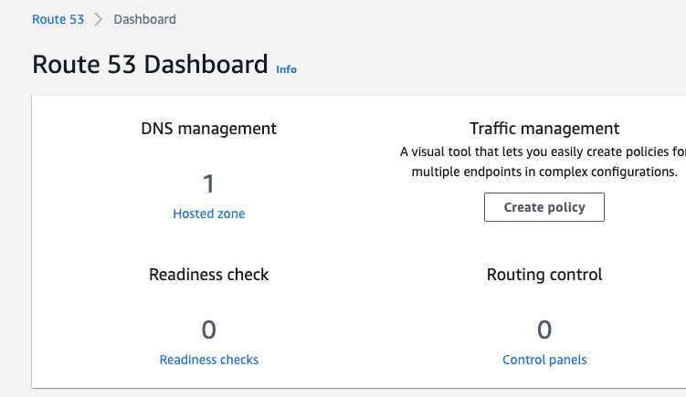
0.0 Foundational UX and Navigation
1
Register for free trial
2
Choose method for account creation
3
Call AWS Cognito service
4
Confirmation email
5
First-time login
6
Guided tour / Navigation help
7
Design starter model

Slide 25
1.0 Model structure / data ingestion
1
Get user data from 4.0 User Experience / Upload File
2
Ingest model structure from kintekupload.csv/model
3
Ingest current pipeline data (t₀) from kintekupload.csv/pipeline
4
Ingest forecast variables from kintekupload.csv/statistics
5
Infer model structure from current pipeline file / Confirm structure with UX 1.1 > Model design
6
Populate data lake and user account
7
Pass model design data and data files to 2.0 Calculate Statistics

Slide 26
2.0 Calculate Statistics
Determine method of model creation a. Survey based, File upload CRM Integrated / machine learning
1
2
Calculate new opportunities statistics
AWS Databrew:
Cleans and prepares data for analysis
AWS Backup:
Centrally managed and automatically scheduled backups
3
Calculate progression statistics
4
Calculate progression statistics
5
Confirm statistics with UX 2.1 > Validate Model Variables
6
Populate user account and data lake
7
Pass statistics to 3.0 Run simulation

Slide 27
3.0 Run Simulation
1
Access model structure variables from 1.0
2
Access statistics from 2.0
EC2/S3 - host/store simulation model and data
CodeCommit - repository to work on the model
SageMaker - ML model to get progression statistics for a set of sales leads
PyMC3/Lambda
Amazon forecast - ML model to forecast revenue growth from a JSON/CSV file of past data
Data must be cleaned and formatted specifically (can be done with aws glue databrew)
Python API for Amazon forecast
Hosted on an ec2 instance that writes to/reads from an S3 bucket
3
Send model data via API to PyMC4.0
4
Populate data lake with results from PyMC4.0
5
Send results to 4.0 Display Results / User Experience
6
Get updated scenario analysis input variables from 4.0 Display Results / User Experience
7
Send results to 4.0 Display Results / User Experience

Slide 28
4.0 User Experience / Display Results
1
Collect user data from UX4.1 - Create account
2
Post user data in [TBD] for use by 1.0 Ingest Data
3
Access data from UX4.2 - Create Model
4
Get simulation results from 3.0
5
Display simulation data in UX4.3 - Scenario Analysis
6
Collect updated scenario analysis input variables from UX4.3
7
Send updated model variables to 3.0 Run Simulation

Slide 29
Pipeline velocity metrics power forecasting engine
Key Design Points
Average Weekly Pipeline Velocity Metrics
Stochastic model based on historical pipeline analysis - mean - standard deviation
Historical statistics calculated using weekly comparison of pipeline at opportunity level
Projections based on actual current with simulation of weekly activity using standard normal statistics
Weekly projections summed to monthly and quarterly forecasts
New leads
stall
88
5
EN 100
close
5
progress
7
43
revert
QL 50
stall
close
3
3
progress
4
19
revert
DS 25
stall
close
4
2
progress
2
stall
revert
PR 10
close
progress
revert
NG 5
Win
Loss

Slide 30
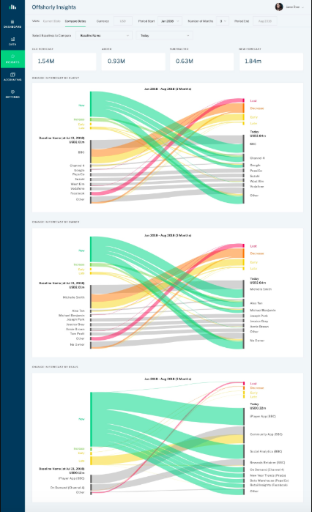
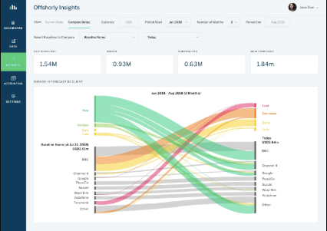
Go-to market visualizations - II
http://christophjanz.blogspot.com/2016/06/a-better-way-to-visualize-pipeline.html
Notes:
Challenge of looking at total pipeline when leads are constantly coming in, going out, and buried underneath a lot of poor opportunities

Slide 31
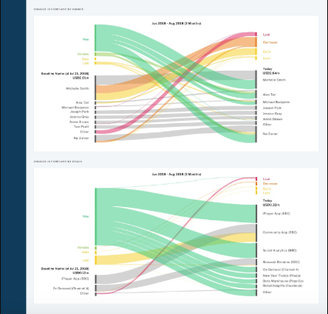
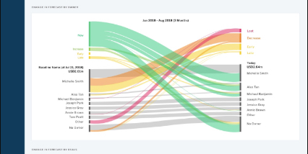
Go-to market visualizations III

Slide 32
Strategic Pipeline Insights Visualizations - I
Market Size / Growth
Relative Market Share
Aligned to Client Priorities / Needs
Awareness / Preference
Offering NPS
Competitive Offering / Portfolio
Marketing Leads
Core/Invest Account Growth
Healthy Lead Stream
VP$M Growth Initiatives
Growth Segments
Industry Sellers
Won-Loss Analysis
Competitive Price
Business Partner leads
GBS banking partner/AP
feedback
New Leads / Month (last 12 months)
ID > VL Progression velocity
Compelling Value Proposition / Differentiation
Revenue Growth
Business Development
Industry Analyst Rankings
Whitespace Accounts
VL$M Top 5 Tactics
Validated Leads from S&D / Pipeline
BVA-BVI conversion rate
Seller Coverage
Non-competitive proposals / Win Rate
Support NPS
Future Quarter Pipeline growth rate
Sales Mgmt
Seller Productivity
Experience NPS
OO / Seller
Number of Sellers / Trend
Client Experience
Strong Lead Progression
Progression Tactics
Pull forward opportunities
Pipeline / Seller
Progression / Seller
Digital Experience
Client Events
Win Rate (quarterly)
VL > QL Progression velocity
Downloads / Seller Feedback
Automatically color code based on pipeline metrics vs. average or
Trial Conversion
Strategic deals
Seller Competency Ratings
Special Incentives

Slide 33
Strategic Pipeline Insights Visualizations - I
Aligned to Client Priorities / Needs
Awareness / Preference
Offering NPS
Competitive Offering / Portfolio
Healthy Lead Stream
Marketing Leads
Growth Segments
Industry Sellers
Competitive Price
Business Partner leads
Compelling Value Proposition / Differentiation
Business Development
Whitespace Accounts
Revenue Growth
Support NPS
Seller Coverage
Sales Mgmt
Experience NPS
Client Experience
Seller Productivity
Strong Lead Progression
Digital Experience
Pull forward opportunities
Progression Tactics
Trial Conversion
Client Events
Strategic deals
Special Incentives

Slide 34
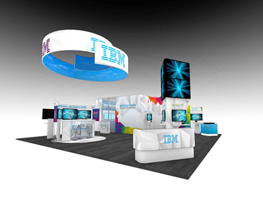
Root cause analysis
1
2
3
Pipeline analysis and visualization
Analyze where gaps exist
Identify root cause issues
need more leads
Equation Variables (metrics)
Drivers
VL > QL progression
Aligned to Client Priorities/Needs
Competitive Offering / Portfolio
Growth Segments / Top Accounts
Competitive Price
Win Rate
Compelling Offerings / Value Proposition
Awareness / Preference
Signings Growth
Healthy Lead Stream
Marketing Leads
S&D Alignment
Alliances
Early Stage Business Development
Strong Lead Progression
Seller Coverage
Delivery Capacity / Utilization
# of days to close
Seller Productivity
4
Determine tactics to address
5
6
Seller Skills
Frame tactics and size impact
Drive account team execution
To: IOT Leaders
From: General Manager
RE: Pipeline > New Event
Reach 100
Response 30
Leads 10
Pipeline $30M
“let’s run an event!”

Slide 35
Pipeline growth algorithm and diagnostic metrics
Drivers
Diagnostic Metrics
Equation Variables (metrics)
Market Size / Growth
Relative Market Share
Aligned to Client Priorities / Needs
Competitive Offering / Portfolio
Growth Segments
Core/Invest Account Growth
Competitive Price
VP$M Growth Initiatives
Won-Loss Analysis
Compelling Value Proposition / Differentiation
Client Satisfaction (NPS)
References / Success Stories
GBS banking partner/AP
feedback
Awareness / Preference
Industry Analyst Rankings
Marketing Leads
VL$M Top 5 Tactics
Revenue Growth
Healthy Lead Stream
Industry Alignment
Validated Leads from S&D / Pipeline
New Leads / Month (last 12 months)
ID > VL Progression velocity
Business Partner leads
BVA-BVI conversion rate
Early Stage Business Development
Non-competitive proposals / Win Rate
Whitespace Accounts
Future Quarter Pipeline growth rate
Pull forward opportunities
Seller Coverage
OO / Seller
Number of Sellers / Trend
Strong Lead Progression
Seller Productivity
Pipeline / Seller
Progression / Seller
Win Rate (quarterly)
VL > QL Progression velocity
Progression /Closing Tactics
Downloads / Seller Feedback
Seller Competency Ratings

