Slide 1
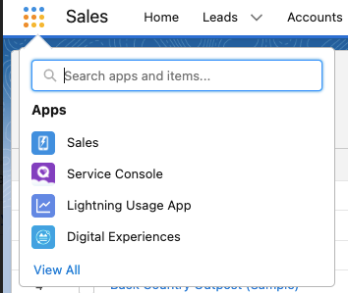
Kinetik Home Screen kinetik.solutions/home
0.0
General Manager
Forecast
Run Simulation
Scenarios
Structure Model
Visualization
Analyze Data
Upload Files
Dashboards
Replay
Understand
Forecast
Optimize
Model

Slide 2
Kinetik Home Screen kinetik.solutions/home
0.0
General Manager
Forecast
Run Simulation
Scenarios
Structure Model
Visualization
Analyze Data
Upload Files
Dashboards
Run Simulation
Structure Model
Scenarios
Discovery
Analyze Data
Upload Files
Dashboards
Slider UX
Resource levels and mix
20 minute survey
Visualize system dynamics
Calculate velocity statistics
Upload CSV
General Manager
Load top 5 scenarios
Visual g2m builder
Calculate current course and speed statistics
Simple upload: two files with dates
Chief Revenue Officer
Productivity Drivers
Replay historical performance
Update key variables
Upload files and refine (min 2)
Sales
Multiple file upload: upload from box file or drive; infer dates or tag
Operational Outcomes
Constraining factor analysis
Journey statistics for user defined tranches
Sales Operations
Detailed Assumptions
Calibrate Model
Marketing
Pipeline State and key metrics
Connect CRM
Profile user defined tranches
Channels
Route path statistics for user defined tranches
Strategy
Tranches and Velocity Statistics
AI proposed tranches and route-path statistics ($1M)

Slide 3
Go-to market System Visualization
4.1
Prospecting
Qualification
Demo / Meeting
Proposal
Negotiation
Won
Lead Streams
Stall | Lost | Progress
Stall | Lost | Progress
Stall | Lost | Progress
30%
5 4 3 2 1 0
Account Rep
30% | 30% | 40%
30% | 30% | 40%
Cascading icons
120 Opps
120 Opps
3/10
Speed = leads / week
new / total
Brand Rep
20% | 50% | 30%
20% | 50% | 30%
30%
Color code = tactic
60 Opps
60 Opps
3 / 10
Conversion to opp visualized to OI source > notification
new / total
Business Partner
20%
60% | 30% | 10%
60% | 30% | 10%
20 Opps
20 Opps
1 / 5
new / total
25% | 15% | 60%
25% | 15% | 60%
0%
Specialist
18 Opps
18 Opps
0 / 9
new / total
Other
40% | 30% | 30%
40% | 30% | 30%
66%
25 Opps
25 Opps
Contacts
Leads
Opportunities
1,000
100
10
2 /3
Now
new / total
Wk Mon Qtr Yr

Slide 4
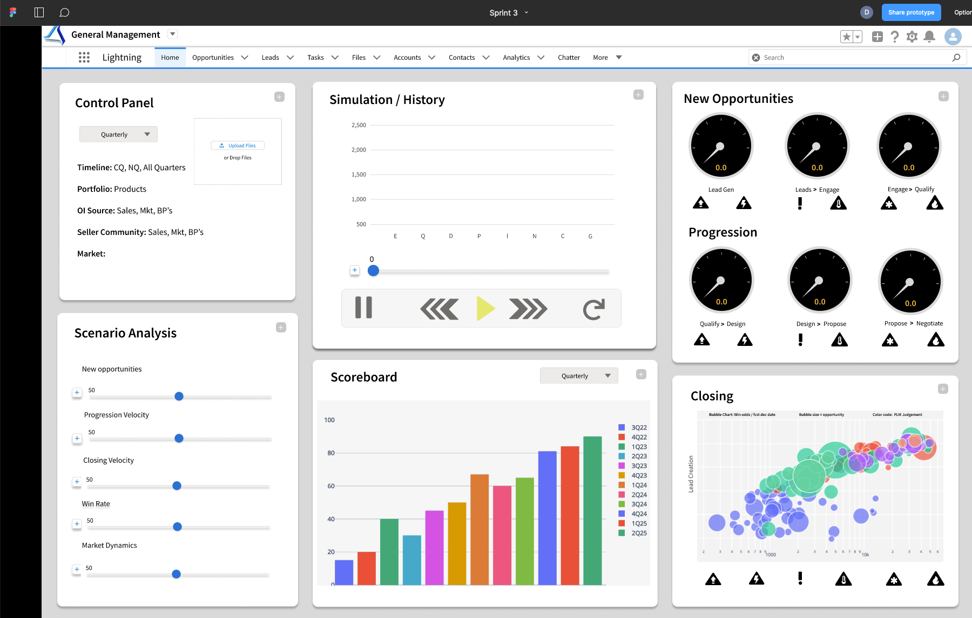
1.1

Slide 5
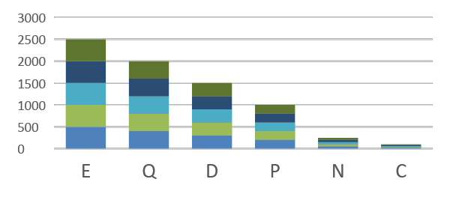
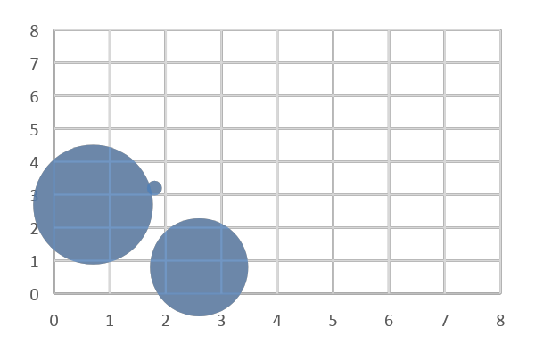
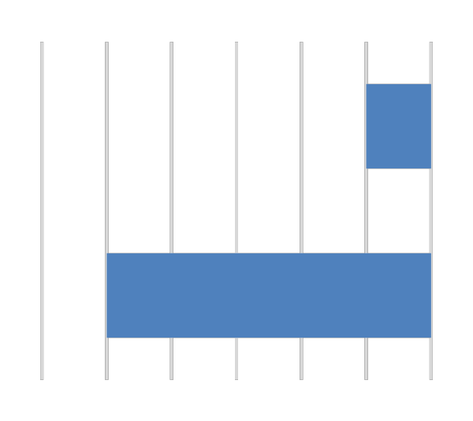
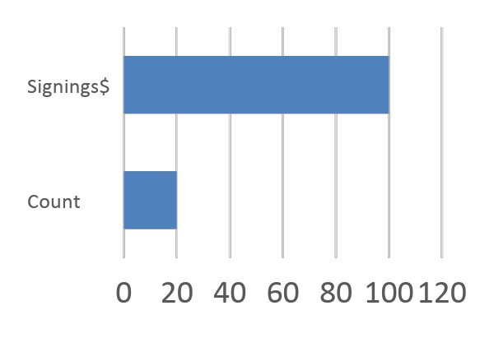
Marketing
Shrink panel
UX Design 2
Default: weekly
Simulation / History
Toggle view: Business or marketing
Campaign Performance
7.5
Control Panel
Timeline:
CQ, NQ, All Quarters
Portfolio:
Products
Leads > Opportunities
E/Q/D Progression
Cost / Lead
Login
Define profile
Switch profile
Detailed Scenario Analysis
OI Source:
Sales, Mkt, BPs
Seller Community
S&D, Industry, Brand, Consulting
Market
19 Markets
Lead Quality
Scenario Analysis
+
t₀
t₅₂
+
CC&S
t₋₅₂
Cost / Win
Prog Velocity for Mkt Opps
Win Rate of Mkt Leads
Leads
+
CC&S
Scoreboard
Select: Meekly, Weekly, Quarterly,
XX
Wins
$XX.XM
Toggle: Bottom 15 tactics
Leads to Opportunities
Tactic Performance (Top 15 tactics)
Expand buttons to develop more detailed scenarios
XX
Loss
$XX.XM
+
CC&S
XX
DNP
$XX.XM
Bubble Chart: new opportunities / new leads
Bubble size = opportunity
Color code mkt create, mkt influence,
Hover: campaign, tactic,
Marketing Mix
Lead Creation
+
CC&S
Incremental Resource
CC&S
Win Rate
Progression
+
TBD
Show time series view; Select: Meekly, Weekly, Quarterly,

Slide 6
Sales VP
Shrink panel
UX Design 3
Default: quarterly
Simulation / History
New Opportunities
Control Panel
7.3
Timeline:
CQ, NQ, All Quarters
Portfolio:
Products
OI Source:
Sales, Mkt, BPs
Lead Gen
Leads > Engage
Engage > Qualify
Seller Community
Sales, Mkt, BPs
Market
Progression
Scenario Analysis
+
t₀
t₅₂
+
CC&S
t₋₅₂
Qualify > Design
Design > Propose
Propose > Negotiate
New Opportunities
+
CC&S
Scoreboard
Select: Meekly, Weekly, Quarterly,
XX
Wins
$XX.XM
Closing
Qualify Velocity
Top 20 opportunities forecasted to close
Bubble Chart: Win odds / fcst dec date
Bubble size = opportunity
Color code FLM Judgement
Hover: FLM, Seller Odds, Dec Date; Request text update
Expand buttons to develop more detailed scenarios
XX
Loss
$XX.XM
+
CC&S
XX
DNP
$XX.XM
Lead Creation
Closing Velocity
+
CC&S
Win Rate
Win Rate
Progression
+
CC&S
Seller Productivity
Show time series view; Select: Meekly, Weekly, Quarterly,

Slide 7
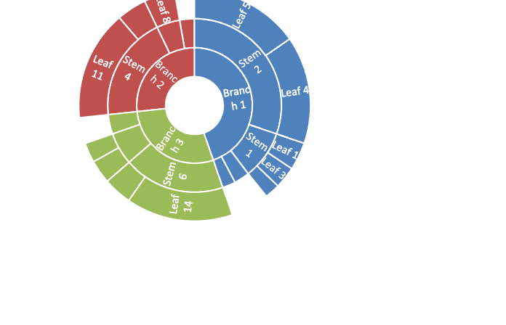
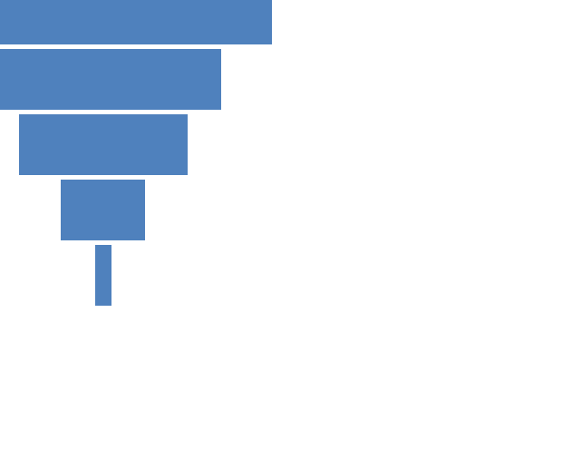
Strategy > Discovery
UX Design 4
7.7
New Leads
Digital Experience
Growth Segments
Market Dynamics
Lead Progression
Update labels
Scenario definition panel
Update labels
Preference
Win Rate
Update labels
Support NPS
Awareness
Market Alignment
Product NPS
Client Experience
Trial Conversion
+
t₀
t₅₂
t₋₅₂
Color code based on quintile benchmarks
Color code based on quintile benchmarks

Slide 8
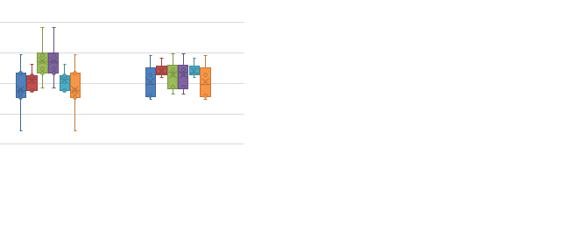
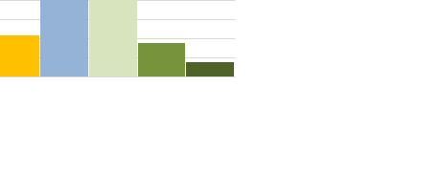
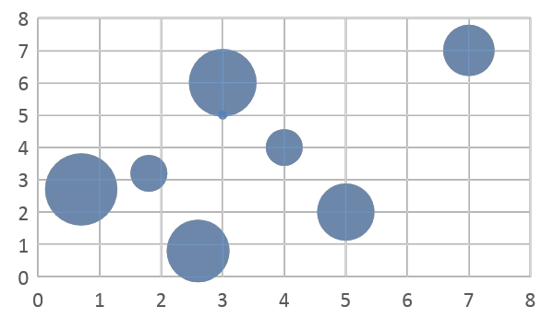
Pipeline health > tranche definition
Default: quarterly
Control Panel
UX Design 5
4.5
Timeline:
CQ, NQ, All Quarters
Portfolio:
Products
OI Source:
Sales, Mkt, BPs
C
D
Seller Community
Sales, Mkt, BPs
Market
B
E
Scenario Analysis
A
F
+
CC&S
New Opportunities
Pipeline Distribution
+
CC&S
G
Progression Velocity
D
Expand buttons to develop more detailed scenarios
+
CC&S
E
Closing Velocity
Lead Creation
B
A
CC&S
F
+
C
Win Rate
Win Rate
+
CC&S
+
t₀
t₅₂
t₋₅₂
TBD
Progression
Notes:
Deal Size
FLM Call
Days since update
Days in sales stage
OI Source
Product Category
Sales Stage at Entry

Slide 9
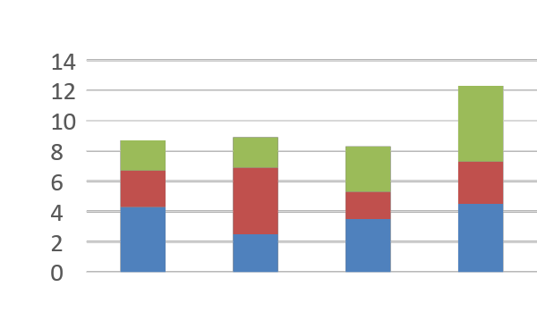
Shrink panel
Strategy > Forecasting
Default: quarterly
Simulation
7.7.1
Control Panel
UX Design 6
Forecast Horizon:
Quarter, Year, Three Years
Portfolio:
Select Products
Where are leads coming from?
Geography:
Select Geographies
Lead Sources:
Select all that apply
Opportunity Owners
Select all that apply
Assumptions vs Actuals vs. benchmarks
Lead Passing
From – to - rules
Resources
Select number and type
Productivity
By resource and tactic
Scenario Analysis
Over / Under
+
t₀
t₁₅₆
+
CC&S
t₋₀
Seller Capacity required
New Opportunities
CC&S
Top 5 risk areas
+
Scoreboard
Progression Velocity
Expand buttons to develop more detailed scenarios
Show range of outcomes; choose variables with greatest impact
+
CC&S
$XX.XM
Closing Velocity
$XX.XM
$XX.XM
$XX.XM
+
CC&S
Win Rate
+
CC&S
Q1
Q2
Q3
Q4
TBD
Show time series view; Select: Weekly, Quarterly, Annually

Slide 10
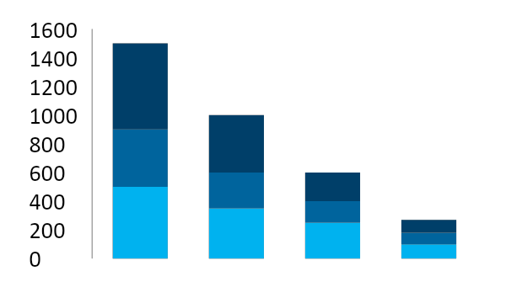
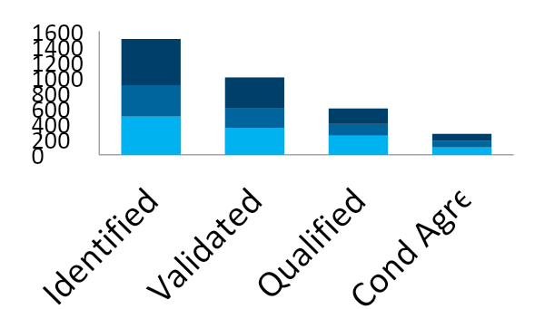
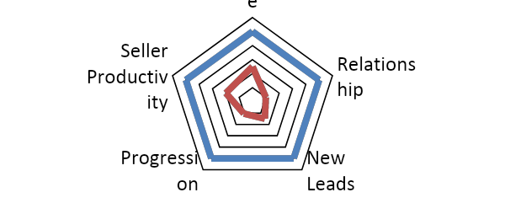
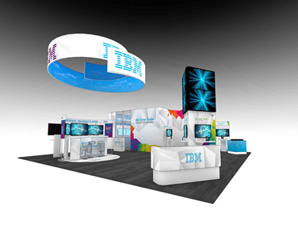
Pipeline Insights
4.3
1
2
3
Pipeline analysis and visualization
Analyze where gaps exist
Identify root cause issues
need more leads
Equation Variables (metrics)
Drivers
VL > QL progression
Aligned to Client Priorities/Needs
Competitive Offering / Portfolio
Growth Segments / Top Accounts
Competitive Price
Win Rate
Compelling Offerings / Value Proposition
Awareness / Preference
Signings Growth
Healthy Lead Stream
Marketing Leads
S&D Alignment
Alliances
Early Stage Business Development
Strong Lead Progression
Seller Coverage
Delivery Capacity / Utilization
# of days to close
Seller Productivity
4
Determine tactics to address
5
6
Seller Skills
Frame tactics and size impact
Drive account team execution
To: IOT Leaders
From: General Manager
RE: Pipeline > New Event
Reach 100
Response 30
Leads 10
Pipeline $30M
UX Design Challenge: What is main screen? How does navigation work? What does the overall architecture look like and how do we document and update? Standard screens for create an account; change password etc. Microsoft CRM version. Salesforce version. Can we copy look and feel and navigation directly from Salesforce?
“let’s run an event!”

Slide 11
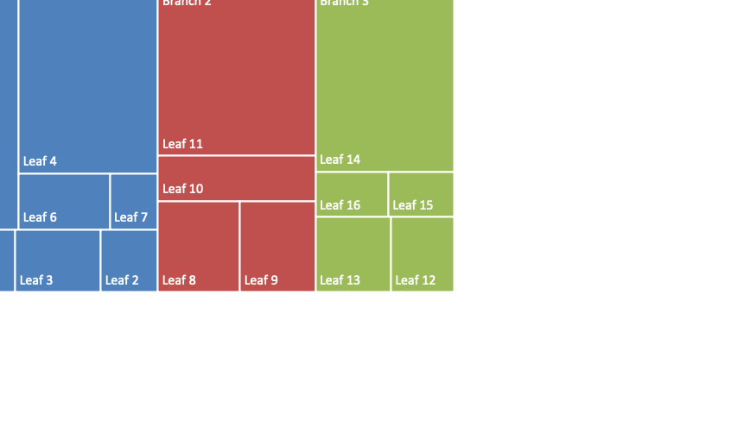
Default: quarterly
Control Panel
OI Diagnostics
Forecast Horizon:
Quarter, Year, Three Years
UX Design 7
Portfolio:
Select Products
Geography:
Select Geographies
Lead Sources:
Select all that apply
Opportunity Owners
Select all that apply
Lead Passing
From – to - rules
Resources
Select number and type
Productivity
By resource and tactic
Scenario Analysis
+
CC&S
New Opportunities
+
CC&S
Progression Velocity
Expand buttons to develop more detailed scenarios
+
CC&S
Closing Velocity
+
CC&S
Win Rate
CC&S
+
t₀
t₅₂
+
t₋₅₂
TBD

Slide 12
Default: quarterly
UX Design 8
Control Panel
Forecast Horizon:
Quarter, Year, Three Years
Portfolio:
Select Products
Geography:
Select Geographies
Lead Sources:
Select all that apply
Opportunity Owners
Select all that apply
Lead Passing
From – to - rules
Resources
Select number and type
Productivity
By resource and tactic
Scenario Analysis
+
CC&S
New Opportunities
+
CC&S
Progression Velocity
Expand buttons to develop more detailed scenarios
+
CC&S
Closing Velocity
+
CC&S
Win Rate
+
CC&S
TBD

Slide 13
Analyst
UX Design 9
Structure model
Upload file [cleanse data with anonomizer]
Calibrate model with actual results
Regression of forecast vs actuals for training periods
Resources / Actions / Outcomes input screens and review
Load Targets. Target vs actual settings
Define Traunches. Auto-calculate traunches
Define executive settings
Upload sales plans and coverage model
Upload marketing campaign and tactic history
Upload business partner profiles and history
Review traunche definition and profiles

Slide 14
Customer Journey
Describe objectives
Define scope of model
Accuracy parameters
Choose your adventure
tbd
tbd
1
2
3
DIY Version
Kinetik Assist
Kinetik Labs
Single product, single geography, <5 OI sources, <5 OO channels
Enterprise Analyst (EA) or consultant uploads files – or downloads python scripts to calculate offline
EA runs and calculates new opportunities statistics and Velocity Statistics (VS)
EA uploads current pipeline and VS to secure instance on the cloud
EA validates forecast vs actuals and manually adjusts VS and new opportunities
No Cluster analysis
No Traunche Definition
tbd
tbd
‹#›

Slide 15
Tranche hypotheses
Definition
Profile variables
Deal size
FLM Call
Days since opened
Days in Sales Stage
OI Source
Business Unit / Product
Sales Stage at Entry
Geographic Market
New leads. / week
Progression by sales stage
Win Rate

Slide 16
Narrative
Why?
How?
What?
Dreamforce Conference. Keynote speaker. Sharing personal story about an organizational turnaround that started in 2023.
Team was stuck for a long time. Functions were pointing fingers at each other.
Frustration. Lack of success is energy draining. High turnover.
Adopted a Moneyball approach. Next generation statistics with advanced simulation to align the team and agree on the right set of actions and milestones.
Enabled bold action. Everyone bought in. Execution accelerated and won championship. Instead of cutting jobs to maintain profit we returned to Job growth. Return to innovation and growth for large enterprises.
Microsoft. Ballmer vs. Nadalla.
Build on enterprises massive investment in CRM systems; improvement in workflow but not predictive capability or insights
Underestimated complexity in understanding interdependencies across route-to-market systems (IBM Marketing 35 FTEs creating 100 page presentations every week)
Multi-billion dollar problem. Impact of 2% incremental growth on market capitalization at IBM (
Disaggregate pipeline of sales opportunities and profile progression patterns for clusters with same combination of attributes
Continuously learning application based on weekly pipeline updates
Monte Carlo simulation powered by by historical pipeline statistics
Scenario analysis that reflects causal relationships between resources, actions, and outcomes
Website
Clickable demo; freemium version with self-service model creation
Core team (1 data science, 1 CRM expert, 1 UX designer, 1 statistics modeler)
$250K proof of concept project

Slide 17
Narrative > Why
Dreamforce Conference. Keynote speaker. Sharing personal story about an organizational turnaround that started in 2023.
Team was stuck for a long time. Functions were pointing fingers at each other. Frustration. Lack of success is energy draining. High turnover. Business was stagnant and kept being challenged with resource reductions.
Adopted a Moneyball approach. Next generation statistics with advanced simulation to align the team and agree on the right set of actions and milestones.
Enabled bold action. Everyone bought in. Execution accelerated and the momentum from the early changes we made drove enabled .
Industry is being disrupted. Competitors are moving quickly. Eaten from below. Advantages of being a market share leader are outweighed by complexity of the organization.
Wins championship.
Everyone wants to be successful.
Job growth. Return to innovation and growth for large enterprises.
Microsoft. Ballmer vs. Nadalla.

Slide 18
Industries
Manufacturing
Media
Not For Profit
Other
Recreation
Retail
Shipping
Technology
Telecommunications
Transportation
Utilities
Agriculture
Apparel
Banking
Biotechnology
Chemicals
Communications
Construction
Consulting
Education
Electronics
Energy
Engineering
Entertainment
Environmental
Finance
Food & Beverage
Government
Healthcare
Hospitality
Insurance
Machinery

