Slide 1
Cluster analysis use cases
Identify lead and opportunity segments: Cluster analysis will group leads and opportunities into distinct segments based on their shared characteristics, such as demographics, behavioral patterns, and engagement levels. These segments will represent customer personas and buying stages, providing valuable insights into how different types of leads and opportunities progress through the sales funnel.
Analyze lead conversion rates: Analyze conversion rates and progression velocity to identify which segments are most likely to convert into wins. This information will be used for lead scoring to prioritize sales opportunities.
Predict lead qualification: Develop predictive models that identify leads with the highest probability of qualification. High propensity clusters will be prioritized for sales outreach and as an input to optimize marketing campaigns.
Identify constraints in the sales process: Analysis of velocity statistics provides insights into the time it takes for leads and opportunities to progress through stages of the sales funnel. Kinetik used cluster analysis to identify constraining factors that slow the sales process.
Tailor marketing and sales strategies: Kinetik analyzes lead and opportunity attributes to understand lead segments . Insights are used to tailor marketing and sales strategies to each segment. This can include targeted messaging, personalized outreach, and customized sales approaches.
Improve customer acquisition: Identify the most effective marketing channels and strategies for converting leads for new customers. Insights are applied to design campaigns to meet new customer acquisition objectives while optimizing marketing spend.

Slide 2
Functional Requirements
Data Acquisition:
The solution will import and process marketing lead and sales opportunity data from AWS S3 databases at kinetik.solutions
The data import process will support Salesforce, Eloqua, Microsoft, Adobe, Hubspot, Oracle, and Snowflake data and allow for customization based on specific client configurations.
Data Pre-processing:
The solution should handle missing values, outliers, and inconsistencies within the data.
Data cleaning and preprocessing techniques should be applied to ensure data quality for reliable analysis.
Feature Engineering:
Create relevant features based on lead attributes, engagement patterns, and other relevant information.
The solution should allow for customizable feature engineering to cater to specific marketing goals and objectives.
Clustering:
Implement various clustering algorithms to identify distinct groups within the lead pool.
The solution should allow users to choose from different algorithms, such as K-Means, Hierarchical clustering, or DBSCAN.
Provide visualizations and metrics to assess the quality and performance of the clustering results.
(conceptual design on pg. 5)
Cluster Analysis:
Analyze the characteristics, behaviors, and conversion rates of each cluster.
Identify key patterns and trends within each cluster to understand the underlying motivations and preferences of different lead groups.
Six cluster analysis use cases are described on page 2)
Visualization and Reporting:
Generate visually appealing and informative reports that summarize key findings and insights from the cluster analysis.
Allow for easy export and sharing of reports for further analysis and decision-making
Allow user to view results through either Power BI or Tableau

Slide 3
Non-Functional Requirements
Performance:
The solution should be able to handle large datasets efficiently and perform clustering tasks within a reasonable timeframe.
Scalability:
The solution should be scalable to accommodate future growth and allow for the analysis of larger datasets as the lead pool increases.
Flexibility:
The solution should be flexible and customizable to accommodate changing marketing objectives and lead data.
Allow for the integration of additional features and functionalities as needed.
User Interface:
Provide a user-friendly interface that is intuitive and easy for marketing users to navigate.
Documentation:
Provide comprehensive documentation that explains the functionality of the solution, step-by-step instructions, and troubleshooting tips.
Technical Requirements
Programming Language: Python
Libraries and Dependencies:
Scikit-learn for clustering algorithms
Pandas for data manipulation
NumPy for scientific computing
Matplotlib and Seaborn for data visualization
Front End System: React.js
Hardware: AWS Cloud

Slide 4
Future Considerations
Integration with other marketing automation tools
Machine learning models for lead scoring and conversion prediction
Real-time data analysis and dynamic lead segmentation
Deliverables
Python code for the cluster analytics solution
Documentation for installation, usage, and troubleshooting
User guides and tutorials
Sample reports for different scenarios
Deployment instructions
Success Criteria
The solution successfully identifies distinct and meaningful clusters within the marketing lead pool.
The cluster analysis reveals actionable insights that can be used to improve marketing campaigns and lead conversion rates.
The solution is user-friendly and easy to use by marketing professionals without extensive technical expertise.
The solution meets all non-functional requirements, including performance, scalability, and flexibility.

Slide 5
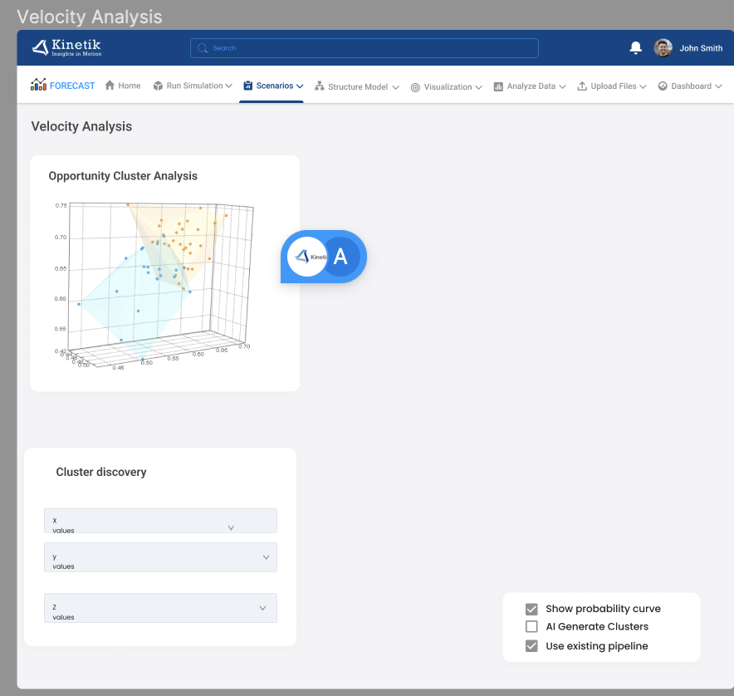
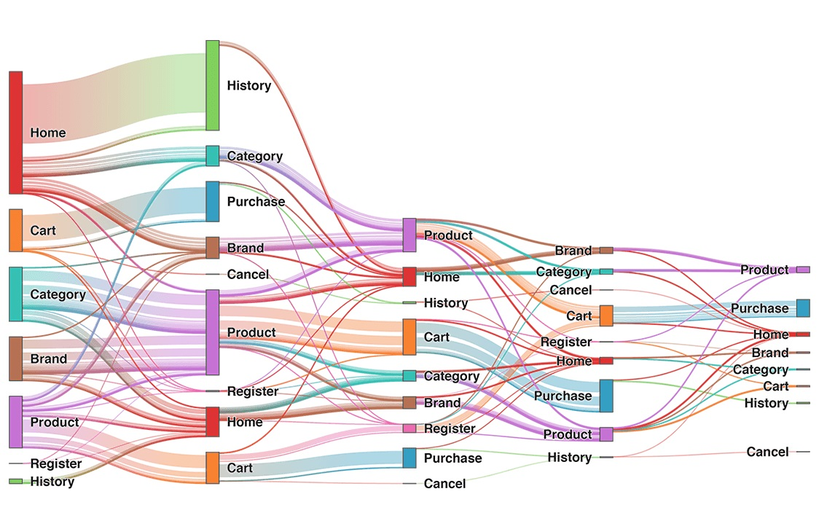
4.4 Cluster Analysis
Cluster Analysis > Opportunities
C-H Index: 10
New Opportunities
Opp Source
Pct Marketing
MQL Conversion
Wins
Losses
DNP
Win Rate
Early Stage Progression
Late Stage Progression
Pct of pipeline
185
%A; %B; %C; % Other
%
0.5
100
50
50
50%
9%
14%
9%
WCSS: 6.5
Z Axis
Drop Down List
D-B Index: 0.5
Select Cluster
Cluster Profile:
Cluster A
X Axis
Drop Down List
Y Axis
Drop Down List
Scope
Journey
Cluster B
Campaign
Tranche
Tactic
Age
Nurture
Velocity
Channel
TBD
Cluster C
Product
TBD
Region
TBD
Notes:
Silhouette coefficient: The silhouette coefficient measures how well a data point is clustered within its cluster and how far it is from other clusters. A silhouette coefficient of 1 indicates that a data point is well-clustered, while a silhouette coefficient of -1 indicates that a data point is poorly clustered.
Within-cluster sum of squares (WCSS): The WCSS measures the variability within each cluster. A lower WCSS indicates that the data points within a cluster are more similar to each other than data points in different clusters.
Calinski-Harabasz index: The Calinski-Harabasz index is a ratio of the between-cluster variance to the within-cluster variance. A higher Calinski-Harabasz index indicates that the clusters are well-separated.
Davies-Bouldin index: The Davies-Bouldin index measures the ratio of the average silhouette width to the average cluster diameter. A lower Davies-Bouldin index indicates that the clusters are well-separated and compact.
Gap statistic: The gap statistic compares the WCSS of a clustering solution to the WCSS of expected clusters from a uniform random distribution. A lower gap statistic indicates that the clustering solution is significantly better than the expected clusters from a uniform random distribution.

Slide 6
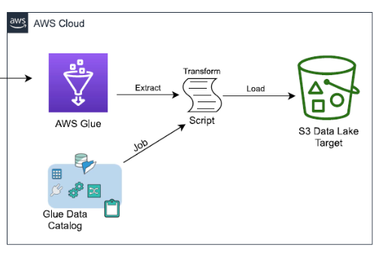
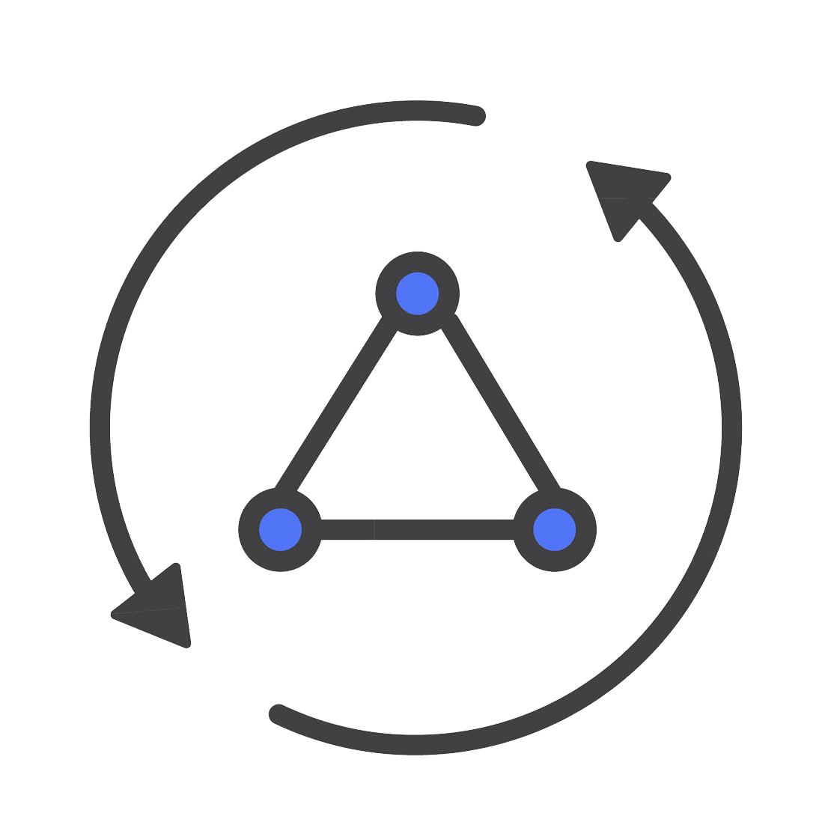
Kinetik High Level AWS Architecture
Automated Data Ingestion
Amazon Route 53
DNS Service
Local Storage
AWS Amplify
Deployment
Nivo Package
Visualizations
AWS Lambda (Python)
Simulation
React.js
Frontend
CSV Input
Pipeline Summary
JavaScript
Data Processor
AWS Lambda (Python)
Sensitivity Analysis
CSV Input
Initial Pipeline
CSV Input
Marketing Input
AWS Cognito
Authentication
AWS AppSync
Query
DynamoDB
Database

