Slide 1
Software and System Testing

Slide 2
Why do we care?
Epic Software Fails
Therac-25 (1985)
6 massive radiation overdoses
Multiple space fiascos (1990s)
Ariane V exploded after 40 seconds (conversion)
Mars Pathfinder computer kept turning itself off (system timing)
Patriot missile misquided (floating point accuracy)
Millenium bug (2000)
Microsoft attacks (ongoing)
NIST: cost to US, $59 billion (2002)

Slide 3
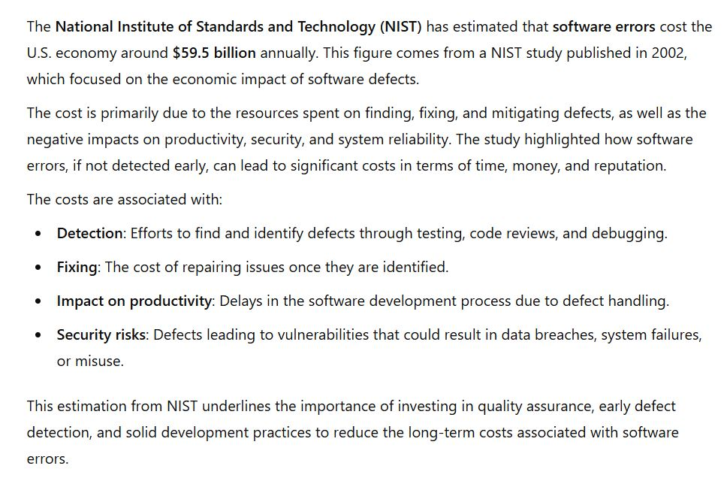
ChatGPT summary

Slide 4
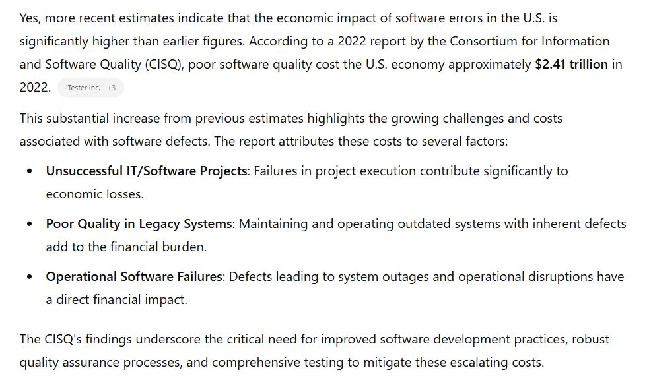
ChatGPT summary
Report link

Slide 5
Quality and testing
“Errors should be found and fixed as close to their place of origin as possible.” Fagan, Brooks, Beck, Boehm, everyone
“Trying to improve quality by increasing testing is like trying to lose weight by weighing yourself more often.” McConnell, in "Code Complete"
Software quality is far more that testing, but testing can contribute towards it
Code quality, requirements quality, design quality, testing quality (!!)
Performance, reliability
Robustness, security
Usability
Documentation

Slide 6
Types of Testing
For Different Purposes
Functional Testing ( unit, integration, system )
Usability testing
Acceptance testing
Performance testing
Stress testing
Reliability testing
Conformance testing (standards)
…

Slide 7
Other classifications
Scope
unit, module, system, regression (time), …
Time
after design/coding
before (test-driven development, agile)
during / mixed… and post deployment, ongoing
Code visibility / structure
Black box: code treated as input/output function and no use of code structure is used (programming by contract)
White box: code structure is used to determine test cases and coverage

Slide 8
How important is unit test?
The Voyager bug (sent the probe into the sun).
‘90: The AT&T bug that took out 1/3 of NYC telephones (crash on receipt of crash notice).
The DCS bug that took out the another 1/3 a few months later.
‘93: The Intel Pentium chip bug (it was software, not hardware).
‘96: The Ariane V bug: auto-destruct (data conversion).

Slide 9
What are you trying to test?
Basic Functionality?
many techniques
Most common / likely actions?
Cleanroom (Harlan Mills)
Most likely problem areas?
Risk-based testing

Slide 10
Risks
Identify criteria of concern: availability, quality, performance, …
Risk of it not being met
likelihood
consequences
If I’m testing code for a grocery store, what is the impact of the code failing (or down)?
What about missile guidance?
What about nuclear power plant control?

Slide 11
Mills: Cleanroom
Test based on likelihood of user input
User profile: study users, determine most probable input actions and data values
Test randomly, drawing data values from the distribution (see monkey testing )
Means most likely inputs occur more often in testing
Finds errors most likely to happen during user executions

Slide 12
How to identify what to test
New features
New technology
Overworked developers
Regression
Dependencies
Complexity
Bug history
Language specific bugs
Environment changes
Late changes
Slipped in “pet” features
Ambiguity
Changing requirements
Bad publicity
Liability
Learning curve
Criticality
Popularity

Slide 13
Four Parts of Testing
Model
establish the expected behavior ( "oracle" )
Select test cases
choose the scenarios to test ( e.g., based on requirements )
Execute test cases
run the tests and observe the results.
Measure
compare results with expected outcomes to assess software quality

Slide 14
ChatGPT summary

Slide 15
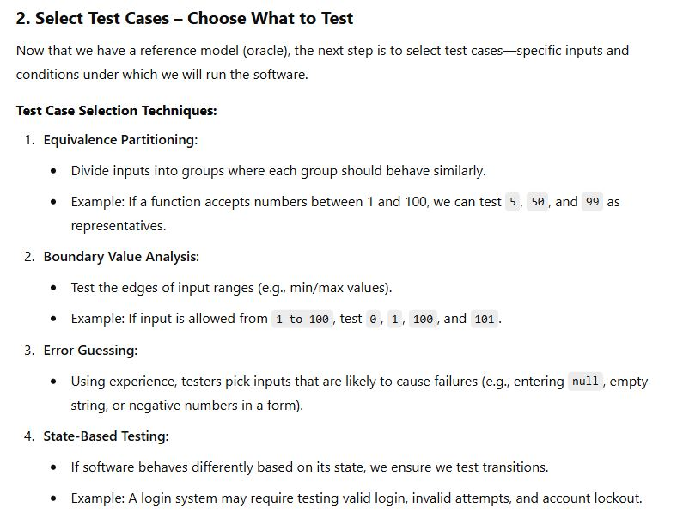
ChatGPT summary

Slide 16
ChatGPT summary

Slide 17
ChatGPT summary

Slide 18
Basic Software System Model
User interfaces
APIs
Operating system
Files
environment
capabilities
Input / Output
data structures
algo processing
"business logic"

Slide 19
Test Case Selection
Environment
What happens if a file changes out from under you?
Consider all error cases from system calls
( e.g., you can’t get memory allocated )
Test on different platforms: software and hardware
Test on different OS versions, and with different languages

Slide 20
Test Case Selection
Capabilities
Inputs (boundary conditions, equivalence classes)
What about unexpected inputs
Outputs (can I generate a bad output?)
States (reverse state exploration)
Algo processing

Slide 21
From the User Interface: Inputs
Error messages
Default values
Character sets and data types
Overflow input buffers
Input interactions
Repeated inputs
Unlikely inputs
How easy is it to find bugs in Word?

Slide 22
Questions to Ask for Each Test
How will this test find a defect?
What kind of defect?
What failure or error do I hope to expose?
How powerful is this test against that type of defect? Are there more powerful ones?
Is there a test that will expose the error and give me information to help fix it?

Slide 23
Testing Practices (Boris Beizer)
Unit testing to 100% coverage: necessary but not sufficient for new or changed
Integration testing: at every step; not once
System testing: AFTER unit and integration testing
Testing to requirements: test to end users AND internal users
Test execution automation: not all tests can be automated
Test design automation: implies building a model. Use only if you can manage the many tests

Slide 24
Testing Practices (Boris Beizer)
Stress testing: only need to do it at the start of testing. Runs itself out
Regression testing: needs to be automated and frequent
Reliability testing: not always applicable. statistics skills required
Performance testing: need to consider payoff
Independent test groups: not for unit and integration testing
Usability testing: only useful if done early
Beta testing: not instead of in-house testing

Slide 25
Usability Testing
Evaluating a UI/UX design

Slide 26
Usability Testing
Testers watch for these issues:
Frequency with which the problem occurs
common, or rare?
Impact of the problem if it occurs
easy or difficult to overcome?
insignificant, or damaging?
Persistence of the problem
one-time occurrence, or repeated?

Slide 27
Wizard of Oz Testing
Inputs and outputs are as expected
How you get between the two is “anything that works”
Particularly useful when you have
an internal interface
choices to make on user interfaces
Children’s Intuitive Gestures in Vision-Based Action Games
CACM Jan 2005, vol. 48, no. 1, p. 47

Slide 28
# Usability Test Users Needed
Usability problems found = N(1-(1-L)^{n})
N = total number of usability problems in the design
L = proportion of usability problems discovered by a single user
n = number of users
L=31%

Slide 29
Using as an Estimator
Found 100 problems with 10 users
Assumption: each user find 10% of problems
How many are left?
found = N(1-(1-L)^{n})
100 = N(1-(1-.1)¹⁰)
N = 100/(1-.9¹⁰)=154
54 left

Slide 30
Test Measurements

Slide 31
Test Coverage Metrics
Statement coverage
Basic block coverage, or edges in control flow graph
Decision coverage (branch coverage)
Each sense of each Boolean expression
Condition coverage
Each entity varied in each Boolean expressions
Path coverage
Loops, branch combinations
Impractical, N items can have 2^N different paths
We get to see the code to guide testing, help with test case gen
These are “white box” methods

Slide 32
Statement/Block Coverage
A
A
x=9
x=2
x=9
x>5
x>5
Bt
Bf
Bt
C
C

Slide 33
Decision Coverage
A
A
x=9
x=2
x=9
x=2
x>5
x>5
Bt
Bf
Bt
C
C

Slide 34
Condition Coverage
A
x=9, y=20
Bt
Ct
x>5 &&
y <100
x<20 &&
y >10
D
Bf
Cf
x=2, y=20

Slide 35
Path Coverage
A
x=9, y=20
Bt
Ct
x>5 &&
y <100
x<20 &&
y >10
D
Bf
Cf
x=2, y=20

Slide 36
When can we stop testing?
Historical data
Capture-recapture model
Error seeding

Slide 37
Historical Data
Lots of variants based on statistical modeling
What data should be kept?
When are releases comparable?
Dangers with a good release (few bugs)
test forever
adversarial relation between developers and tester
Dangers with a bad release (lots of bugs)
stop too soon

Slide 38
Capture-recapture model
Estimate animal populations: How many deer in the forest?
Tag and recount
If all tagged, assume you’ve seen them all
Applied to software by Basin in 73
Number of errors = |e₁| * |e₂| / |e₁ ∩ e₂ |
where e_{n} = errors found by tester n
2 testers: 25, 27, 12 overlap: 56 total errors
What’s wrong with this model (aside from the fact the denominator can be 0)?
Assumptions about independence of testers

Slide 39
Error “seeding”
Also called mutation testing
Deliberately put errors into code (seeding)
Testing finds the seeded errors as well as "real" ones put there by developers
Percentage of seeded errors found is related to percentage of “normal” errors found

Slide 40
Test Tools

Slide 41
Unit Test
What do they do?
Regression testing framework
Incrementally build test suites
Typically language specific
What is available?
JUnit most well known (Java)
SUnit was the first (Smalltalk)
xUnit where x is most every language known
Eclipse has unit test plugins for many languages
http://en.wikipedia.org/wiki/List_of_unit_testing_frameworks

Slide 42
Regression Test
Automated
Run with every build
Issues
Time
GUI based
Tools
Wide range of capabilities and quality
Avoid pixel-based tools
Random vs. scripted testing
One list

Slide 43
Performance Test Tools
What do they do?
Orchestrate test scripts
Simulate heavy loads
Check software for meeting non-functional requirements (speed, responsiveness, etc.)
What is available?
JMeter (can do Web apps, mobile, and desktop programs)
Grinder

Slide 44
Performance Test Tools

Slide 45
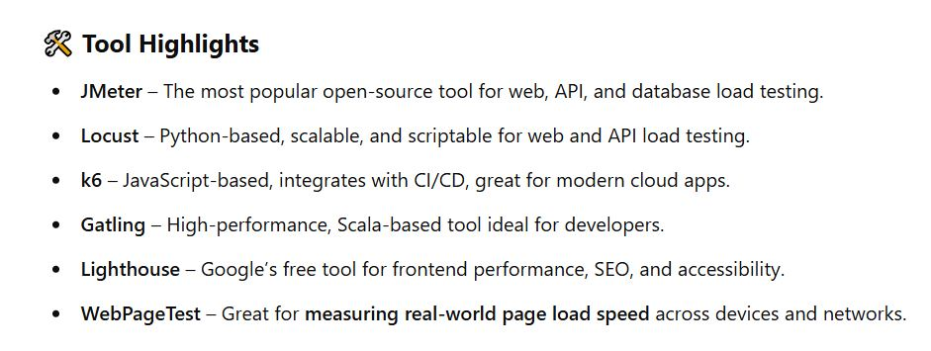
Performance Test Tools

Slide 46
Stress Testing
A kind of performance testing
Determines the robustness of software by testing beyond the limits of normal operation
Particularly important for "mission critical" software, where failure has high costs
“stress” makes most sense for code with timing constraints or resource limits
servers that are made to handle, say, 1000 requests per minute, etc.
environments that can handle hundreds of users simultaneously
multi-player network games… can it handle 5K users? 10k? 50K?
Tests demonstrate robustness, availability, and error handling under a heavy load

Slide 47
Fuzz Testing, or Fuzzing
Involves providing invalid, unexpected, or random data as inputs of a program
Program is monitored for exceptions such as
crashes
failing built-in code assertions
memory leaks
Fuzzing is commonly used to test for security problems in software or computer systems, or reliability / robustness

Slide 48
Other Test Tools
Tons of test tools
One starting point
http://www.softwareqatest.com/qatweb1.html

Slide 49
Other Quality Improvers

Slide 50
Other Ways of Improving Quality
Static testing methods (vs. dynamic)
reviews and inspections
formal specification
program verification and validation
Self-checking (paranoid) code
Duplication, voting
Deploy with capabilities to repair

Slide 51
Formal Methods and Specs
Mathematically-based techniques for describing system properties
Used in inference systems
Do not require executing the program
Proving something about the specification not already stated
Formal proofs
Automatable
Examples: theorem provers and proof checkers
Model checkers
FSM-based, not inference

Slide 52
Uses of Specifications
Requirements analysis
rigor
System design
Decomposition, interfaces
Verification
Specific sections
System analysis and evaluation
Reference point, uncovering bugs
Documentation

Slide 53
Examples
Abstract data types
Algebras, theories, and programs
VDM (Praxis: UK Civil aviation display system CDIS), Z (Oxford and IBM: CICS), Larch (MIT)
Concurrent and distributed systems
State or event sequences, transitions
Hoare’s CSP, Transition axioms, Lamport’s Temporal Logic
Programming languages!

Slide 54
Self Checking Code
Exploit redundancy
Run multiple copies of the code, vote on critical results and decisions
Identifies erroneous system via its disagreement
Develop functionally identical versions with different code compositions, different teams
Perhaps use different hardware hosts
Used on space shuttle

Slide 55
Self-Repairing Code
http://www.tomsguide.com/us/darpa-self-healing-software,news-17761.html
http://venturebeat.com/2013/09/17/hp-launches-self-healing-computer-start-software/
http://www.technologyreview.com/news/416036/software-that-fixes-itself/

Slide 56
AI in Testing

Slide 57
AI in Software Testing
We know AI has made big inroads into coding and coding support
What about testing code?
Some irony here, as AI code is often wrong, or incomplete
Older tools like ChatGPT even tell you things about PLs that are factually not true
But, they are getting better rapidly

Slide 58
AI in Software Testing
( ChatGPT )

Slide 59
AI in Software Testing
( ChatGPT )

Slide 60
AI in Software Testing
( ChatGPT )

Slide 61
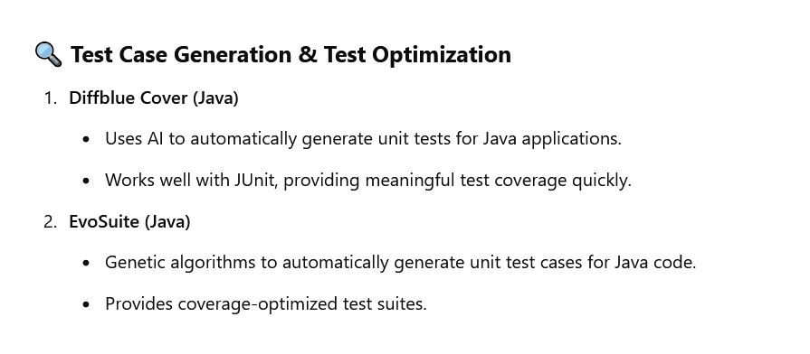
AI Testing Tools
( ChatGPT )

Slide 62
AI Testing Tools
( ChatGPT )

Slide 63
AI Testing Tools
( ChatGPT )

Slide 64
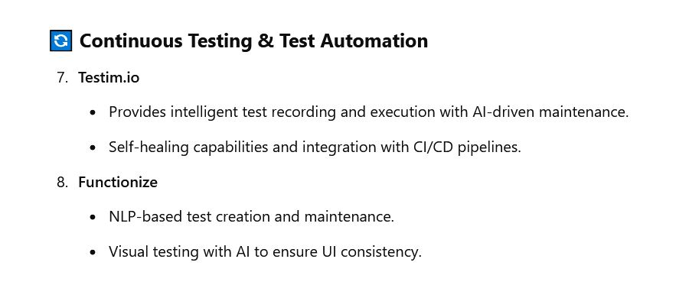
AI Testing Tools
( ChatGPT )

Slide 65
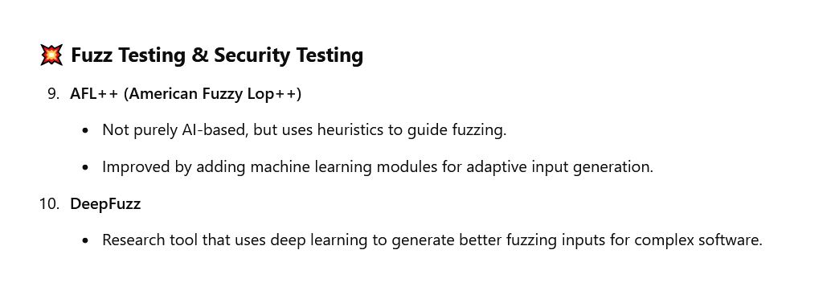
AI Testing Tools
( ChatGPT )

Slide 66
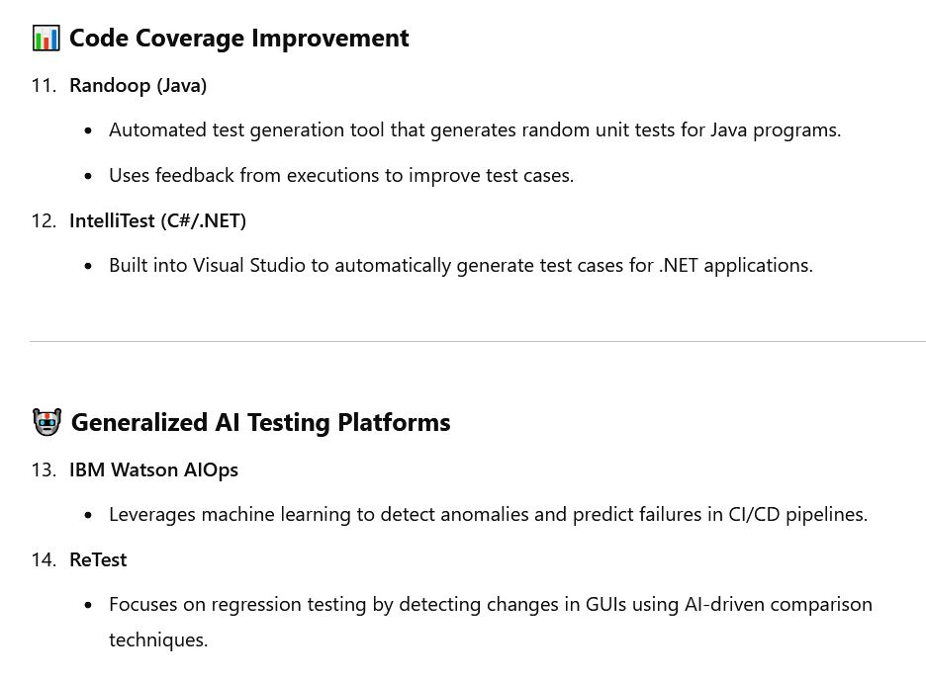
AI Testing Tools
( ChatGPT )

Slide 67
References
Bugs
Therac-25: http://courses.cs.vt.edu/~cs3604/lib/Therac_25/Therac_1.html
Patriot missile: http://www.fas.org/spp/starwars/gao/im92026.htm
Ariane 5: http://www.esa.int/export/esaCP/Pr_33_1996_p_EN.html
Testing
Whittaker, How to Break Software (presentation)

Slide 68
Life Testing
Used regularly in hardware
Addresses “normal use”
n specimens put to test
Test until r failures have been observed
Choose n and r to obtain the desired statistical errors
As r and n increase, statistical errors decrease
Expected time in test = mu₀ (r / n)
Where mu₀ = mean failure time

Slide 69
Butler and Finelli
“The Infeasibility of Experimental Quantification of Life-Critical Software Reliability” (1991)
In order to establish that the probability of failure of software is less than 10⁻⁹ in 10 hours, testing required with one computer is greater than 1 million years
http://naca.larc.nasa.gov/search.jsp?R=20040139297&qs=N%3D4294966788%2B4294724588%2B4294587118

