Slide 1
Software and System Testing
And related considerations
COMP 523 UNC-CH

Slide 2
Why do we care?
Epic Software Fails
Therac-25 ( 1985 )
    6 massive radiation overdoses
Multiple space fiascos ( 1990s )
    Ariane V exploded after 40 seconds (conversion)
    Mars Pathfinder computer kept turning itself off (system timing)
    Patriot missile misquided (floating point accuracy)
Millenium bug ( 2000 )
CrowdStrike update bug ( 2024 ), 9 mil worldwide
NIST: cost to US, $59 billion ( 2002 )

Slide 3
Why do we care?
Consortium for Information & Software Quality
(CISQ)
Technical debt is the accumulated cost of shortcuts, deferred decisions, and suboptimal design choices made during software development that will eventually need to be paid back — with interest.
Publishes periodic "Cost of Poor Software Quality" report
2018 : $1.275 trillion,
2020 : $1.56 trillion
  total estimated US figure of $2.08 trillion when including technical debt and legacy system costs
2022 : $2.41 trillion in the US alone, including losses from cybercrime, technical debt, and software failures

Slide 4
Technical Debt
Two main forms
Deliberate debt ( a conscious tradeoff )
  We know this design is wrong but we need to ship by Friday.
  We'll refactor it next sprint.
This is the least damaging kind, assuming you really pay it back.
The danger is that "next sprint" becomes never.
Accidental (or inadvertent) debt
  The codebase made sense when it was 10,000 lines
  but at 500,000 lines, the original architecture is now a bottleneck
  nobody designed for
This can be the larger problem in practice
Nobody made a bad decision — the system just outgrew its design
There is no “debt marker” demanding or reminding payment

Slide 5
What is testing ?
“Testing is the process of executing a program with the intention of finding errors.” – Myers
“Testing can show the presence of bugs but never their absence.” – Dijkstra
"No amount of testing can prove a software right. A single test can prove a software wrong.“ — Adapted from Karl Popper
"If debugging is the process of removing bugs, then programming must be the process of putting them in." — Dijkstra
"Testing is not about finding bugs. It's about making sure the bugs you ship are the ones you chose to ship.“ — Common QA wisdom
"All software stinks. The question is whether it stinks in a way you can live with.“ — Anonymous

Slide 6
What is testing ?
"It works on my machine.“ — Every developer, since forever
"A program is never fully debugged until the last user dies."— Anonymous
"Pay me now for testing, or pay me much more later when production is on fire.“ — Anonymous
"Weeks of coding can save you hours of planning. Months of production failures can save you days of testing.“ — Sarcastic dev wisdom
"QA doesn't break software. Software is already broken. QA just tells you about it."— Common in QA circles
"Software testing is like being the canary in the coal mine — except nobody listens until after the explosion.“ — Anonymous QA engineer

Slide 7
Quality and testing
Software quality is far more that testing, but testing can contribute towards it
  Code quality, requirements quality, design quality, testing quality (!!)
  Performance, reliability
  Robustness, security
  Usability
  Documentation
“Trying to improve quality by increasing testing is like trying to lose weight by weighing yourself more often.” McConnell, in "Code Complete"
“Errors should be found and fixed as close to their place of origin as possible.” Fagan, Brooks, Beck, Boehm, everyone

Slide 8



The Cost-of-Finding-Late Curve
The economic case for shift-left testing
Relative cost to fix a defect by phase found:
The practical implication
A defect found in requirements costs $1 to fix. The same defect found post-release costs $50–200. Testing ROI is highest early in the SDLC.
1×
Requirements
Design
5×
The honest caveat
Development
10×
These multipliers come from case studies in specific eras. The direction is correct; the exact numbers are not gospel. Use them directionally.
Integration / QA
20×
Post-release
50–200×
What this means for practice
Shift-left: linters, type checkers, and unit tests in the inner loop. Reserve expensive E2E and manual testing for what only they can catch.
Source: Boehm / IBM — directional claim is robust;
exact multipliers are illustrative, not precise

Slide 9
Basic Software System Model
User interfaces
APIs
Operating system
Files
environment
capabilities
Input / Output
data structures
algo processing
"business logic"

Slide 10
More Exact Terminology
Different concepts are mixed in colloquial “testing”
faults
    - static flaws in source code (or design), findable before execution
errors
    - happen at execution, as faults (or other issues) cause improper data state
    - also called fault activation
failures
    - visible indication of an error (in program environment)
    - observable deviation from correct behavior
When we say “testing” we often mean a collection of different activities designed to uncover as many of these as possible
Most widely intended meaning of “testing” is
executing code to reveal failures

Slide 11
Terminology
Faults → Errors → Failures
When we say “testing” we broadly mean a collection of different activities designed to uncover as many of all these as possible
More specifically, we can make these distinctions
  Finding failures:
  Finding faults:
  Finding errors:
Testing, (running code on inputs)
debugging, code review, formal verification
error handlers, fault tolerance in PL
What about the “Erlang philosophy” of “let it fail” ?

Slide 12
Types of Testing
For Different Purposes
Functional Testing ( unit, integration, system )
Acceptance testing
Performance testing
Stress testing
Usability testing
Reliability testing
Conformance testing (standards)
…

Slide 13
Types of Testing
Functional Testing
Unit testing
  -- basic logic in smallest coherent components
Integration testing
  -- interactions among units
  -- real-time and concurrent systems cannot be checked for safety,
  liveness, etc. at unit level
System testing
  -- E2E ( end to end, involving the UI )
Acceptance testing
  -- is E2E testing, but done by the client and guided by requirements

Slide 14
The Testing Pyramid
Balance speed, cost, and confidence across test types
Slow, brittle, expensive. Test full flows. Use sparingly.
E2E / UI Tests (~10%)
Test component interfaces together. Medium speed.
Integration Tests (~20%)
Unit Tests (~70%)
Numerous, isolated, fast. Core of a healthy test suite.
⚠️ The Ice Cream Cone Anti-Pattern
❌
Many teams accidentally invert the pyramid — few unit tests, lots of slow E2E tests. This creates a flaky, slow-to-run suite that nobody trusts.

Slide 15
The Testing Pyramid
Balance speed, cost, and confidence across test types
Slow, brittle, expensive. Test full flows. Use sparingly.
E2E / UI Tests (~10%)
Test component interfaces together. Medium speed.
Integration Tests (~20%)
These are proportions among test categories
Unit Tests (~70%)
Numerous, isolated, fast. Core of a healthy test suite.
For total test size
a former IBM Fellow told me once that at IBM,
it was not unusual for the test scaffolding to be
10x the size of the source code under test
⚠️ The Ice Cream Cone Anti-Pattern
❌
Many teams accidentally invert the pyramid — few unit tests, lots of slow E2E tests. This creates a flaky, slow-to-run suite that nobody trusts.

Slide 16
Other classifications
Scope
  unit, module, system, regression (time), …
Time
  after design/coding
  before (TDD test-driven development, agile)
  during / mixed… and post deployment, ongoing
Code visibility / structure
  Black box: code treated as input/output function and no use of code structure is used (programming by contract)
  White box: code structure is used to determine test cases and coverage

Slide 17
How important is unit test?
The Voyager bug (sent the probe into the sun).
‘90: The AT&T bug that took out 1/3 of NYC telephones (crash on receipt of crash notice).
    The DCS bug that took out the another 1/3 a few months later.
‘93: The Intel Pentium chip bug (it was software, not hardware).
‘96: The Ariane V bug: auto-destruct (data conversion).

Slide 18
What are you trying to test?
Basic Functionality?
many techniques
Most common / likely actions?
Cleanroom (Harlan Mills)
Most costly/unacceptable problem areas?
Risk-based testing

Slide 19
Risks
Identify criteria of concern: availability, quality, performance, …
Risk of it not being met
    likelihood
    consequences
If I’m testing code for a grocery store, what is the impact of the code failing (or down)?
What about missile guidance?
What about nuclear power plant control?

Slide 20
Mills: Cleanroom
Test based on likelihood of user input
User profile: study users, determine most probable input actions and data values
Test randomly, drawing data values from the distribution (see monkey testing )
Means most likely inputs occur more often in testing
Finds errors most likely to happen during user executions

Slide 21
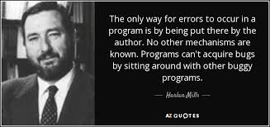
Harlan Mills: Cleanroom
Test based on likelihood of user input
User profile: study users, determine most probable input actions and data values
Test randomly, drawing data values from the distribution (see monkey testing )
Means most likely inputs occur more often in testing
Finds errors most likely to happen during user executions

Slide 22
Mills: Cleanroom
Testing was integration level and up
Unit testing was via program verification
Mills’ Functional Semantics… like Hoare Axioms but functional
A unit programmer has a “compiler” that was only a syntax checker
The unit was verified and proven correct (according to an input/output contract)
Then verified units given to the testing team
Turns out programmers wanted to write code, not prove code and be mathematicians (80’s, before good theorem provers)

Slide 23
How to identify what to test
New features
New technology
Overworked developers
Regression
Dependencies
Complexity
Bug history
Language specific bugs
Environment changes
Late changes
Slipped in “pet” features
Ambiguity
Changing requirements
Bad publicity
Liability
Learning curve
Criticality
Popularity

Slide 24
Four Parts of Testing
Model
    establish the expected behavior ( "oracle" )
Select test cases
    choose the scenarios to test ( e.g., based on requirements )
Execute test cases
    run the tests and observe the results.
Measure
    compare results with expected outcomes to assess software quality

Slide 25
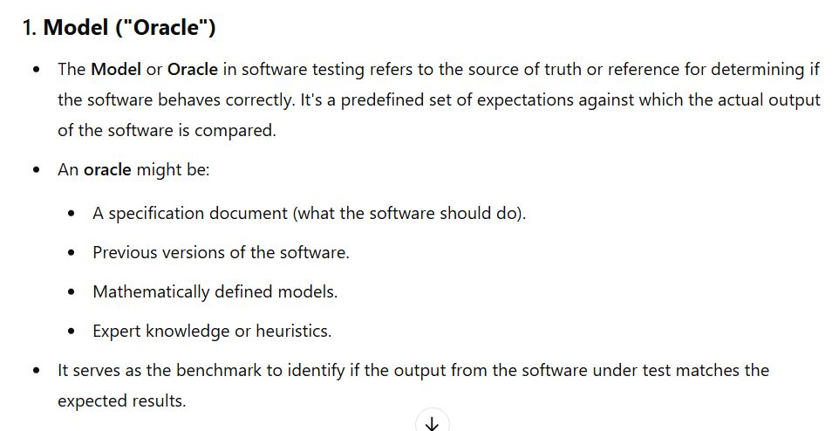
ChatGPT summary

Slide 26
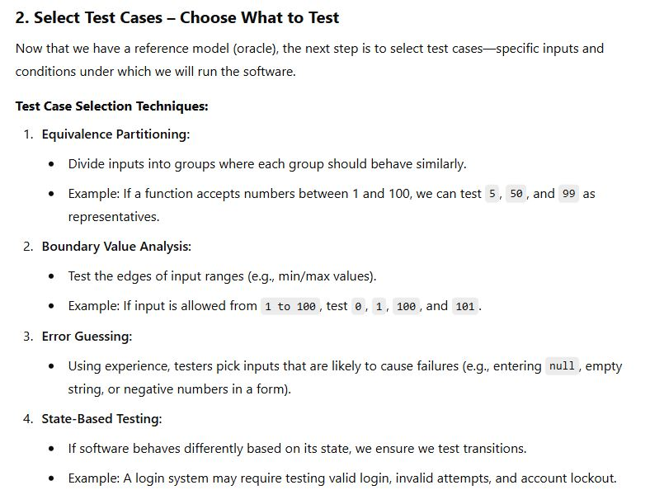
ChatGPT summary

Slide 27
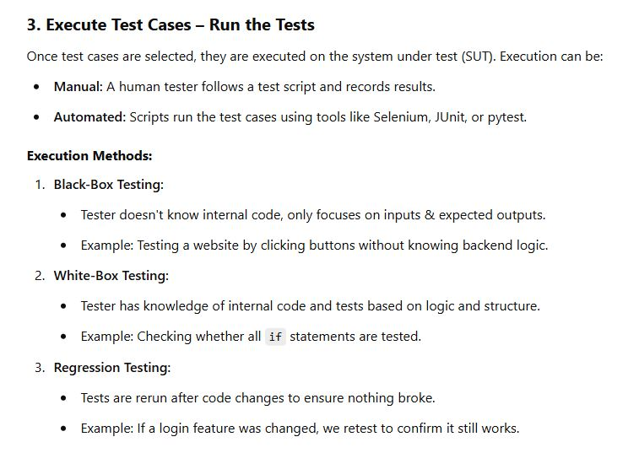
ChatGPT summary

Slide 28
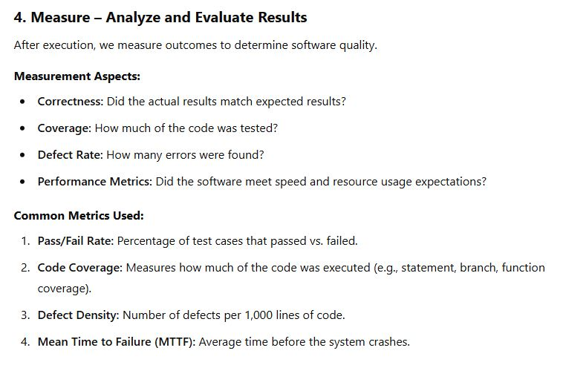
ChatGPT summary

Slide 29
Basic Software System Model
User interfaces
APIs
Operating system
Files
environment
capabilities
Input / Output
data structures
algo processing
"business logic"

Slide 30
Test Case Selection
Environment
  What happens if a file changes out from under you?
  Consider all error cases from system calls
    ( e.g., you can’t get memory allocated )
  Test on different platforms: software and hardware
  Test on different OS versions, and with different languages

Slide 31
Test Case Selection
Capabilities
  Algo processing (business logic)
  Data structures… unit test as ADTs
  Inputs (boundary conditions, ranges, equivalence classes)
  positive tests… good input → expected output
  What about unexpected inputs
  negative tests … can I make this thing generate bad output ?
  error handlers
  ALAC testing (Act Like A Customer)
    do it wrong
    do erroneous inputs or combos, do too much, too little
  Startup/shutdown tests
  States (reverse state exploration)
    some systems are state machines…
    behavior on some inputs depends on history… what state exists

Slide 32
Test Case Selection
State based thinking
Another opportunity to reverse-think… pos and neg tests
Consider testing an e-commerce system -- the state you care about is "order marked as delivered."
Forward thinking: place order → pay → ship → deliver. ✓ Works great
Reverse thinking: start from "delivered" and ask backwards —
  Can I mark something as delivered that was never shipped?
  Can I mark something as delivered that was never paid for?
  Can I re-deliver something already delivered?
  Can I deliver a cancelled order?
  Can I arrive at "delivered" by skipping the "shipped" state entirely?
Each is a potential bug or security vulnerability that forward testing won’t find
  forward testing follows the intended path

Slide 33
Test Case Selection
More on state based thinking
A system might handle every individual input perfectly on the expected path, or order
but still break when those inputs arrive in an unexpected order or from an unexpected state.
ATM machine example The intended data flow is:
insert card → enter PIN → select amount → dispense cash → eject card
But what happens if we:
  Remove the card mid-transaction?
  Select an amount after the session times out?
  Somehow trigger "dispense cash" twice?
  Arrive at "enter PIN" without inserting a card?
Banks have lost real money to exactly these kinds of state sequence errors
not because any single step was erroneous,
but because the transitions between states weren't properly guarded.

Slide 34
From the User Interface: Inputs
Error messages
Default values
Character sets and data types
Overflow input buffers
Input interactions
Repeated inputs
Unlikely inputs
How easy is it to find bugs in Word?

Slide 35
Questions to Ask for Each Test
How will this test find a defect?
What kind of defect?
What failure or error do I hope to expose?
How powerful is this test against that type of defect? Are there more powerful ones?
Is there a test that will expose the error and give me information to help fix it?

Slide 36
Testing Practices (Boris Beizer)
Unit testing to 100% coverage: necessary but not sufficient for new or changed
Integration testing: at every step; not once
System testing: AFTER unit and integration testing
Testing to requirements: test to end users AND internal users
Test execution automation: not all tests can be automated
Test design automation: implies building a model. Use only if you can manage the many tests

Slide 37
Testing Practices (Boris Beizer)
Stress testing: only need to do it at the start of testing. Runs itself out
Regression testing: needs to be automated and frequent
Reliability testing: not always applicable. statistics skills required
Performance testing: need to consider payoff
Independent test groups: not for unit and integration testing
Usability testing: only useful if done early
Beta testing: not instead of in-house testing

Slide 38
Usability Testing
Evaluating a UI/UX design

Slide 39
Usability Testing
Testers watch for these issues:
Frequency with which the problem occurs
    common, or rare?
Impact of the problem if it occurs
    easy or difficult to overcome?
    insignificant, or damaging?
Persistence of the problem
    one-time occurrence, or repeated?

Slide 40
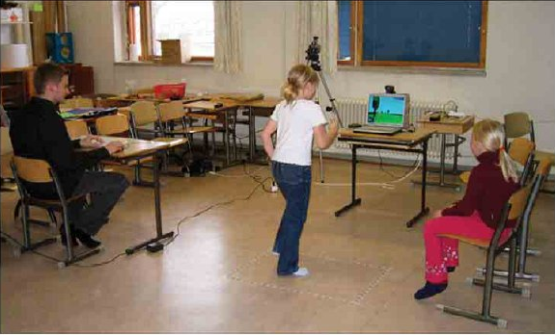
Wizard of Oz Testing
Inputs and outputs are as expected
How you get between the two is “anything that works”
Particularly useful when you have
  an internal interface
  choices to make on user interfaces
Children’s Intuitive Gestures in Vision-Based Action Games
CACM Jan 2005, vol. 48, no. 1, p. 47

Slide 41
Test Measurements

Slide 42
Test Coverage Metrics
Statement coverage
  Basic block coverage, or edges in control flow graph
Decision coverage (branch coverage)
  Each sense of each Boolean expression
Condition coverage
  Each entity varied in each Boolean expressions
Path coverage
  Loops, branch combinations
  Impractical, N items can have 2^N different paths
We get to see the code to guide testing, help with test case gen
These are “white box” methods

Slide 43
Statement/Block Coverage
A
A
x=9
x=2
x=9
x>5
x>5
Bt
Bf
Bt
C
C

Slide 44
Decision Coverage
A
A
x=9
x=2
x=9
x=2
x>5
x>5
Bt
Bf
Bt
C
C

Slide 45
Condition Coverage
A
x=9, y=20
Bt
Ct
x>5 &&
y <100
x<20 &&
y >10
D
Bf
Cf
x=2, y=20

Slide 46
Path Coverage
A
x=9, y=20
Bt
Ct
x>5 &&
y <100
x<20 &&
y >10
D
Bf
Cf
x=2, y=20

Slide 47
When can we stop testing?
Historical data
Capture-recapture model
Error seeding

Slide 48
Historical Data
Lots of variants based on statistical modeling
What data should be kept?
When are releases comparable?
Dangers with a good release (few bugs)
  test forever
  adversarial relation between developers and tester
Dangers with a bad release (lots of bugs)
  stop too soon

Slide 49
Error “seeding”
Also called mutation testing
Deliberately put errors into code (seeding)
Testing finds the seeded errors as well as "real" ones put there by developers
Percentage of seeded errors found is related to percentage of “normal” errors found

Slide 50
Capture-recapture model
Estimate animal populations: How many deer in the forest?
    Tag and recount
    If all tagged, assume you’ve seen them all
Applied to software by Basin in 73
Number of errors = |e₁| * |e₂| / |e₁ ∩ e₂ |
      where e_{n} = errors found by tester n
  2 testers: 25, 27, 12 overlap: 56 total errors
What’s wrong with this model (aside from the fact the denominator can be 0)?
  Assumptions about independence of testers

Slide 51
Test Tools

Slide 52
Unit Test
What do they do?
  Regression testing framework
  Incrementally build test suites
  Typically language specific
What is available?
  JUnit most well known (Java)
  SUnit was the first (Smalltalk)
  xUnit where x is most every language known
  Eclipse has unit test plugins for many languages
  http://en.wikipedia.org/wiki/List_of_unit_testing_frameworks

Slide 53
Regression Test
Automated
Run with every build
Issues
  Time
  GUI based
Tools
  Wide range of capabilities and quality
  Avoid pixel-based tools
  Random vs. scripted testing
One list

Slide 54
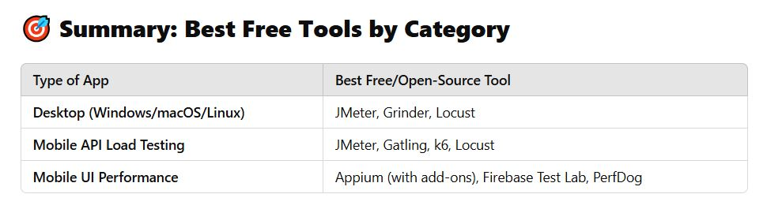
Performance Test Tools
What do they do?
  Orchestrate test scripts
  Simulate heavy loads
  Check software for meeting non-functional requirements (speed, responsiveness, etc.)
What is available?
  JMeter (can do Web apps, mobile, and desktop programs)
  Grinder

Slide 55
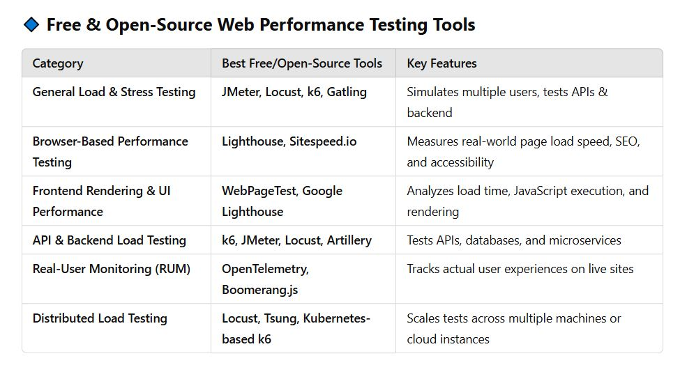
Performance Test Tools

Slide 56
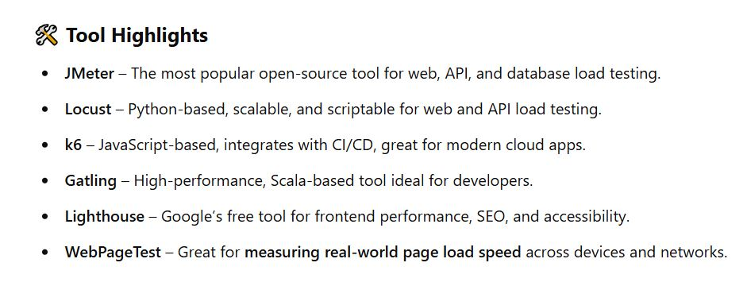
Performance Test Tools

Slide 57
Stress Testing
A kind of performance testing
Determines the robustness of software by testing beyond the limits of normal operation
Particularly important for "mission critical" software, where failure has high costs
“stress” makes most sense for code with timing constraints or resource limits
  servers that are made to handle, say, 1000 requests per minute, etc.
  environments that can handle hundreds of users simultaneously
  multi-player network games… can it handle 5K users? 10k? 50K?
Tests demonstrate robustness, availability, and error handling under a heavy load

Slide 58
Fuzz Testing, or Fuzzing
Involves providing invalid, unexpected, or random data as inputs of a program (or module)
Program is monitored for exceptions such as
    crashes
    failing built-in code assertions
    memory leaks
Fuzzing is commonly used to test for security problems in software or computer systems, or reliability / robustness

Slide 59
Similar Forms
These are black-box methods
Fuzz testing: module level, random data given to the computational engines (modules, methods, etc)
Monkey testing: random UI events given to a system (as if the users are monkeys bashing on the keyboards)
Also called random testing, or ad-hoc testing, or stochastic testing
Chaos testing: random injection of system-level failures (for distributed systems, others with non-determinism)
Tools: Android Monkey Tool, Gremlins.js, MonkeyRunner

Slide 60
Other Test Tools
Tons of test tools
One starting point
    http://www.softwareqatest.com/qatweb1.html

Slide 61
Other Quality Improvers

Slide 62
Other Ways of Improving Quality
Static testing methods (vs. dynamic)
  reviews and inspections
  formal specification
  program verification and validation
Self-checking (paranoid) code
Duplication, voting
Deploy with capabilities to repair

Slide 63
Formal Methods and Specs
Mathematically-based techniques for describing system properties
Used in inference systems
  Do not require executing the program
  Proving something about the specification not already stated
  Formal proofs
  Automatable
  Examples: theorem provers and proof checkers
Model checkers
  FSM-based, not inference

Slide 64
Uses of Specifications
Requirements analysis
  rigor
System design
  Decomposition, interfaces
Verification
  Specific sections
System analysis and evaluation
  Reference point, uncovering bugs
Documentation

Slide 65
Examples
Abstract data types
  Algebras, theories, and programs
  VDM (Praxis: UK Civil aviation display system CDIS), Z (Oxford and IBM: CICS), Larch (MIT)
Concurrent and distributed systems
  State or event sequences, transitions
  Hoare’s CSP, Transition axioms, Lamport’s Temporal Logic
Programming languages!

Slide 66
Self Checking Code
Exploit redundancy
Run multiple copies of the code, vote on critical results and decisions
Identifies erroneous system via its disagreement
Develop functionally identical versions with different code compositions, different teams
Perhaps use different hardware hosts
Used on space shuttle

Slide 67
Self-Repairing Code
http://www.tomsguide.com/us/darpa-self-healing-software,news-17761.html
http://venturebeat.com/2013/09/17/hp-launches-self-healing-computer-start-software/
http://www.technologyreview.com/news/416036/software-that-fixes-itself/

Slide 68
AI in Testing

Slide 69
AI in Software Testing
We know AI has made big inroads into coding and coding support
What about testing code?
Some irony here, as AI code is often wrong, or incomplete
Older tools like ChatGPT even tell you things about PLs that are factually not true
But, they are getting better rapidly

Slide 70
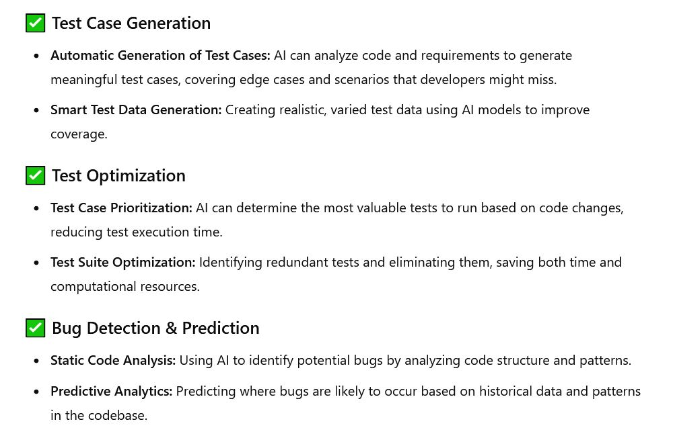
AI in Software Testing
( ChatGPT )

Slide 71
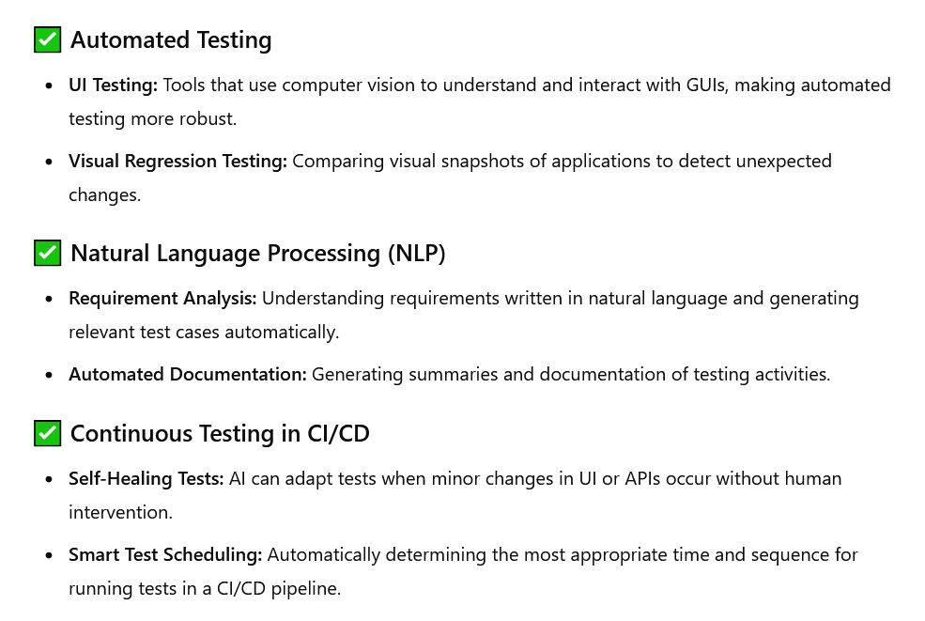
AI in Software Testing
( ChatGPT )

Slide 72
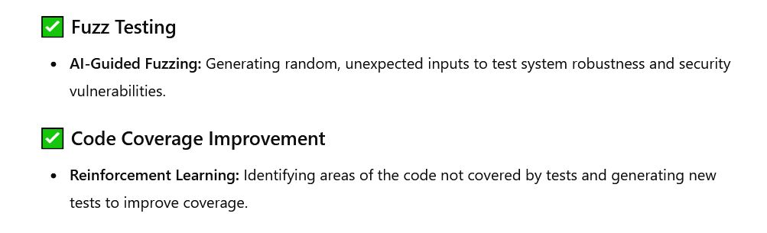
AI in Software Testing
( ChatGPT )

Slide 73
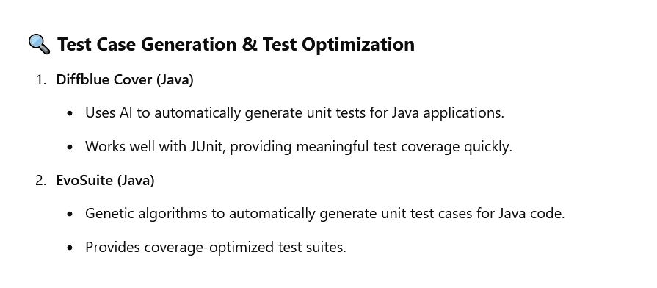
AI Testing Tools
( ChatGPT )

Slide 74
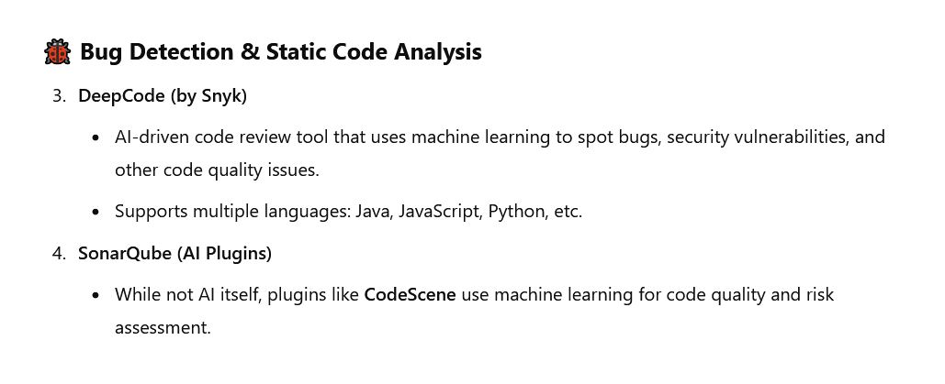
AI Testing Tools
( ChatGPT )

Slide 75
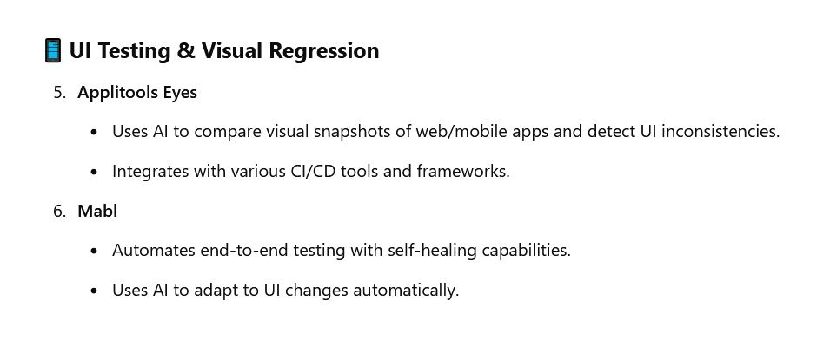
AI Testing Tools
( ChatGPT )

Slide 76
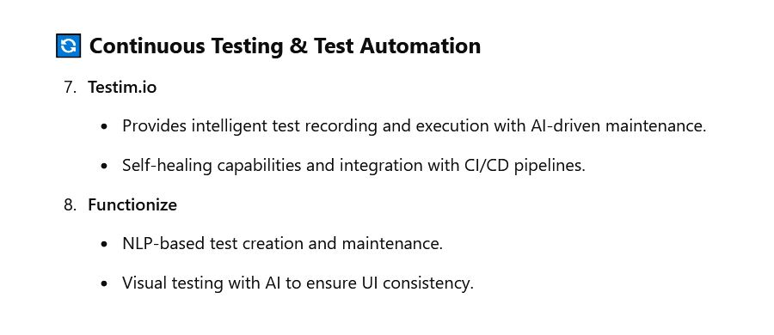
AI Testing Tools
( ChatGPT )

Slide 77
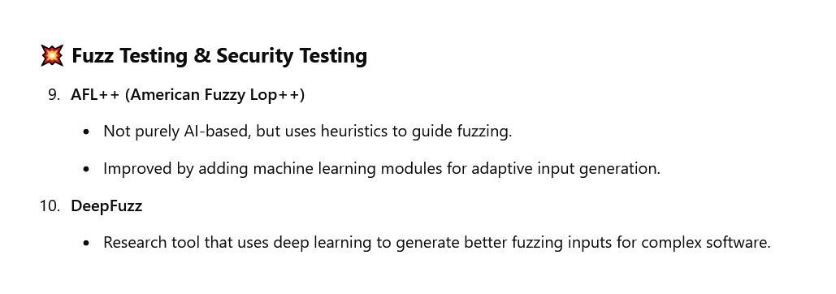
AI Testing Tools
( ChatGPT )

Slide 78
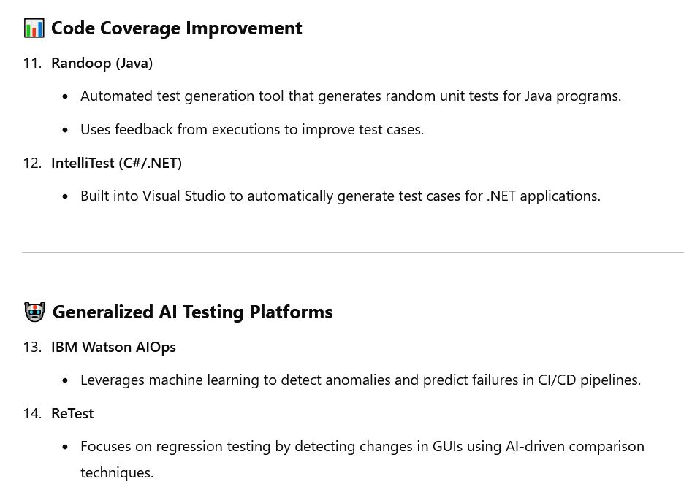
AI Testing Tools
( ChatGPT )

Slide 79
Testing Example (Unit, Integration)
Unit testing is checking the behavior of a method, or a class
  Good for logic of how data protected by the object is manipulated
  Not good for how data is transferred across boundaries of units
Integration testing is checking how well data exchanges work as communication is done among modules, objects, subsystems
  This might be network comms, or method calls across units
  Clearly the boundary across subsystems, like client side to server side

Slide 80
Unit test
// UnitConverter.java
public final class UnitConverter {
private UnitConverter() {}
public static double lbfSecondsToNewtonSeconds(double lbfSeconds) {
return lbfSeconds * 4.4482216152605; // 1 lbf = 4.4482216152605 N
}
}
// UnitConverterTest.java
import static org.junit.jupiter.api.Assertions.*;
import org.junit.jupiter.api.Test;
class UnitConverterTest {
@Test void convertsZero() {
assertEquals(0.0, UnitConverter.lbfSecondsToNewtonSeconds(0.0), 1e-12);
}
@Test void convertsTypicalValue() {
double ns = UnitConverter.lbfSecondsToNewtonSeconds(10.0);
assertEquals(44.482216152605, ns, 1e-9);
}
@Test void handlesPrecision() {
double ns = UnitConverter.lbfSecondsToNewtonSeconds(0.123456);
assertEquals(0.549, ns, 1e-3); // within 1e-3 tolerance
}
}

Slide 81
Unit test
// ThrusterControl.java
public class ThrusterControl {
public double fire(double forceLbf, double durationSeconds) {
if (forceLbf < 0 || durationSeconds < 0) throw
new IllegalArgumentException();
return forceLbf * durationSeconds; // lbfÂ·s
}
}
// GuidanceSubsystem.java
public class GuidanceSubsystem {
private final double vehicleMassKg;
public GuidanceSubsystem(double vehicleMassKg) {
if (vehicleMassKg <= 0) throw new IllegalArgumentException();
this.vehicleMassKg = vehicleMassKg;
}
public double computeDeltaV(double impulseNewtonSeconds) {
return impulseNewtonSeconds / vehicleMassKg;
}
}

Slide 82
Subsystem test
// SubsystemTest.java
import static org.junit.jupiter.api.Assertions.*;
import org.junit.jupiter.api.Test;
class SubsystemTest {
@Test void thrusterPlusGuidance_usingExplicitConversion() {
ThrusterControl thruster = new ThrusterControl();
GuidanceSubsystem guidance = new GuidanceSubsystem(1000.0);
double impulseLbfS = thruster.fire(20.0, 5.0);
double impulseNS =
UnitConverter.lbfSecondsToNewtonSeconds(impulseLbfS);
double deltaV = guidance.computeDeltaV(impulseNS);
assertEquals(0.444822, deltaV, 1e-6);
}
}

Slide 83
Integration test
// ImpulseProvider.java
public interface ImpulseProvider { double lastBurnImpulseNewtonSeconds(); }
// BuggyThrusterService.java
public class BuggyThrusterService implements ImpulseProvider {
private double lastImpulseLbfS = 0.0;
public void fire(double forceLbf, double durationSeconds) {
lastImpulseLbfS = forceLbf * durationSeconds; // lbfÂ·s
}
@Override
public double lastBurnImpulseNewtonSeconds() {
return lastImpulseLbfS; // BUG: no conversion
}
}
// NavigationComputer.java
public class NavigationComputer {
private final ImpulseProvider impulseProvider;
private final double massKg;
public NavigationComputer(ImpulseProvider impulseProvider, double massKg) {
this.impulseProvider = impulseProvider;
this.massKg = massKg;
}
public double deltaVFromLastBurn() {
double impulseNS = impulseProvider.lastBurnImpulseNewtonSeconds();
return impulseNS / massKg;
}
}

Slide 84
Integration test
// IntegrationTest.java
import static org.junit.jupiter.api.Assertions.*;
import org.junit.jupiter.api.Test;
class IntegrationTest {
@Test void detectsUnitMismatchAcrossBoundary() {
BuggyThrusterService thruster = new BuggyThrusterService();
NavigationComputer nav = new NavigationComputer(thruster, 1000.0);
thruster.fire(20.0, 5.0);
double deltaV = nav.deltaVFromLastBurn();
assertEquals(0.444822, deltaV, 0.02,
"Integration should reveal a unit mismatch");
}
}

Slide 85
Integration test
// FixedThrusterAdapter.java
public class FixedThrusterAdapter implements ImpulseProvider {
private final BuggyThrusterService underlying;
public FixedThrusterAdapter(BuggyThrusterService underlying) {
this.underlying = underlying;
}
public void fire(double forceLbf, double durationSeconds) {
underlying.fire(forceLbf, durationSeconds);
}
@Override
public double lastBurnImpulseNewtonSeconds() {
return UnitConverter.lbfSecondsToNewtonSeconds(
underlying.lastBurnImpulseNewtonSeconds()
);
}
}

Slide 86
Integration test
// IntegrationFixedTest.java
import static org.junit.jupiter.api.Assertions.*;
import org.junit.jupiter.api.Test;
class IntegrationFixedTest {
@Test void passesWhenBoundaryAdapterConvertsUnits() {
BuggyThrusterService raw = new BuggyThrusterService();
FixedThrusterAdapter adapter = new FixedThrusterAdapter(raw);
NavigationComputer nav = new NavigationComputer(adapter, 1000.0);
adapter.fire(20.0, 5.0);
double deltaV = nav.deltaVFromLastBurn();
assertEquals(0.444822, deltaV, 1e-6);
}
}

Slide 87
Testing "Pyramid"
Unit testing
  -- Single module, many, fast, precise, "business logic" and ADT behavior
Integration testing
  -- Middle, moderate in number, check contracts, comm interfaces
Subsystem testing
  -- Cluster of modules/services tested together as mini-system
System testing
  -- Near top, fewer, broad coverage
  -- All subsystems integrated together
Acceptance testing
  -- Validation against customer expectations, requirements

Slide 88
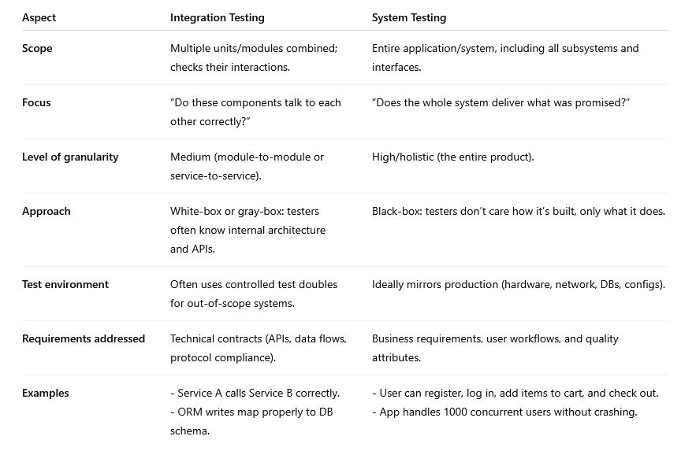
Integration vs. System Test

Slide 89
Unit Test
Scope: Smallest components (functions, classes, modules).
Focus: Does this unit’s logic work correctly in isolation?
Who runs it: Developers
Approach: White-box, heavy mocks/stubs
When: Earliest, runs continuously during development
Example: Cart.addItem() computes total correctly

Slide 90
Integration Test
Scope: Multiple units/modules combined
Focus:
Do components interact correctly across boundaries?
Who runs it: Developers/QA
Approach:
White/gray-box; limited mocks, may stub only external
systems, like real DBs/APIs
When: After unit tests, before subsystem testing
Example: POST/cart/items
calls DB, persists rows, and returns expected JSON

Slide 91
Subsystem Test
Scope
A full subsystem (a set of related modules) treated as a
mini-system.
Focus
Does this subsystem meet its functional requirements end-to-end?
Who runs it: QA team or subsystem development team
Approach:
Black/gray-box; stubs used only for subsystems not under test
When: After integration tests, before full system testing
Example:
Authentication subsystem (login, registration, password reset,
session management) works correctly as a whole.

Slide 92
System Test
Scope: Entire application or software product
Focus: Does the full system meet its technical specifications?
Who runs it: Independent QA team
Approach: Black-box, production-like environment.
When: After subsystem tests, before acceptance testing
Example:
Full e-commerce flow: register → login → add items →
checkout → receive confirmation.

Slide 93
Acceptance Test
Scope: Entire system, from customer/user perspective
Focus:
Does the delivered system satisfy business needs and is it
acceptable for release?
Who runs it: Customers, stakeholders, or user representatives
Approach:
Black-box; requirement-driven; often includes UAT (user
acceptance testing), alpha, beta testing.
When: After system testing, as release/deployment gate
Example:
Business owner verifies that checkout flow meets contractual
requirements and user expectations

Slide 94
END

Slide 95
LeftOvers

Slide 96
References
Bugs
Therac-25: http://courses.cs.vt.edu/~cs3604/lib/Therac_25/Therac_1.html
Patriot missile: http://www.fas.org/spp/starwars/gao/im92026.htm
Ariane 5: http://www.esa.int/export/esaCP/Pr_33_1996_p_EN.html
Testing
  Whittaker, How to Break Software (presentation)

Slide 97
Life Testing
Used regularly in hardware
  Addresses “normal use”
n specimens put to test
Test until r failures have been observed
Choose n and r to obtain the desired statistical errors
As r and n increase, statistical errors decrease
Expected time in test = mu₀ (r / n)
  Where mu₀ = mean failure time

Slide 98
Butler and Finelli
“The Infeasibility of Experimental Quantification of Life-Critical Software Reliability” (1991)
In order to establish that the probability of failure of software is less than 10⁻⁹ in 10 hours, testing required with one computer is greater than 1 million years
http://naca.larc.nasa.gov/search.jsp?R=20040139297&qs=N%3D4294966788%2B4294724588%2B4294587118

Slide 99
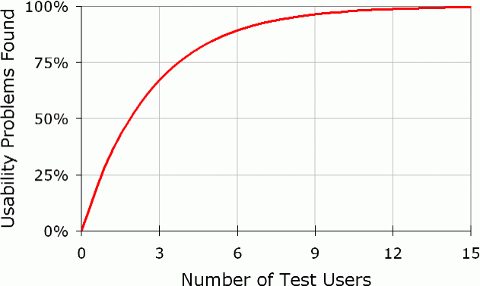
# Usability Test Users Needed
Usability problems found = N(1-(1-L)^{n})
N = total number of usability problems in the design
L = proportion of usability problems discovered by a single user
n = number of users
L=31%

Slide 100
Using as an Estimator
Found 100 problems with 10 users
Assumption: each user find 10% of problems
How many are left?
found = N(1-(1-L)^{n})
  100 = N(1-(1-.1)¹⁰)
  N = 100/(1-.9¹⁰)=154
54 left

