Slide 1
Executing Runtime Checks (For Comp401 and Comp410)
Adapted from: Prasun Dewan

Slide 2
Goal
To run checks provided by the instructor on some testable project a student has written

Slide 3
Download Instructor Checks
Available in sakai under each assignment.
You will need to download this for each assignment, since we will be updating the jar

Slide 4
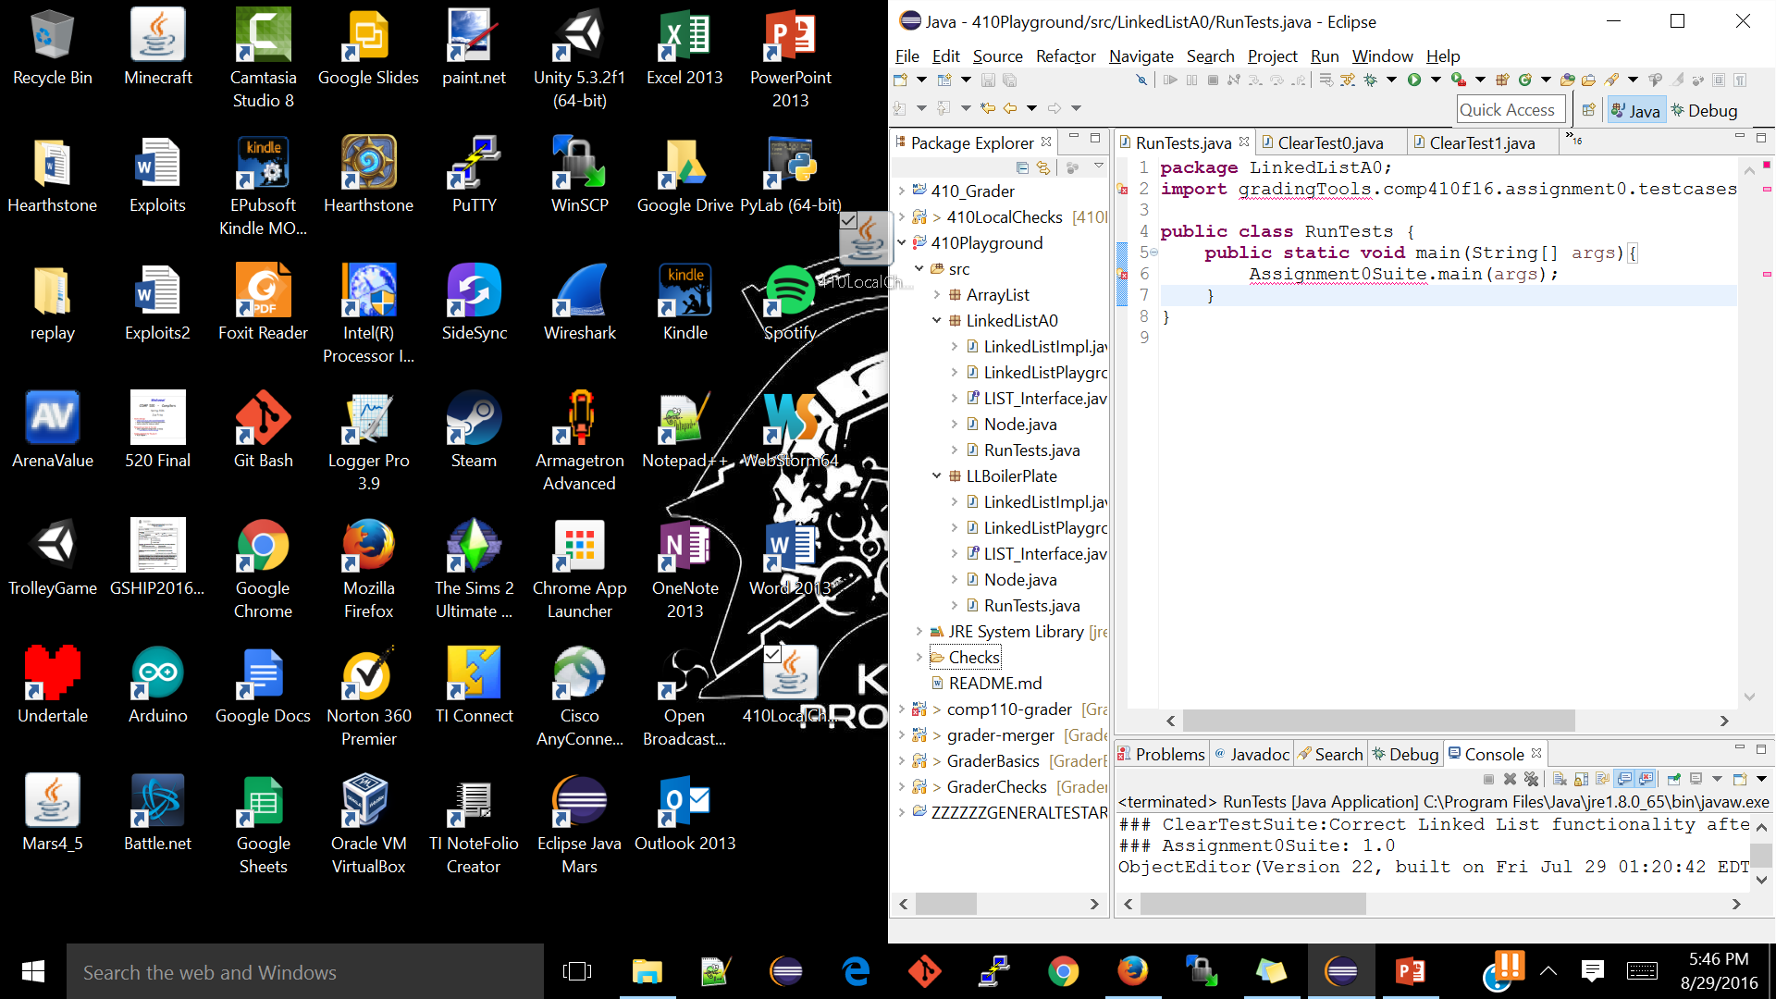
Add the JAR to your testable Project
Right now I am dragging and dropping the jar into the base of project called “410Playground”. You will drop it in the base of the testable project. AssignmentX
Be sure to copy the files, not link them! (Eclipse will prompt you)

Slide 5
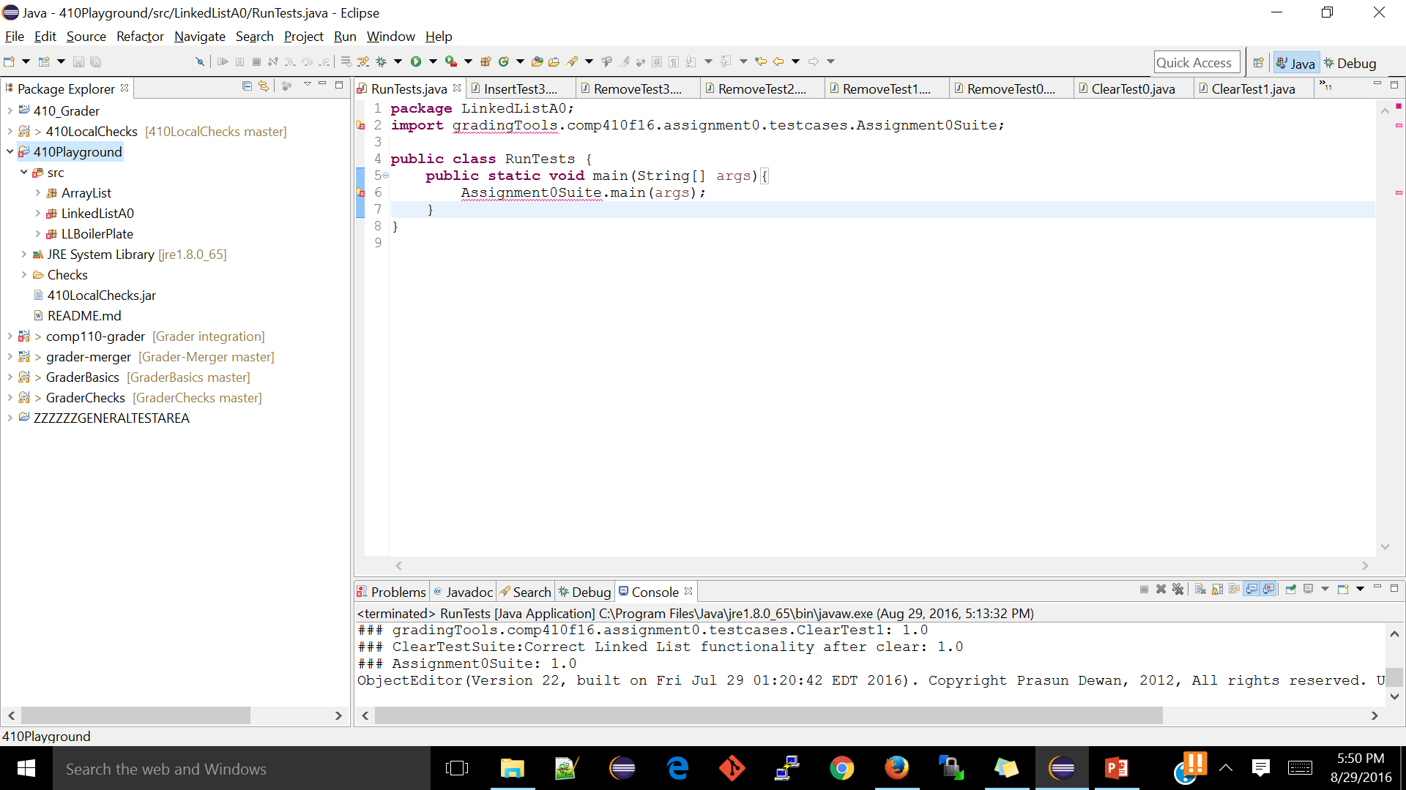
Should now look like this
The jar should now be in the base of testable project like so.

Slide 6
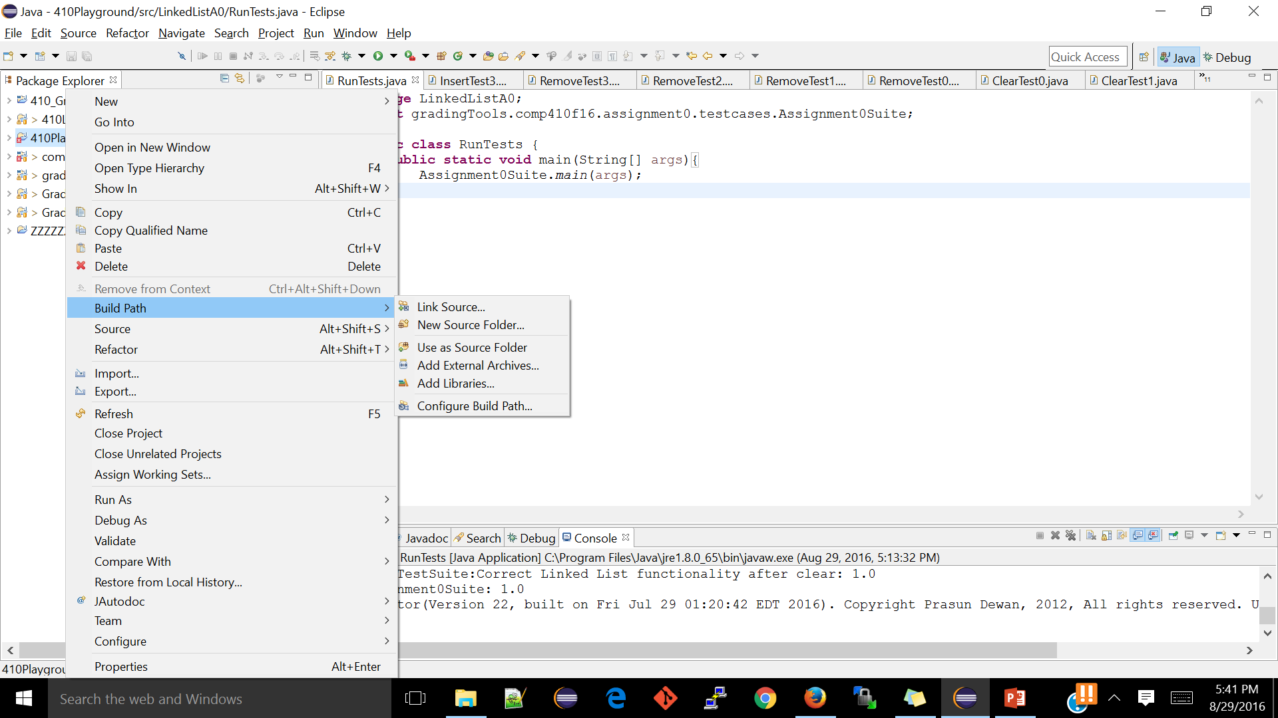
Select Testable Project and Right-Click
From here click on “Configure Build Path”.

Slide 7
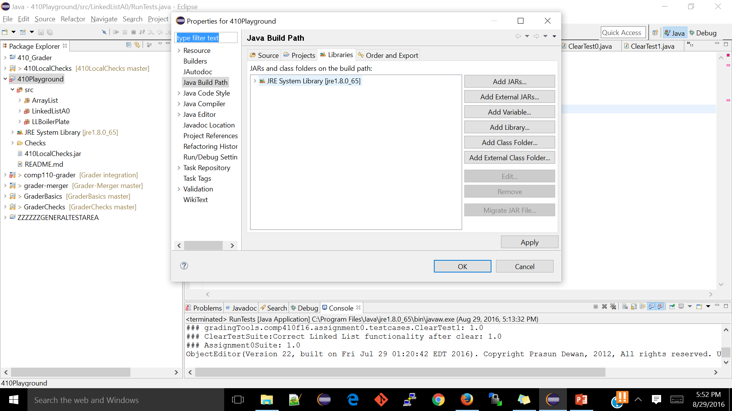
Build Path
After selecting External Jars you should choose the 410LocalChecks jar

Slide 8
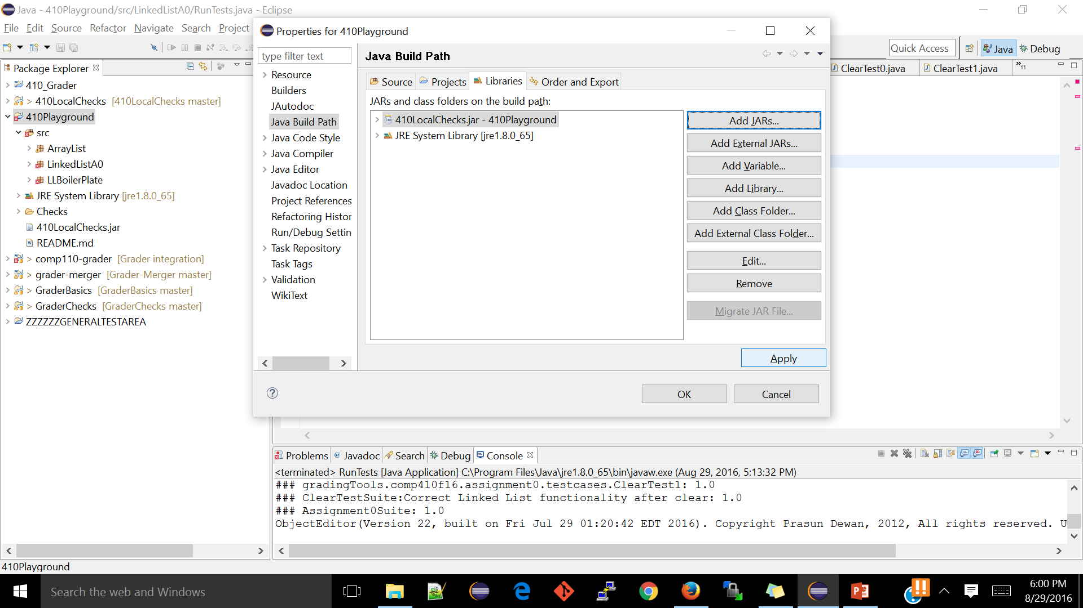
Build Path Cont
Click Apply and you should be good to go!

Slide 9
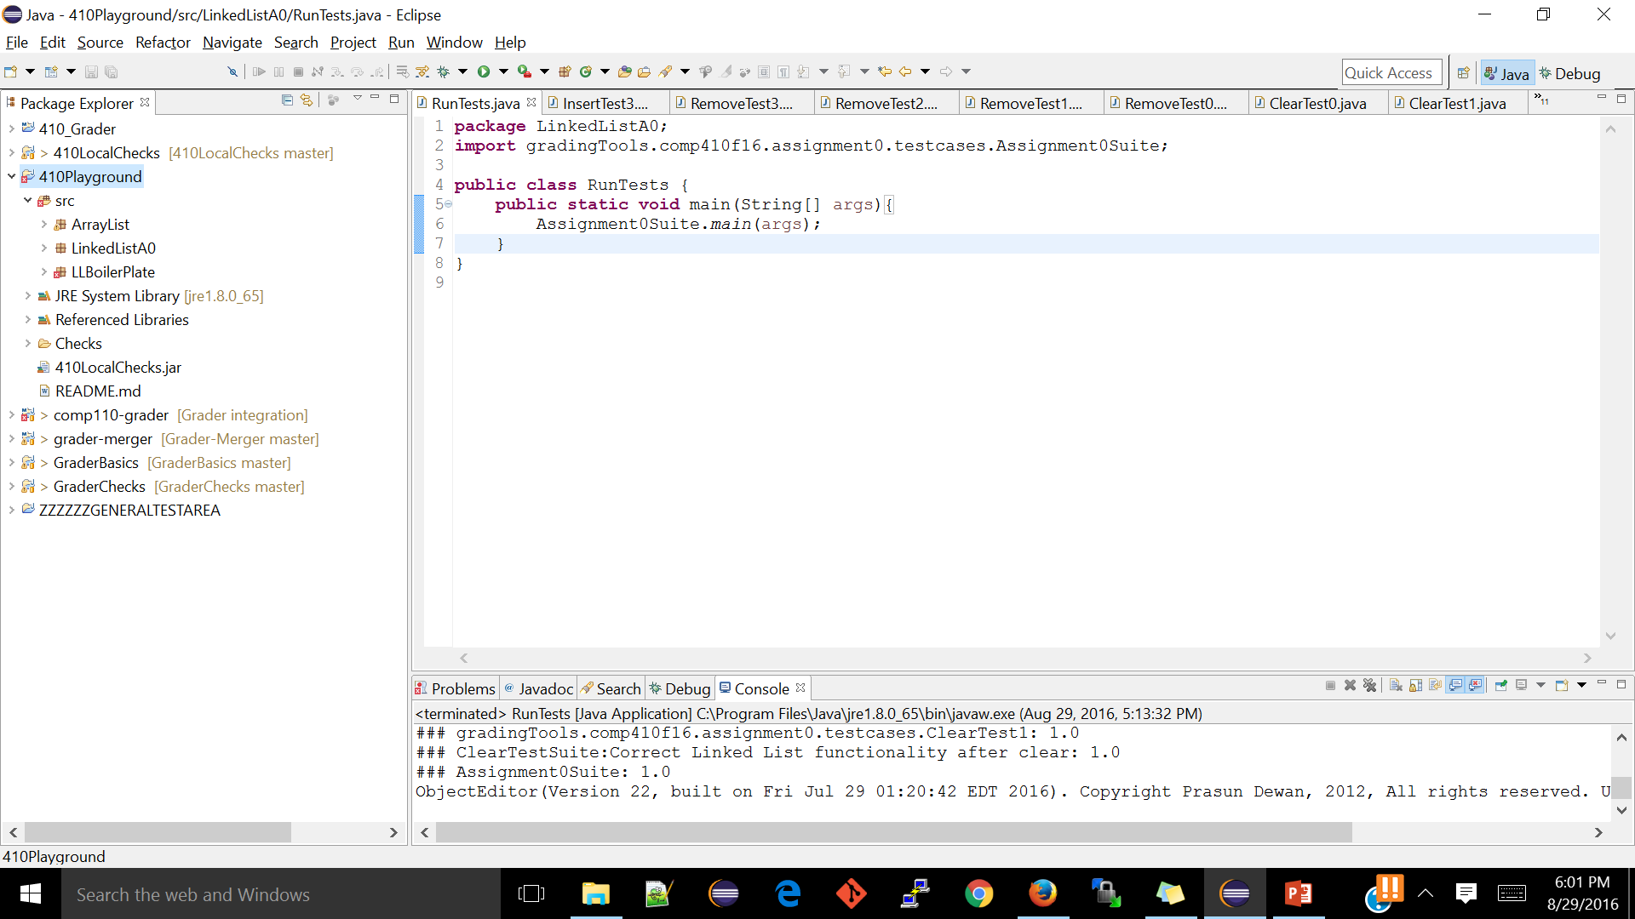
Should now look like this
Note now you should have a Referenced Libraries folder with all the dependencies needed.

Slide 10
Creating Test Main Class in Testable Project
Create a main class in your project (e.g. RunTests.java) that calls the appropriate main class in the library jar
Import the library main class (The name follows the pattern: gradingTools.<CourseName><Semester>.<Assignment>.testcases.<Assignment>Suite
Call the library main from your main class
410 Students: We provide this class for you in the boilerplate. Just run it and if you added the jar to the project and build path correctly you are good to go! Refer to previous slide for how your project should look before running

Slide 11
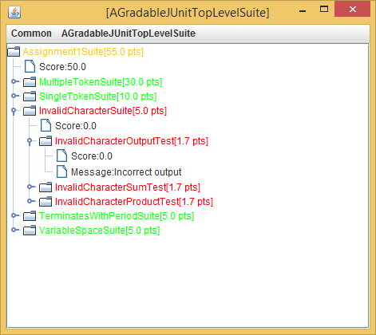
Result of Running Tests in Controls
Pink, orange in between
Max points
Actual points
Green means success
Red means failure

Slide 12
If you see null pointers instead of helpful fail message….
Refer to the test dump provided with every assignment. It will detail the procedure behind each test, so you can replicate and debug!

Slide 13
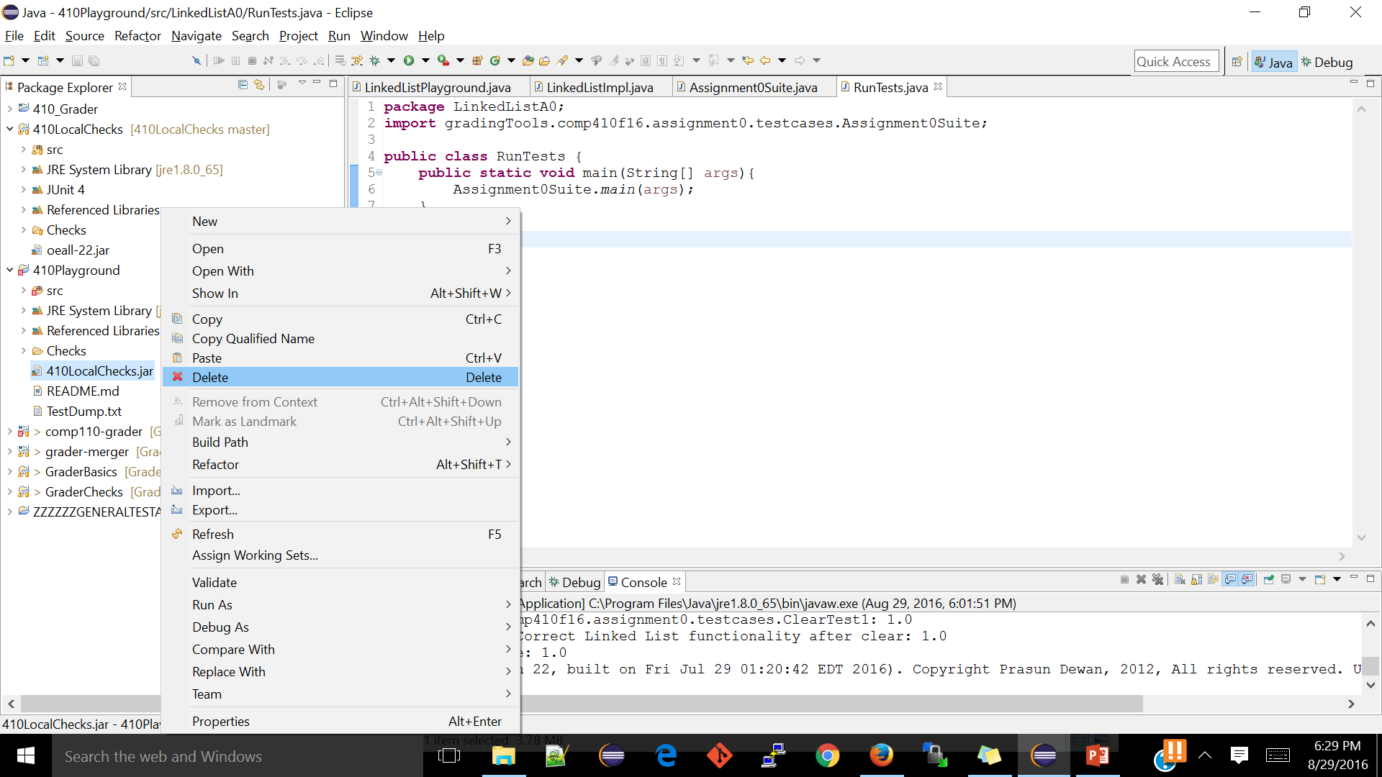
Ready to Turn in?
Awesome! Please just delete the jar, runtests.java file and then remove the jar from your build path, pics on next few slides

Slide 14
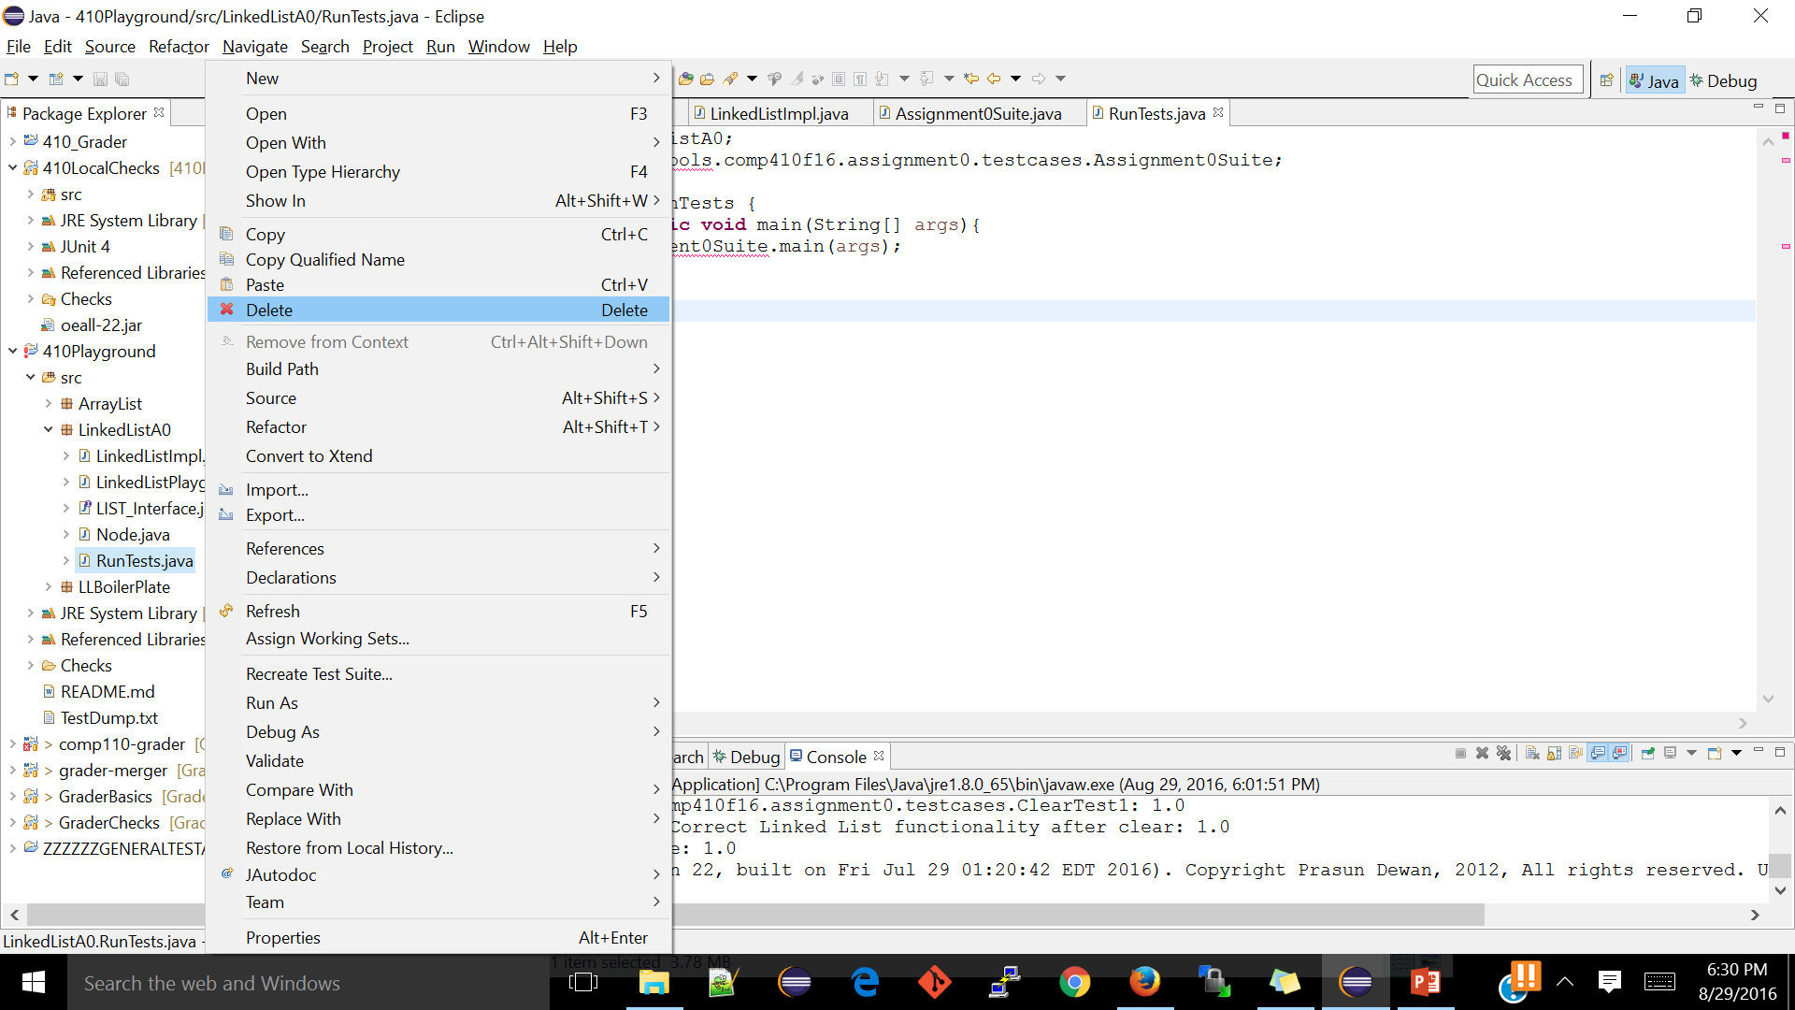

Slide 15
