Slide 1

Data Structures and Analysis
(COMP 410)
David Stotts
Computer Science Department
UNC Chapel Hill

Slide 2
Skip Lists
( some slides adapted from UMd CMSC 420, Bill Pugh et al. )

Slide 3
Skip List
Generalization of sorted linked list
  Invented by Bill Pugh (UMd) in 1990
  Original CACM paper:
    Pugh, W. (1990). "Skip lists: A probabilistic alternative to balanced trees" (PDF). Communications of the ACM. 33 (6): 668.
An alternative to balanced BST
Probabilistic Data Structure
  we roll dice, flip coins to build the structure
but first …

Slide 4
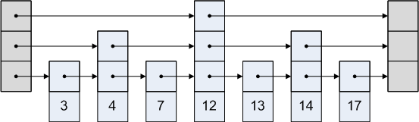
“Perfect” skip list
first… no dice
Multiple lists, multi-level list, O(log N) levels
Level i+1 has half as many items as level i
Level i+1 divides level i in half
x
12
3
x
2
4
14
x
1
3
7
13
17
x
x
3
4
7
12
13
14
17
sentinels

Slide 5
“Perfect” skip list
first… no dice
List nodes are variable size… each with 1 to O(log N) pointers
Sentinels at each end of “empty list”
Each level lets you “skip over” many items below in one hop
x
12
3
x
2
4
14
x
1
3
7
13
17
x
x
3
4
7
12
13
14
17
sentinels

Slide 6
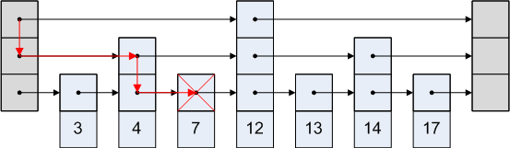
“Perfect” skip list
Search path… find(7)
Start at top level, move right on a level, down as compare
x
3
12
x
2
4
x
1
7
x
x

Slide 12
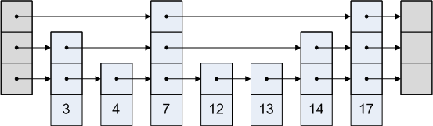
Now add probability
Imperfect list, randomized order of cell sizes
Cell size is chosen on add by roll-of-dice
Level i not guaranteed to have twice level i+1, but random numbers will make it near twice
Level i not guaranteed to split level i-1 into equal parts
x
3
x
2
x
1
x
x

Slide 14
Example insert
insert(9)
X
X
X
X
3
12
29
42
74
X
Roll dice: get a 1 new node should be a one-level cell
9

Slide 15
Example insert
insert(35)
X
X
X
X
3
9
12
29
42
74
X
Roll dice: get a 3
new node should be a three-level cell
35

Slide 16
Example insert
insert(35)
X
X
X
X
3
9
12
29
35
42
74
X
Roll dice: get a 3
new node should be a three-level cell

Slide 17
Another example

Slide 18
Another example

Slide 19
Another example

Slide 20
Another example

Slide 22
Rolling the Dice
function genRandomLevel ( ) {
// generate an integer 0 or larger
// following a distribution where 0 is 0.5 likely
// 1 is .025 likely, 2 is .0125 likely, 3 is .00625,
// etc.
var ranLev=0;
while ( Math.random() > 0.5 ) ranLev++;
return ranLev;
}

Slide 23
Checking the distribution
var nLevels = 16;
var nTrials = 1000;
var SL = makeSkipList(nLevels);
var levHits = [ ];
for (var i=0; i<nLevels; i++) { levHits[i]=0; }
for (var i=0; i<nTrials; i++) { levHits[ SL.dice(nLevels) ]++; }
alert(levHits);
Gives these node level counts:
9965, 5037, 2519, 1263, 619, 289, 149, 84, 30, 24, 14, 6, 0, 1, 0, 0

Slide 24
ADT: SKLIST of Elt
OO Signature
new: → SKLIST
insert: Elt →
remove: Elt →
find: Elt → Boolean (searching)
size: → Int+ (non-negative integers)
empty: → Boolean

Slide 25
SKLIST Implementation
Time complexity of operations
  insert worst: O(n), avg: O(log n)
  remove worst: O(n), avg: O(log n)
  find worst: O(n), avg: O(log n)
  empty O(1)
  size O(1)
  iterator O(n) (traversal)

Slide 31
END
Beyond this is just templates

Slide 32
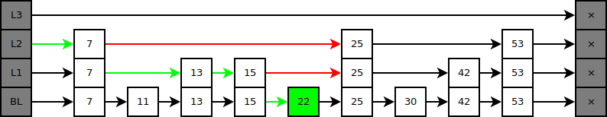

Slide 33
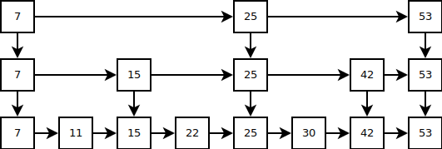

Slide 34
