Slide 1

Data Structures and Analysis
(COMP 410)
David Stotts
Computer Science Department
UNC Chapel Hill

Slide 2
Tree Data Structures
(n-ary tree, binary tree)

Slide 3
On Beyond Lists
Lists are linear… each cell has a single “next”
If we relax this…
allow more than one next
we get a TREE
“lo”
“hi”
“ok”
“ya”

Slide 4
Tree
Tree allows one or more “next” links
termed children
“lo”
“hi”
“so”
“mi”
“re”
“ok”
“fa”
“ya”
“ti”

Slide 5
Tree
“lo”
Often draw a tree downwards
don’t draw cells
Show the “levels” as rows
Depth 3
Root “lo” (no in links)
Leaves “ti” “fa” “mi” “so” (no out links)
“ok”
“hi”
“ya”
“re”
“so”
“ti”
“fa”
“mi”

Slide 6
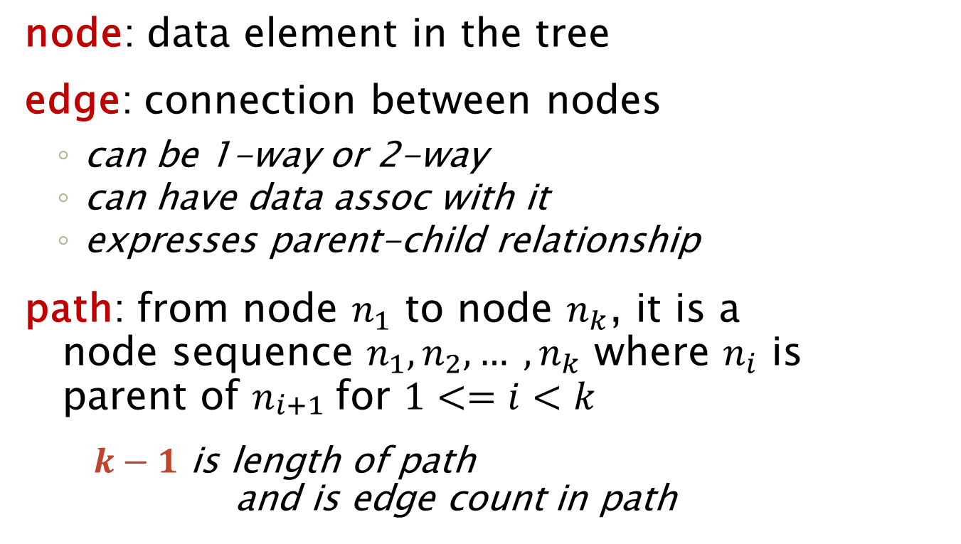
Tree Terminology
node: data element in the tree
edge: connection between nodes
  can be 1-way or 2-way
  can have data assoc with it
  expresses parent-child relationship
path: from node $n_{1}$ to node $n_{k}$, it is a
node sequence $n_{1}, n_{2}, … , n_{k}$ where $n_{i}$ is
parent of $n_{\begin{aligned}i+1 \\ \end{aligned}}$for $1<=i<k$
    $k−1$ is length of path
  and is edge count in path

Slide 7
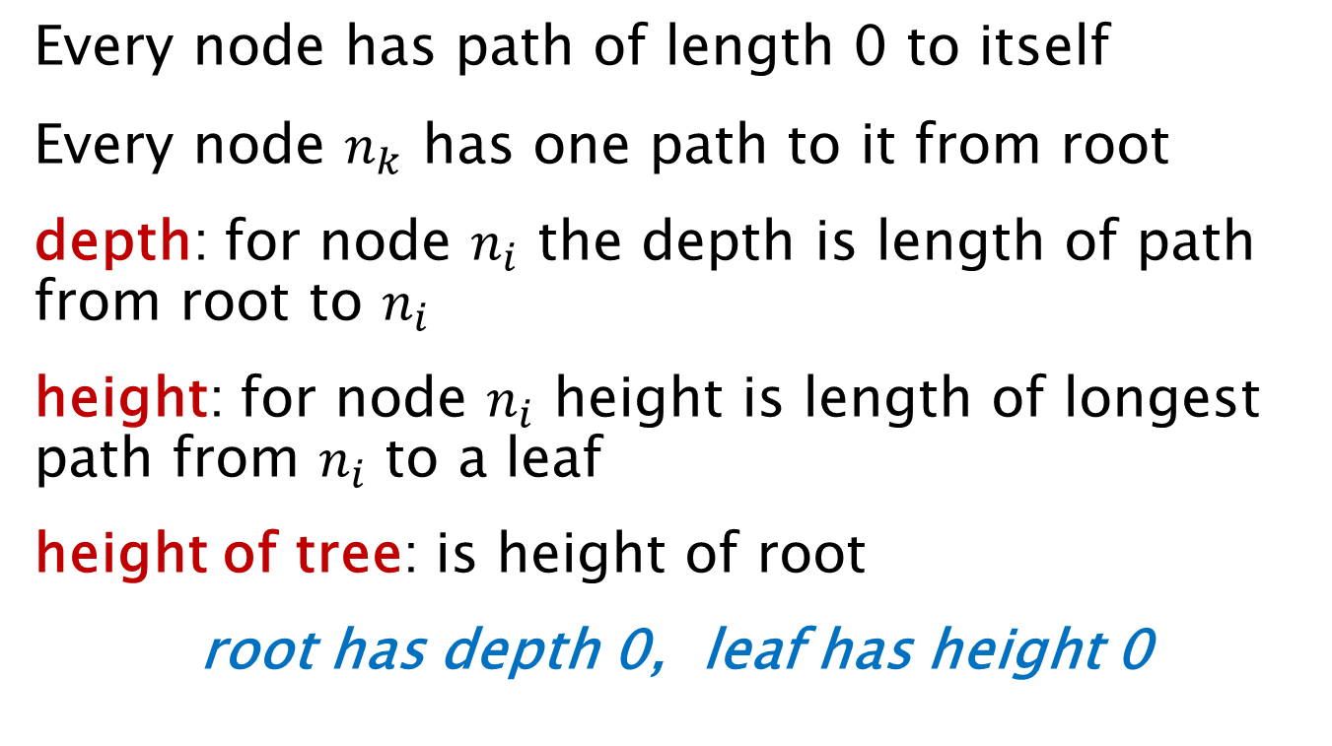
Tree Terminology
Every node has path of length 0 to itself
Every node $n_{k}$ has one path to it from root
depth: for node $n_{i}$ the depth is length of path from root to $n_{i}$
height: for node $n_{i}$ height is length of longest path from $n_{i}$ to a leaf
height of tree: is height of root
root has depth 0, leaf has height 0

Slide 8
Recursive Definition
“lo”
Tree is a root
with 0 or more trees under it
“hi”
“ok”
“so”
“ya”
“re”
“ti”
“fa”
“mi”
Tree can be empty too… no nodes at all, no root
A special case

Slide 9
n-ary Tree
“lo”
The max number of children of a node determines the “arity” of the tree
“ok”
“hi”
“ya”
“re”
“ad”
“so”
“ti”
“fa”
“mi”
“tu”
“no”
“ok”
“mu”
“go”
“zz”
“k2”
arity 3, a 3-ary tree

Slide 10
Uses for n-ary Tree
We do need these… like for OS directory structures
Files, folders, we have no idea a priori how many sub folders we might have in a folder

Slide 11
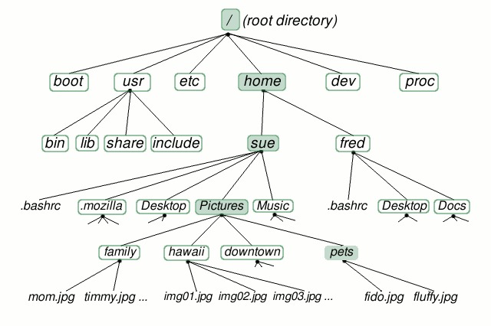
File System Hierarchy

Slide 12
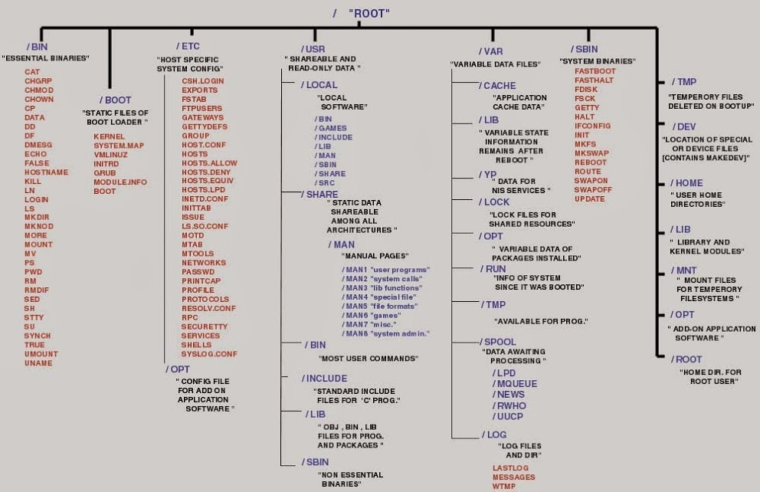
File System Hierarchy

Slide 13
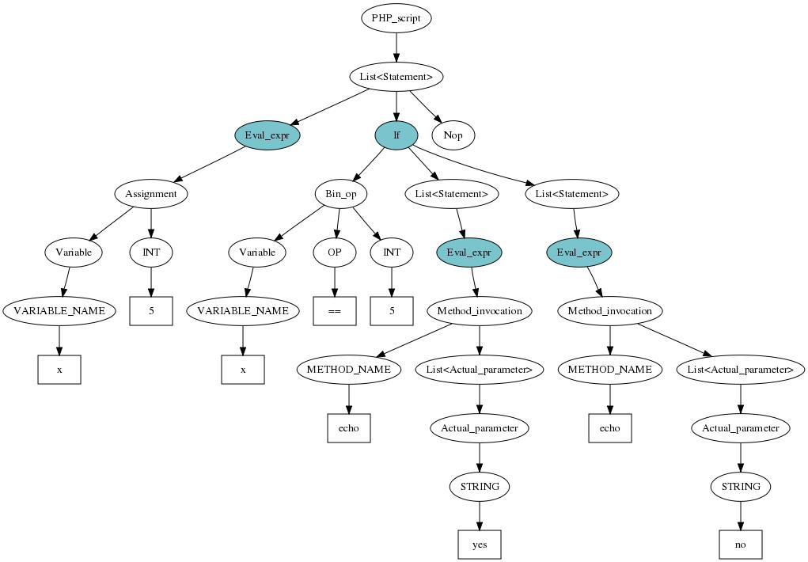
Syntax/Parse Trees

Slide 14
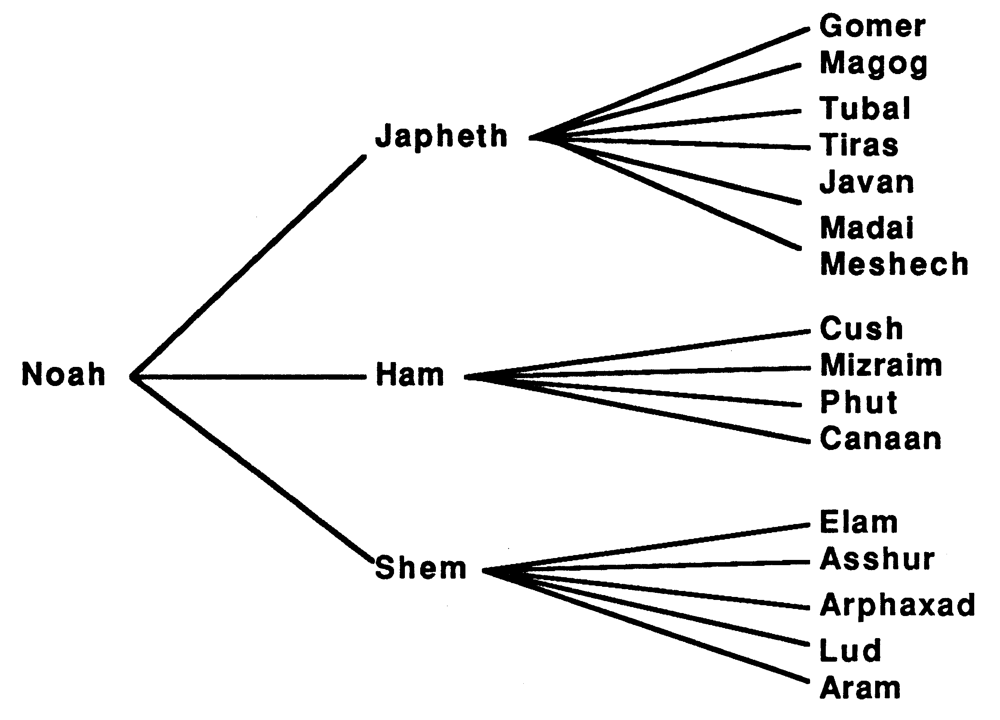
Family Tree

Slide 15
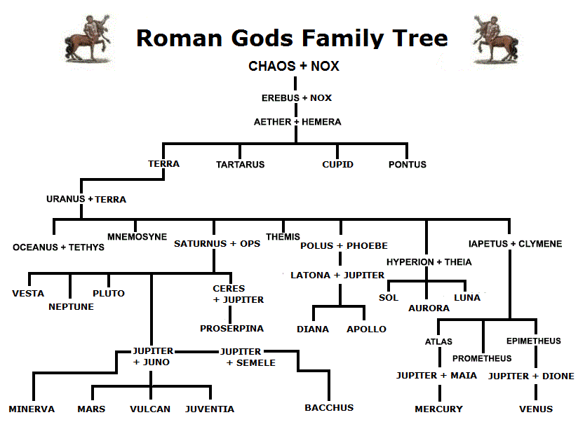

Slide 16
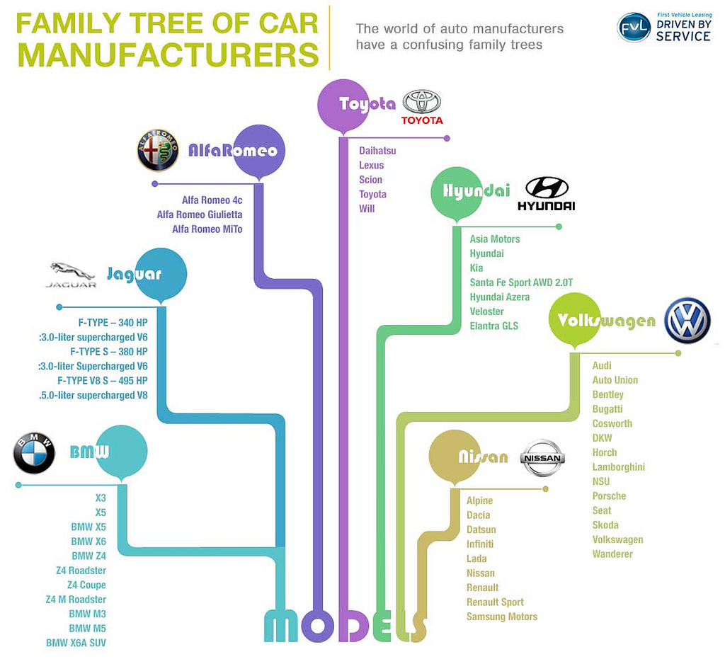

Slide 17

Org Charts

Slide 18
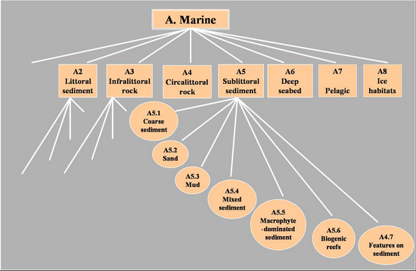
Science Models

Slide 19
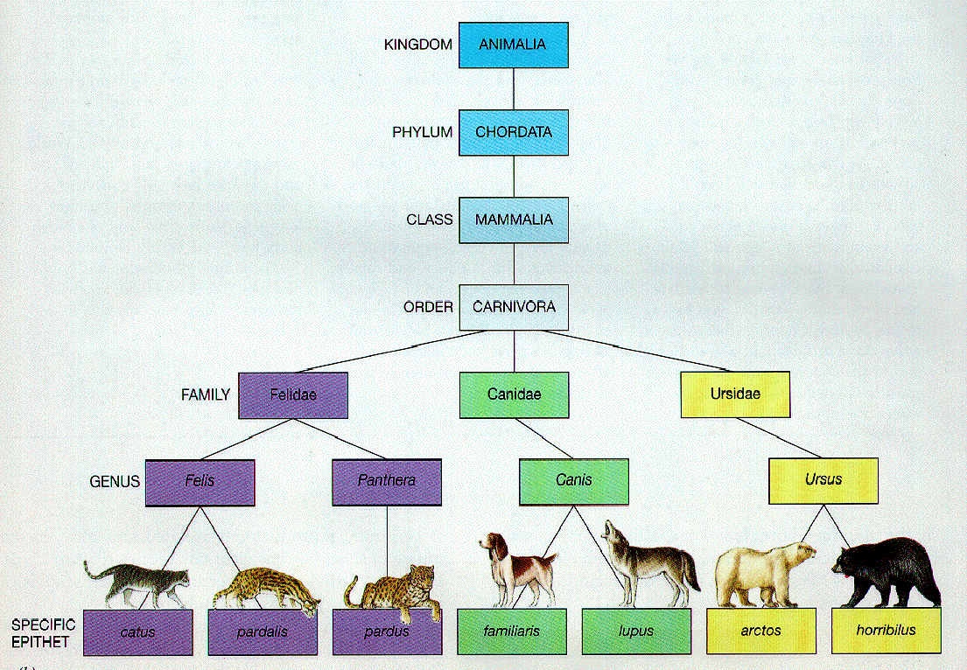
Bio Classifications
Animalia, Chordata, Mammalia, Carnivora, Canidae, Canis, C. lupus
is a path

Slide 20
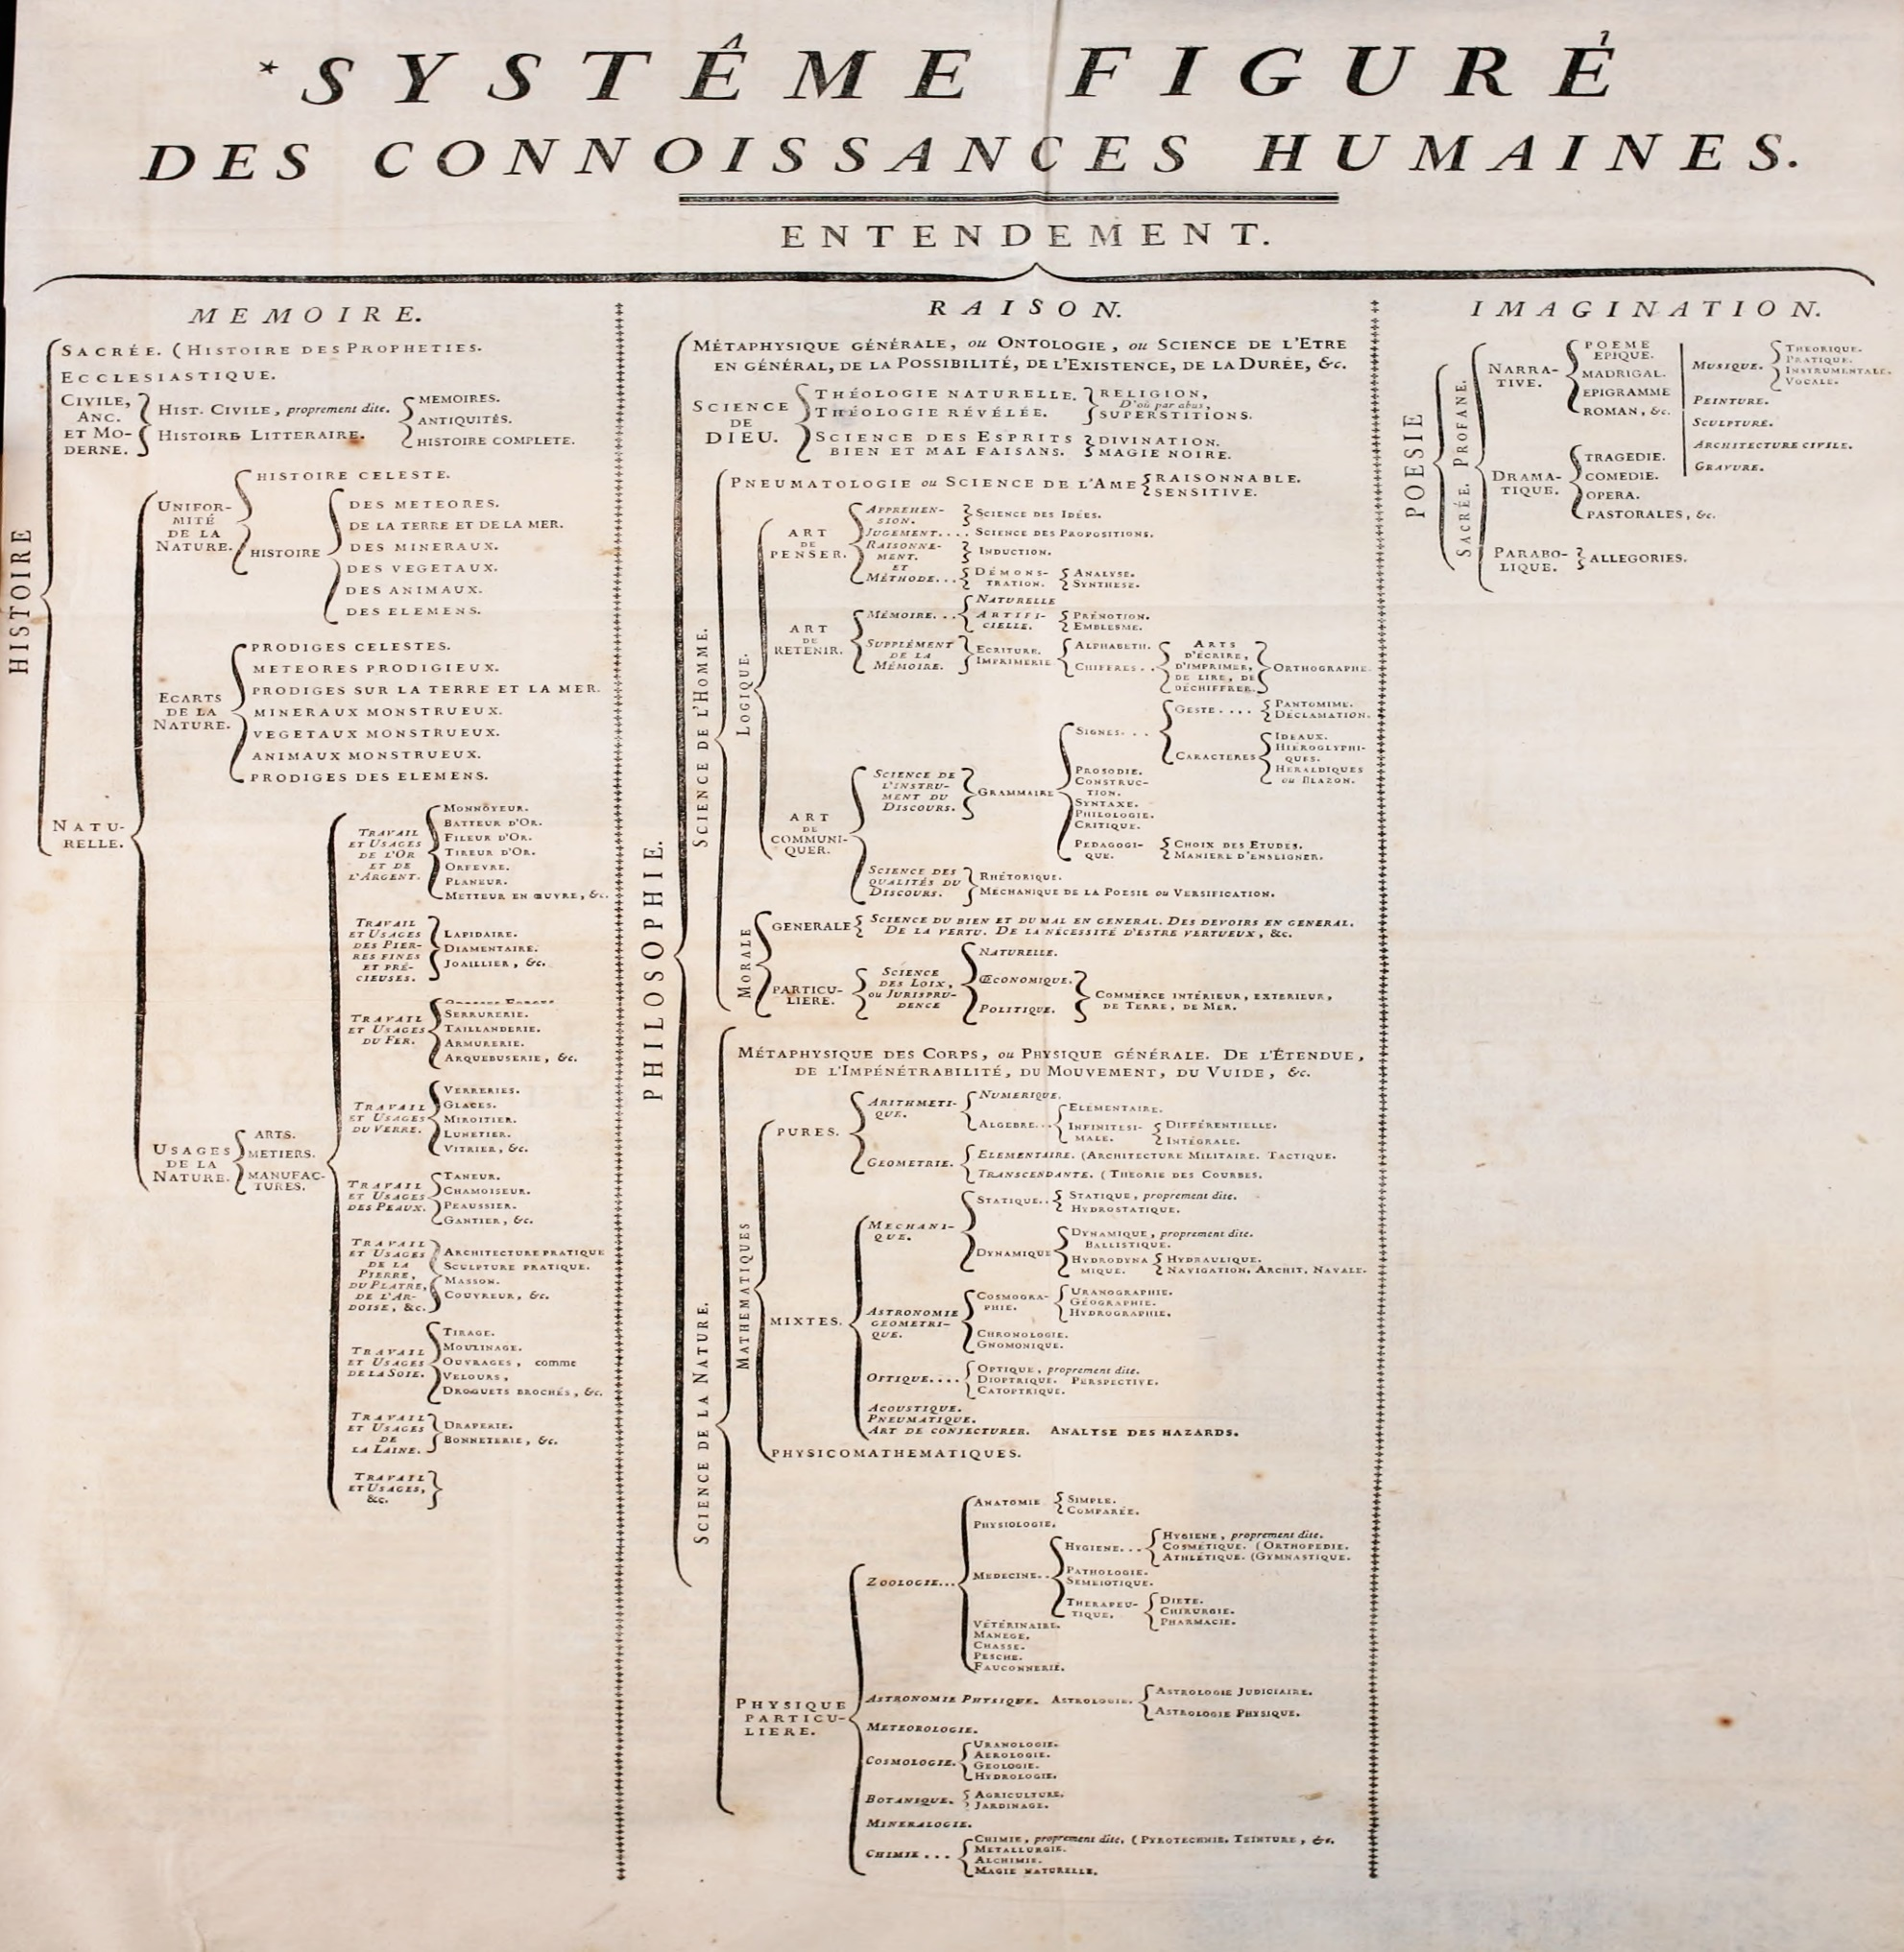

Slide 21
Traversals
Visit all nodes in some order, following edges
Come in two flavors:
    Depth first
      Basic idea is to travel down paths towards leaves until forced to stop
    Breadth first
      Basic idea is to visit all children of a node before going deeper down paths

Slide 22
Depth-First Traversals
Visit a node means do something with its data value
PreOrder
  Visit root, then recursively visit children (L to R)
PostOrder
  Visit children (L to R) and finally visit root
InOrder
  Visit L child, then visit root, then visit R child
  For n-ary tree, have to decide where in “middle” to put root visit

Slide 23
“lo”
Pre: lo, ok, ya, re, fa, go, zz, k2, mi, mu, hi, ad, tu, no, so
Post: ya, go, zz, k2, fa, mi, re, ok, mu, tu, no, ad, so, hi, lo
In: ya, ok, go, fa, zz, k2, re, mi, lo, mu, tu, ad, no, hi, so
“ok”
“mu”
“hi”
“ya”
“re”
“ad”
“so”
“fa”
“tu”
“mi”
“no”
“go”
“zz”
“k2”

Slide 24
Breadth-First Traversal
Uses levels to get node order, not tree links
Use a Queue data structure Q to keep track
enque root on Q
deque a node n from Q and examine it …
    “do the work”
    enque all children of n into Q
If empty Q we are done
!empty Q, then goto setp (b)

Slide 25
“lo”
Breadth: lo, ok, mu, hi, ya, re, ad, so, fa, mi, tu, no, go, zz, k2
Use a stack instead of a queue… you get depth-first traversal
“ok”
“mu”
“hi”
“ya”
“re”
“ad”
“so”
“fa”
“tu”
“mi”
“no”
“go”
“zz”
“k2”

Slide 26
Implementing an n-ary Tree
Linked cells
Tree Cell structure:
  tree {
  root: string
  child1: tree
  child2: tree
  child3: tree
  child4: tree
  child5: tree
  …
  }
How many children links shall we put in?

Slide 27
Implementing an n-ary Tree
Linked cells
Tree Cell structure:
  tree {
  root: string
  child1: tree
  child2: tree
  child3: tree
  child4: tree
  child5: tree
  …
  }
How many children links?
If tree is uniform (all cells have nearly same # children) then this will work ok
If # children varies a lot, then this wastes space
Most cells will have many null pointers (empty subtrees)

Slide 28
Binary Tree
Special case of n-ary tree, has some very important uses
Arity 2, tree with 2 children
Call these left and right children
Implement with cell with 2 links (L and R)
We don’t worry about wasted space

Slide 29
Binary Tree
Binary Tree linked structure
tree {
root: string
left: tree
right: tree
}
Compare this to our child/next cell
for n-ary tree

Slide 30
Implementing an n-ary Tree let’s reconsider…
Linked cells
Tree Cell and List cell structure:
  tree {
  root: string
  child: LIST of tree
  }
  list {
  elt: tree
  next: list
  }
If LIST is null there are no children
If not null then order is L to R

Slide 31
Implementing n-ary Tree
(
,
)
“hi”
(
,
null
)
“ok”
(
,
)
“mi”
(
,
)
“fa”
(
,
)
“re”
null
(
,
)
(
,
)
“ya”
null
“ti”
null

Slide 32
Implementing n-ary Tree
“hi”
“ok”
“fa”
“mi”
“ya”
“ti”
“re”
arity 3, a 3-ary tree

Slide 33
Implementing an n-ary Tree
Linked cells
Tree Cell : (root/child/next)
  tree {
  root: string
  child: tree
  nextsib: tree
  }
Every tree cell has a
Link to children
Link to next sibling

Slide 34
Implementing n-ary Tree
“hi”
“ok”
“fa”
“mi”
“ya”
“ti”
“re”
arity 3, a 3-ary tree

Slide 35
END
Beyond this is just templates

Slide 36
ADT: BT of Int
Signature
new: Int → BT
addL: BT x Int → BT
addR: BT x Int → BT
delL: BT → BT
delR: BT → BT
root: BT → Int
left: BT → BT
right: BT → BT
get: BT x Int → BT
isin: BT x Int → Boolean (searching)
size: BT → Nat (natural number)
empty: BT → Boolean

Slide 37
Behavior for LIST
LIST ops: new, add, rem, get, find, size, empty
Axioms LHS
    rem( new(), i ) = ?
    rem( ins(L,e,k), i ) = ?
    get( new(), i ) = ?
    get( ins(L,e,k), i ) = ?
    find( new(), e ) = ?
    find( ins(L,e,i), f ) = ?
    size( new() ) = ?
    size( ins(L,e,i) ) = ?
    empty( new() ) = ?
    empty( ins(L,e,i) ) = ?

Slide 38
Behavior for LIST 1.3
size( new() ) =
0
size( ins(L,e,i) ) =
size(L) + 1
empty( new() ) =
true
empty( ins(L,e,i) ) =
false
get( new(), i ) =
err
get( ins(L,e,k), i ) =
if ( i=k )
then e
else get( L, i )

Slide 39
LIST Implementation
head
linked structure
31
17
8
1
ins( 27, 2 )
31
17
8
1
head
27

Slide 40
Tree Implementation
Linked: Time complexity of operations
  insCell O(1) move 2 link pointers
  delCell O(1)
  get O(n)
  find O(n) content searching
  empty O(1)
  size O(n), O(1)
  ins(e,i) O(n) + O(1) is O(n)
  get + insCell
  rem(i) O(n) + O(1) is O(n)

