Slide 1
Extreme Programming
Diane Pozefsky

Slide 2
1960’s
60’s
  “Cowboys” wrote software anyway that they could
  Difference between best programmers and worst as high as 28:1 (many sources)
  Start of the “software crisis”
1968
  Edsger Dijkstra, “GOTO Statement Considered Harmful” (CACM)
  Recognition that rules can improve the average programmer

Slide 3
Structuring Software Development
Few rules helped immensely
Good rules and practices developed over the 70’s and 80’s
If a few rules are good, more are better…
Late 80’s, major focus on process as a key to quality
  ISO 9000 (first published 1987)
  Malcolm Baldrige National Quality Award
  (just celebrated 25th anniversary)

Slide 4
ISO 9000
ISO: International body
  150 national standards organization (US: ANSI)
  Originally technical standards
  Has broadened its scope: e.g., quality
ISO 9000: family of standards
  Generic management system standard
  Not the process but the management of the process
    Compendium of best practices
  Continues to be updated
ISO 9001 key standard

Slide 5
ISO 9001 Requirements
Business
  customer requirement based
    communication and validation
  internal audits
    evaluation and improvements
  problem management and effectiveness monitoring
    non-conformances and bad product
Quality Policy
  formal statement from management
  understood and followed at all levels by all employees
  used to establish employee measurable objectives
Quality System
  regularly audited and evaluated for conformance and effectiveness
  decisions based on recorded data
  records that trace raw materials and products to the source

Slide 6
Why not apply to software development?
Companies started codifying their practices
Large documents and people to manage them
  Rise of the project manager
“Honored in the breach”
More large projects and more late or failed projects

Slide 7
1995 Standish Group Study
50% software projects challenged
  2x budget
  2x completion time
  2/3 planned function
30% impaired
  Scrapped
20% success

Slide 8
Jerry Saltzer Presentation
Who is Jerry Saltzer?
  Early time sharing (CTSS)
  Multics Operating System (“inspired” Unix)
  Project Athena
    Thin client computing
    Kerberos
    LDAP
    Instant messaging

Slide 9
Software Engineering Processes
Differ by how often you do the steps
  Points on the spectrum
  Differences in overhead
Three fundamental models
  Waterfall
  Spiral
  Iterative
Widely used models
  Integrated Product Development
  Unified Software Development Process
  Extreme Programming

Slide 10
All models address the 4 P’s of Software Engineering
People: those doing it
Product: what is produced
Process: manner in which it is done
Project: the doing of it

Slide 11
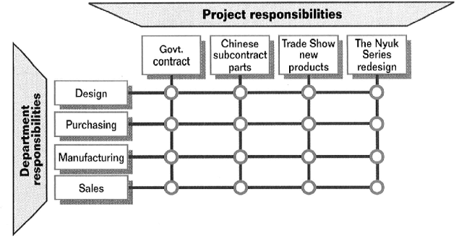
Integrated Product Development (IBM)
Originated at GE
Cross-functional teams at all phases
Phased approval (easy to start, easy to kill)
  Concept
  Plan
  Ship
  Sunset

Slide 12
Unified (Software Development) Process
Iterations within phases
4 phases and core workflows for each
Inception
Elaboration
Construction
Transition
Requirements
Analysis
Design
Implementation
Test

Slide 13
Agile Methodologies

Slide 14
Agile Methodologies
Keep only those rules and processes that help
  Antidote to bureaucracy
  License to hack
Key characteristics
  Adaptive
  People-oriented

Slide 15
Agile Manifesto
February 2001
Representatives from
  Extreme Programming
  SCRUM
  DSDM
  Adaptive Software Development
  Crystal
  Feature-Driven Development
  Pragmatic Programming

Slide 16
Extreme Programming

Slide 17
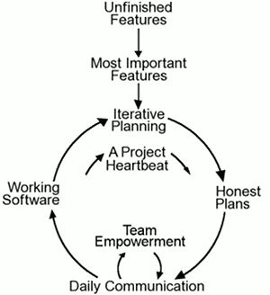
Extreme Programming
Complete development process
First code drop 2-3 weeks after start (what is the start?)
Customer part of the development team
Iterative development to the max
Derive requirements with customer through hands-on experimentation
Agile methodology

Slide 18
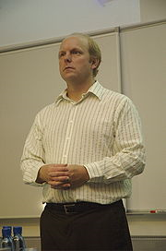
History
Kent Beck considered the inventor
Ideas developed in the early 90’s
First project at Daimler Chrysler in 1996
Smalltalk
Design patterns
Extreme programming

Slide 19
XP Bills of Rights
Developer has a right to
  Clear requirements and priorities
  Determine how long a requirement will take to implement
  Revise estimates
  Always produce quality code
Customer has a right to
  An overall plan
  See progress in a running system
  Change requirements and priorities
  Be informed of changes to schedule and have input as to how to adapt
  Cancel in the middle and still have something to show for the investment

Slide 20
XP Bills of Rights
Developer has a right to
  Clear requirements and priorities
  Determine how long a requirement will take to implement
  Revise estimates
  Always produce quality code
Customer has a right to
  An overall plan
  See progress in a running system
  Change requirements and priorities
  Be informed of changes to schedule and have input as to how to adapt
  Cancel in the middle and still have something to show for the investment

Slide 21
XP Value System
Communication
  Focus on people, not documentation
Simplicity
  Of process and code
Feedback
  Mechanism to make useful progress
Courage
  To trust in people (Bollinger: what you would like to know about software that your life depended on)

Slide 22
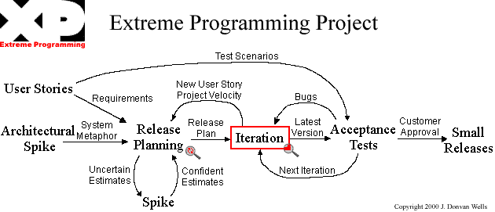
Extreme Programming Flowchart
http://www.extremeprogramming.org/

Slide 23
User Stories
Use cases
Written by customer
Used for planning
  Developers estimate by story
  Stories basis for iteration
Used to build acceptance tests
  Remember that correctness equals meeting requirements

Slide 24
System Metaphor
Initial system design

Slide 25
Spikes
Technology explorations
Focus on high risk items
Typically considered throw-away code
  If not, needs to be agreed to by the whole team

Slide 26
Release Planning
Each iteration has its own plan
  Function OR date (other is adjusted accordingly)
    (Recall 4 variables: function, date, resources, quality)
Planning adapts as the project progresses
  Measure project velocity
    Number of user stories and tasks completed
  Next iteration looks at planned vs. actual time
    Allowed to plan last iteration’s number for this iteration

