Slide 1
Extreme Programming (CONT)
Diane Pozefsky

Slide 2
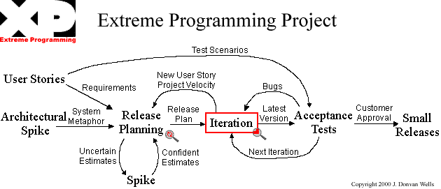
Extreme Programming Flowchart
http://www.extremeprogramming.org/

Slide 3
Iteration
Scope: all parts of the system
  Only add functions needed for current user stories
Recommendation: 3 weeks
Moving people around
  Backup and training
  Code is owned by the whole team
Pair programming
Re-factoring

Slide 4
Pair Programming
Two people working at a single computer
Built-in backup and inspections
Collaboration builds better code
Mechanical model
  One drives, the other talks
  Keyboard slides between the two
Logical model
  One tactical, the other strategic
  Both think about the full spectrum but bring different perspectives

Slide 5
Pair Programming Experiments
Typical numbers show the total manpower consumed not very different
  Numbers range, but no more than ¼ additional manpower
Implication: actual time is reduced
Improved satisfaction also improves productivity
Williams et al, “Strengthening the Case for Pair-Programming”

Slide 6
Refactoring
Each iteration adds just the function needed
If you continue to add new functions every two weeks, code can get messy
Refactoring is the cleaning up of the code at the end of the iteration
Critical to maintaining quality code
(Also applies to the design)
Difference between refactoring & rewriting?

Slide 7
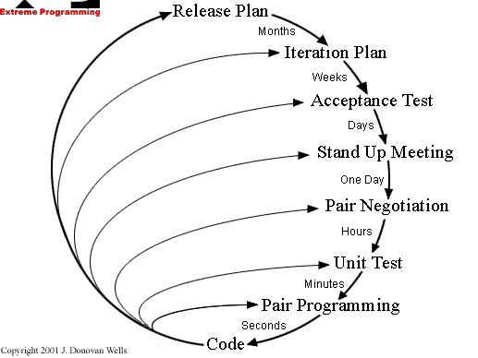
Feedback Loops

Slide 8
The Rules of Extreme Programming
Planning
Managing
Designing
Coding
Testing

Slide 9
When to Use XP
Types of projects
  High risk
  Poorly understood requirements
Team
  Small size: 2 to 12
  Needs to include customer
Automated testing
  Timing issue

Slide 10
What Makes a Project XP
Paradigm
  see change as the norm, not the exception
  optimize for change
Values
  communication, simplicity, feedback, and courage
  honor in actions
Power sharing
  business makes business decisions
  development makes technical decisions
Distributed responsibility and authority
  people make commitments for which they are accountable
Optimizing process
  aware of process and whether it is working
  experiment to fix
  acculturate new team members
Ward Cunningham, Ron Jeffries, Martin Fowler, Kent Beck

Slide 11
NOT everyone loves XP

Slide 12
References
Agile Methodologies www.martinfowler.com/articles/newMethodology.html
Discussion http://xp.c2.com/ExtremeProgrammingRoadmap.html

Slide 13
More on Trust in People

Slide 14
Egoless Programming
Weinberg 1971, The Psychology of Computer Programming
  During the “cowboy” era
  Re-issued in 1998
Observed that programmers needed to be team players
  Accept inspections and reviews
  Open to corrections and critiques

Slide 15
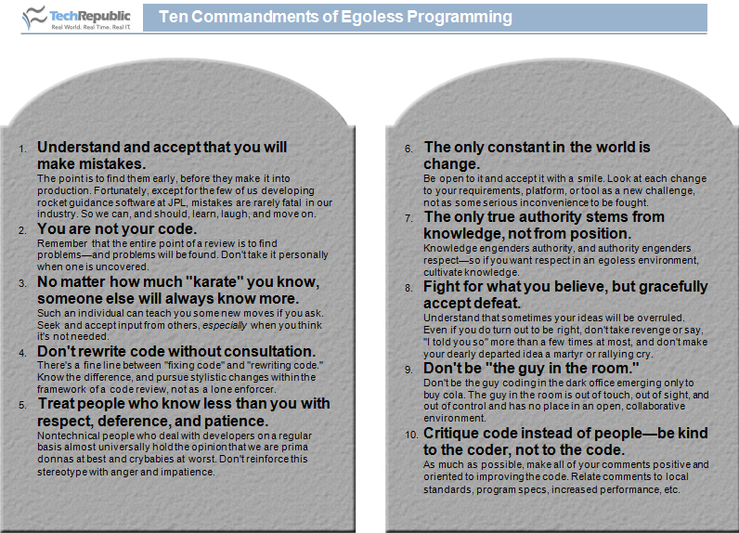
(Lamont Adams)

Slide 16
But pride of ownership is critical to quality

Slide 17
Software Craftsmanship
Emphasizes coding skills of the developers
Recognition of importance of the individual
Basis
  Pragmatic Programmer (Hunt and Thomas)
  Software Craftsmanship (McBreen)
Manifesto
First conference 2009
Fundamentals
  Apprenticeship
  Pride in your work

Slide 18
Can Craftsmanship Help?
Craftsmen sign their work
  basis for reputation
  hiring on portfolio
  Forget licensing
Exploit productivity differences between individuals
  not managing hordes of 'average' programmers
  small teams of good developers
  pay differentials
Expose the fallacy of good enough software
Software development is a social, intellectual activity
  not mechanical : engineering wrong metaphor
  mythical man month problem still exists
Apprenticeship more effective than training
  software development as a craft
  not the same as being taught how to program.

