Slide 1
EPIC Software Failures
David Stotts
UNC Computer Science

Slide 2
Bugs vs. Poor Design
Some failures come from hackers exploiting design flaws
Some failures come from logic flaws
Some failures come from deliberate decisions made by programmers (Y2K)
Some might not be accidental “failures”

Slide 3
Other sources of failure
Some failures come from code that accurately implements incorrect or inconsistent specs
Some failures come from code that incorrectly implements correct specs
Some failures are allowed by (not caused by) incomplete testing (incompetence or by plan)
Some failures come from mix of old code with new… old code mismatch with code from new specs

Slide 4
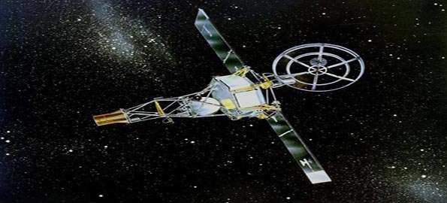
Mariner I Venus Probe July 22, 1962
Collaboration among JPL, NASA, USAF
Bug in guidance system software causes rocket to diverge from intended path on launch
Range safety officer destroys it over the Atlantic
Investigation finds that a formula written in pencil on paper was incorrectly transcribed into computer code… wrong punctuation character in a single line of code

Slide 5
Mariner I Venus Probe July 22, 1962
Caused computer to mis-calculate the rocket’s trajectory
Exact error is unclear… different stories are around… best account seems to be a missing “overbar” in an equation when it was coded
Overbar became “the most expensive hyphen in history” for public consumption
Details http://en.wikipedia.org/wiki/Mariner_1

Slide 6
Mariner I Venus Probe July 22, 1962
What is the failure mode then?
Code and requirements/specs don’t agree
Coder to blame?
Or requirements writer? Specs on a napkin?
Note that this event is prior to the days where the specs/requirements were laid out specifically as a step in development

Slide 7
Second launch
“Two days after that launch, the backup probe and booster (Atlas vehicle 179D) were rolled out to LC-12. Mariner 2 nearly met the same fate as its predecessor when one of the Atlas's verniers moved to maximum stop shortly before booster engine cutoff. “
“This caused a rapid roll of the launch vehicle that quickly approached one revolution per second. With the structural integrity of the booster in jeopardy, the range safety officer prepared to issue the destruct command”
“… almost as soon as it started, the rolling motion stopped and the launch proceeded uneventfully. The incident was traced to a loose wire in the guidance computer which was pushed back into place by the centrifugal force of the roll.

Slide 8
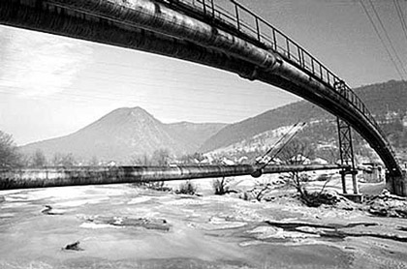
Trans-Siberian Gas Pipeline 1982
Not clear this is an accidental error… alleged deliberate sabotage
Not clear its even true… tale of CIA, KGB, Canada
CIA got word of Soviet stealing Canadian control systems for huge trans-siberian gas
CIA put “bug” in software before it was “stolen”

Slide 9
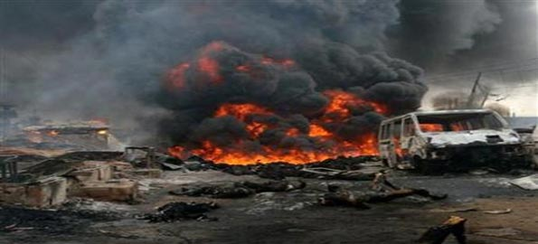
Trans-Siberian Gas Pipeline 1982
Bug causes pumps to overwork and pressure controls to fail… super overpressure and boom
Visible from space, biggest non-nuclear explosion ever
Details http://en.wikipedia.org/wiki/Siberian_pipeline_sabotage

Slide 10
Trans-Siberian Gas Pipeline 1982
What is the failure mode then?
Code worked as spec’d, requirements were correct
Code was “deliberately deceptive”
Appeared as normal controller, while behavior was different from what monitors showed
And now… Stuxnet?

Slide 11
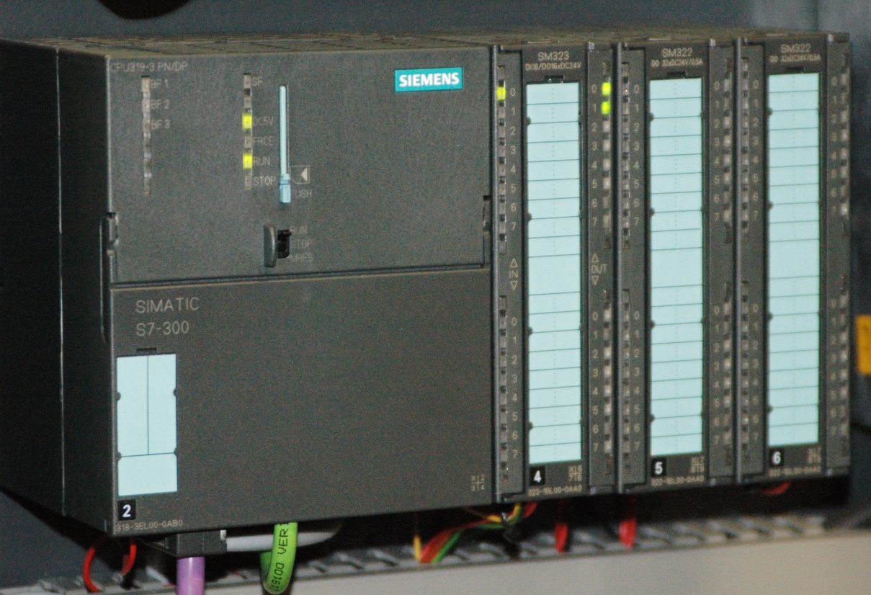
Stuxnet virus June 2010
Specifically attacks Siemens Step7 software running under Windows
Code for centrifuge control (uranium enrichment)
Ruined 1/5 of Iran’s centrifuges
Created overspeed in the rotors while sending “good” normal readings to the monitors

Slide 12
Stuxnet virus June 2010
What is the failure mode?
Another example of a deliberately deceptive program

Slide 13
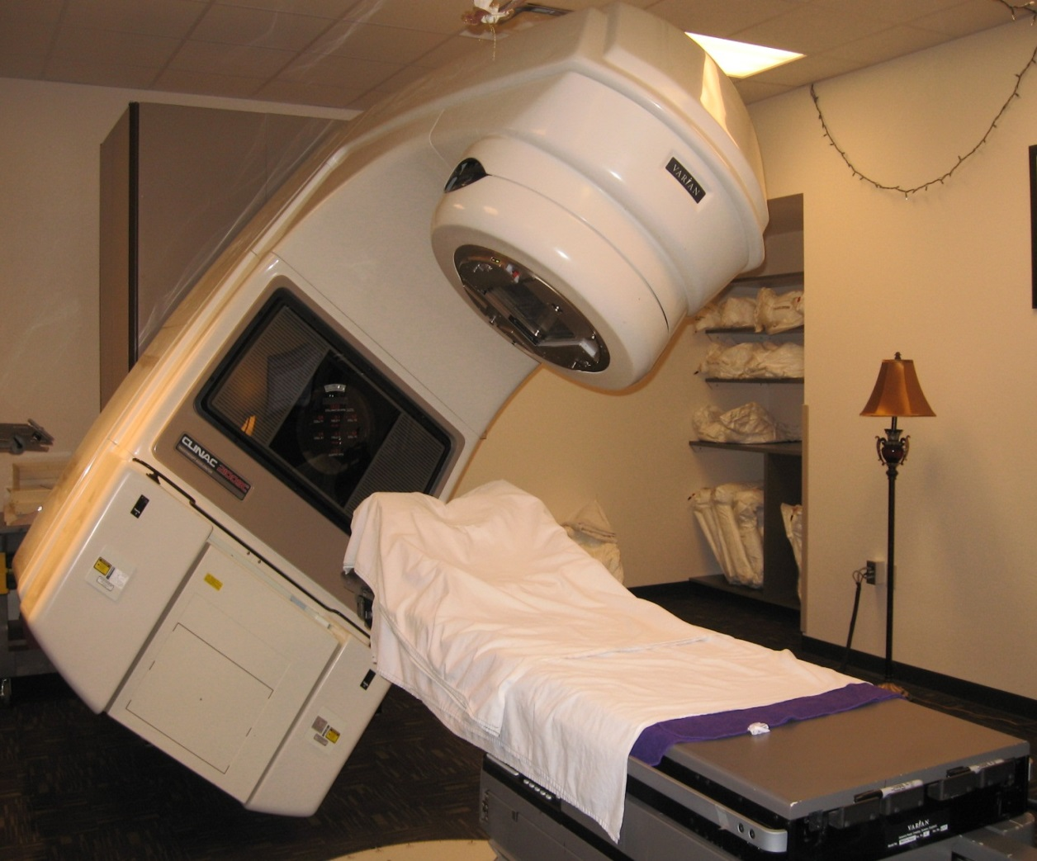
Therac-25 Medical Accelerator 1985-1987
Radiation therapy device malfunctions, delivers lethal doses at several facilities
The 25 was an improved version of an older model
It could deliver beta-particles (electron beam) or x-rays

Slide 14
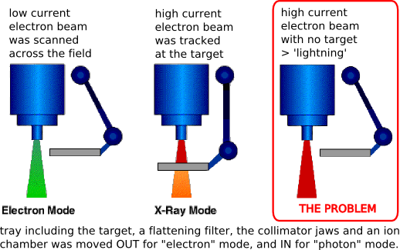
Therac-25 Medical Accelerator 1985-1987
Older model mechanical fail-safes were replaced with “modern” software fail-safes
It was possible to set the electron beam onto X-ray strength before the metal target was in place

Slide 15
Therac-25 Medical Accelerator 1985-1987
Researchers who investigated the accidents found the following institutional causes:
AECL did not have the code independently reviewed.
AECL did not consider the design of the software during its reliability modeling.
The system documentation did not adequately explain error codes.
AECL personnel initially did not believe complaints.

Slide 16
Therac-25 Medical Accelerator 1985-1987
Investigators also found several engineering issues:
No hardware interlocks to prevent the electron-beam from operating in its high-energy mode without the target in place.
Reused software from older models that had hardware interlocks and were therefore not as vulnerable to the software defects.
Hardware provided no way for the software to verify that sensors were working correctly.
The equipment control task did not properly synchronize with the operator interface task, so that race conditions occurred if the operator changed the setup too quickly. This was missed during testing, since it took some practice before operators were able to work quickly enough for the problem to occur.
Software set a flag variable by incrementing it. Occasional arithmetic overflow caused the software to bypass safety checks.

Slide 17
Therac-25 Medical Accelerator 1985-1987
What is the failure mode?
Old code, new specs
Failure to code review
Failure to test thoroughly
Lack of mechanical safety (no software will be perfect)

Slide 18
Morris Worm Nov 2, 1988
Early malware, infected 10% of the computers on the arpanet (no real internet at the time, mostly universities and govt. labs, some companies)
Cleanup costs at each site ranged from $200 to $53,000 (in 1988 $$)
99-line program written to infiltrate DEC VAX and Sun 3 machines and do nothing but make copies of itself
Robert Morris was a 1st yr grad student at Cornell

Slide 19
Morris Worm Nov 2, 1988
Experiment gone wrong… no malicious code in it, Morris’ goal was to show that sendmail could be used to propagate a worm (demo a software flaw)
Exploited buffer overflow in the Unix finger daemon and in sendmail, others using gets()
Gets() does not check its input string to see if it fits the allocated char array… so send too much input and you get into memory areas beyond the program
Bogged machines down to near stoppage with simply servicing the worms behavior… copying itself

Slide 20
Morris Worm Nov 2, 1988
Worm error: asked if a machine had the worm, no copy if “yes”. However, every 7th “yes” it copied anyway (to prevent admins killing the worm by just saying yes). 7 was not slow enough. Not nearly
Multiple software errors… gets(), morris’ 7 try limit, failure to test before release
Effective due to homogeneity of the 80’s net
Details here http://www.eweek.com/c/a/Security/Who-Let-The-Worms-Out/

Slide 21
Morris Worm Nov 2, 1988
What is the failure mode?
“Failure” was intentional, exploiting OS design flaw
No testing in isolation for intentional behavior
Poor estimation of parameters (speed)

Slide 22
Kerberos Random Number Gen 1988-1996
network authentication protocol, used in OS and shared file system manager
Secret key encryption, used random num generator used to create user “tickets”
Random generator was predictable, so user could be spoofed and files accessed
Found at Perdue by Gene Spafford students… similar to issue with Netscape random number flaw in SSL, 1994
Details http://tech.mit.edu/V116/N11/kerberos.11n.html

Slide 23
Kerberos Random Number Gen 1988-1996
What is the failure mode?
Dependency on unreliable random number generator
Random number generator did not correctly implement its specs (not random enough)

Slide 24
AT&T Network Outage January 15, 1990
A bug in a new release of the software that controls AT&T's #4ESS long distance switches causes these mammoth computers to crash when they receive a specific message from one of their neighboring machines
The problem message? One that the neighbors send out when they recover from a crash… oops…

Slide 25
AT&T Network Outage January 15, 1990
The first domino… a switch in New York crashes and reboots, causing its neighboring switches to crash, then their neighbors' neighbors, and so on.
114 switches fail, crashing and rebooting every 6 seconds
60,000 customers with no service for 9 hours
The fix: reload previous software version
Details http://www.phworld.org/history/attcrash.htm

Slide 26
AT&T Network Outage January 15, 1990
What is the failure mode?
Insufficient testing of new software before release… bug in message handling was not found
Kismet… huge crash cascade failure was pure bad luck that the crash recovery message was the bad one
Perhaps testing can try to anticipate risks like this in the code

Slide 27
Patriot Missile Failure Feb. 1991
American Patriot Missile battery in Dharan, Saudi Arabia, failed to track and intercept an incoming Iraqi Scud missile
It hit a barracks, 28 killed, over 100 wounded
Tracking error came from two different versions on internal clocking routing; one was from older missile system (from assembly code), another was an updated routing for newer faster missiles.
The mismatch created a time skew large enough to allow the Scud to be ½ kilometer off its computed location
http://www.ima.umn.edu/~arnold/disasters/patriot.html

Slide 28
Patriot Missile Failure Feb. 1991
What is the failure mode?
Mismatch of new specs and old specs

Slide 29
Intel Pentium FP Divide 1993
Design error causes Intel's highly promoted Pentium chip to make mistakes when dividing floating-point numbers that occur within a specific range.
Example: dividing 4195835.0/3145727.0 yields 1.33374 instead of 1.33382, an error of 0.006 percent
Caused by a few missing values in lookup table http://www.intel.com/support/processors/pentium/sb/CS-013007.htm
Discovered by Prof. Thomas Nicely, Lynchburg College in VA. http://www.trnicely.net/pentbug/bugmail1.html

Slide 30
Intel Pentium FP Divide 1993
Affects few users, but it becomes a public relations nightmare.
3 to 5 million defective chips in circulation
Intel offers to replace chips only for customer who can prove they need high accuracy !!
Relents and replaces chip for any customer
Cost: $475 million

Slide 31
Intel Pentium FP Divide 1993
Intel makes some recalled defective chips into keychains (oh yeah, they have $450 million to recoup)
http://pinterest.com/chipsetc/cpu-computer-chip-keychains/
http://www.chipsetc.com/intel-keychains-page-3.html
For fun http://www.maa.org/mathland/mathland_5_12.html

Slide 32
Intel Pentium FP Divide 1993
What is the failure mode?
Missing data values in lookup table, software? Or hardware? Firmware
Testing? Can testing be made exhaustive at least on lookup table values?

Slide 33
The Ping of Death 1995/1996
denial of service (DoS) attack caused by an attacker deliberately sending an IP packet larger than the 65,535 bytes allowed by the IP protocol
Normal ping packet is 32 to 84 bytes
Long packets are broken up and sent as smaller ones, then reassembled… no check was done to make sure they add up to <= 65,535
Affected Unix, Linux, Mac, Windows, printers, and routers running early TCP/IP implementations

Slide 34
The Ping of Death 1995/1996
OS didn’t know how to handle a “too long” packet and would freeze, crash, do unpredictable stuff
Yet another buffer overflow problem -- a classic in C due to the nature of arrays (“buffers”) in the language
Newer versions of TCP/IP are fixed, but some net firewalls still deny pings because of this

Slide 35
The Ping of Death 1995/1996
What is the failure mode?
Deliberate exploit of design flaw in OS
Flaw is fixed but no way to force old code to be eliminated

Slide 36
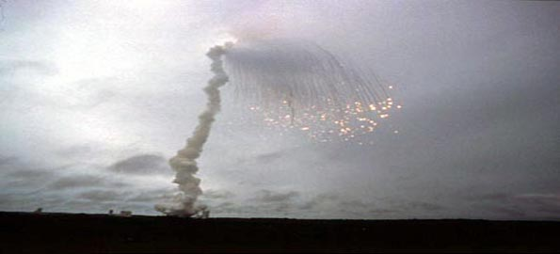
Ariane 5 Flight 501 June 4, 1996
French rocket reuses code from Ariane 4
5’s faster engines triggers bug in arithmetic routine in flight computer
Convert 64-bit FP to 16-bit signed int

Slide 37
Ariane 5 Flight 501 June 4, 1996
The 5 generates larger 64-bit values, causes overflow in the 16-bit int ( a variable representing horizontal bias )
Controller traps due to overflow, crashes during launch, so backup computer is called into play
Backup had already crashed… it was running the same software (redundancy was incase of hardware failure)
Boom 37 seconds into flight (unmanned), losing $370 million rocket and scientific cluster payload
Video http://www.youtube.com/watch?v=gp_D8r-2hwk

Slide 38
Ariane 5 Flight 501 June 4, 1996
From Pentium chip error link http://www.maa.org/mathland/mathland_5_12.html
“Interestingly, the launch failure of the Ariane 5 rocket, which exploded 37 seconds after liftoff on June 4, 1996, occurred because of a software error that resulted from converting a 64-bit floating point number to a 16-bit integer. The value of the floating point number happened to be larger than could be represented by a 16-bit integer. The overflow wasn't handled properly, and in response, the computer cleared its memory. The memory dump was interpreted by the rocket as instructions to its rocket nozzles, and an explosion resulted.

Slide 39
Ariane 5 Flight 501 June 4, 1996
What is the failure mode?
Old code not compatible with new specs yet new system mixed old and new code

Slide 40
Mars Pathfinder Shutdown Aug 1997
Onboard computer would just shutdown and reboot… happened many times early on in the mission
Traced to a timing problem in multi-taking operating system
Processes have priorities and very occasionally a med priority task could start in the tiny time slice when a high priority task was being interrupted for a low task
The med task would prevent the low from running, and the high was waiting for the low to finish and give it data

Slide 41
Mars Pathfinder Shutdown Aug 1997
Software handled this by noticing a stuck task and rebooting
Parallel system on Earth was used to find the bug, patches sent up to Mars
No huge dollar loss but each reboot caused a day delay in data transmission
https://www.rapitasystems.com/blog/what-really-happened-to-the-software-on-the-mars-pathfinder-spacecraft

Slide 42
Mars Pathfinder Shutdown Aug 1997
What is the failure mode?
Inconsistent / incorrect specs, correct code perhaps
Perhaps incorrect multi-processor design allows race conditions, or OS for multi-processor
Human error: “Engineers later confessed that system resets had occurred during pre-flight tests. They put these down to a hardware glitch and returned to focusing on the mission-critical landing software”

Slide 43
Nat’l Cancer Inst., Panama City November 2000
Radiation planning software by Multidata Systems International
Technicians draw on screen locations of “blocks” that shield healthy tissue from radiation
Software allows 4 blocks, Panama docs usually want to use 5
Discover they can “trick” the system by drawing all 5 blocks as one large block with a hole in the center

Slide 44
Nat’l Cancer Inst., Panama City November 2000
Problem: draw hole in one direction, get correct gamma ray dosage calculated
Draw hole in the other direction, get 2x the proper gamma ray dose
8 patients die, 20 badly injured
Physicians, who were legally required to double-check the computer's calculations by hand, are indicted for murder.
Details http://www.baselinemag.com/c/a/Projects-Processes/We-Did-Nothing-Wrong/

Slide 45
Nat’l Cancer Inst., Panama City November 2000
What is the failure mode?
“undocumented feature” purposeful or not, from user POV
But this was really code error, not well tested
Code with larger user base… these are found and fixed (open source e.g.)

Slide 46
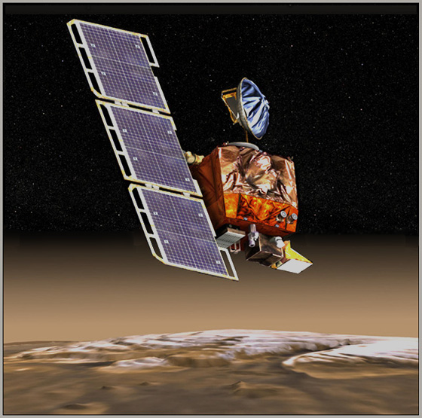
Mars Climate Orbiter September 23, 1999
Remember in physics class, when the instructor was so adamant about units?
You gave an exam answer of “2.5” and they would write in red all over it “2.5 what?? Weeks? Puppies? Jelly Donuts?
Turns out it can really matter

Slide 47
Mars Climate Orbiter September 23, 1999
Ground-based software produces output in pound-seconds (imperial) instead of the newton-seconds (metric) specified in the NASA contract with Lockheed
Flight controller on Orbiter written to take thrust instructions in metric units; ground software generating those instructions sends them in imperial units
“What we have heyah… is failure to communicate”

Slide 48
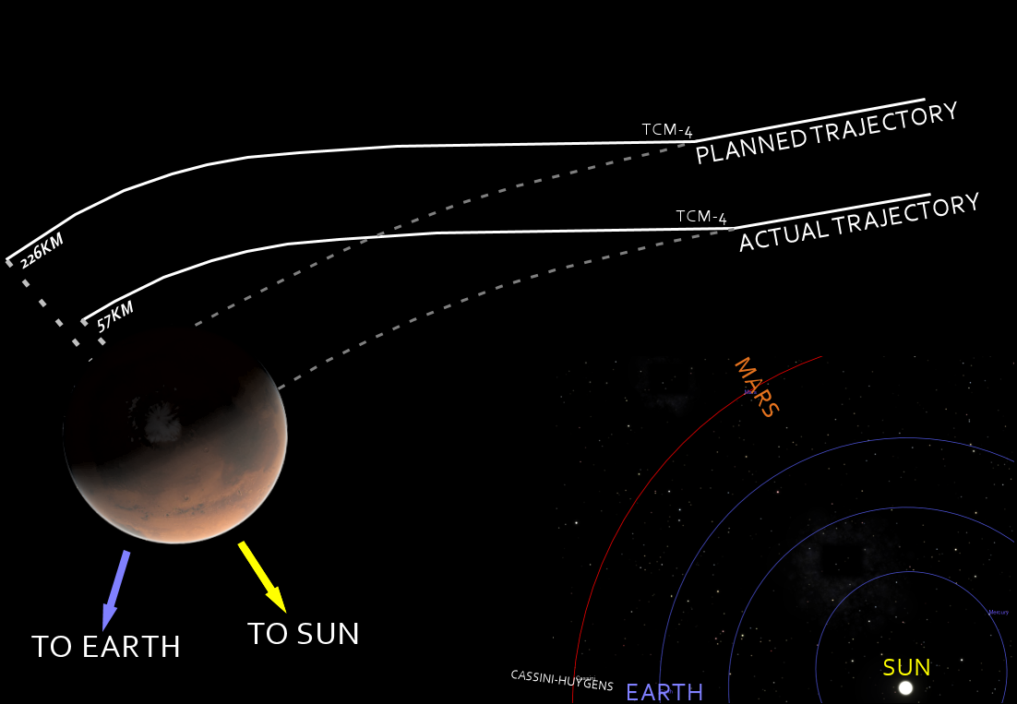
Mars Climate Orbiter September 23, 1999
Wrong thrust causes wrong orbit, craft ends up too low and contacts the atmosphere, burns

Slide 49
Mars Climate Orbiter September 23, 1999
The discrepancy between calculated and measured position, resulting in the discrepancy between desired and actual orbit, had been noticed earlier by at least two navigators, who were ignored.
A meeting of trajectory software engineers, trajectory software operators (navigators), propulsion engineers, and managers, was convened to consider the possibility of executing Trajectory Correction Maneuver-5 (in the schedule).
Attendees of the meeting recall an agreement to conduct TCM-5, but it was ultimately not done.

Slide 50
Mars Climate Orbiter September 23, 1999
What is the failure mode?
Inconsistent specs, code correctly matches the specs

Slide 51
LAX Grounded 2007
A single faulty piece of embedded software, on a network card, sends out faulty data on the United States Customs and Border Protection network, bringing the entire USCBP system to a halt (morris-worm like, a bit)
Nobody is able to be authorized to leave or enter the U.S. from the Los Angeles Airport for over eight hours.
Over 17,000 planes grounded for the duration of the outage
DHS report

Slide 52
LAX Grounded 2007
What is the failure mode?
Network card failure… firmware?
Aging systems at end of replacement lifetime

Slide 53
World War III 1983
Soviet early warning satellites picked up sunlight reflections off cloud-tops and mistakenly interpreted them as missile launches in the United States.
Software was in place to filter out false missile detections of this very nature, but a bug in the software let the alerts through anyway.
The Russian system instantly sent priority messages up saying that the United States had launched five ICBMs.

Slide 54
World War III 1983
Protocol in such an event was to respond decisively, launching the entire Soviet nuclear arsenal before any US missile detonations could disable USSR response capability.
The duty officer for the system, Lt. Col Stanislav Petrov, intercepted the messages and flagged them as faulty, stopping the Soviet “response”
Petrov said he had a “funny feeling in my gut” about the attack… if the U.S. was really attacking they would launch more than five missiles.

Slide 55
World War III 1983
What is the failure mode?
Who knows… bad spec? More likely code that was incomplete… false positives too easy to generate

Slide 56
Y2K … of course um… 2000
Dates in code written in the “early days” used 2 digits to represent the year
E.g., 10 / 05 / 73
The “19” in “1973” was assumed in the code itself.
What happens when a program finds out it is “00”… and thinks it is “1900” ?

Slide 57
Y2K … of course um… 2000
All sorts of dire predictions… nuclear plants to fail, government records to become false (payments stop), manufacturing plants to shut down, food distribution failure, energy delivery failure, etc.
General societal chaos… preppers
Made a lot of consulting cash for retired COBOL programmers
Nothing happened. So not a failure perhaps

Slide 58
Y2K … of course um… 2000
What is the failure mode?
Incomplete specs, assumptions that become invalid
Poor estimation of product lifetime
Very expensive non-failure

Slide 59
Healthcare.gov Oct. 2013
Website to integrate data and functions from users, insurance companies, and government databases
30-some different versions for different states
High-traffic site, handles a few dozens users first day
No testing to speak of done
$600 million costs of development

Slide 60
Healthcare.gov Oct. 2013
Front end developed by a startup company
Back end developed by CGI (a Canadian company that has developed a large system for Canada, was estimated to cost $2 million and ended up costing $2 billion)
Coordination? Integration testing failure
Function testing end to end? No.
Stress testing? No.

Slide 61
Healthcare.gov Oct. 2013
What is the failure mode?
No testing to speak of
Two different companies working on major chunks, not interacting

Slide 62
Future… cars? and beyond
Cars these days are computer networks… wireless networks
Can be hacked from outside and hijacked
External control of throttle, brakes, fuel mix, ingition, lights, etc.
Software bugs that allow this takeover?
Software system security will be huge problem in society for time to come

Slide 63
IOT… and security
Internet-enabled devices are so common, and so vulnerable,
hackers broke into a casino through its fish tank. The tank had internet-connected sensors measuring its temperature and cleanliness.
hackers got into the tank’s sensors, then to the computer used to control them, and from there to other parts of the casino’s network.
The intruders were able to copy 10 gigabytes of data to somewhere in Finland.

Slide 64
Devices made to share
Whether you know it or not
Our fish tanks, smart televisions, home thermostats, Fitbits, smartphones constantly gather information about us and our environment.
Programmers make sure they are data sharing devices… your info sent all over
And Alexa… she’s listening

Slide 65
Do you mind?
Roomba… robotic vacuum cleaner
Since 2015, high-end models have created maps of its users’ homes, to more efficiently navigate through them
Local data? No. IOT device
Reuters and Gizmodo reported, iRobot planned to share those maps of the layouts of people’s private homes with its commercial partners

Slide 66
Others….
the Mirai botnet (2016) took control of smart home devices, like security cameras, home routers, all over the world
turned them into zombie machines to do DDoS attacks to take down popular websites like GitHub, Twitter, Reddit, Netflix, Airbnb

Slide 67
OK … eye rester …
with unlimited data …

