Slide 1
Heroku Workshop
A lecture for COMP 523
Aaron Smith
Wednesday, Feb. 12, 2020

Slide 2
Web architecture
Database
MongoDB
PostgreSQL
MySQL
Redis
Server
Django (Python)
Express (JavaScript)
Rails (Ruby)
Laravel (PHP)
ORM
Client
(browser)
React
Angular
Vue
RESTful API
File Store
Local storage
Dropbox
Google Drive
AWS S3 Bucket
HTTP

Slide 3
Server options
Cloud platforms
Firebase
Heroku
Self-hosting
Example: AWS, Azure, Google Cloud
Good for static assets or “serverless” design
Good for maximum control
Good for real-time updates and user accounts
Good for balance of simplicity and flexibility

Slide 4
Heroku is a “Platform as a Service” (PaaS)

Slide 5
Heroku features
Quick deployment
Easy scaling
Uptime
Automatic patches
Add-ons available for:
Databases
Logging
Monitoring usage
Sending emails

Slide 6
Heroku dynos
Your app is a container (similar to Docker)
Heroku will load your app into a dyno to run it
Dynos will periodically reset
Environment is not persistent (for example, the filesystem)

Slide 7
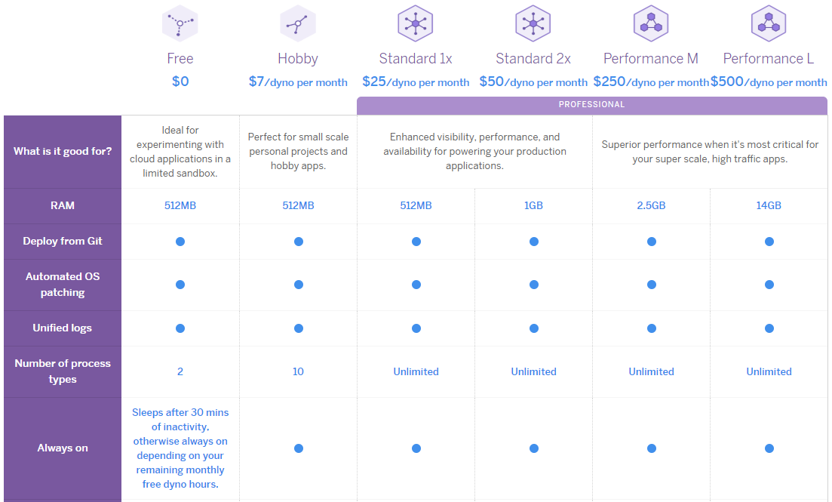
Heroku pricing

Slide 8
Today’s application
Hosting: Heroku
Framework: Express.js
Environment: Node.js

Slide 9
Tasks
Create a Heroku account
Download and install the Heroku CLI
Create a skeleton Node server app with Express
Deploy the app to Heroku

Slide 10
Log in to Heroku CLI
$ heroku login

Slide 11
Create a new Express app
$ npx express-generator –h
Usage: express [options] [dir]
Options:
-h, --help output usage information
--version output the version number
-e, --ejs add ejs engine support
--hbs add handlebars engine support
--pug add pug engine support
-H, --hogan add hogan.js engine support
--no-view generate without view engine
-v, --view <engine> add view <engine> support (ejs|hbs|hjs|jade|pug|twig|vash) (defaults to jade)
-c, --css <engine> add stylesheet <engine> support (less|stylus|compass|sass) (defaults to plain css)
--git add .gitignore -f, --force force on non-empty directory
$ npx express-generator --no-view --git todo-express

Slide 12
Run the app locally
$ cd todo-express
$ npm install
$ npm start
Now navigate to http://localhost:3000

Slide 13
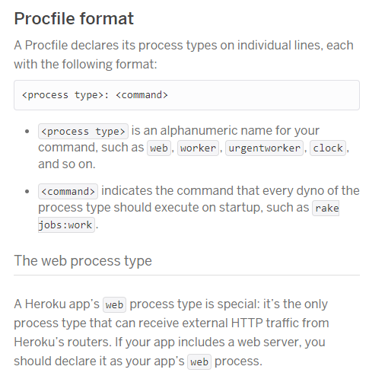
Heroku Procfile
Make a text file named Procfile at the root of your repository
Tells Heroku how to launch your app
Procfile contents:
web: node app.js

Slide 14
Set port in app.js
var express = require('express');
var path = require('path');
var cookieParser = require('cookie-parser');
var logger = require('morgan');
var indexRouter = require('./routes/index');
var usersRouter = require('./routes/users');
var app = express();
app.use(logger('dev'));
app.use(express.json());
app.use(express.urlencoded({ extended: false }));
app.use(cookieParser());
app.use(express.static(path.join(__dirname, 'public')));
app.use('/', indexRouter);
app.use('/users', usersRouter);
var port = process.env.PORT || 3000;
app.listen(port);
module.exports = app;

Slide 15
Deploy to Heroku
$ git init
$ git add .
$ git commit -m "initial commit"
$ heroku create todo-express-ajs
$ git push heroku master
$ heroku ps:scale web=1
$ heroku open

Slide 16
Add Sequelize and Postgres to app
$ npm install sequelize pg
$ git add .
$ git commit -m "add sequelize and pg"

Slide 17
Add Postgres to Heroku
Add Postgres as an add-on to Heroku
Heroku randomly assigns a color to uniquely identify the database
Remember the name!
$ heroku addons:add heroku-postgresql:dev
Adding heroku-postgresql:dev on fast-dusk-7858... done, v5 (free)
Attached as HEROKU_POSTGRESQL_BRONZE_URL
Database has been created and is available
! This database is empty. If upgrading, you can transfer
! data from another database with pgbackups:restore.
Use `heroku addons:docs heroku-postgresql:dev` to view documentation.

