Slide 1
SCAMBUSTERS®
COMP 585 Proposal

Slide 2
Before substantiating my Comp 523 proposal, there is a very timely and important email I feel obligated to share with you.

Slide 4
This email is typical of much communication constantly blitzing all of us. It is, in fact, bogus. I know this to be true because I took just a few minutes and created it myself. The following picture shows how a scammer might have used the email.

Slide 6
It is simple for a scammer to gain the confidence of his intended victim by copying and inserting actual logos and misguiding the recipient by falsifying who is the actual sender. The scammer’s call to action might be a request for money or information, or redirection to a site which will infect the victim’s computer with malware. The sample above is a good example of the latter. Since it is convincing in other ways, the reader is apt to let down his/her guard and click on the provided email address. But hovering one’s cursor over that link would show that following the link will not take you where expected. Instead, it will lead to an unsecure website having no connection to NCDHHS.

Slide 7
$50 BILLION
It is estimated that over $50 billion is lost to scams annually in the United States. Scambusters® is designed to teach participants to recognize and avoid scams. It was originally designed to be presented live in schools and has met with great success. Over 95% of the time schools have invited BBB to return in order to reach more students. BBBs throughout the US and Canada have adopted the program.

Slide 8
Nevertheless, the number of scammers multiply faster than BBB’s resources. We only have so much time and manpower available for presentations. Therefore, creating alternate delivery methods for Scambusters®’ messages is key. Such steps were taken during the pandemic, when live presentations were limited.

Slide 9
New Additions to the Scambusters® Suite
Scambusters® Flip Lessons
Scambusters® The Video Game

Slide 10
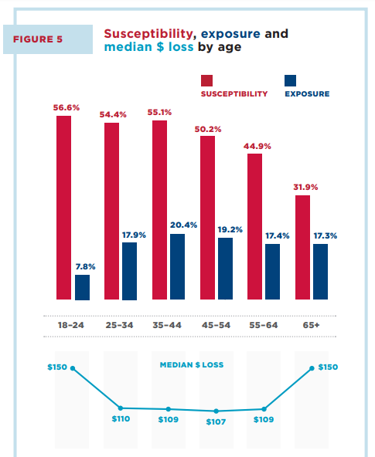
Contrary to the popular belief that the elderly is the age group most often scammed, those falling prey most often are between the ages of eighteen and twenty-four. In fact, all age brackets up to forty-five years old are the ones most at risk.

Slide 11
Coincidentally, these are also the ages of the most active video gamers. This makes video games an ideal vehicle for delivering the valuable lessons within Scambusters®. But people of these ages are also more likely to use phones or tablets when accessing the internet. For this reason, it is important that Scambusters® The Video Game, or a new Scambusters® video game, be accessible from these devices.

Slide 12
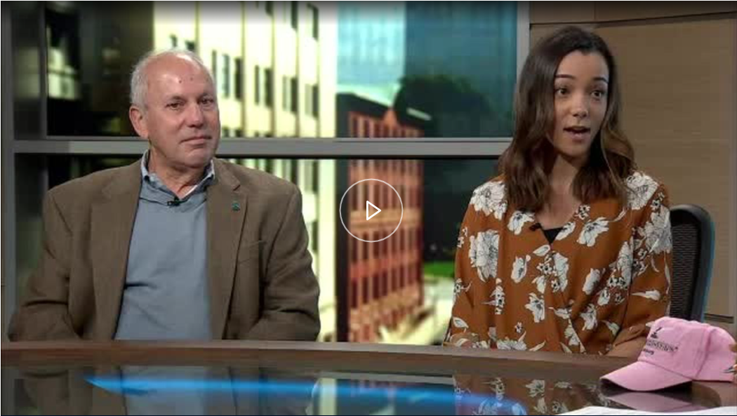
Scambusters® in the News

Slide 13
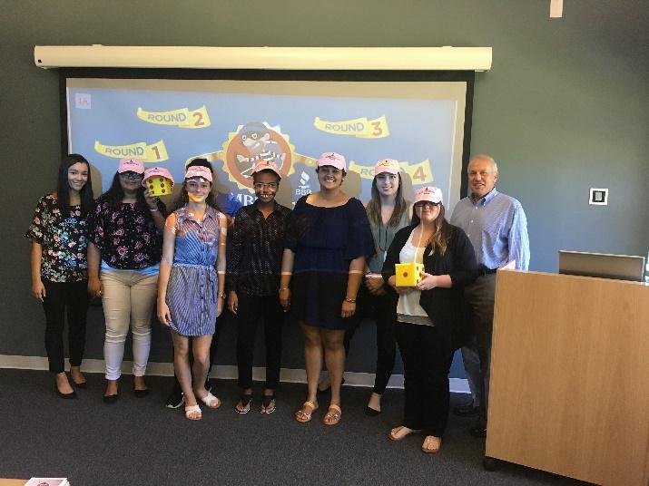
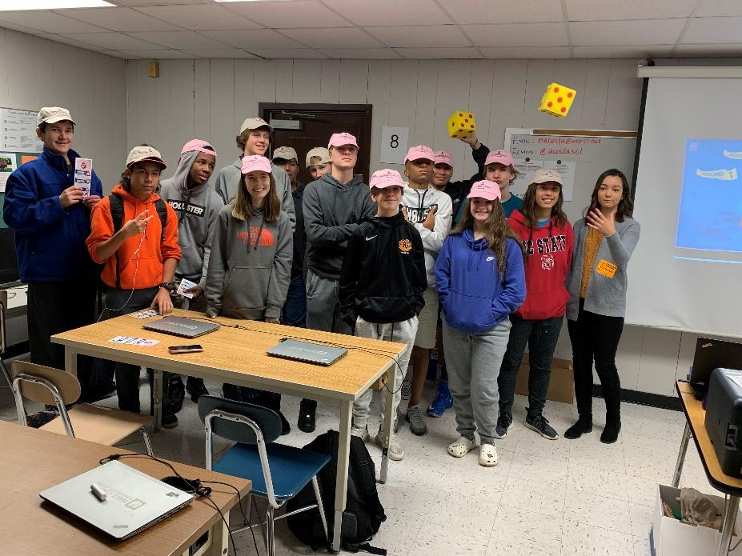
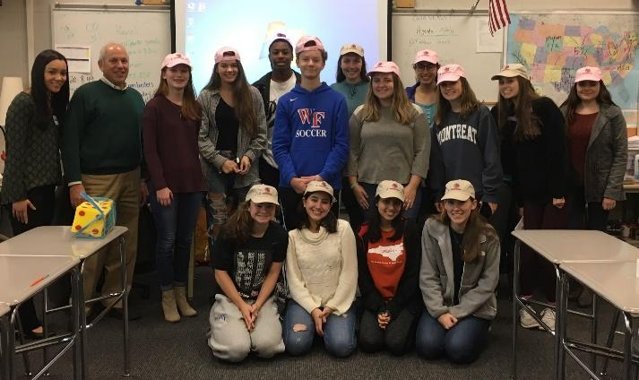
Scambusters® Live Presentations

