Slide 1
N 351: Suja P. Davis, PhD, RN

Slide 2
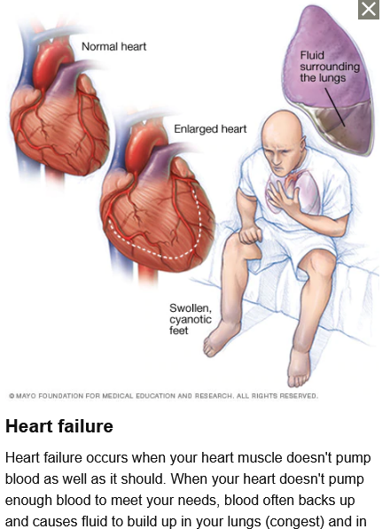
What is Pathophysiology?
Pathophysiology is the study of what happens when normal anatomy and physiology are altered. These alterations can cause
Disease and/or abnormal states of being
Signs and Symptoms
Abnormal state of being
Changes in normal lab values

Slide 3
Why Do Nurses Care About It?
Helps to sharpen clinical reasoning to develop a strong foundation for nursing practice
Pathophysiology helps nurses understand why patients look and respond as they do and provides the rationale for evidence-based medicine and care
Highest quality patient care
Nurses care because it is the ”why” that unlocks the mysteries of the human body and its response to medical and nursing therapies
PATHOPHYSIOLOGY
PATHOPHYSIOLOGY
PATHOPHYSIOLOGY
PATHOPHYSIOLOGY
Helps to deliver holistic patient centered care
PATHOPHYSIOLOGY

Slide 4
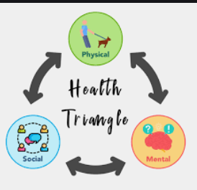
Health: State of complete physical, mental and social wellbeing and not merely the absence of disease and infirmity (WHO, 2006)
Source: clipartkey.com
Disease: a disorder of structure or function in a human, animal, or plant, especially one that produces specific signs or symptoms or that affects a specific location and is not simply a direct result of physical injury
Hereditary : E.g: Hemophilia
Congenital: Neural tube defect
Developmental: Scoliosis
Inflammatory : IBD
Degenerative: OA
Metabolic: Diabetes
Neoplastic: Cancer

Slide 5
Main slide – used for hyperlink interaction do not delete
Etiology:
Study of disease causation
DISEASE
Manifestations: clinical effects or evidence of disease
Idiopathic: Unknown cause
Chronic: May never resolve completely, but
is manageable
Acute : Short term (resolves quickly)
Iatrogenic: Unintended effect
Syndrome:
Groups of signs/symptoms
that occur together
Pathogenesis: How a disease develops

Slide 6
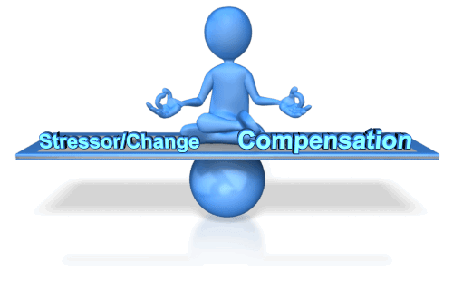
Homeostasis: Equilibrium, balance, stability
Every part of the human body—from small cells to the largest organs—needs balance to perform usual function
Self-regulating to respond to minor changes with compensatory mechanisms
Feedback:
Negative- think thermostat and blood sugar regulation; Two loops
Positive- same direction as original stressor- think childbirth; One loop
HOMEOSTASIS

Slide 7
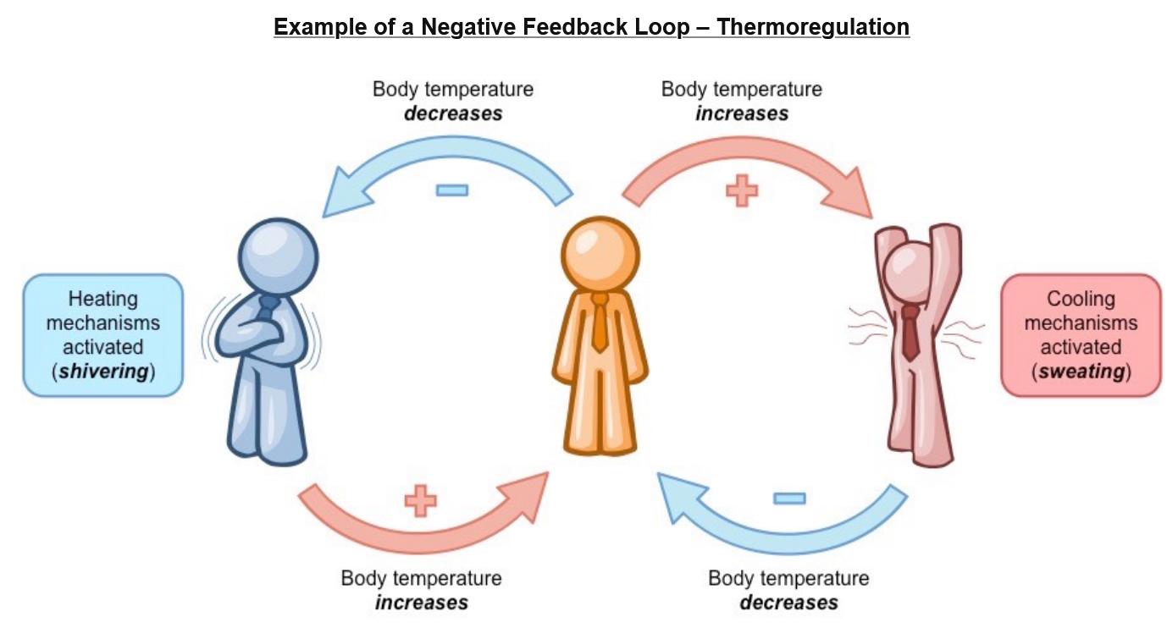
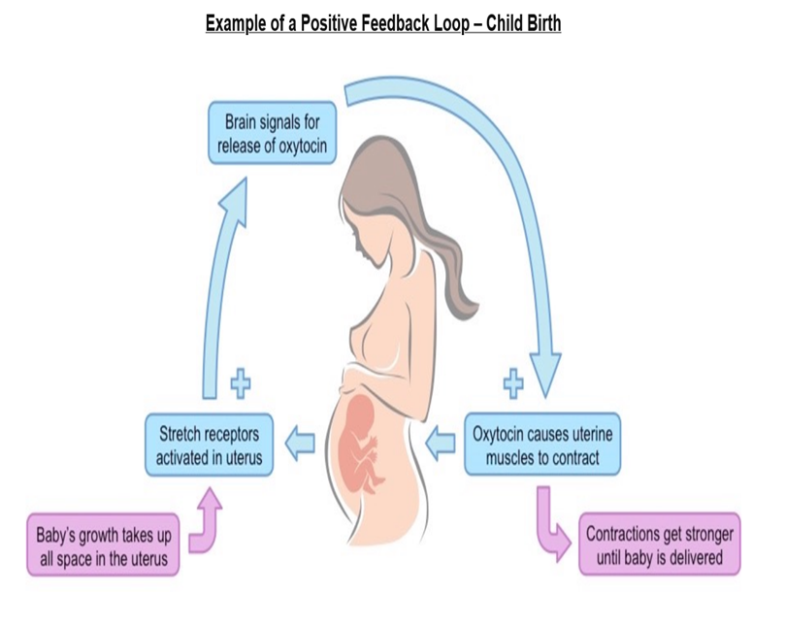
Feedback Examples To Maintain Homeostasis

Slide 8
Source: Clipartlibrary.com

