Slide 1
PHARMACOKINETICS & PHARMACODYNAMICS
Suja P. Davis, PhD, RN

Slide 2
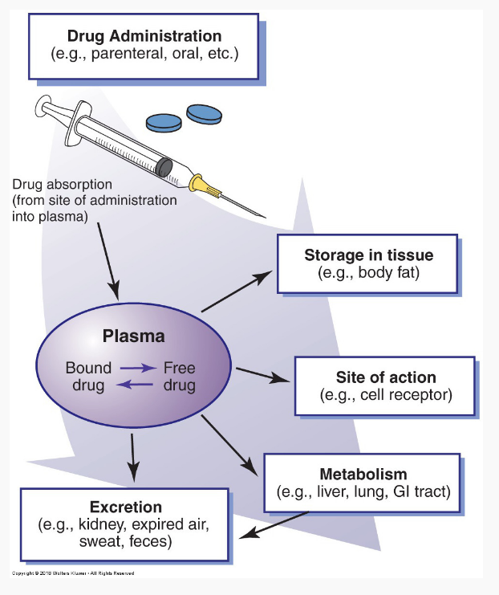
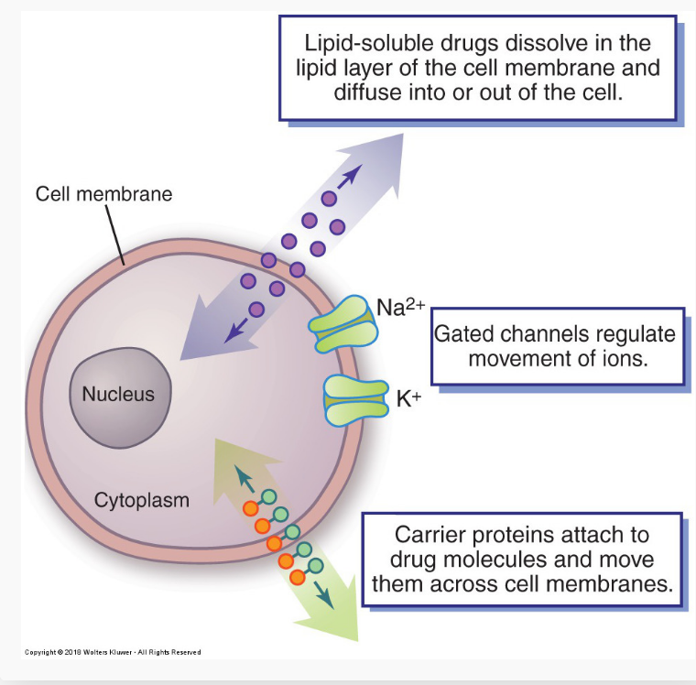
DRUG TRANSPORT THROUGH CELL MEMBRANES
Lipid Penetration
Channels
Carrier Proteins

Slide 3
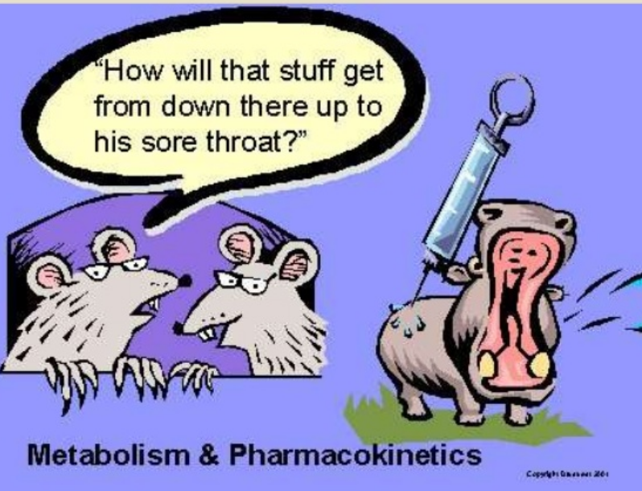
PHARMACOKINETCS
What the body does to the drug?
Source: https://www.slideshare.net/jpv2212/clinical-pharmacokinetics-part-1-dr-jayesh-vaghela

Slide 4
PHARMACOKINETICS
The study of drug movement and concentration once it enters the body
A-
D-
M-
E-
All drugs undergo these processes
Influenced by age, genetics, ethnicity & comorbidities

Slide 5
PHARMACOKINETICS: ABSORPTION
1
ABSORPTION
(input)
It is the process of delivering a drug to the blood stream
*Dosage form * Administration route
*GI Function *Blood flow to the site
*Presence of food *Presence of other
meds
Factors affect the rate & extent of absorption
2
3
% of drugs that reach systemic circulation & is available to act on body cells; IV drugs = 100% bioavailability
BIOAVAILABILITY
Except IV medications all other medications need to be absorbed to bloodstream; IV med = directly to blood stream
4
ABSORPTION

Slide 6
ABSORPTION: ROUTES OF MEDICATION ADMINISTRATION
ROUTES OF MEDICATION ADMINISTRATION
ENTERAL (GI Tract/intestine)
PARENTERAL (injected)
TOPICAL
MUCOUS MEMBRANE
Ophthalmic
Respiratory inhalation
Oral (PO)
Buccal
*OG/NG/G/J tubes
Subcutaneous (SQ)
Intramuscular (IM)
Intravenous (IV)
Epidural
Applied directly to skin (ointment)
Sublingual (SL)
Rectum (PR)
*OG = Orogastric; NG= Nasogastric; G = Gastrostomy; J = Jejonostomy
Notes:
Buccal = placing a drug between your gums and cheek

Slide 7
ABSORPTION: MEDICATION ROUTES
Parenteral routes (IV, IM, SQ)
Oral
Route of choice in acute condition
Sublingual route (Nitroglycerine for heart attack)
Route of choice in chronic condition
Transdermal
Inhalation route (in acute asthma attack)
Topical

Slide 8
ABSORPTION: GENERAL COMPARISON
SQ medications = 15-30 minutes
IM medications = 10-20 minutes
IV medications = 30- 60 Seconds

Slide 9
PHARMACOKINETICS:DISTRIBUTION
Transportation of drugs to various tissues
Drugs are carried by blood and tissue fluids to:
Action sites
Metabolism sites
Excretion sites

Slide 10
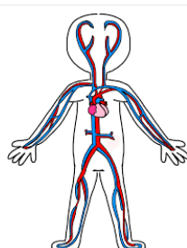
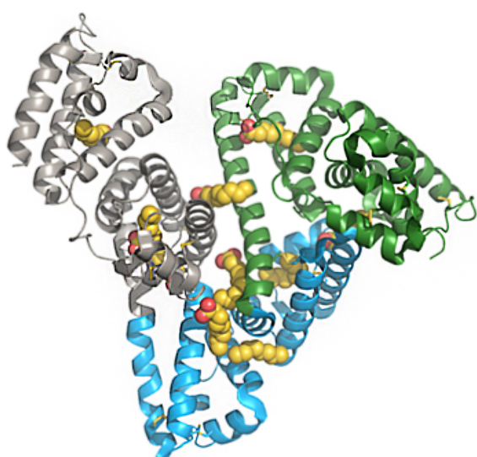
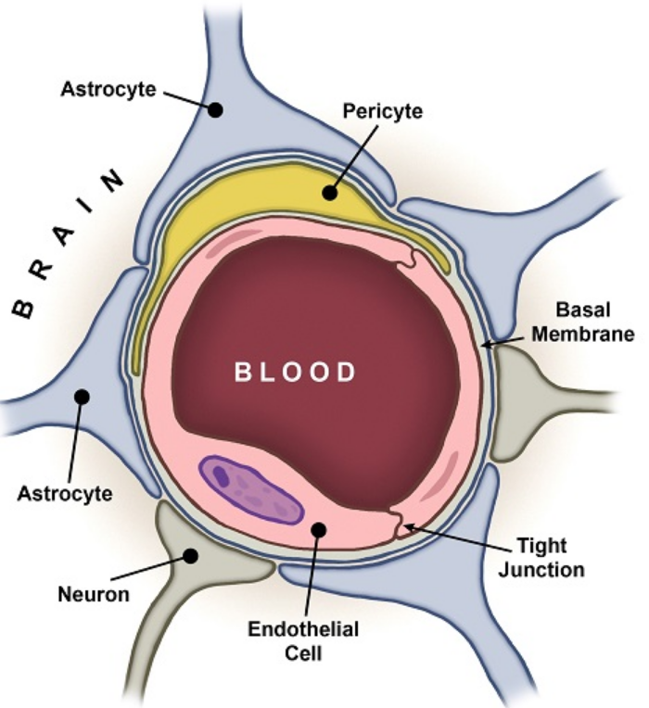
VARIABLES THAT AFFECT DISRIBUTION
Adequacy of blood circulation
E.g. Rapid distribution of drugs through heart, liver and kidney
Source: Knudsen& Lau, 2019; Elsevier
Protein Binding
especially
Albumin
Source: http://www.cbtddc.org/news/blog-bbb.aspx
Blood Brain Barrier

Slide 11
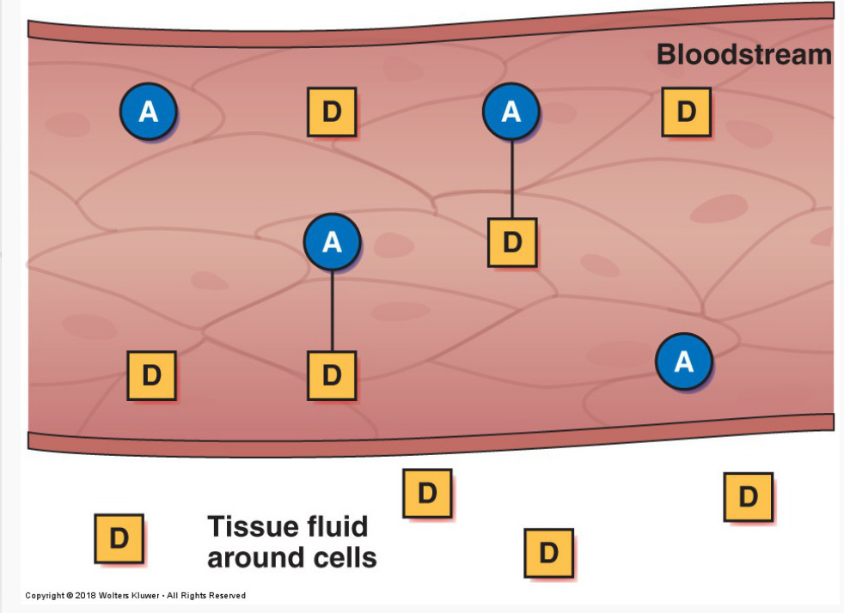
PHARMACOKINETICS: DISTRIBUTION: ALBUMIN & PROTEIN BINDING
Plasma proteins, mainly albumin (A), act as carriers for drug molecules (D). Bound drug (A–D) stays in the bloodstream and is pharmacologically inactive. Free drug (D) can leave the bloodstream and act on body cells.
Albumin decreases with
Age
Liver disease
Poor nutritional status

Slide 12
PHARMACOKINETICS:DISTRIBUTION: ALBUMIN & PROTEIN BINDING
Protein binding helps to store the drugs and release as needed
Generally stored in muscles and fat
This storage mechanism helps:
Maintain consistent drug levels in blood
Decreases the risk of drug toxicity
Some drugs are highly protein bound
Longer duration of action
Drugs can compete for albumin binding sites
100 molecules of Drug A: 80% are bound if no other substance is present
100 molecules of Drug B: 80% are bound if no other substance is present
If you give Drug A and Drug B together:
They will compete for sites on Albumin and neither will be 80% bound

Slide 13
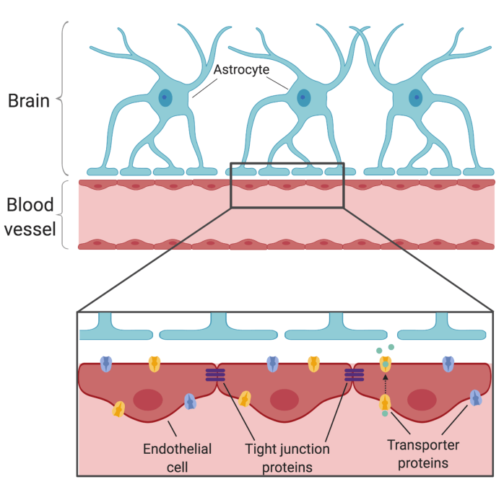
PHARMACOKINETICS: DISTRIBUTION: Blood-Brain Barrier
Capillaries with tight walls limit the movement of drug molecules into brain tissues
Only drugs that are lipid soluble or have a transport system can cross to a significant degree
Significant obstacle to therapy (especially chemotherapy)
Protects the brain from potentially toxic substances
Unique anatomy of
capillaries in the central
nervous system (CNS)

Slide 14
PHARMACOKINETICS: METABOLISM
Inactivation: An active drug is changed to inactive metabolites
Drugs can be transformed into
Active metabolites from an active drug
Prodrug: Activation of an inactive drug
Notes:
Metabolism is the process by which drugs are chemically altered to make them sufficiently water-soluble for excretion in urine or faeces (via the biliary tract). Metabolites = products of metabolism
Prodrug = when it is administered, it is in the inactive form. Body converts to an active form later

Slide 15
PHARMACOKINETICS: ENZYMATIC ALTERATION IN METABOLISM

Slide 16
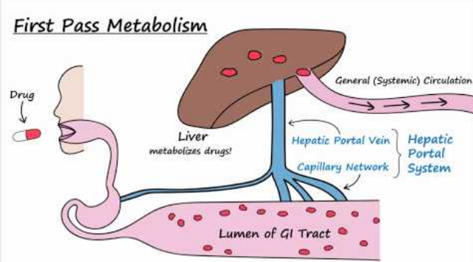
PHARMACOKINETICS: First –pass effect/pre-systemic metabolism
PO Medications reach the GI tract and then taken through liver via portal circulation
The drug is extensively metabolized in the liver
Only a fraction of the dose is available for distribution
Source: https://www.dideo.ir/v/yt/BQQns7RAUzA/bioavailability-and-first-pass-metabolism
?list=PLD38Ngpf5XH-GR9Yi4149PUoGUDpwKo7-
So, what is the solution to avoid first pass effect?

Slide 17
PHARMACOKINETICS: Factors Affect Metabolism
Age
Genetics
Nutritional status
Low protein diet
Hepatic disorders
What are the teaching points to maintain a normal metabolism of drugs?

Slide 18
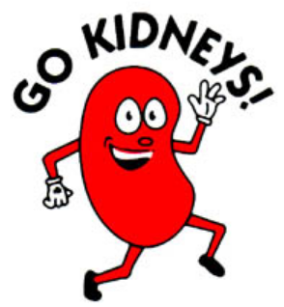
PHARMACOKINETICS: EXCRETION
The process by which drugs and metabolites are eliminated from the body. Primarily in the kidneys
Requires Adequate Organ Function (Heart, Kidneys, GI Tract, Lungs & Skin)
Lab Values: BUN, Creatinine, GFR

Slide 19
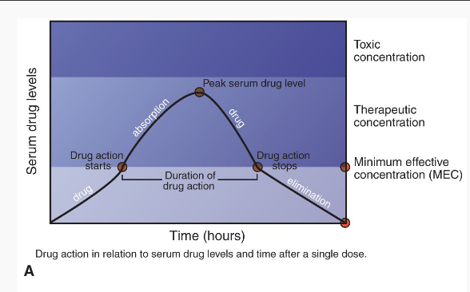
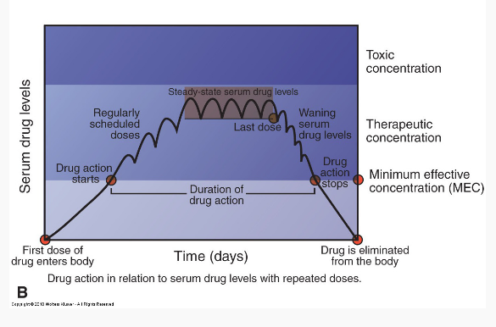
SERUM DRUG LEVELS
Amount of drug in the blood at a particular time

Slide 20
SERUM DRUG
LEVELS
1
Minimum Effective Concentration (MEC)
The required amount of the serum drug level that must be present for the medication to be effective
2
Toxic Concentration
Excessive Drug levels in the blood stream
3
Desired response with no toxicity
Goal is to maintain drug levels in this concentration
Therapeutic Concentration

Slide 21
PEAK & TROUGH LEVELS
1
Peak Concentration
Highest serum level
Keep below toxic concentration
2
Lowest serum level reached by a drug before the next dose
Normal Trough Level: keep above or near MEC
Trough Concentration
Minimize fluctuations by keeping dosing consistent
Draw Serum Drug Levels:
Peak: After dose given at peak of action (b/w 30-60mts after the drug)
Trough: Right before (30 minutes) dose given
3
Implications

Slide 22
Peak & Trough Clinical Implications
A patient is receiving Vancomycin 1500mg IVPB every 12 hourly. There is an order to collect Vancomycin trough after the third dose, but 30 minutes prior to the 4th dose. The RN send the blood.
Vancomycin Trough Normal level = 5-15 mcg/ml
Patient value = 25 mcg/ml
What does this indicate?
What needs to be done?

Slide 23
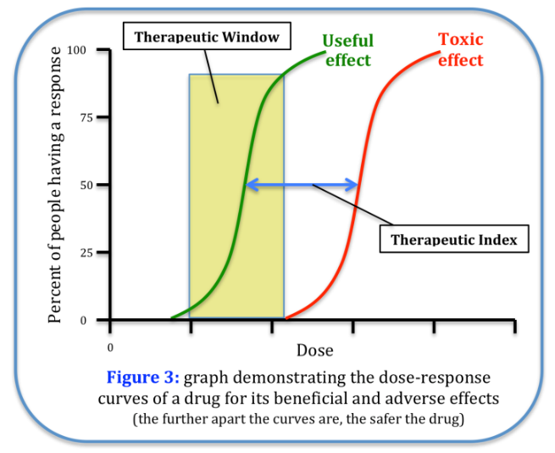
Therapeutic Index
Measure of the relative safety of the drug
Toxic dose: The dose that is toxic in 50% of lab animals tested
Effective dose: The dose that is required to produce a therapeutic effect in 50% of a similar population
Drugs with a low therapeutic index require close monitoring
E.g. Digoxin, Lithium, Warfarin
Source: https://bcore.brighamandwomens.org/wp-content/uploads/2018/06/BCORE-Important-Nomenclature.pdf

Slide 24
Half-Life
Half-life: Time needed for the drug’s serum concentration to decrease by 50% or the amount of time it takes a drug to reach ½ of its original concentration in plasma
Determined by rate of metabolism & Excretion
Implications:
Shorter half-life: More frequent dosing
Long half -life: Less frequent dosing
May be prolonged in patient’s with hepatic or renal dysfunction
Notes:
Half life of amiodarone = 10 days; NTG = 1-4 minutes

Slide 25
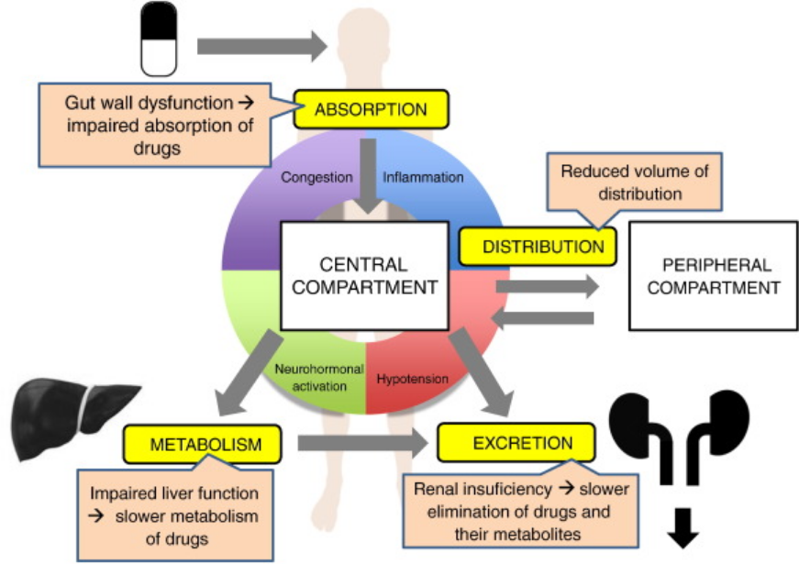
PHARMACOKINETCS OF DRUGS IN IMPAIRED BODY FUNCTION
Source:Lainscak, M., Vitale, C., Seferovic, P., Spoletini, I., Cvan Trobec, K., & Rosano, G. M. (2016). Pharmacokinetics and pharmacodynamics of cardiovascular drugs in chronic heart failure. International journal of cardiology, 224, 191–198. https://doi.org/10.1016/j.ijcard.2016.09.015

Slide 26
PHARMACOKINETICS: EXAMPLE FROM BOOK
Warfarin (Coumadin): Pharmacokinetics
“Warfarin is well absorbed after oral administration. Administration with food may delay the rate but not the extent of absorption. The drug is highly bound to plasma proteins (98%), mainly albumin. Metabolism takes place in the liver. Excretion, primarily as inactive metabolites, occurs in the kidneys. Renal impairment does not affect drug metabolism but may decrease excretion of the drug.”
Source: Abrams’ Book

Slide 27
PHARMACODYNAMICS

Slide 28
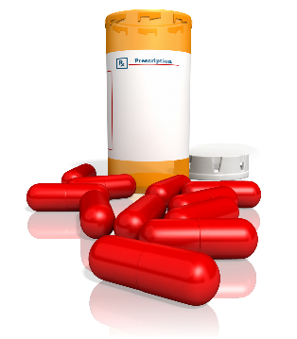
Pharmacodynamics
The study of biochemical and physiologic
effects of the drugs
Target organ
Receptor
Mechanism of action
Physiologic effect/
Therapeutic effect
Adverse effect
Dose-Response
What a drug does to the body

Slide 29
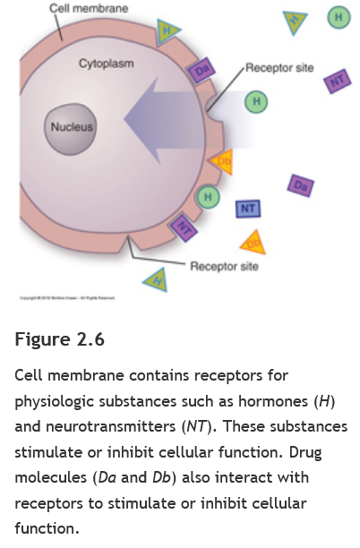
Pharmacodynamics
Receptor: Reactive cellular site where a drug interacts to produce a pharmacologic response
Key in a lock
Mechanism of Action (MOA): The process by which the drug causes an effect to happen
Dose- Response: The association between a drug’s concentration and an effect
Magnitude of the effect of a drug in relation to the dose (very low to very high)

Slide 30
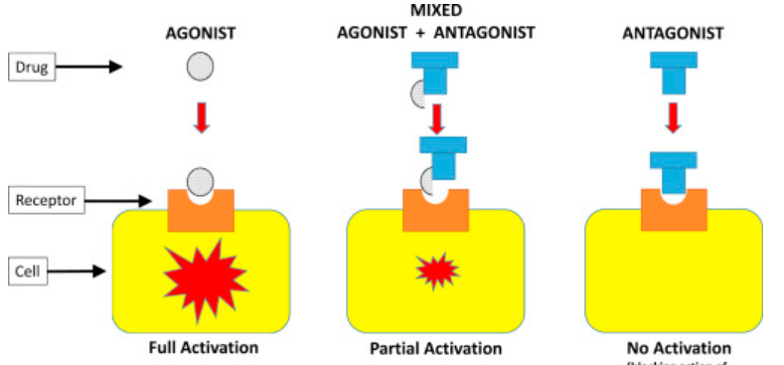
PHARMACODYNAMICS: Drug - Receptors
Agonists = naturally occurring substances (favors drugs)
Antagonists (opposes drugs)
Mixed
Source: Hormones, Brain and Behavior (Third Edition), 2017

Slide 31
References
Source: Simmer & Miller, 2018

Slide 33
PHARMACODYNAMICS: Drug –Drug interactions
Occur when the effects of one drug are affected by prior or concurrent administration of another drug
Can increase the therapeutic or adverse effects of the drugs
Many are of minor importance and do not require interventions
Some can be life-threatening
Risk increases with the number of medications taken
Antidote: Given to counteract the toxic effects of another drug.
E.g. Naloxone for Opioid overdose
Notes:
Diflucan increases the adverse effect of Coumadin and patient may bleed

Slide 34
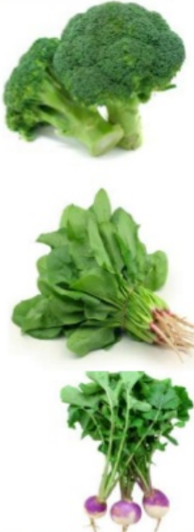
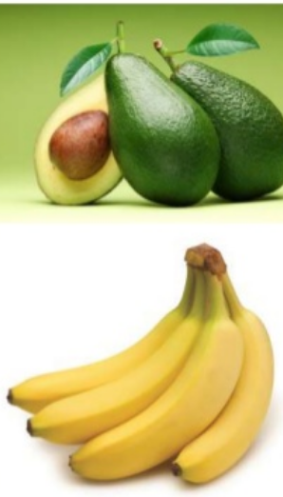
PHARMACODYNAMICS: Drug-Diet Interaction
Vitamin K rich foods
Antagonizes (opposes) the action of Warfarin
Interacts with ARBs & ACE Inhibitors
K rich Foods
Tyramine rich foods (Aged Cheese & Wine) interacts with Monoamine oxidase inhibitors

Slide 35
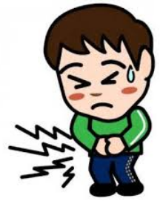
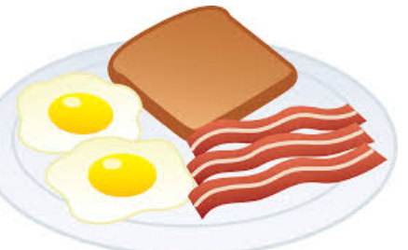
DRUG ADMINISTRATION TIMING (PO Meds)
Review drug administration guidelines
Many drugs can cause GI upset when taken without food
“On empty stomach” means to administer 1 hour before or 2 hours after a meal
“With food” means to administer with or shorty after meals
Source:https://www.medidose.com/

Slide 36
PHARMACODYNAMICS: ADVERSE EFFECTS/SIDE EFFECTS
Often predictable
Often unavoidable secondary effect produced by a drug at usual therapeutic doses
Black box Warning = serious injury or death
Most Common: N/V/D, Anorexia, drowsiness, dizziness, GI upset, constipation
Source: https://drugopinions.wordpress.com/2018/02/12/black-box-warning-what-do-i-need-to-know/

Slide 37
TYPES OF ADVERSE REACTIONS
Toxicity – Adverse drug reaction d/t excessive dosing
Allergic reaction – Immune response
Idiosyncratic effect – Uncommon drug response resulting from a genetic predisposition
Iatrogenic Disease – Adverse effect caused by drug or medical treatment
Physical Dependence – Can develop with long-term use of certain medications. Withdrawal symptoms can cause physical harm.
Carcinogenic effect – Ability of drugs to cause cancer
Teratogenic effect – Drug –induced birth defect
Notes:
SJS - antiepilepetics

Slide 38
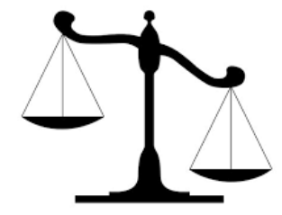
PRECAUTION & CONTRAINDICATION
Precaution: Measures taken to prevent the known harm of a medication
Contraindication: A drug is contraindicated if the risk associated with the drug is higher compared to its therapeutic benefits. Only the known risks can be the reason for contraindication
Risk
Benefit
Source: https://www.fda.gov/files/drugs/published/Warnings-and-Precautions--Contraindications--and-Boxed-Warning-Sections-of-Labeling-for-Human-Prescription-Drug-and-Biological-Products-%E2%80%94-Content-and-Format.pdf
Notes:
Correct : b

Slide 39
PHARMACODYNAMICS: EXAMPLE FROM BOOK
Warfarin
Action:
“Warfarin acts in the liver to prevent synthesis of vitamin K–dependent clotting factors (i.e., factors II, VII, IX, and X). Similar to vitamin K in structure, warfarin therefore acts as a competitive antagonist to hepatic use of vitamin K. Conversely, vitamin K serves as the antidote for warfarin. Warfarin has no effect on circulating clotting factors or on platelet function, so the anticoagulant effects do not occur for 3 to 5 days after warfarin is started because clotting factors already in the blood follow their normal pathway of elimination.”
Adverse Effects
“The primary adverse effect associated with warfarin therapy is hemorrhage. Additionally, nausea, vomiting, abdominal pain, alopecia, urticaria, dizziness, and joint or muscle pain may occur.”
Contraindications:
“Contraindications to warfarin include GI ulcerations, blood disorders associated with bleeding, severe kidney or liver disease, severe hypertension, and recent surgery of the eye, spinal cord, or brain.”
Source: Abrams’ Book
Notes:
Correct : b

Slide 40
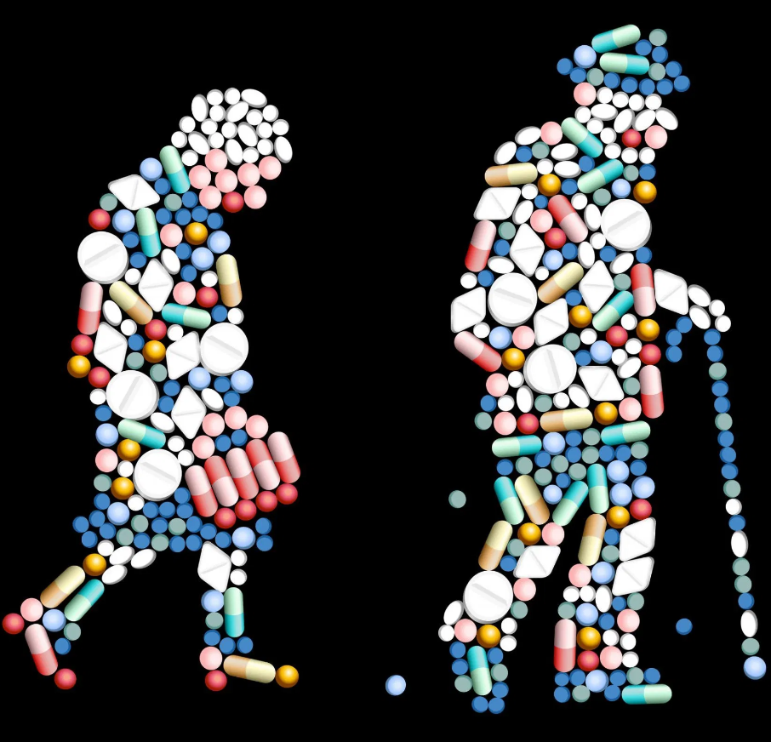
Drug Therapy in Older Adults
What is the evidence?
Elderly (>65): 44% of men & 57% women
36% older US adults are on ≥ 5 prescription medications
67% of older US adults on ≥ 5 prescription medications +over the counter medication + Supplements
Source:https://ajp.com.au/news/recommended-an-expert-pharmacist-presence/

Slide 41
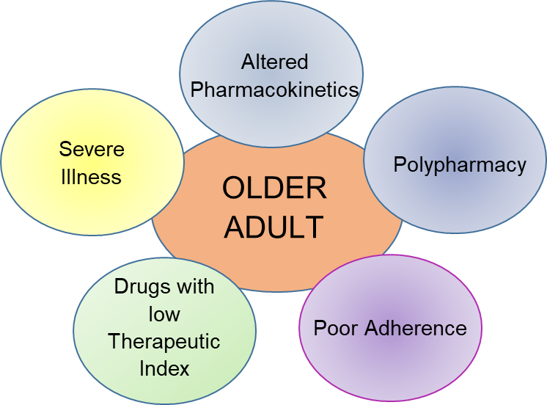
Drug Therapy in Older Adults
May experience more adverse reaction & drug-drug interactions
Slow rate of absorption
Decreased gastric function
Absorption
Altered body fat
Decreased total body water
Decreased serum albumin
Distribution
↓ hepatic metabolism
Half-lives may increase
Responses may be prolonged
Metabolism
Decreased renal function
Excretion

Slide 42
Drug Therapy in Older Adults
Goals of treatment: Reduce symptoms and improve quality of life
Individualization is essential
Require monitoring for desired and adverse responses
Assess regimen compliance
Beer’s List
Page 77-82, Chapter 5 in Abrams’ Text
Potentially inappropriate medications used by the older adults; American Geriatric Society updates it every 3 year

Slide 43
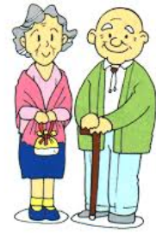
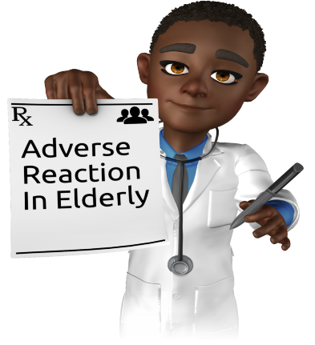
Adverse Drug Reaction in Older Adults
Adverse Drug Reaction in Elderly Implications
Click mouse to advance arrow numbers
1
Obtain through drug history
2
Consider age related pharmacokinetic changes
Significant cause of hospitalization & medication related deaths
Symptoms may be non-specific
Dizziness, cognitive impairment
3
Monitor clinical response & serum drug levels
4
Advocate for simple drug regimen as possible
5
Assess for barriers to drug compliance
6
Avoid drugs on Beers list

Slide 44
ETHNICITY & SEX CONSIDERATIONS IN DRUG THERAPY
Historically drug development focused on data from White men
Interethnic variations observed in drug responses
African Americans – In general, Diuretics & Calcium channel blockers are more effective for BP management than ACE inhibitors & Beta blockers
In general, Asian descendants require smaller doses of Beta blockers & antipsychotics
Women
Women may respond well to certain antidepressants
Hormonal fluctuations during menstrual cycle affect drug therapy
Better pain relief from Opioid analgesics
More likely to experience adverse drug effects

Slide 45
Question 1
A nursing student was reviewing the medical history of a patient. The student found the medical diagnosis of “Idiopathic Thrombocytopenic Purpura” in the medical record. The student needs to infer based on the term “idiopathic” that:
The condition is caused by an unknown cause
The condition is caused by a degenerative cause
The condition is caused by a metabolic cause
The condition is caused by a developmental cause

Slide 46
Question 2
A nursing student was reviewing the content about controlled substances. Which of the following conclusion of the controlled substance by the nursing student is correct?
Controlled substances are available as over the counter medications
Controlled substances are only regulated by Title II controlled substances act
Controlled substances are stored in locked containers and proper documentation is required
All the controlled substances are accepted for medical use
Notes:
A = not available; b = both Title II controlled substances act and DEF
D = only schedule II, III, IV and V are accepted

Slide 47
QUESTION 3
A 50 year old patient is admitted to the Medicine floor. On assessment, the patient’s BP was 165/95mm of Hg. The provider ordered an antihypertensive medication. Which action by the nurse is part of the planning stage of the nursing process?
Monitoring the patient for drug interactions after giving the medication
Obtaining a medication history when the patient is admitted to the unit
Teach the patient about orthostatic hypotension
Check the blood pressure prior to administering medications

Slide 48
Question 4: Examples
The patient’s temperature is 101 degree F. The RN administered Tylenol 650mg by mouth. How will you assess the therapeutic effect of this medication?
A patient complained of diarrhea ( 6 loose stools within 4 hours). The RN administered an antidiarrheal medication per provider order. How will you assess the therapeutic response of the antidiarrheal medication?
3. A patient’s hemoglobin level was 10mg/dl. The provider prescribed iron tablets. How will you assess the therapeutic effects of iron tablets?

Slide 49
Question 5
A nursing student was reviewing the term pharmacokinetics. Which of the following statements of the nursing student is correct regarding pharmacokinetics? Select All That Apply
Pharmacokinetics means what the body does to the drugs
Pharmacokinetics means what a drug does to the body
Pharmacokinetics covers mechanism of action, therapeutic effect and adverse effect of a medication
Pharmacokinetics covers absorption, distribution, metabolism and excretion of a medication
Pharmacokinetics focuses on agonist, antagonist and mixed drug receptors
Pharmacokinetics is being influenced by age, genetics, ethnicity & comorbidities

Slide 50
Question 6
A nursing student was reviewing the term pharmacokinetics properties of Medication A. The student found that Medication A is highly protein bound. This means that
Medication A has shorter duration of action
Medication A has longer duration of action
Medication A has increased risk of drug toxicity
Medication A has potential for abuse

Slide 51
Question 7
A nurse was caring for a patient who has worsening kidney disease. The nurse needs to understand that a patient with kidney disease may have impaired drug
Absorption
Distribution
Excretion
Receptors

Slide 52
Question 8
A nurse was caring for an 85 year old patient admitted with congestive heart failure. The nurse needs to understand that this patient may experience more adverse reaction and drug-drug interactions due to
Altered cell receptors
Altered pharmacokinetics
Altered blood brain barrier
Altered first pass effect

Slide 53
Study Tips
Listen to voice threads; just reviewing the power point is not enough
Look at the objectives for each week and make sure that you are thorough with the addressed concepts
Review practice questions on page 7 & 20, 83, & 85 in Abram’s Book
Practice makes a man Perfect: Additional questions in HESI
Notes:
Correct : b

Slide 54
REFERENCE
Qato, D. M., Wilder, J., Schumm, L. P., Gillet, V., & Alexander, G. C. (2016). Changes in Prescription and Over-the-Counter Medication and Dietary Supplement Use Among Older Adults in the United States, 2005 vs 2011. JAMA internal medicine, 176(4), 473–482. https://doi.org/10.1001/jamainternmed.2015.8581
Cureatr. (2021). Polypharmacy in Older Adults: Statistics That Help Tell the Story. https://blog.cureatr.com/polypharmacy-in-older-adults-statistics-that-help-tell-the-story
https://www.fda.gov/drugs/drug-interactions-labeling/preventable-adverse-drug-reactions-focus-drug-interactions
Lainscak, M., Vitale, C., Seferovic, P., Spoletini, I., Cvan Trobec, K., & Rosano, G. M. (2016). Pharmacokinetics and pharmacodynamics of cardiovascular drugs in chronic heart failure. International journal of cardiology, 224, 191–198. https://doi.org/10.1016/j.ijcard.2016.09.015

Slide 55
THANK YOU
Source: Clipartlibrary
Notes:
Correct : b

