Slide 1
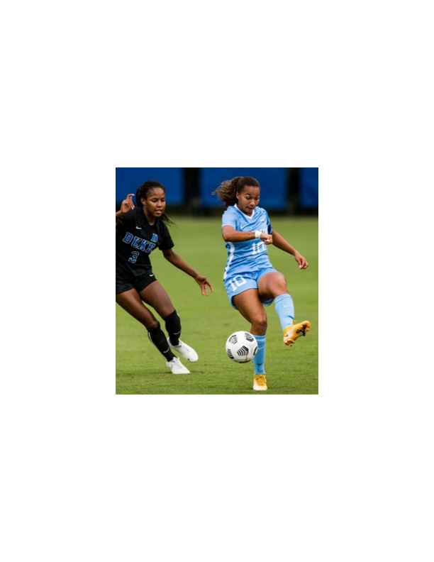
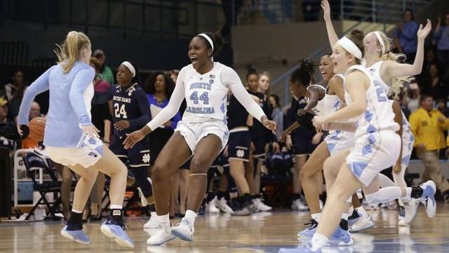
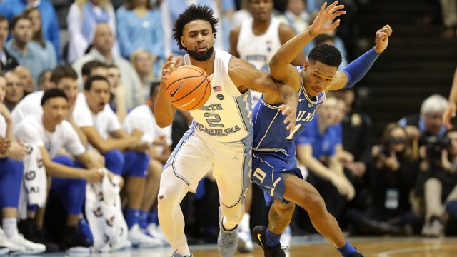
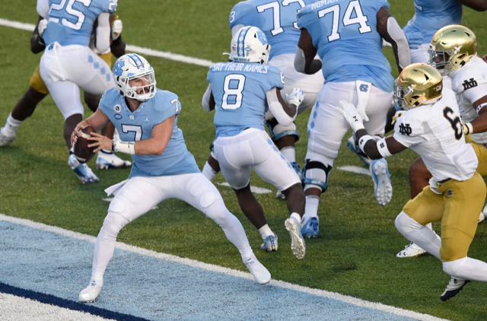
Body text goes here.
SUBHEAD
The GAME within a Game!
Bulleted text here.
Bulleted text here.
Bulleted text here.
COMP 523 UNC
December 8, 2021
H Taylor Walls
Founder/Chief Executive Athlete

Slide 2
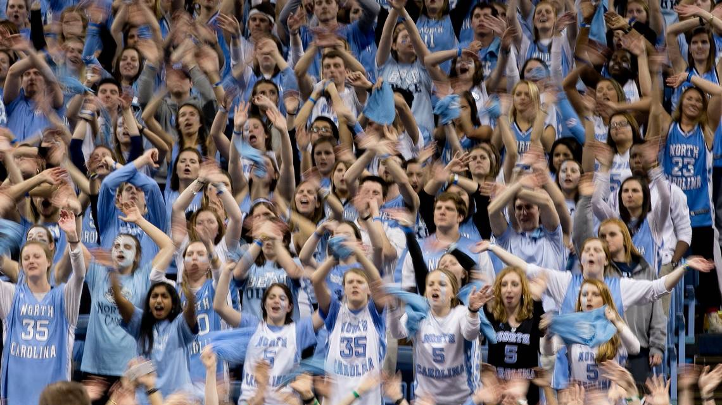
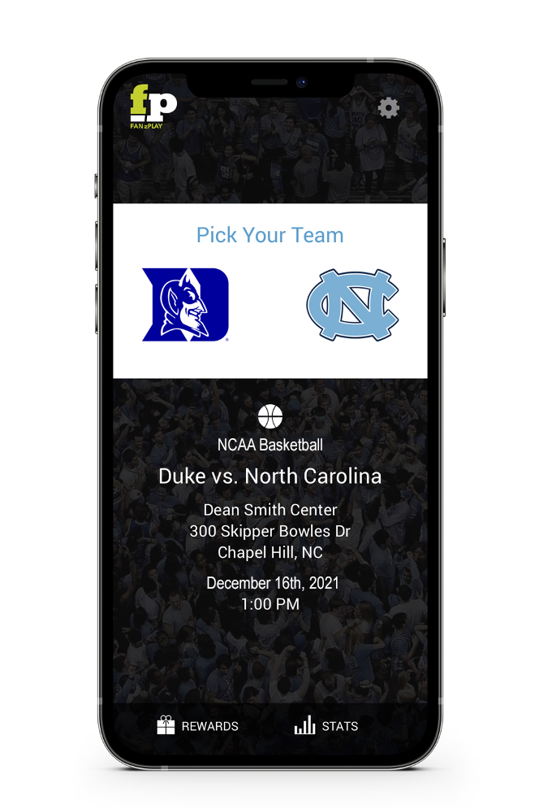
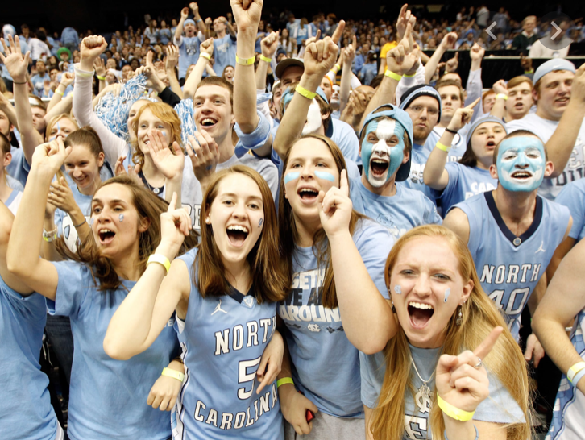
Biggest Rivalries in Sports | Live on Game Day

Slide 3
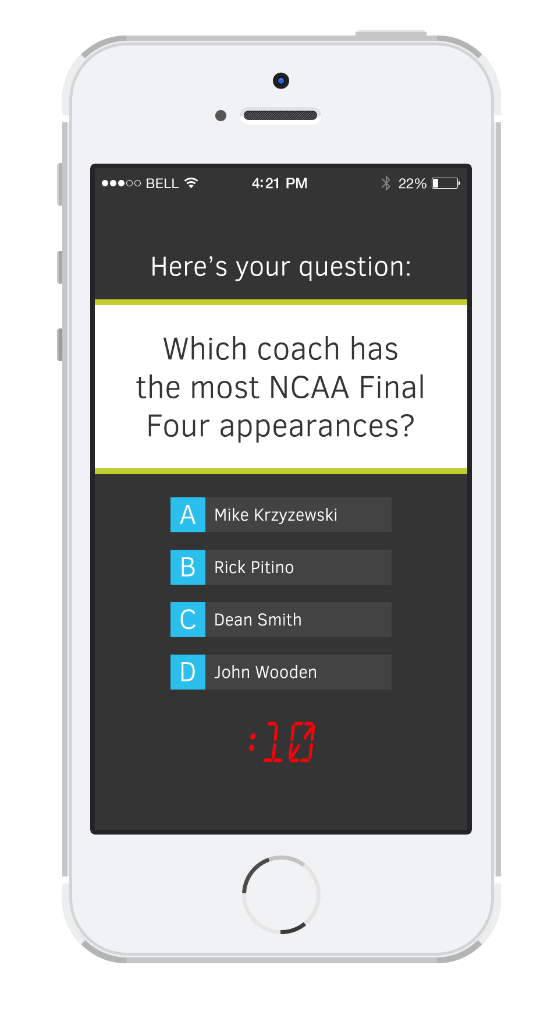
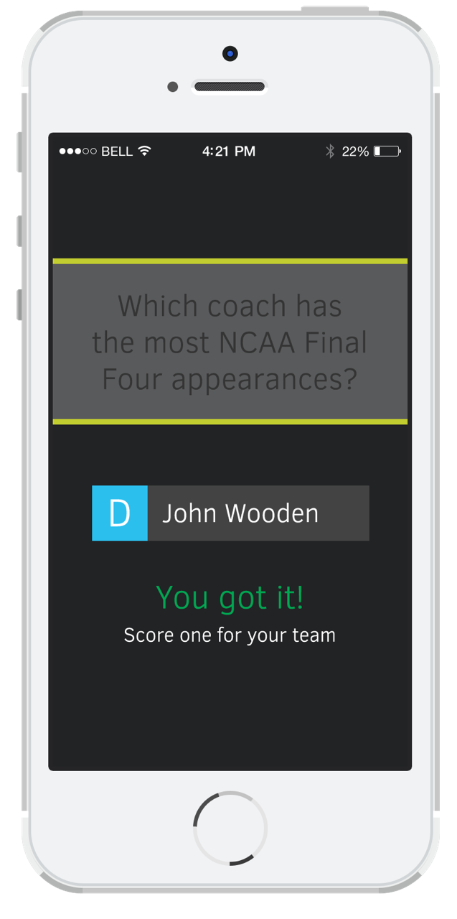
FANs versus FANs…Bragging Rights!
Body text goes here.
SUBHEAD
Bulleted text here.
Bulleted text here.
Bulleted text here.

Slide 4
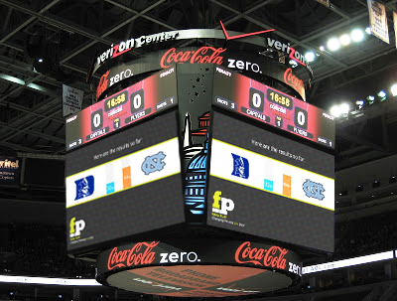
Biggest Rivalries in Sports | Live on Game Day

Slide 5
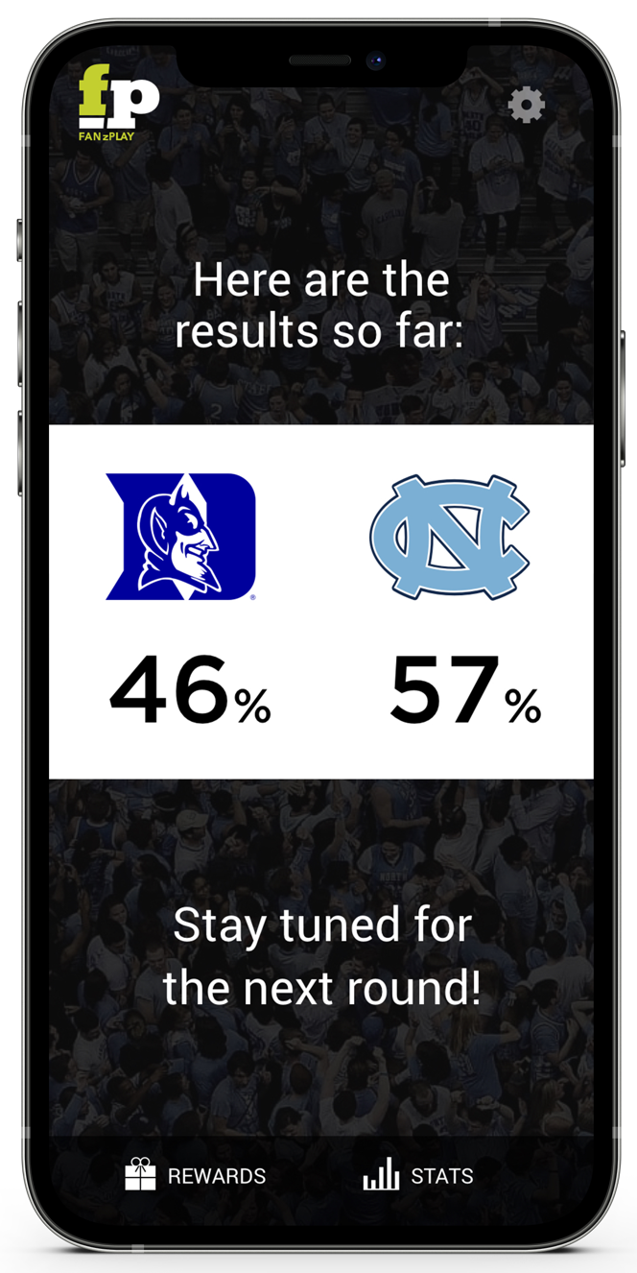
Biggest Rivalries in Sports | Live on Game Day
40,000 Fans
In the Arena
4,200,000 Fans
Outside the Arena

Slide 6
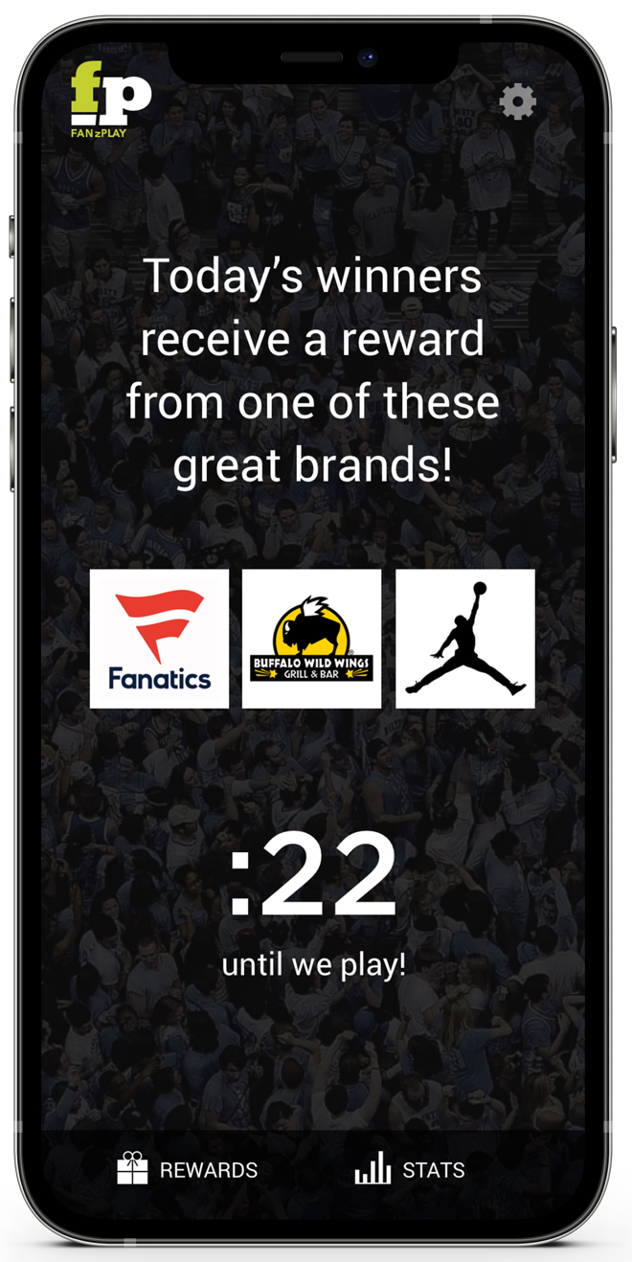
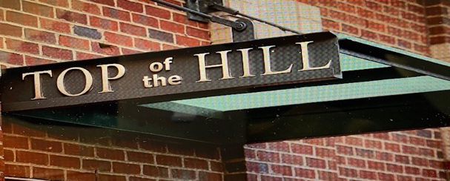
Biggest Rivalries in Sports | Live on Game Day
$73
Billion
National Sponsors
Local Supporters

Slide 7
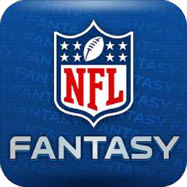
Real-Time Competition | No Gamble | No Fantasy
Live Game Competition
Team/Fan Brand Appeal
Fan Experience
Sponsor Benefits
Overall ROI
Live with you on game day

Slide 8
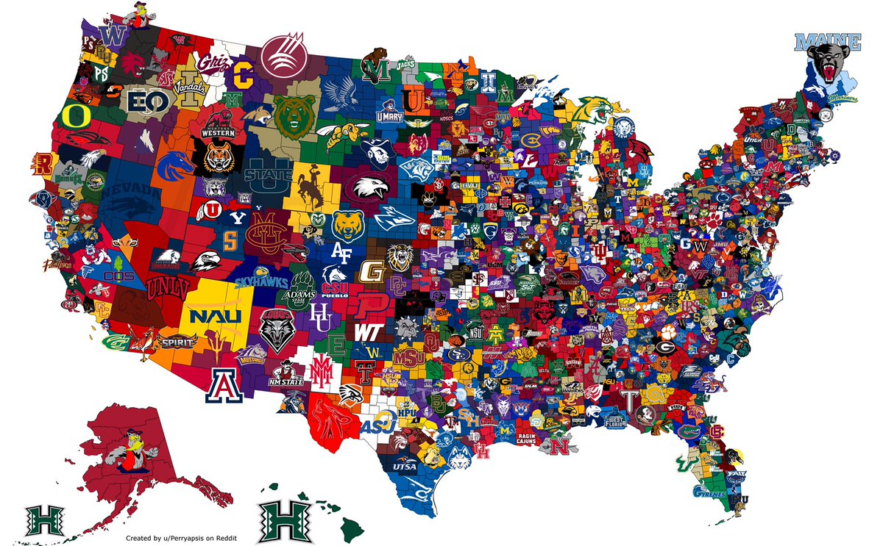
Real-Time Competition | No Gamble | No Fantasy

Slide 9
Legal
Social Media Marketing
Sports/Entertainment
Technology
Forward Thinkers
Powered by The DREAM TEAM
UNC Duke image from https://thedurham.com

Slide 11
Would You Play?
Taylor Walls, Founder and Chief Executive Athlete
htaylorwalls@gmail.com

