Slide 1
Software and System Testing
(adapted from Diane Pozefsky)

Slide 2
Why Do We Care?
EPIC SOFTWARE FAILS

Slide 3
Why do we care?
Therac-25 (1985)
  6 massive radiation overdoses
Multiple space fiascos (1990s)
  Ariane V exploded after 40 seconds (conversion)
  Mars Pathfinder computer kept turning itself off (system timing)
  Patriot missile misquided (floating point accuracy)
Millenium bug (2000)
Microsoft attacks (ongoing)
NIST: cost to US, $59 billion (2002)

Slide 4
Quality and testing
“Errors should be found and fixed as close to their place of origin as possible.” Fagan
“Trying to improve quality by increasing testing is like trying to lose weight by weighing yourself more often.” McConnell
http://www.unc.edu/~stotts/comp523/quotes.html

Slide 5
Types of Testing
For Different Purposes
Testing (functional, unit, integration)
Usability testing
Acceptance testing
Performance testing
Reliability testing
Conformance testing (standards)
…

Slide 6
Other classifications
Scope
  Unit, component, system, regression, …
Time
  After design/coding
  Before (test-driven development, agile)
  During… ongoing
Code visibility
  Black box: code treated as input/output function and no use of code structure is used (programming by contract)
  White box: code structure is used to determine test cases and coverage

Slide 7
How important is unit test?
The Voyager bug (sent the probe into the sun).
‘90: The AT&T bug that took out 1/3 of US telephones (crash on receipt of crash notice).
  The DCS bug that took out the other 1/3 a few months later.
‘93: The Intel Pentium chip bug (it was software, not hardware).
‘96: The Ariane V bug: auto-destruct (data conversion).

Slide 8
What are you trying to test?
Basic Functionality?
many techniques
Most common actions?
Cleanroom (Harlan Mills)
Most likely problem areas?
Risk-based testing

Slide 9
Risks
Identify criteria of concern: availability, quality, performance, …
Risk of it not being met
    likelihood
    consequences
If I’m testing code for a grocery store, what is the impact of the code failing (or down)?
What about missile guidance?
What about nuclear power plant control?

Slide 10
Mills: Cleanroom
Test based on likelihood of user input
User profile: study users, determine most probable input actions and data values
Test randomly, drawing data values from the distribution (see monkey testing)
Means most likely inputs occur more often in testing
Finds errors most likely to happen during user executions

Slide 11
How to identify what to test
New features
New technology
Overworked developers
Regression
Dependencies
Complexity
Bug history
Language specific bugs
Environment changes
Late changes
Slipped in “pet” features
Ambiguity
Changing requirements
Bad publicity
Liability
Learning curve
Criticality
Popularity

Slide 12
Four Parts of Testing
Model (“oracle”)
Select test cases
Execute test cases
Measure

Slide 13
Basic Software Model
User interfaces
APIs
Operating system
Files
environment
capabilities
Input
Output
Storage
Processing

Slide 14
Test Case Selection
Environments
  What happens if a file changes out from under you?
  Consider all error cases from system calls
    (e.g., you can’t get memory)
  Test on different platforms: software and hardware
  Test on different versions and with different languages

Slide 15
Test Case Selection
Capabilities
  Inputs (boundary conditions, equivalence classes)
  Outputs (can I generate a bad output?)
  States (reverse state exploration)
  Processing

Slide 16
From the User Interface: Inputs
Error messages
Default values
Character sets and data types
Overflow input buffers
Input interactions
Repeated inputs
Unlikely inputs
How easy is it to find bugs in Word?

Slide 17
Questions to Ask for Each Test
How will this test find a defect?
What kind of defect?
How powerful is this test against that type of defect? Are there more powerful ones?

Slide 18
Testing Practices (Boris Beizer)
Unit testing to 100% coverage: necessary but not sufficient for new or changed
Integration testing: at every step; not once
System testing: AFTER unit and integration testing
Testing to requirements: test to end users AND internal users
Test execution automation: not all tests can be automated
Test design automation: implies building a model. Use only if you can manage the many tests

Slide 19
Testing Practices (Boris Beizer)
Stress testing: only need to do it at the start of testing. Runs itself out
Regression testing: needs to be automated and frequent
Reliability testing: not always applicable. statistics skills required
Performance testing: need to consider payoff
Independent test groups: not for unit and integration testing
Usability testing: only useful if done early
Beta testing: not instead of in-house testing

Slide 20
Usability Testing

Slide 21
Usability Testing
Frequency with which the problem occurs
    Common or rare?
Impact of the problem if it occurs
    Easy or difficult to overcome?
Persistence of the problem
    One-time problem or repeated?

Slide 22
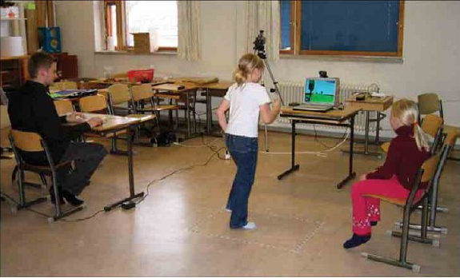
Wizard of Oz Testing
Inputs and outputs are as expected
How you get between the two is “anything that works”
Particularly useful when you have
  An internal interface
  Choices to make on user interfaces
Children’s Intuitive Gestures in Vision-Based Action Games
CACM Jan 2005, vol. 48, no. 1, p. 47

Slide 23
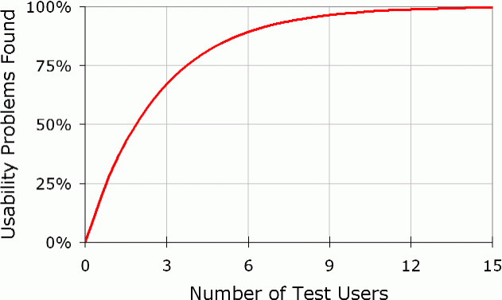
# Usability Test Users Needed
Usability problems found = N(1-(1-L)^{n})
N = total number of usability problems in the design
L = proportion of usability problems discovered by a single user
n = number of users
L=31%

Slide 24
Using as an Estimator
Found 100 problems with 10 users
Assumption: each user find 10% of problems
How many are left?
found = N(1-(1-L)^{n})
  100 = N(1-(1-.1)¹⁰)
  N = 100/(1-.9¹⁰)=154
54 left

Slide 25
Test Measurements

Slide 26
Test Coverage Metrics
Statement coverage
  Basic block coverage, or edges in control flow graph
Decision coverage (branch coverage)
  Each sense of each Boolean expression
Condition coverage
  Each entity varied in each Boolean expressions
Path coverage
  Loops, branch combinations
  Impractical, N items can have 2^N different paths
These are “white box” methods

Slide 27
Statement/Block Coverage
A
A
x=9
x=2
x=9
x>5
x>5
Bt
Bf
Bt
C
C

Slide 28
Decision Coverage
A
A
x=9
x=2
x=9
x=2
x>5
x>5
Bt
Bf
Bt
C
C

Slide 29
Condition Coverage
A
x=9, y=20
Bt
Ct
x>5 &&
y <100
x<20 &&
y >10
D
Bf
Cf
x=2, y=20

Slide 30
Path Coverage
A
x=9, y=20
Bt
Ct
x>5 &&
y <100
x<20 &&
y >10
D
Bf
Cf
x=2, y=20

Slide 31
Estimating how many bugs are left
Historical data
Capture-recapture model

Slide 32
Historical Data
Lots of variants based on statistical modeling
What data should be kept?
When are releases comparable?
Dangers with a good release
  Test forever
  Adversarial relation between developers and tester
Dangers with a bad release
  Stop too soon

Slide 33
Capture-recapture model
Estimate animal populations: How many deer in the forest?
    Tag and recount
    If all tagged, assume you’ve seen them all
Applied to software by Basin in 73
Number of errors = |e₁| * |e₂| / |e₁ ∩ e₂ |
      where e_{n} = errors found by tester n
  2 testers: 25, 27, 12 overlap: 56 total errors
What’s wrong with this model (aside from the fact the denominator can be 0)?
  Assumptions about independence of testers

Slide 34
Error “seeding”
Also called mutation testing
Deliberately put errors into code
Testing finds the seeded errors as well as one put there by developers
Percentage of seeded errors found is related to percentage of “normal” errors found

Slide 35
Test Tools

Slide 36
Unit Test
What do they do?
  Regression testing framework
  Incrementally build test suites
  Typically language specific
What is available?
  JUnit most well known (Java)
  SUnit was the first (Smalltalk)
  xUnit where x is most every language known
  Eclipse has unit test plugins for many languages
  http://en.wikipedia.org/wiki/List_of_unit_testing_frameworks

Slide 37
Regression Test
Automated
Run with every build
Issues
  Time
  GUI based
Tools
  Wide range of capabilities and quality
  Avoid pixel-based tools
  Random vs. scripted testing
One list

Slide 38
Performance Test Tools
What do they do?
  Orchestrate test scripts
  Simulate heavy loads
  Check software for meeting non-functional requirements (speed, responsiveness, etc.)
What is available?
  JMeter
  Grinder

Slide 39
Stress Testing
A kind of performance testing
Determines the robustness of software by testing beyond the limits of normal operation
Particularly important for "mission critical" software, where failure has high costs
“stress” makes most sense for code with timing constraints… such as servers that are made to handle, say, 1000 requests per minute, etc.
Tests demonstrate robustness, availability, and error handling under a heavy load

Slide 40
Fuzz Testing, or Fuzzing
Involves providing invalid, unexpected, or random data as inputs of a program
Program is monitored for exceptions such as
    Crashes
    failing built-in code assertions
    memory leaks
Fuzzing is commonly used to test for security problems in software or computer systems

Slide 41
Other Test Tools
Tons of test tools
One starting point
    http://www.softwareqatest.com/qatweb1.html

Slide 42
Other Quality Improvers

Slide 43
Other Ways of Improving Quality
Static testing methods (vs. dynamic)
  Reviews and inspections
  Formal specification
  Program verification and validation
Self-checking (paranoid) code
Duplication, voting
Deploy with capabilities to repair

Slide 44
Formal Methods and Specifications
Mathematically-based techniques for describing system properties
Used in inference systems
  Do not require executing the program
  Proving something about the specification not already stated
  Formal proofs
  Mechanizable
  Examples: theorem provers and proof checkers

Slide 45
Uses of Specifications
Requirements analysis
  rigor
System design
  Decomposition, interfaces
Verification
  Specific sections
Documentation
System analysis and evaluation
  Reference point, uncovering bugs

Slide 46
Examples
Abstract data types
  Algebras, theories, and programs
  VDM (Praxis: UK Civil aviation display system CDIS), Z (Oxford and IBM: CICS), Larch (MIT)
Concurrent and distributed systems
  State or event sequences, transitions
  Hoare’s CSP, Transition axioms, Lamport’s Temporal Logic
Programming languages!

Slide 47
Self Checking Code
Exploit redundancy
Run multiple copies of the code, vote on critical results and decisions
Identifies erroneous system via its disageement
Develop functionally identical versions with different code compositions, different teams
Perhaps use different hardware hosts
Used on space shuttle

Slide 48
Self-Repairing Code
http://www.technologyreview.com/news/416036/software-that-fixes-itself/
http://www.tomsguide.com/us/darpa-self-healing-software,news-17761.html
http://venturebeat.com/2013/09/17/hp-launches-self-healing-computer-start-software/

Slide 49
References

Slide 50
References
Bugs
Therac-25: http://courses.cs.vt.edu/~cs3604/lib/Therac_25/Therac_1.html
Patriot missile: http://www.fas.org/spp/starwars/gao/im92026.htm
Ariane 5: http://www.esa.int/export/esaCP/Pr_33_1996_p_EN.html
Testing
  Whittaker, How to Break Software (presentation)

Slide 51
Life Testing
Used regularly in hardware
  Addresses “normal use”
n specimens put to test
Test until r failures have been observed
Choose n and r to obtain the desired statistical errors
As r and n increase, statistical errors decrease
Expected time in test = mu₀ (r / n)
  Where mu₀ = mean failure time

Slide 52
Butler and Finelli
“The Infeasibility of Experimental Quantification of Life-Critical Software Reliability” (1991)
In order to establish that the probability of failure of software is less than 10⁻⁹ in 10 hours, testing required with one computer is greater than 1 million years
http://naca.larc.nasa.gov/search.jsp?R=20040139297&qs=N%3D4294966788%2B4294724588%2B4294587118

