Slide 1

Security for Avionics Systems
By: Teryl Taylor

Slide 2
Agenda
The trouble with typical security paradigms
Rushby’s Solution.
Common Criteria
MILS Architecture
Integrity OS
Bell-La Padula Model for Security
Covert Channels

Slide 3
Security
Security is all about trust
  Can we trust the applications we are running?
  Can we trust the person on the other side of the computer?
Many applications weren’t/aren’t built with security in mind.
Systems are doing things they were never meant to do.

Slide 4
Security Kernel
Purpose: to isolate all security critical software in one place.
Prove kernel is secure.
Software applications become irrelevant to security.
Military Applications: unauthorized flow of info is unacceptable.
Security Kernel must enforce security policy on all apps and within itself.
Notes:
Purpose of a security kernel is to isolate and localize all ‘security critical’ software in one place – the kernel.

Slide 5
Problem with Conventional Security
System protects physical representation of data but not the information itself.
One Security Policy for the whole system:
  Problem? Different processes require different privileges.
  Solution? Trusted Processes – Breaks security policy… Bad idea…
Must verify the Kernel and the trusted processes.
Notes:
Once trusted processes are added to the system, the kernel is no longer the sole arbiter of security.
Need to ensure that the privileges of those trusted processes aren’t abused or usurped by other processes.
How do we know when to trust a process?

Slide 6
Single Security Policy
A single security policy does not work.
Policy must be particular to the function of each component.
Rushby wants:
“A system structure that allows each component to make its own contribution to the security of the overall system and that treats all contributions equally”
Notes:
You can’t elevate a process to a trusted level and then give it free reign of the system. This can cause inconveniences to the other processes within the system.
Once you start having a secure kernel and a trusted process all of a sudden there is no separation between the kernel and the process because they are no longer independent.

Slide 7

In other words…DTA
Don’t
Trust
Applications?
Notes:
We need to separate the properties of the application from the secure kernel

Slide 8
Distributed Security
Security does not rely on a single centralized mechanism.
Individual functions are provided by separate subsystems.
Only limited channels of communication with one another.
Simplifies security.
Notes:
The various functions in a distributed system are provided by specialized individual subsystems which are physically separated from each other and provided with only limited channels of communication with one another.
A lot of security issues vanish as a result.
The security problems here at at least less significant than in a system where everything runs together.

Slide 9

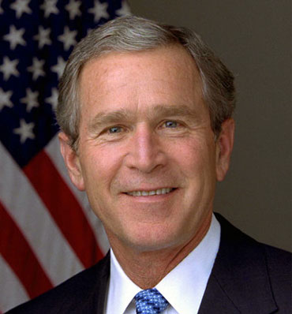
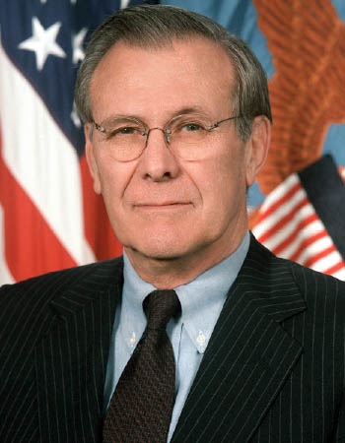
Example
File Server
Notes:
Files are the only means of information flow between users of different security classifications.
File Server, physical separation from the user.
Only need to enforce one security policy on the file server itself.
Users do not have direct access to one another.
Rest of security comes from the physical separation from the file system and the inability of the users to directly communicate with one another.

Slide 10
File Server in more detail
Only does one function.
Requires no user programming or operating system.
In order to guarantee the security of the whole system we only need to verify that the file server is secure.
Security properties are specific to the task – not a set of overall general properties.

Slide 11
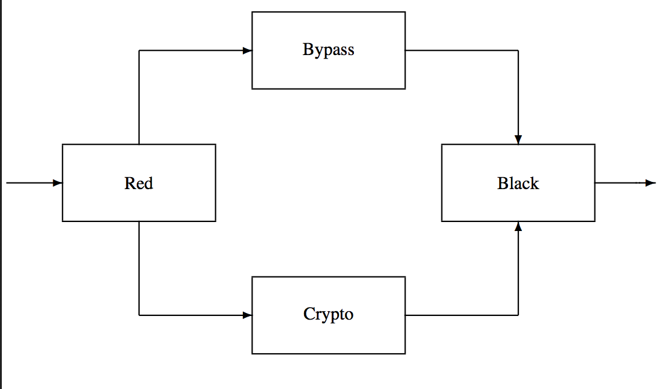
Another Example SNFE
Notes:
Secure Network Front End. – interposed between a host and a network to provide end to end encryption.
Contains components for handling the protocol, and message buffering.
The host side is the red component. The network side is the black component.
Red component passes cleartext to the crypto to be encrypted and passed to the black to be passed along the line.
The bypass is used to pass headers between the red and black components so they can cooperate.
Red component can’t be allowed to pass cleartext informaiton to the black component through the bypass.
To create a separation, a sensor is placed in the bypass to perform procedural checks on the traffic passing through – to check that legitimate protocol info is passed.
The issue isn’t that the Red and black can communicate. But rather what channels are available for them to communicate.

Slide 12
Solution – Separation Kernel
Create a distributed system on a single processor.
Logical rather than physical separation of components.
Create security channels between the processes for information flow.
The security policies are embedded in the individual components.
Notes:
The critical components require no special privileges of the kernel
We have completely decoupled the properties required of the security kernel from those concerned with the larger questions of the system’s overall purpose.
The security kernel just maintains the distributed environment and the critical components describe the security policies.
Security Kernel just focuses on keeping the processes separate.
Have a whole bunch of individual virtual machines.

Slide 13
Common Criteria
Is an international standard for computer security certification.
Users specify their functional and assurance requirements.
Vendors make claims about the security attributes of their products.
Testing laboratories verify the claims made.
Notes:
In other words, Common Criteria provides assurance that the process of specification, implementation and evaluation of a computer security product has been conducted in a rigorous and standard manner.

Slide 14

Common Criteria Concepts
Protection Profile – security requirements document.
Security Target – document discussing the attributes of the target.
Security Functional Requirements – specifies the functions provided by the target.
Notes:
a document, typically created by a user or user community, which identifies security requirements for a class of security devices (for example, smart cards used to provide digital signatures, or network firewalls) relevant to that user for a particular purpose
A protection profile contains two sets of requirements: Functional requirements and assurance requirements.
Functional Requirements: What does the product do?
Security Target: This allows vendors to tailor the evaluation to accurately match the intended capabilities of their product. This means that a network firewall does not have to meet the same functional requirements as a database management system, and that different firewalls may in fact be evaluated against completely different lists of requirements.
SFR’s - The Common Criteria presents a standard catalogue of such functions. For example, an SFR may state how a user acting a particular role might be authenticated. The list of SFRs can vary from one evaluation to the next, even if two targets are the same type of product.
Assurance Requirements: What information can you provide that will demonstrate that it will do what you say it will do?
Protection profile must be evaluated using the Common Methodology for Information Technology Security Evaluation.

Slide 15
Concepts Continued…
Security Assurance Requirements - descriptions of the measures taken during development and evaluation of the product to assure compliance with the claimed security functionality.
Evaluation Assurance Level - the numerical rating describing the depth and rigor of an evaluation.
Notes:
EAL - Each EAL corresponds to a package of security assurance requirements (SARs, see above) which covers the complete development of a product, with a given level of strictness. Common Criteria lists seven levels, with EAL 1 being the most basic (and therefore cheapest to implement and evaluate) and EAL 7 being the most stringent (and most expensive). Normally, an ST or PP author will not select assurance requirements individually but choose one of these packages, possibly 'augmenting' requirements in a few areas with requirements from a higher level. Higher EALs do not necessarily imply "better security", they only mean that the claimed security assurance of the TOE has been more extensively verified.

Slide 16
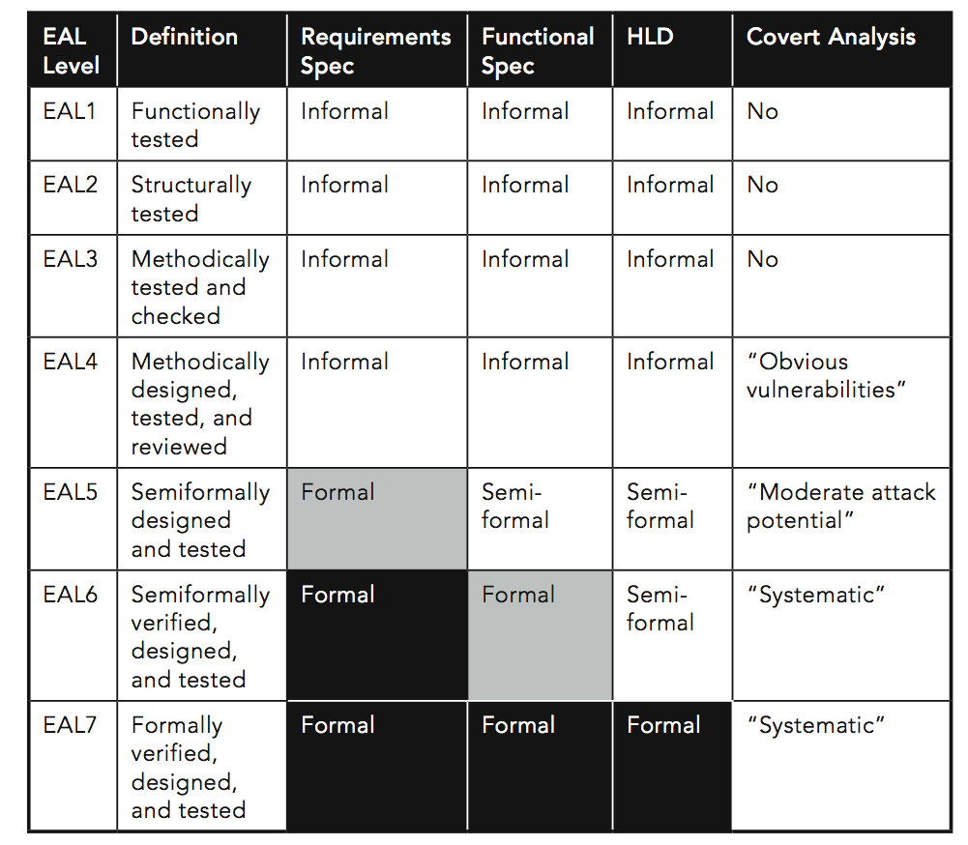
EAL’s

Slide 17
Integrated Modular Avionics
Provides an approach where multiple applications can operate on the same processor.
RTOS management of resources is guided by ARINC 653 – “Avionics Application Software Standard Interface”
Applications targeted for IMA must follow the APEX API.
Makes for ease of portability.
Notes:
ARINC 653 dictates the partitioning of resources.

Slide 18
MILS System
Problem: In military applications we need to prove a system is secure and correct.
Much more difficult as systems become increasingly complex – Moore’s Law doesn’t help.
Imperative to modularize components to reduce complexity and use divide and conquer approaches to proving.

Slide 19
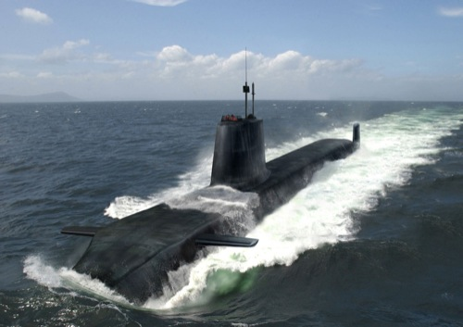
MILS System Cont’d
MILS Architecture is designed to accomplish four goals:
  Enforcing Data Isolation
  Control of Information Flow
  Period Processing
  Damage Limitation Policies
  That’s it…????
KISS principle – the simpler, the better…and more verifiable.
Notes:
Enforcement of the data isolation policy is the guarantee that an application can access only the memory that has specifically been allocated for its use. Enforcement of this policy counters the threats of compromise, tamper and virus. Compromise is the unauthorized reading of data. Tamper is the unauthorized writing of data. Virus employs tamper to spread instances of malicious code throughout the system.
Enforcement of the control of information flow is the guarantee that entities in a system can communicate with each other only by approved paths. Enforcement of this policy counters the threat of bypass, where errant or malicious code can circumvent the protection mechanisms built into the system, rendering them ineffective.
Enforcement of the periods processing policy is the guarantee that the processor itself is not the means for compromise. Before switching from one partition to another, the microprocessor is scrubbed. This scrubbing, combined with deterministic CPU time allocation, counters the threat that side effects of authorized system usage can be used as covert channels. A covert channel, an unintended data path through the system, is another potential vehicle for compromise.
Damage limitation is the policy that all failures are contained locally and are recovered from locally. Failure of one component can’t cause failure of another. Errant or malicious software in the system, or malicious users, may be able to make one component fail, but that failure will not cause any other component to fail. Our system will not suffer domino-like chain reactions of failure, a threat called cascade.

Slide 20
MILS Characteristics
It is the only code that runs in supervisory or privileged modes.
  Applications run in user mode.
  No code – device drivers or MMU can affect the kernels protection.
The kernel is kept small.
  4000 lines of code or less.
  Easier for provability.
  Only has to be done once – reusability.
Notes:
The small size of the separation kernel is a manifestation of the most important MILS design objective: Dramatically reduce the amount of policy enforcement code so that we can dramatically increase the inspection of that code. It is because of this rigorous inspection that the MILS separation kernel can be trusted.

Slide 21
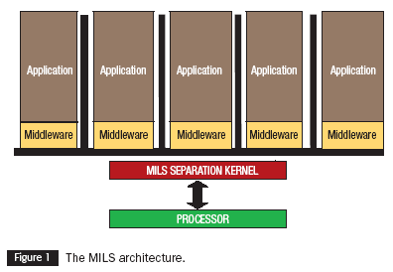
MILS Architecture
Notes:
Middleware is defined as reusable software components that provide services to the applications. Middleware resides in the same kind of partition as the application that it supports, either co-resident with the application or in a partition by itself. Middleware runs in unprivileged (user) mode, making these services subject to separation kernel policy enforcement. The services that are typically found in an operating system, such as memory allocation, device drivers, I/O primitives, file systems and network stacks are all relegated to the middleware layer.

Slide 22

NEAT
Need application level protection: reference monitor
Non-Bypassable
Evaluatable
Always Invoked
Tamperproof
Notes:
An important part of making any application robust is to provide components that protect the application itself. These components typically include error checking, parameter validation, user authentication and access control. Protection functions are called reference monitors. Application-level reference monitors are the most effective because they can be tightly focused on the specific requirements for that application rather than trying to be general purpose.
• Non-bypassable: The reference monitor can’t be circumvented
• Evaluatable: The reference monitor is small enough that rigorous inspection is practical
• Always Invoked: The reference monitor runs each and every time
• Tamperproof: The reference monitor and its data are protected from unauthorized modification
. In order to be effective, all system protection must be NEAT.
An important point is that the reference monitor is not part of the separation kernel but it has all of the same guarantees (i.e., NEAT-ness) as if it were a part of that kernel. There is no risk that application level reference monitors will have any side effects on the separation kernel’s policy enforcement because that reference monitor is subject to those policies itself.

Slide 23
Networking in MILS
Socket API is the same as in normal systems.
API is partitioned separately from the stack and drivers.
Uses the kernel’s high assurance information flow policy.
Policy is enforced by the Partitioning Communications System PCS.

Slide 24
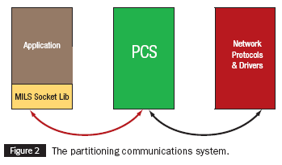
PCS

Slide 25
PCS cont’d
Strong Identity of Nodes.
Data Separation, According to Policy.
Application of Encryption – before hitting the protocol stack.
Policy Management.
Covert Channel Suppression.
Notes:
PCS enables the system designer to control and even redesign how processing, data, services and even connectivity are distributed across the entire system without affecting the applications. The PCS ensures that data will flow only according to how it has been configured, eliminating threats to confidentiality and integrity.
• Strong Identity of Nodes
Protection against spoofing, man in the middle and other means used to extract sensitive data from a system without authorization.
• Data Separation, According to Policy
Not all data has the same sensitivity level. Trade secrets must be kept separate from confidential business data. Both of these must be kept separate from public data such as parts lists and ordering information normally made available on E-business web sites.
• Application of Encryption
The PCS can apply either software or hardware encryption in accordance with the protection policy. By encrypting the data before it ever reaches the network stack, we can use standard commercial network components without fear of tamper or compromise because all data is “in the black.” Any attempt to hack or attack the network stack will yield only encrypted data.
• Policy Management
The PCS validates that its policy data is both consistent and compatible with the policies at “the other end.” Inconsistent and incompatible policy data in distributed systems is a significant vulnerability.
• Covert Channel Suppression
An errant or even malicious application can control the transmission of data to cause unauthorized disclosure of sensitive data as a side effect of normal system traffic. Imagine controlling the timing of legitimate traffic to signal sensitive data in Morse code. The PCS is logically between the application and the network protocol stack. The PCS transmits and receives data only in accordance with the protection policy, including timing constraints when applicable. Because the PCS throttles data to the rates configured in the policy, malicious applications on either end can’t mount a Denial of Service attack.

Slide 26
Integrity MILS RTOS.
Designed for high robustness (as described by the NSA).
Certified based on the “Separation Kernel Protection Profile” – contains both functional and assurance requirements.
Requirements include separation and information flow control.
Products evaluated against SKPP must exceed EAL 6.
Notes:
NSA has published guidance documents to describe its robustness levels.
SKPP helps to ensure that the kernel meets the N A and T requirements of the neat principles.
An evaluation to SKPP presents the highest Common Criteria Security level for commercial software.

Slide 27
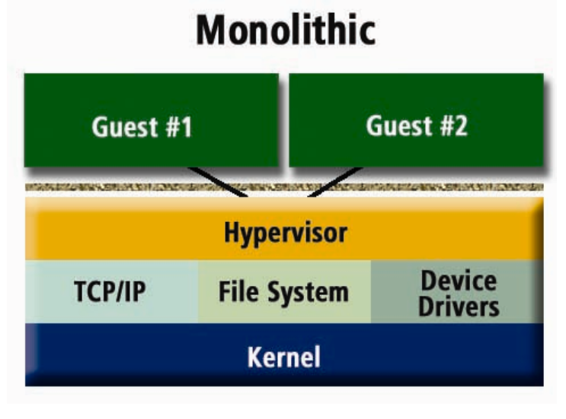
Virtual Machines
MILS compliant systems must ensure that inter-VM intrusions are not possible.
Higher requirement than basic hypervisors.
Basic VM Architecture
Notes:
The basic VM architecture is susceptible to vulnerabilities of the main underlying host OS as well as the vunerabilities of the guest OS’s.

Slide 28
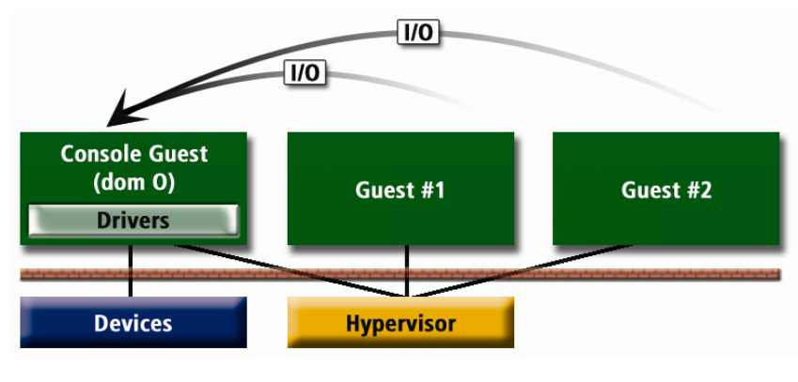
Bare Metal Virtual Machine
Notes:
Hypervisor controls the hardware, not a host operating system.
Results in millions of bytes of privileged code which can contain vulnerabilities.
Xen is an example hypervisor. This is used in many cloud computing environments for security and monitoring.

Slide 29
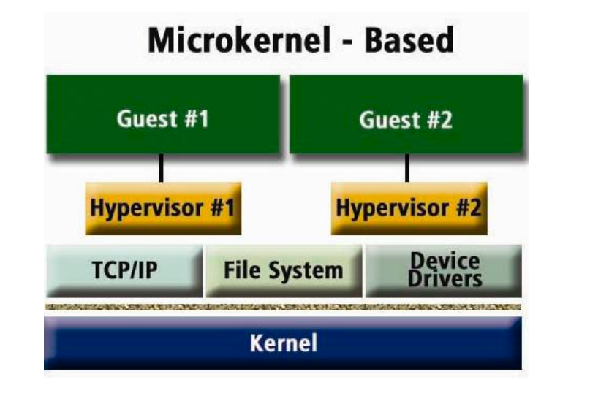
Integrity’s Architecture
Micro Kernel Based
Notes:
Designed for high assurance applications.
Can host multiple partitioned ARINC 653 applications.
Virtual machines operate completely in their own partitions – this is referred to as padded cell.
Nothing in the guest confines can escape the partition or affect the other critical applications.
Guest OS and applications run unmodified in it’s own partition.

Slide 30
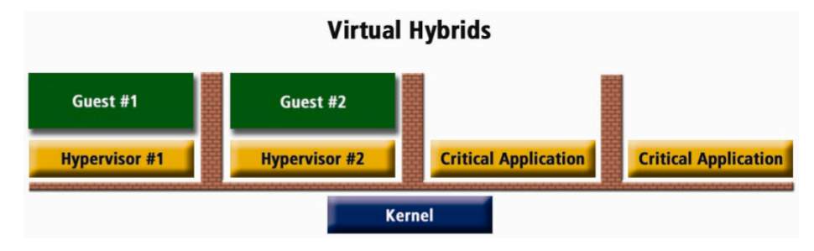
Hybrid VM
Notes:
Example of having non-critical and critical applications together.

Slide 31
Bell-La Padula Model
Was proposed to enforce access control in military applications.
Subjects and objects are partitioned into different security levels.
Thought about what would happen when a shared object had it’s security level changed.
Label’s ranged from Top-secret to Unclassified.
Notes:
A subject can only access objects at certain levels determined by his security level. For instance, the following are two typical access specifications: ``Unclassified personnel cannot read data at confidential levels'' and ``Top-Secret data cannot be written into the files at unclassified levels''.
Control – of extending or rescinding access to an object.

Slide 32
Bell-La Padula Model Cont’d
Unrestricted users could modify files without others realizing it.
One cannot protect an item with finer granularity than the protection system supports.
Two Options:
    Monitor the flow of info
    Deny access to two objects simultaneously if the flow of information could be objectionable.
Notes:
If a paragraph from an intelligence report could be copied into a file with bowling scores than the system had lost accurate control of the situation.
They chose option 2.
Implemented it by denying the second access request. Less overhead than option 1.
That is, if the high-level object is successfully opened or read, a subsequent request to open the low-level object for write would be denied.

Slide 33
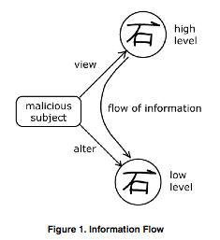
Information Flow

Slide 34
Rules
Designed a set of rules governing every change in access mode.
Each rule preserved:
    Simple security (user has proper access rights)
    Discretionary security (user has rights to object).
    *-property
These rules were used to create a state machine for access control.
Rules ensured remaining in a safe state.
Notes:
Simple security – the subject’s classification is higher than the object’s classification.
Discretionary Security - the subject has access to the object (regardless of classification).
*-property – basically, a subject of higher classification cannot create a resource of a lower classification.

Slide 35
Rules govern
Getting access to objects
Releasing access
Giving access to another subject
Rescinding other subject’s accesses
Changing security levels
Creating objects
Deleting them

Slide 36
Theorem 4.1
Let w = {p1, p2, …., p10} the pi as defined in the section entitled The Rules, and z0 be a secure state which satisfies the *-property. The Σ(R, D, W(w), z0) is a secure system which satisfies *-property

Slide 37
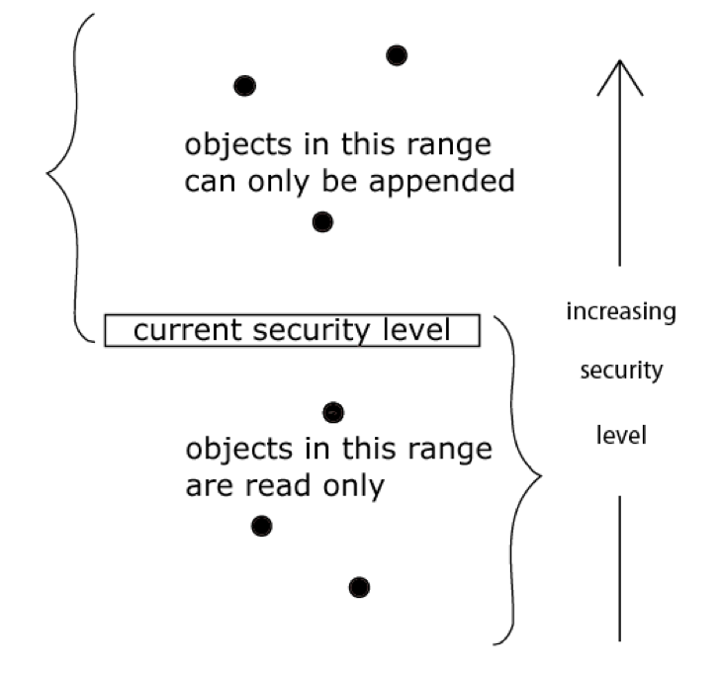
Resulting *-property
No Read-up……No Write-down…
Notes:
With Bell-La Padula, users can create content only at or above their own security level (i.e. secret researchers can create secret or top-secret files but may not create public files; no write-down). Conversely, users can view content only at or below their own security level (i.e. secret researchers can view public or secret files, but may not view top-secret files; no read-up).

Slide 38
Yet another revision!
What about the OS scheduler? It had to read and write objects of all categories?
Solution – Trusted Subjects.
Trusted subjects: those who will never mix information of different security levels.
Not required to follow the *-property.
Notes:
This created 17 Rules.

Slide 39
Covert Channels
An illicit communication in which info is passed from high to low.
Four Categories:
  Non-deducible
  Positive-deducible
  Negative-deducible
  Partially-deducible
Notes:
A covert timing channel is an illicit communication path in which one item (High) signals information to another entity (Low) against the system security policy, by modulating its use of system resources in such a way that this manipulation affects the response time in Low
Based upon the degree of deducibility and types of information deducible by Low.
Most realtime scheduling algorithms are priority based where a process of higher priority gets precedence over a lower priority process. When the higher priority task gets to run is determined by the scheduling algorithm. Many are pre-emptive.
Scheduling preemptiveness may cause a covert timing channel

Slide 40
Rate-Monotonic Scheduling
Son and Alves-Foss want to show that there is a vulnerability in RMS that can create a covert channel under certain circumstances.
RMS:
  Tasks with shorter periods have higher priority.
  Priority assigned to task is fixed.
  Intrinsically pre-emptive.

Slide 41
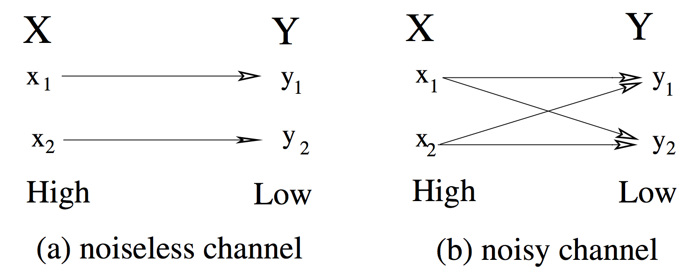
Modeling Channel
Notes:
The channel is discrete and memoryless given that the output symbols only depend on the input symbols from X.
When noise occurs during the transmission of a symbol, the symbol might be altered and affect the output observed by the receiver.
The behavior of a noisy channel may be non-deterministic in a sense that the output observed by the receiver is no longer a function of the input transmitted.

Slide 42
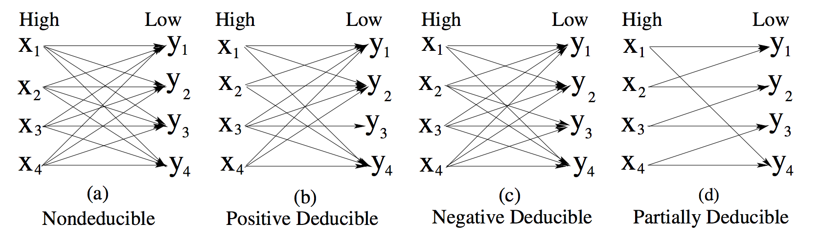
Deducibility
Notes:
Non-deducible: Upon receiving any symbol. Low cannot reliably deduce which symbol has been sent by High.
Positive Deducible: Low can tell exactly which symbol has been sent by High by observing some symbols.
Negative Deducible: Low can determine exactly which symbol has not been transmitted by High.
Partially Deducible: Low can deduce the occurrence of a set of multiple input symbols or the non occurrence of a set of multiple input symbols.

Slide 43
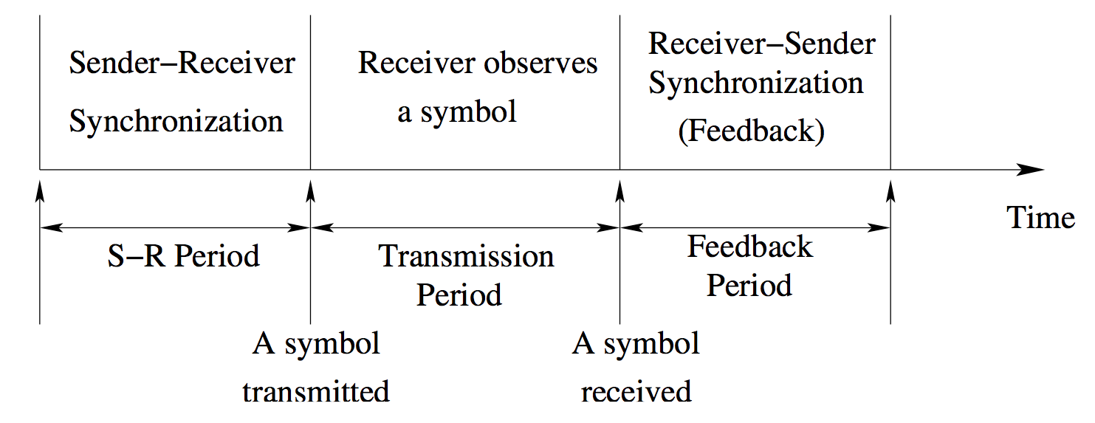
Transmission Cycle of Channel

Slide 44
Degree of Deducibility
The noise level of the environment.
The longevity of the channel (short-term vs. long-term).
Existence of the feedback path.
Intention of the Trojan Horse (long message vs. short message).

Slide 45
Channel Capacity
More information can be transferred from High to Low if the channel is less noisy.
The quantity of information transferred is known as the channel capacity.
Channel capacity is to show the severity of a covert channel.
Son and Alves-Foss propose a security metric called “relative channel capacity” to compare the degree of deducibility between two covert channels.

Slide 46
Summary
A system wide security policy is not enough.
Each application needs its own component level security policy.
Separation Security just keeps applications isolated and controls information flow.
Resource checking is always-on.
Covert Channel communications can still be a problem.

Slide 47
References
http://www.aviationtoday.com/av/issue/columns/perspectives/Perspectives-Security-and-the-Separation-Kernel_9897.html
http://www.aviationtoday.com/av/categories/military/799.html
http://rtcmagazine.com/articles/view/100319

