Slide 1
Fault-Tolerance in Avionics Systems
Jonathan Herman

Slide 2
Overview
Introduction
Byzantine Faults
Common Mode Faults
Fault Tolerant Scheduler
History and Examples
Notes:
Once every 400 days

Slide 3
Introduction
Fault Tolerance is the ability to detect errors, assess damage, isolate the fault, and recover from the error.
A fault is the cause of a problem. E.g. you always assign a pointer to null.
An error is the result of the fault. E.g. you access said pointer and throw an exception.
A failure is the negative result of an error. E.g. your dodgeMountains() module fails and you hit a mountain.
Modern fault tolerance focuses on two kinds of faults, Byzantine Faults and Common Mode Faults
Notes:
Once every 400 days

Slide 4
Justification
Byzantine Faults
For verification, older systems would have to prove that they had an error rate of 10⁻⁹ an hour.
Assuming each hardware component had an error rate of 10⁻⁴ an hour, other faults would need to be around 10⁻⁵.
Certifying that all these other faults occurred once every 400 days became prohibitively expensive.
Can we design a system which, instead of looking for any single fault, takes into account any adverse behavior?
Theoretically considered as Byzantine Generals’ Problem.
Notes:
Once every 400 days

Slide 5
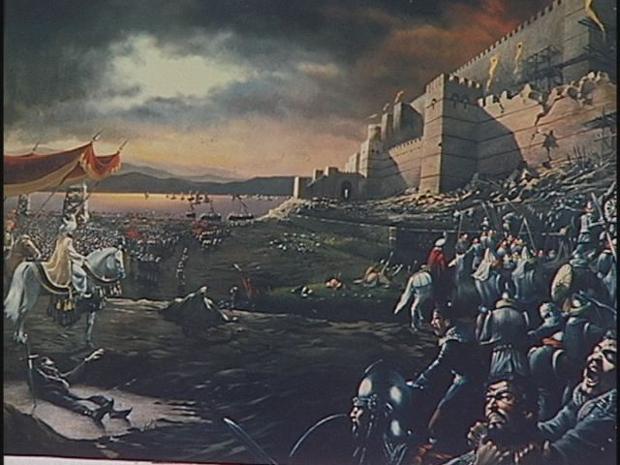
Byzantine Generals’ Problem
Byzantine Faults
Generals of the Byzantine Empire must decide unanimously whether to attack the Turkish army.
Separated geographically, must send messengers to each other.
Turks are crafty and can co-opt your messengers, trick a single general into a suicidal Charge of the Light Brigade, or confuse generals into inaction.
Notes:
Once every 400 days

Slide 6
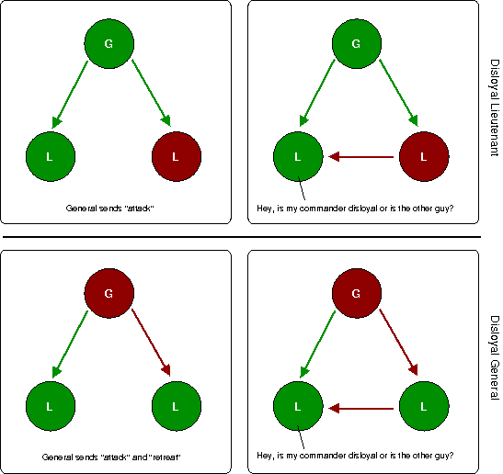
Byzantine Generals’ Problem - cont
Byzantine Faults
Byzantine Fault Tolerance here is having all loyal generals attack.
Can theoretically show how many generals / messengers / lieutenants you need and under what conditions.
Notes:
Once every 400 days

Slide 7
Byzantine Resilience
Byzantine Faults
A Byzantine Fault consists of any arbitrary behavior from a failed component. Could include:
Sending different output to different destinations
Starting and stopping execution randomly
Can also be thought of as any unpredicted hardware error.
A Byzantine Resilient system makes no assumption about component behavior.
Show instead that if any single component fails, you can survive.
Byzantine Resilience theory can specify exact number of components / algorithms needed, though in practice systems aren’t entirely resilient but use theory to show their error rate meets certain metrics.
Notes:
Once every 400 days

Slide 8
Fault Containment Region
Byzantine Faults
Systems are partitioned into Fault Containment Regions, your Byzantine generals.
Errors outside a Fault Containment Region (FCR) cannot cause an error inside, nor can error inside propagate outside.
In practice, usually requires that FCR has independent processor, memory, IO, data, and often power.
Notes:
Once every 400 days

Slide 9
Voting
Byzantine Faults
Voting is one method of using multiple FCRs, where a voter takes output from the FCRs and decides the correct output.
3 varieties:
Exact: output values must match bit for bit.
Approximate: values must be w/in a certain range of avg.
Mechanical: system physically creates correct output. E.g.
Each component provides a fraction of force needed to move output
A bad component will have its output overwhelmed by good
Notes:
Once every 400 days

Slide 10
Voting Applications
Byzantine Faults
Your messengers must be Byzantine Resilient also.
Inputs, such as samples of sensor data, can also use a voter.
Most aircraft provide redundant sensors.
Transmission media can use voters and multiple connections.
Voters are components! They must be extremely reliable or the system is pointless.
Voting is often used to vote on the state of a component.
Notes:
Once every 400 days

Slide 11
Triple Modular Redundancy
Byzantine Faults
Originated with Apollo.
3 systems operate on input. Majority value or average wins.
The voter can optionally shutdown and reconfigure bad components.
Created and used before Byzantine Generals’ paper, though it solves the same problem.
Still widely in use today.
Other applications in:
Minority Report
Rendezvous with Rama
Notes:
Once every 400 days

Slide 12
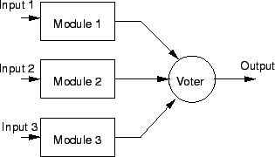
Triple Modular Redundancy
Byzantine Faults
Notes:
Once every 400 days

Slide 13
Replication
Byzantine Faults
This is not voting. Uses simpler hardware or software to reconcile outputs.
Command / Monitor: command is primary CPU, monitor merely checks output of command.
Primary / Backup: same as C/M, but backup computer can take over as primary.
Hot Swap: backup always has same state as primary for instantaneous replacement.
Notes:
Once every 400 days

Slide 14
Dual - Dual
Byzantine Faults
Two pairs of each processing component, both executing on all input.
In each pair, both components send their output to simple hardware comparator. If it finds that output differs, switches over to other pair until first pair reconfigured / replaced.
Used in lots of old interplanetary satellites.
Notes:
Once every 400 days

Slide 15
Integrated Modular Avionics
Byzantine Faults
IMA recap: instead of distributing systems throughout airplane based on application (say radar CPU, HUD CPU), a network of processing modules runs distributed applications.
If you lose part of the plane other modules can take over your tasks.
Each of these modules is a Fault Containment Region.
Line between TMR, Dual-Dual and IMA is blurry.
Notes:
Once every 400 days

Slide 16
Effects on Software
Byzantine Faults
Programs need to be written without knowledge of hardware resilience.
Even operating systems are unaware of Byzantine Resilience, instead software just assumes that Byzantine Errors don’t happen.
The hardware and software used to detect and isolate faults, mask errors, and reconfigure components are kept separate form any operational software.
Simplifies code.
Notes:
Once every 400 days

Slide 17
Error Detection
Byzantine Faults
If bitwise comparison with other components fails, declare failed component faulty. Most voting systems work this way.
Thresholds / Reasonableness: check that component output is within a certain threshold. E.g.
Asked to calculate time, returns 25 o’clock or STRAWBERRY
Built-in Test: components check themselves for failures.
Power-on BIT: checks itself at startup. Think POST.
Continuous BIT: components check themselves periodically during slack time.
Notes:
Once every 400 days

Slide 18
Component Synchronization
Byzantine Faults
For components to work together smoothly, their clocks must be synchronized.
Clocks themselves must be Byzantine Resilient (to a certain degree).
Surprise, redundancy needed.
Voting used to determine the specific time.
After time determined, push out to all Fault Containment Regions.
Notes:
Once every 400 days

Slide 19
Note on Buses
Byzantine Faults
The buses (such as communication or power, if you don’t have independent generators) must also be Byzantine Resilientish.
Similar techniques would apply with small changes. E.g.
Communication buses might have voting components located at each interface to an FCR, with multiple buses feeding in
Backup buses in case one is damaged
Etc..
Notes:
Once every 400 days

Slide 20
Reconfiguration
Byzantine Faults
Remove faulty component at the cost of redundancy.
Replace faulty component with hot swap or spare, costs more in power or money.
Fix state. E.g.
Use voting to remake internal state of offending component
Error Correcting Codes: use extra data in bits to find correct values
Rollback: load state of system before crash. Usually impractical.
Transient Errors: vast majority of errors encountered do not repeat.
Two ways of dealing with this:
Keep rechecking value. If it persists, fault is permanent. Reconfigure something.
Immediately reconfigure on failure, run BIT, and reintegrate if passes
Notes:
Once every 400 days

Slide 21
Overview
Introduction
Byzantine Faults
Common Mode Faults
Fault Tolerant Scheduler
History and Examples
Notes:
Once every 400 days

Slide 22
Common Mode Failures
Common Mode Failures
The issue of Byzantine Resilience is generally considered solved.
A Common Mode Failure could effect more than one FCR simultaneously. Types:
Transient (external): temporary result of environment (lightning)
Permanent (external): constant interference from environment (flying in a tsunami)
Intermittent (design): introduced during design of the system (can’t turn left in Illinois sometimes)
Permanent (design): introduced during design of the system, doesn’t leave (can’t ever turn left in Illinois)
Notes:
Once every 400 days

Slide 23
Common Mode Failures - cont
Common Mode Failures
Combat using 3 things:
Fault Avoidance during design
Fault Removal through testing, evaluation, fault insertion
Fault Tolerance through exception handlers and program checkpointing / restarting
Notes:
Once every 400 days

Slide 24
Fault Avoidance
Common Mode Failures
Don’t reinvent wheel.
Problems arise because manufactures like to design own hardware
Existing hardware has already been tested / verified in field
COTS hardware offers a cheap alternative with lots of unofficial testing **
Conform to existing standards for similar reasons
Formal Methods
The Space Shuttle takes this approach
Design Diversity
Run systems using different hardware / software designed by different teams
Notes:
Once every 400 days

Slide 25
**Cots Interlude
Common Mode Failures
COTS components are not as rigorously designed and tested for safety as custom-made aircraft components.
Say you wanted to use an IEEE 1394 (Firewire) bus in your airplane. Designed with a tree topology; if you kill a root, you orphan its children.
If you want to use COTS, need to wrap it. Levels:
Enhanced Fault Protection: add another layer of hardware /software to monitor / maintain COTS.
Fault Protection by Design Diversity: add backup.
For 1394 example, this would mean adding different system as backup
Fault Protection by Redundancy: replicate the COTS component.
Notes:
Once every 400 days

Slide 26
Fault Removal
Common Mode Failures
Basically means test the system rigorously to find problems.
Fault Insertion: fake faults to make sure you system can handle them.
Notes:
Once every 400 days

Slide 27
Fault Tolerance
Common Mode Failures
Watchdog Timers: task which occasionally runs and verifies system state.
Could find an invalid PC, for example
Hardware Exceptions: when invalid hardware operation found, throw and catch hardware exceptions.
Runtime Checks: software exceptions, etc.
Program Checkpointing: periodically save state, reload state when an error is found. Impractical often.
Restarting: always an option.
Notes:
Once every 400 days

Slide 28
Ada Interlude
Common Mode Failures
Quick example explains Ada’s use in systems like these.
type Day is range 1 .. 31;
type Month is range 1 .. 12;
type Year is range 1800 .. 2100;
type Date is
record
Day : Day;
Month : Month;
Year : Year;
end record;
Try to assign 32 to a date’s day and program raises exception.
Notes:
Once every 400 days

Slide 29
Overview
Introduction
Byzantine Faults
Common Mode Faults
Fault Tolerant Scheduler
History and Examples
Notes:
Once every 400 days

Slide 30
Fault-Tolerant Scheduling Example
Scheduler
Assume we are working with duplicated processing modules (like IMA).
Requirements:
Schedule tasks among candidate processors which can handle timing requirements
Provide mechanisms for fault tolerance, like managing replicated executions and checking tasks executed successfully
Surprise, the solution involves executing tasks at different modules.
All replicated tasks and any verification of those tasks must complete before task’s deadline.
Notes:
Once every 400 days

Slide 31
Hardware Implementation
Scheduler
Each processing module has a Redundancy Management System (RMS) for synchronization and voting.
RMS votes on values collected from replicated tasks as well as state of entire processing module.
Only after RMSs have voted on a value can application act on it.
If the RMSs decide another module is faulty, it is penalized and given a chance to recover with new data.
Notes:
Once every 400 days

Slide 32
Software Implementation
Scheduler
On task release, task is replicated across modules. When the modules task completes, its results are moved to a voting queue.
After the Voting Run Time, which is between the release and deadline of a task, voter is executed and calculates results from voting queue. The Voting Ready Time is determined by the algorithm used.
Any task added to voting queue but not processed by voter must be processed next time around.
Notes:
Once every 400 days

Slide 33
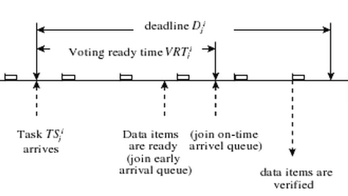
Software Implementation
Scheduler
Notes:
Once every 400 days

Slide 34
Overview
Introduction
Byzantine Faults
Common Mode Faults
Fault Tolerant Scheduler
History and Examples
Notes:
Once every 400 days

Slide 35
History
History and Examples
Originally, NASA and avionics manufacturers concentrated on fault avoidance.
Apollo had a computer with rigorously verified code. No permanent failure was ever recorded.
Triple Modular Redundant and Dual-Dual systems appeared in the early 70’s.
Exact consensus was used for fault detection / isolation
First commercial examples appeared in automatic landing for jumbo jets.
747 used TMR, Lockheed L-1011 Dual-Dual
Notes:
Once every 400 days

Slide 36
History - cont
History and Examples
Dual-Dual and TMR designed to prevent Byzantine Faults, though the theory was not yet present.
Later research into Byzantine Resilience provided theoretical basis for design.
Now the main cause of failure is Common-Mode Failures.
Notes:
Once every 400 days

Slide 37
History - cont
History and Examples
Space Shuttle had to be able to finish mission after one failure, land safely after 2.
Used 4 independent computing systems, each its own FCR.
Backup 5th system loaded with simpler which can land shuttle if needed.
All control given to 5th system with the flip of a switch.
Early example of Common-Mode Failure protection, though not explicitly designed as such.
Notes:
Once every 400 days

Slide 38
Boeing 777
History and Examples
Uses 3 triple-redundant systems. Think 12 processors in a 3 by 3 matrix.
Each group of 3 processors has one command, one monitor, and one standby computer.
Each system uses different hardware and software.
One with Motorola 68040, another Intel 80486, last AMD 29050
All designed using Ada, though different compilers have to be used for each system.
Notes:
Once every 400 days

Slide 39
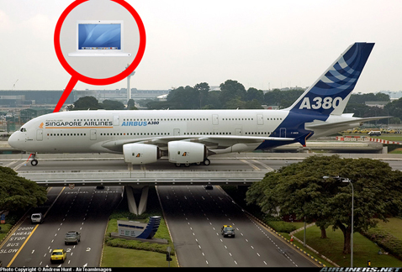
A380
History and Examples
Uses Dual-Dual with hot spares.
Has a backup pair using a simpler microprocessor and independently developed software if the main Dual-Dual system fails
Notes:
Once every 400 days

Slide 40
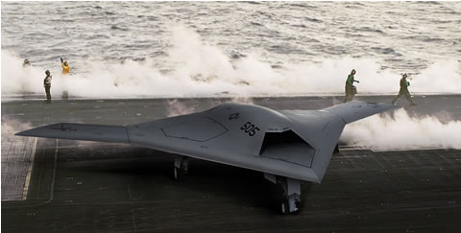
X-47B (UAV)
History and Examples
Vehicle Management Computer (VMC) uses a variant of TMR without an explicit voter.
Each VMC reads inputs, calculates outputs, then compares to other VMCs. Majority sent to output. Does not average results. In case of 2 to 1, minority forced to reboot.
Mission Management Computer is less critical, merely possesses a hot swap.
Source: Mac and Northrop Grumman
Notes:
Once every 400 days

Slide 41
Questions?

