Slide 1
Deadlock
Don Porter
Portions courtesy Emmett Witchel

Slide 2
Concurrency Issues
Past lectures:
  Problem: Safely coordinate access to shared resource
  Solutions:
    Use locks, condition variables
    Coordinate access within shared objects
What about coordinated access across multiple objects?
  If you are not careful, it can lead to deadlock
Today’s lecture:
  What is deadlock?
  How can we address deadlock?

Slide 3

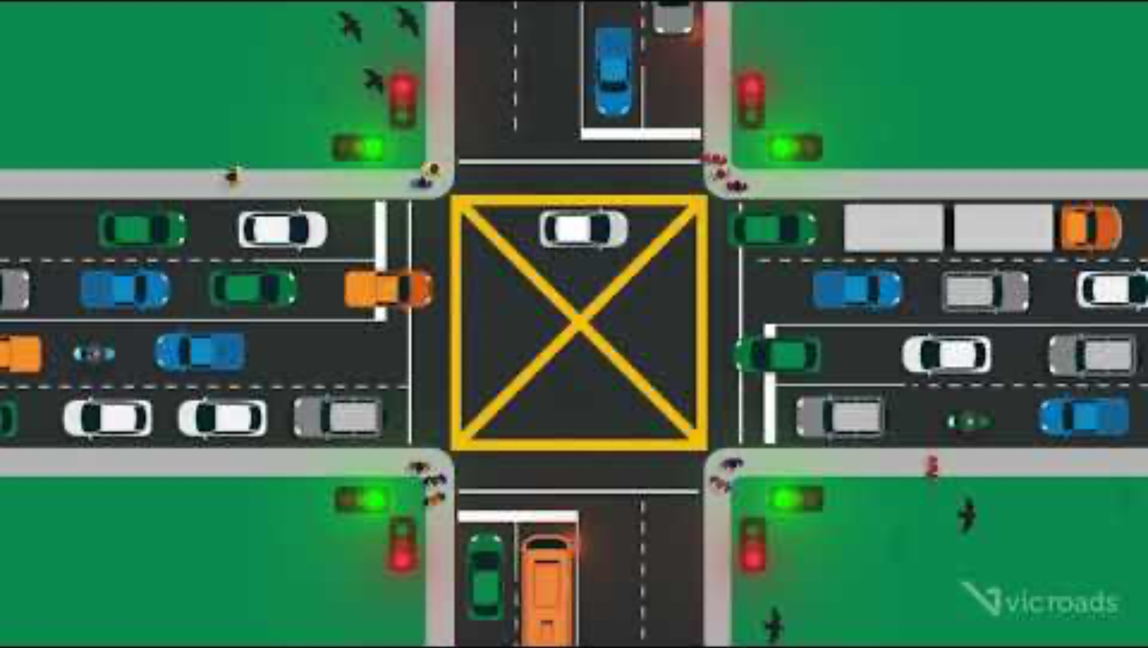
Practical Motivation
What does this traffic sign mean?

Slide 4

The Deeper Issue
“I can make it”
  Traffic Deadlock: This will never resolve

Slide 5
Deadlock: Motivating Examples
Two producer processes share a buffer but use a different protocol for accessing the buffers
A postscript interpreter and a visualization program compete for memory frames
Producer1() {
Lock(emptyBuffer)
Lock(producerMutexLock)
:
}
Producer2(){
Lock(producerMutexLock)
Lock(emptyBuffer)
:
}
PS_Interpreter() {
request(memory_frames, 10)
<process file>
request(frame_buffer, 1)
<draw file on screen>
}
Visualize() {
request(frame_buffer, 1)
<display data>
request(memory_frames, 20)
<update display>
}
Notes:
Abstractly what’s going on here is that there’s a set of resources (the mutex lock and some empty buffers) that both processes are trying to acquire.
There’s a possible set of interleavings of these processes that leads to deadlock.
— Both will be in the waiting state and neither can leave the waiting state without the other one executing (which can’t happen!).
— This assumes that these two processes are the only uses using the buffers (and that there’s only one empty buffer).
Deadlock here is still the user’s fault.
— The problem is due to a bug in the way they are coordinating their access to a set of shared resources.

Slide 6
Deadlock: Definition
Ready
Running
Head
Tail
Waiting
ready queue
Head
semaphore/
condition queues
Tail
A set of threads is deadlocked when every thread in the set is waiting for an event that can only be generated by some thread in the set
Starvation vs. deadlock
  Starvation: threads wait indefinitely (e.g., because some other thread is using a resource)
  Deadlock: circular waiting for resources
  Deadlock ➔ starvation, but not the other way
Notes:
In the definition of deadlock we assume the set of processes contains at least two processes.
— A single process can deadlock itself, however, this is most likely a programmer error and there is little that the OS can do here.
Contrast deadlock with starvation (in the context of scheduling):
— When processes are deadlocked they are all in the waiting state.
— When a process is being starved it is continually in the ready state.
— Moreover, unlike deadlock, it is possible for a starved process to make the transition to the running state. It’s just that entities in the system are conspiring to ensure that this transition never occurs.
— When processes deadlock, it is a provable certainty that a state transition can never occur.

Slide 7
Resource Allocation Graph
Basic components of any resource allocation problem
  Processes and resources
Model the state of a computer system as a directed graph
  G = (V, E)
  V = the set of vertices = {P₁, ..., P_{n}} ∪ {R₁, ..., R_{m}}
P_{i}
R_{j}
  E = the set of edges =
  {edges from a resource to a process} ∪
  {edges from a process to a resource}
request
edge
allocation
edge
P_{i}
P_{k}
R_{j}
Notes:
For allocation edges, the edge is from a resource node (and not from an instance of the resource), to a process node.
— Resource instances are not nodes. They are an annotation.

Slide 8
Resource Allocation Graph: Example
A PostScript interpreter that is waiting for the frame buffer lock and a visualization process that is waiting for memory
V = {PS interpret, visualization} ∪ {memory frames, frame buffer lock}
Visualization
Process
Memory Frames
PostScript
Interpreter
Frame Buffer
Notes:
Are these serially reusable or consumable resources?
— Serially reusable! There are reused serially by processes.
How do you read this graph?
— 3 memory frames are allocated to the PostScript interpreter.
— The frame buffer is allocated to the visualization process.
— The visualization process is requesting memory.
— The PostScript interpreter is requesting the frame buffer.
This system is deadlocked.
— A set of processes are waiting for an event that can only be generated by another process in the set.
— But note that not all the processes are waiting for the same event.
(There are several events (2 in this case) that can undeadlock the system.)

Slide 9
Resource Allocation Graph & Deadlock
Theorem: If a resource allocation graph does not contain a cycle then no processes are deadlocked
  A cycle in a RAG is a necessary condition for deadlock
Is the existence of a cycle a sufficient condition?
Game
Memory Frames
Visualization
Process
PostScript
Interpreter
Frame Buffer
Notes:
This Theorem says that a cycle in a resource allocation graph is a necessary condition for deadlock to occur.
In this example, these processes are not deadlocked.
— The memory request can be satisfied.
— Thus a cycle is not a sufficient condition for deadlock.

Slide 10
Resource Allocation Graph & Deadlock
Theorem: If there is only a single unit of all resources then a set of processes are deadlocked iff there is a cycle in the resource allocation graph
Memory Frames
Visualization
Process
PostScript
Interpreter
Frame Buffer
Notes:
START HERE
For the special case of single-unit resources, a cycle is a necessary and sufficient condition for deadlock.

Slide 11
An Operational Definition of Deadlock
Visualization
Process
Memory Frames
PostScript
Interpreter
Frame Buffer
A set of processes are deadlocked iff the following conditions hold simultaneously
  1. Mutual exclusion is required for resource usage (serially useable)
  2. A process is in a “hold-and-wait” state
  3. Preemption of resource usage is not allowed
  4. Circular waiting exists (a cycle exists in the RAG)
Notes:
The precise conditions for deadlock can be expressed in terms of a graph (cliques and knots).
— For our purposes we’ll use a more operational definition of deadlock.
Note that circular waiting does not imply hold-and-wait (that is, we need both conditions).
— Circular waiting does not imply that any resources have actually been allocated (that any process actually holds a resource).

Slide 12
Deadlock Prevention and/or Recovery
Adopt some resource allocation protocol that ensures deadlock can never occur
  Deadlock prevention/avoidance
    Guarantee that deadlock will never occur
    Generally breaks one of the following conditions:
      Mutex
      Hold-and-wait
      No preemption
      Circular wait *This is usually the weak link*
  Deadlock detection and recovery
    Admit the possibility of deadlock occurring and periodically check for it
    On detecting deadlock, abort
      Breaks the no-preemption condition
      And non-trivial to restore all invariants
  What does the RAG for a lock look like?
Notes:
Deadlock prevention: Guarantee (by the design of the system) that deadlock can never occur.
— Thus one need not worry how resources are allocated.
How easy/hard is this to do?
— Prevention is not likely to be possible in general.
— Mutual exclusion and non-preemptive use are properties that are inherent to the resource and the OS can’t change.
— At best the OS can only effect the hold-and-wait and circular waiting conditions.
Deadlock avoidance: Deadlock will be possible but we’ll continually check to ensure that it does not occur.

Slide 13
Deadlock Avoidance: Resource Ordering
Recall this situation. How can we avoid it?
Producer1() {
Lock(emptyBuffer)
Lock(producerMutexLock)
:
}
Producer2(){
Lock(producerMutexLock)
Lock(emptyBuffer)
:
}
Eliminate circular waiting by ordering all locks (or semaphores, or resoruces). All code grabs locks in a predefined order. Problems?
  Maintaining global order is difficult, especially in a large project.
  Global order can force a client to grab a lock earlier than it would like, tying up a resource for too long.
  Deadlock is a global property, but lock manipulation is local.
Notes:
Where to start when aborting processes?
— Low priority processes.
— Processes with the most resources allocated.
Similar set of issues when trying to stop a system from thrashing…
A new approach is to checkpoint processes periodically and then “roll back” processes to the point of their last checkpoint rather than abort them completely.
— A roll-back is a form of partial abort.

Slide 14
Lock Ordering
A program code convention
Developers get together, have lunch, plan the order of locks
In general, nothing at compile time or run-time prevents you from violating this convention
  Research topics on making this better:
    Finding locking bugs
    Automatically locking things properly
    Transactional memory

Slide 15
How to order?
What if I lock each entry in a linked list. What is a sensible ordering?
  Lock each item in list order
  What if the list changes order?
  Uh-oh! This is a hard problem
Lock-ordering usually reflects static assumptions about the structure of the data
  When you can’t make these assumptions, ordering gets hard
Notes:
START HERE 22

Slide 16
Linux solution
In general, locks for dynamic data structures are ordered by kernel virtual address
  I.e., grab locks in increasing virtual address order
A few places where traversal path is used instead

Slide 17
Lock ordering in practice
From Linux: fs/dcache.c
void d_prune_aliases(struct inode *inode) {
struct dentry *dentry;
struct hlist_node *p;
restart:
spin_lock(&inode->i_lock);
hlist_for_each_entry(dentry, p, &inode->i_dentry, d_alias) {
spin_lock(&dentry->d_lock);
if (!dentry->d_count) {
__dget_dlock(dentry);
__d_drop(dentry);
spin_unlock(&dentry->d_lock);
spin_unlock(&inode->i_lock);
dput(dentry);
goto restart;
}
spin_unlock(&dentry->d_lock);
}
spin_unlock(&inode->i_lock);
}
Care taken to lock inode before each alias
Inode lock protects list;
Must restart loop after modification

Slide 18
mm/filemap.c lock ordering
/*
* Lock ordering:
* ->i_mmap_lock (vmtruncate)
* ->private_lock (__free_pte->__set_page_dirty_buffers)
* ->swap_lock (exclusive_swap_page, others)
* ->mapping->tree_lock
* ->i_mutex
* ->i_mmap_lock (truncate->unmap_mapping_range)
* ->mmap_sem
* ->i_mmap_lock
* ->page_table_lock or pte_lock (various, mainly in memory.c)
* ->mapping->tree_lock (arch-dependent flush_dcache_mmap_lock)
* ->mmap_sem
* ->lock_page (access_process_vm)
* ->mmap_sem
* ->i_mutex (msync)
* ->i_mutex
* ->i_alloc_sem (various)
* ->inode_lock
* ->sb_lock (fs/fs-writeback.c)
* ->mapping->tree_lock (__sync_single_inode)
* ->i_mmap_lock
* ->anon_vma.lock (vma_adjust)
* ->anon_vma.lock
* ->page_table_lock or pte_lock (anon_vma_prepare and various)
* ->page_table_lock or pte_lock
* ->swap_lock (try_to_unmap_one)
* ->private_lock (try_to_unmap_one)
* ->tree_lock (try_to_unmap_one)
* ->zone.lru_lock (follow_page->mark_page_accessed)
* ->zone.lru_lock (check_pte_range->isolate_lru_page)
* ->private_lock (page_remove_rmap->set_page_dirty)
* ->tree_lock (page_remove_rmap->set_page_dirty)
* ->inode_lock (page_remove_rmap->set_page_dirty)
* ->inode_lock (zap_pte_range->set_page_dirty)
* ->private_lock (zap_pte_range->__set_page_dirty_buffers)
* ->task->proc_lock
* ->dcache_lock (proc_pid_lookup)
*/

Slide 19
Deadlock Recovery
R₁
R₂
R₃
R₄
P₁
P₂
P₃
P₄
P₅
Abort all deadlocked processes & reclaim their resources
Abort one process at a time until all cycles in the RAG
are eliminated
Where to start?
  Select low priority process
  Processes with most allocation of resources
Caveat: ensure that system is in consistent state (e.g., transactions)
Optimization:
  Checkpoint processes periodically; rollback processes to checkpointed state
  Common in Databases; Hard in General-Purpose Apps
Notes:
Where to start when aborting processes?
— Low priority processes.
— Processes with the most resources allocated.
Similar set of issues when trying to stop a system from thrashing…
A new approach is to checkpoint processes periodically and then “roll back” processes to the point of their last checkpoint rather than abort them completely.
— A roll-back is a form of partial abort.

Slide 20
Deadlock Avoidance: Banker’s Algorithm
If you know the maximum number of resources (including locks) a process will ever acquire
  Not actually knowable in common case
  Represent with a vector of the max per process
Keep a matrix of all resources in the system x max process needs
Subtract total – sum of max to get available
  Deadlock impossible if no negative values in difference
Only admit new processes if deadlock impossible

Slide 21
Banker’s Algorithm Example
 | Lock 1 | Lock 2 | Lock 3 | Frames DRAM | …
In System | 1 | 1 | 1 | 1000
Proc 1 | 0 | 1 | 0 | 100
Proc 2 | 0 | 0 | 0 | 200
Proc 3 | 1 | 0 | 0 | 50
…
Available | 0 | 0 | 1 | 350
Total
-max
Available
Can we admit:
  A process that needs locks 2 and 3?
  A process that needs 375 frames of DRAM?
  A process that only needs lock 3?

Slide 22
Banker’s Algorithm, recap
What are some problems with the banker’s algorithm?
  Very slow O(n²m)
  Very conservative: may deny safe (in practice) for unsafe worst case
  Unrealistic assumptions for most use cases
Again, of historical significance (Dijkstra)
  Could be used in highly constrained, embedded system
Notes:
So what’s actually done in practice?
So how do we detect and recover from deadlock?

Slide 23
Summary and Editorial
Deadlock is one difficult issue with concurrency
Lock ordering is most common solution
  But can be hard:
    Different traversal paths in a data structure
    Complicated relationship between structures
  Requires thinking through the relationships in advance
Other solutions possible
  Detect deadlocks, abort some programs, put things back together (common in databases)
    Transactional Memory
  Banker’s algorithm

Slide 24
Current Reality
Unsavory trade-off between complexity and performance scalability

