Slide 1
Welcome to COMP 530
Don Porter

Slide 2
Welcome!
Today’s goals:
  Give you a flavor of my teaching style with a mini-lecture
  Cover course organization
My high-level goals for the class:
  Demystify how computers work (No magic)
  Learn core principles: secure multiplexing, scheduling, concurrency, performance analysis
  This is a class for everyone, not just gurus
  Challenging, but supportive, environment

Slide 3
So what is an OS?

Slide 4
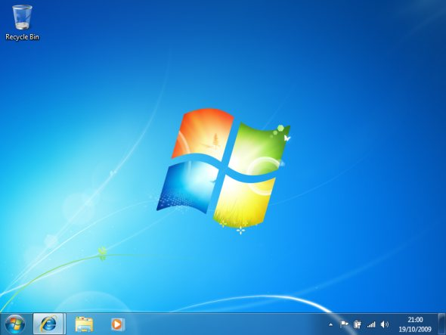

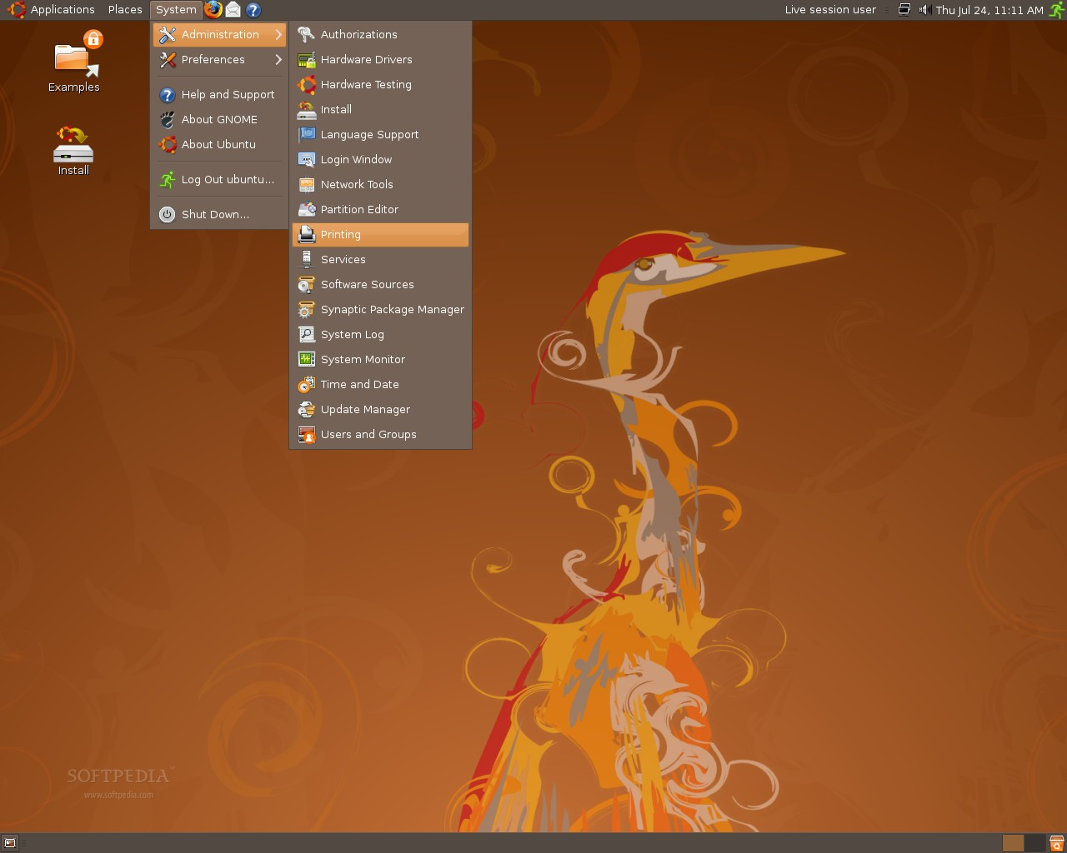
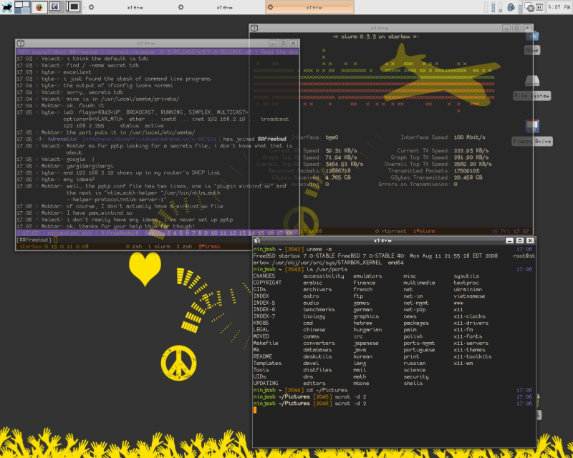
One view of an OS

Slide 5
Another simple view of an OS
App
App
App
App
OS
Hardware
Notes:
But really not quite right

Slide 6
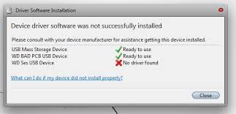
A less happy view of an OS

Slide 7
So which one is right?
They all are

Slide 8
An OS serves three constituencies
Human users: a desktop environment
Application Developers: More usable abstractions of the hardware
Hardware manufacturers: An abstraction of the applications to the device
Notes:
Although these things are bundled into one CD, they need not be
We’ll unpack what each of these looks like, but let’s go back to the architecture picture

Slide 9
Why Study Operating Systems?
Primary Goal: Demystify how computers work
  Lots of abstractions and heuristics between your application and the hardware
  A good computer scientist should understand what happens inside the system when one types a command
Secondary: Learn how to write robust programs
  OSes like Linux have many users and work on a wide range of hardware
  Deal with subtle issues: concurrency, consistency, etc.
Notes:
Philosophical issue for any CS degree holder
By the end of the course, you should understand what happens when you type a command, from the hardware through the OS and into the application

Slide 10
Background (1)
CPUs have 2 modes: user and supervisor
  Sometimes more, but whatevs
Supervisor mode:
  Issue commands to hardware devices
  Power off, Reboot, Suspend
  Launch missiles, Do awesome stuff
User mode:
  Run other code, hardware tattles if you try anything reserved for the supervisor

Slide 11
OS architecture
App
App
App
App
OS
Hardware
Notes:
But really not quite right

Slide 12
OS architecture
App
App
App
App
Libraries
User
Kernel
Super-
visor
Hardware
Notes:
So the OS components in user mode are often called libraries, and the part that runs in super-visor mode is called the kernel.
The kernel itself is often conflated with the OS

Slide 13
User #2: Applications
Application Programming Interface (API)
  Win32 (Windows)
  POSIX (Unix/Linux)
  Cocoa/Cocoa Touch (Mac OS/iOS)
Application-facing functions provided by libraries
  Injected by the OS into each application

Slide 14
OS architecture
App
App
App
App
Libraries
User
Kernel
Super-
visor
Hardware
Notes:
So the OS components in user mode are often called libraries, and the part that runs in super-visor mode is called the kernel.
The kernel itself is often conflated with the OS

Slide 15
OS architecture
App
App
App
Win32
API
Libraries
Libraries
Libraries
User
Kernel
Super-
visor
Hardware
Notes:
So the OS components in user mode are often called libraries, and the part that runs in super-visor mode is called the kernel.
The kernel itself is often conflated with the OS

Slide 16
Famous libraries, anyone?
Windows: ntdll.dll, kernel32.dll, user32.dll, gdi32.dll
Linux/Unix: libc.so, ld.so, libpthread.so, libm.so

Slide 17
Caveat 1
Libraries include a lot of code for common functions
  Why bother reimplementing sqrt?
They also give high-level abstractions of hardware
  Files, printer, dancing Homer Simpson USB doll
How does this work?

Slide 18
System Call
Special instruction to switch from user to supervisor mode
Transfers CPU control to the kernel
  One of a small-ish number of well-defined functions
How many system calls does Windows or Linux have?
  Windows ~1200
  Linux ~350

Slide 19
OS architecture
Open file “hw1.txt”
Ok, here’s handle 4
App
App
App
Libraries
Libraries
Libraries
User
Kernel
Super-
visor
System Call Table (350—1200)
Hardware
Notes:
So the OS components in user mode are often called libraries, and the part that runs in super-visor mode is called the kernel.
The kernel itself is often conflated with the OS

Slide 20
Caveat 2
Some libraries also call special apps provided by the OS, called a daemon (or service)
  Communicate through kernel-provided API
Example: Print spooler
  App sends pdf to spooler
  Spooler checks quotas, etc.
  Turns pdf into printer-specific format
  Sends reformatted document to device via OS kernel

Slide 21
OS architecture
App
App
Daemon
Libraries
Libraries
Libraries
User
Kernel
Super-
visor
System Call Table (350—1200)
Hardware
Notes:
So the OS components in user mode are often called libraries, and the part that runs in super-visor mode is called the kernel.
The kernel itself is often conflated with the OS

Slide 22
User 3: Hardware
OS kernels are programmed at a higher low level of abstraction
  Disk blocks vs. specific types of disks
For most types of hardware, the kernel has a “lowest common denominator” interface
  E.g., Disks, video cards, network cards, keyboard
  Think Java abstract class
  Sometimes called a hardware abstraction layer (HAL)
Each specific device (Nvidia GeForce 600) needs to implement the abstract class
  Each implementation is called a device driver

Slide 23
OS architecture
App
App
Daemon
Libraries
Libraries
Libraries
User
Kernel
Super-
visor
System Call Table (350—1200)
HAL
Driver
Driver
Driver
Hardware
Notes:
So the OS components in user mode are often called libraries, and the part that runs in super-visor mode is called the kernel.
The kernel itself is often conflated with the OS

Slide 24
What about User 1
What is the desktop?
Really just a special daemon that interacts closely with keyboard, mouse, and display drivers
  Launches programs when you double click, etc.
  Some program libraries call desktop daemon to render content, etc.

Slide 25
An OS serves three types of users
Give users a desktop environment
  Desktop, or window manager, or GUI
Give applications a more usable abstraction of the hardware
  Libraries (+ system calls and daemons)
Give hardware manufacturers an abstraction of the applications
  Device Driver API (or HAL)
Notes:
Although these things are bundled into one CD, they need not be
We’ll unpack what each of these looks like, but let’s go back to the architecture picture

Slide 26
Multiplexing Resources
Many applications may need to share the hardware
Different strategies based on the device:
  Time sharing: CPUs, disk arm
    Each app gets the resource for a while and passes it on
  Space sharing: RAM, disk space
    Each app gets part of the resource all the time
  Exclusive use: mouse, keyboard, video card
    One app has exclusive use for an indefinite period

Slide 27
So what is Linux?
Really just an OS kernel
  Including lots of device drivers
Conflated with environment consisting of:
  Linux kernel
  Gnu libc
  X window manager daemon
  CUPS printer manager
  Etc.

Slide 28
So what is Ubuntu? Centos?
A distribution: bundles all of that stuff together
  Pick versions that are tested to work together
  Usually also includes a software update system

Slide 29
OSX vs iOS?
Same basic kernel (a few different compile options)
Different window manager and libraries

Slide 30
What is Unix?
A very old OS (1970s), innovative, still in use
Innovations:
  Kernel written in C (first one not in assembly)
    Co-designed C language with Unix
  Several nice API abstractions
    Fork, pipes, everything a file
Several implementations: *BSDs, Solaris, etc.
  Linux is a Unix-like kernel
Notes:
START after this

Slide 31
What is POSIX?
A standard for Unix compatibility
Even Windows is POSIX compliant!

Slide 32
Administrative
Syllabus, schedule, homework, etc. posted on course website
www.cs.unc.edu/~porter/courses/comp530/f23

Slide 33
Prerequisites
COMP 210 – Data Structures
  Or 410 in the old numbering
COMP 311 – Computer Organization
  Or 411 in the old numbering
The background courses are necessary
In some cases, industry experience is ok
C programming
Basic Unix command-line proficiency

Slide 34
C Programming
You should have learned C in the prerequisite courses
  Ok if you are not a C guru (you will be)
A very good resource is “The C Programming Language” by Kernighan and Ritchie
  Digital version on canvas, under course reserves
  Relatively short, and lots of useful exercises
If you find yourself struggling with C, consider adding some work from this book to be able to complete this course on schedule

Slide 35
Labs: Learn by doing
This course is coding intensive
  You should know C, or be prepared to remediate quickly
  You must learn on your own/with lab partners
You will write several user-level utilities that exercise OS functionality
  Challenging work, but a very marketable skill
Notes:
START HERE

Slide 36
Group Policy
You may do assignments alone, or in teams of up to 3
You must list all teammates in code
Caveat: All teammates must understand code
  I reserve right to ask you about the code; if you can’t explain it to my satisfaction, you will lose points
  Also, there may be exam questions on programming assignments
You may change groups on each assignment
  Except Labs 1 and 2, where Lab 2 builds on Lab 1
    Changes still possible with instructor permission

Slide 37
Productive Frustration
One of the “meta skills” that distinguishes an excellent programmer is the ability to get un-stuck
  Fixing a “heisenbug” has this property
How do you learn this skill?
  Get stuck on a hard, but solvable problem
  Learn which strategies will get you moving again
If you take a quick cheat, you won’t learn the skills to solve truly hard problems
Notes:
START HERE

Slide 38
Academic Integrity
I take cheating very seriously. It can end your career.
  I check, and report to Honor Court
In a gray area, it is your job to stay on right side of line
Never show your code to anyone except your team and course staff
Never look at anyone else’s code (incl. other universities or past sections)
Do not discuss code; do not debug each other’s code
Acknowledge students that give you good ideas
  Note liberal group and lateness policies

Slide 39
Why do we care?
Analogy: This is the programming dojo
  If you don’t do your exercises, you will be unprepared for battle
  You’ve wasted your money and both of our time
  It brings dishonor on the dojo when you lose every battle
Similarly, a lot of what I teach (and what will make you a valuable employee when you graduate) has no short cut
  How do you learn to punch through a board?
  You punch a board over and over until your fist goes through it

Slide 40
Integrity Homework
Exercises applying course policies and ethics to several situations
Due by midnight on Weds 8/30, in gradescope
Note: no other assignments will be graded for you until this is completed

Slide 41
Lateness
Each student gets 72 late hours for programming hw
  Each day after these are gone costs a full letter grade on the assignment
  If you work in a team, each member loses 1 hour for each hour late
It is your responsibility to use these to manage:
  Holidays, weddings, research deadlines, conference travel, new season drops, release of the next Zelda game, etc.
3 Exceptions: illness (need doctor’s note), death in immediate family, accommodation for disability
Notes:
If it isn’t on this list, I don’t want to hear about it.

Slide 42
Lateness, continued
Maximum lateness penalty is a ‘D’ on the assignment
Anything may be turned in up until LDOC for up to 60% credit
  Challenge problems may be turned in up until LDOC
After midnight on LDOC, remaining late hours may be used, but no other late submissions will be accepted
Resubmissions are allowed, including late ones
  We will just grade (and penalize if late) the most recent submission

Slide 43
Challenge Problems
Each lab may include challenge problems, which you may complete for bonus points (generally 5—10 points out of 100)
  Unwise to turn in a lab late to do challenge problems
  Can complete challenge problems at any point in the semester---even on old labs
Indicate any challenge problems completed in challenge.txt file

Slide 44
Lectures
Discuss and supplement reading material
An important chance to clarify issues
  Questions are encouraged!
I expect you to arrive prepared to answer and ask questions about the reading material
Everything in lectures may appear on the exams, even if not in the book
I need you here: Digressions are common to fill in “gaps” and to integrate material from other classes
Notes:
START HERE

Slide 45
Recordings
I usually record lectures for students to review later
  I will share on Panopto/sakai
    I hope automatically, each new classroom is a mini-adventure
  All students in the course should be given access via your ONYEN
Recordings are best effort
  Recordings may fail, be unwatchable, or get deleted by accident
  Or be discontinued if too many students stop attending
    I need your facial expressions and questions to know if lectures make sense
Do not use this as a substitute for class attendance

Slide 46

Textbook
Free online at:
http://pages.cs.wisc.edu/~remzi/OSTEP/
You can buy a hard-copy or ebook format online if you want
Other optional references, definitely not required

Slide 47
Readings
My lectures aren’t perfect; some concepts are subtle
  Reading other words can be helpful for reinforcement and clarification
You will learn more in class if you read before class
  Can’t ask the textbook questions
A few papers will be posted and discussed; these you should read before class

Slide 48
Course email list
We will use campuswire this semester. Link and enrollment code on course sakai site
Will help scale up to a large class
This is the primary announcement medium
And for discussions about course work
  Do not post code here or other solutions
  Goal: Everyone can learn from general questions
Material discussed on the mailing list can be an exam question

Slide 49
Worksheets
You will get worksheets throughout the semester
  And randomly assigned teams
These will not be graded, except for participation
But are valuable practice for the exams
Do not save these until right before the exam
  A lot of work
  The material is cumulative

Slide 50
Other administrative notes
Read syllabus completely
Subscribe to the class campuswire forum
3 exams cover: lectures, labs, mailing list
All staff email goes to comp530ta@cs.unc.edu
  Except private issues for instructor only

Slide 51
Special Offer!
You can write your own exam questions
  Send them to me in advance of the test, if I like them, I will use them
  Do NOT share with anyone else

Slide 52
Getting help
TA’s will keep office hours
  See course calendar for times and zoom links
Instructor keeps office hours
  Note that “by appointment” means more time available on demand

Slide 53
Github Classroom
Git/github are powerful and common industry tools
  And useful for group work
We will use github to distribute and submit assignments (in tandem with gradescope)
  Bear with us as we work out any issues, esp with autograders

Slide 54
Questions?
Remember:
  Do academic honesty homework
  Lab 0 up/coming soon

