Slide 1
GENI in the Classroom: The Graduate vs. Undergraduate Class Experience Violet R. Syrotiuk
NSF Workshop on GENI in Education
26 October 2013 in Brooklyn, New York, U.S.A

Slide 2
My Graduate Networking Class (probably much like yours!)
Goals:
To become familiar with future internet architectures, protocols, and systems
To gain some practice in reading and critically evaluating research papers
To gain experience using state-of-the-art research platforms
Prerequisite:
A first course in networking

Slide 3
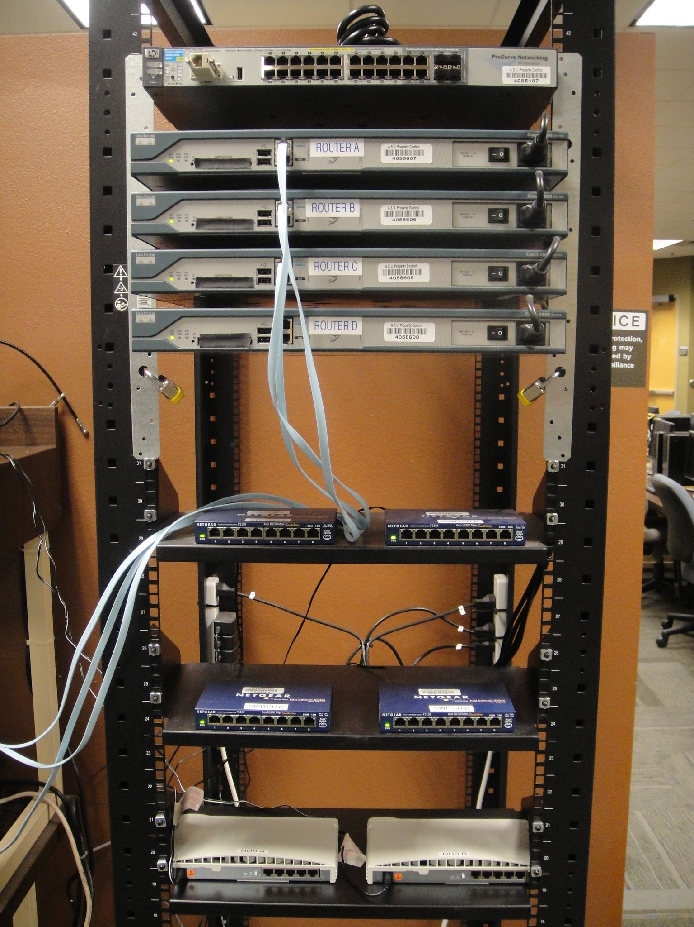
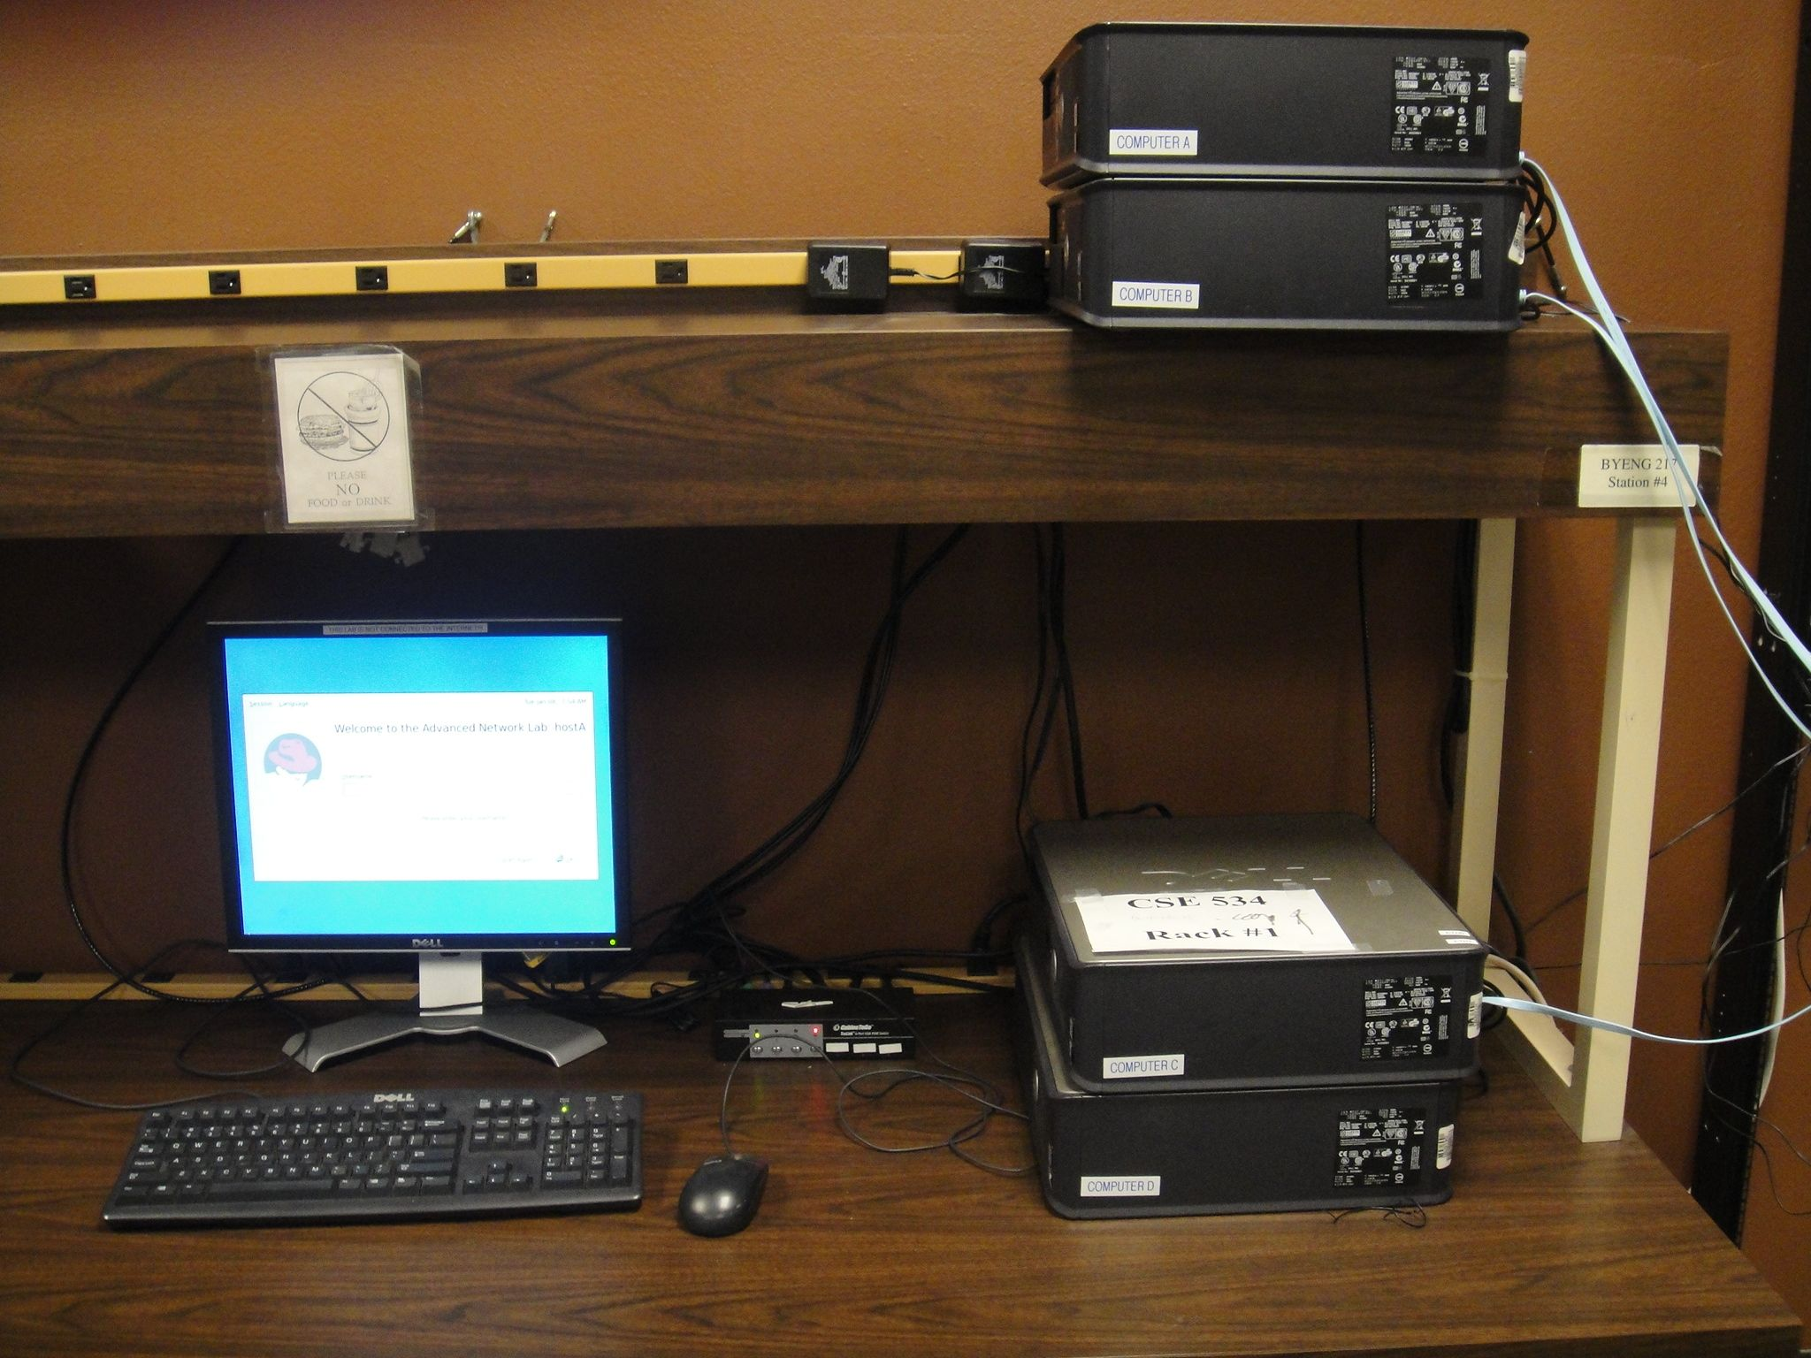
Our Lab Equipment
Three racks of equipment,
each one like this

Slide 4
Lab Manual
Lab topics:
Introduction to the equipment
Single segment IP networks
Static routing
Dynamic routing protocols
Transport layer protocols
LAN switching
NAT and DHCP
DNS
SNMP
IGMP
Selected topics to get “hands on” experience

Slide 5
Advanced Networking Labs
Content Centric Networking, CCNx
Explore static and dynamic data
Project to extend a basic CCNx program or develop a new program
GENI
Non-IP ping layer 2 experiment
OpenFlow tutorial with four experiments
Write a new OpenFlow controller using Mininet
Test controller on GENI topology in OpenFlow tutorial

Slide 6
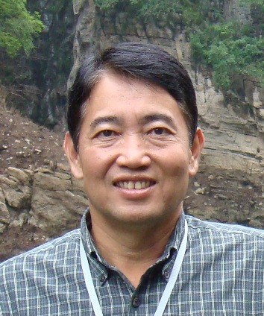
My Undergraduate Networking Class
Cover the 7 layer stack (well, the TCP/IP stack)
Prerequisites:
Course in data structures and algorithms
Experience with Linux
Programming in C or C++
Can we use the networking lab equipment with undergraduates?
Sure, let’s try!

Slide 7
Dilemma!
Teach networking top down, or bottom up?

Slide 8
GENI with Undergraduates
First GENI experience about one month into the course
After doing labs
Introducing the lab equipment,
Single-segment IP networks, and
Static routing

Slide 9
Experience with GENI
First experiment: non-IP ping layer two
One person:
After disabling IP addressing could still see IP addresses!

Slide 10
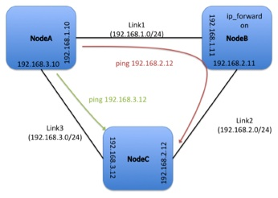
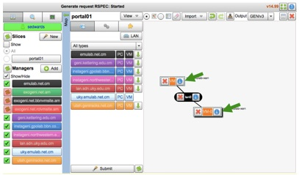
Experience with GENI
Second experiment: static IPv4 routing
Used GENI flack tool to import topology
No ssh button on the information page!
Close flack and reopen it or create topology manually

Slide 11
Ugrad Experience with GENI
How to generate and download ssh keypairs on Windows?
The information is there, just not obvious
Some errors encountered:
Permission denied
SIOCADDRT: No such process
sudo: unable to resolve host NodeB
SIOCADDRT: Operation not permitted!
One or two thought GENI was a simulator!

Slide 12
Summary
Undergrads have less experience with Linux, and less understanding of networking, than grads
They tend to switch aggregates and try random things whenever a problem arises
Maybe a wiki for likely errors encountered?
GENI
Provides a lab environment for networking with incredible potential for education
Appreciated by those students who understand it!

