Slide 1

Practical Advice for
Using GENI in the Classroom
Sarah Edwards, Niky Riga
GENI Project Office

Slide 2
Outline
Classroom Timeline and Checklist
Useful Tips
Online Resources

Slide 3
Classroom
Timeline and Checklist

Slide 4

Timeline/Checklist
Early, at least two weeks in advance of class
1. Notify help@geni.net that you will be using GENI
2. Determine access to GENI
3. Create a project for the class
  request project lead permission in the portal
  create a project in the portal and set project expiration time!
  add other instructors/TAs to project and makes them Admins
4. Choose exercises and test them
  Create GMOC ticket reserving resources
5. Decide what machine/software the students should use
At least one week in advance of class
6. Email pre-work to students
  Invite students to login to the portal
    Students may need to request an account from the GENI IdP
  Setup their machine for the exercise
Before first exercise
7. bulk add students to the project
Many steps are quick and easy.
On the next slides we’ll cover the background you need to do each step.
Feel free to follow along on your handout.
1x
1x
http://groups.geni.net/geni/wiki/GENIEducation/Resources

Slide 5

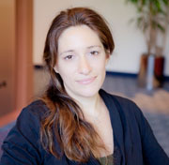

Have a question?
Answer is
help@geni.net
which is an email list which only goes to members of the GPO including…
Sarah Edwards
Niky Riga
Vic Thomas
(However, the archive of the list is public)
Notes:
Have a question?
The answer is always help@geni.net.
help@geni.net goes to a number of friendly faces including Niky, Sarah & Vic. We’ll answer your question or redirect it the appropriate place. Always email help@geni.net instead of emailing us directly, as it ensures a more timely response.

Slide 6
Considering using GENI?
Reasons to let us know you are using GENI in your class…
… especially if this is your first time.
Accounts
Whether they access GENI using InCommon or the GENI IdP, we can make sure students are able to login easily and quickly
Resources
We can help you select resources and reserve resources for your exercises.
1.
Always OK to just say
"I'm thinking of teaching a class using GENI this semester”

Slide 7
Accessing GENI via the Portal
  https://portal.geni.net
Anyone with an account at a federated identity provider (IdP) can sign in, with no privileges
To get privileges must be a member of a
GENI Project
Notes:
Anyone with an account at a supported identity provider can log in to the GENI portal but they will have no privileges. You must be a member of a project to do anything interesting.

Slide 8
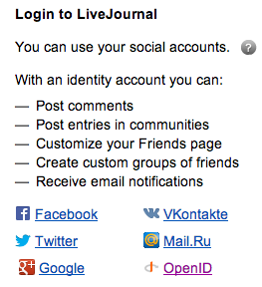
What is an Identity Provider?
“A user clicks on a Service Provider’s resource. Using federating single sign-on software, the user is authenticated by his or her Identity Provider, which releases only enough identity data to allow the Service Provider to make an access decision.”
  -- https://incommon.org/federation/basics.html
Analogous to using your facebook account to sign in to a third-party website.

Slide 9


InCommon
Leverage InCommon for
single sign-on authentication
Experimenters from 328 educational and research institutions have InCommon accounts
For many experimenters:
  no new passwords
  familiar login screens
  GPO has an IdP to provide accounts for members of institutions who are not part of the federation
Notes:
The GENI Portal trusts identity providers who are members of the InCommon federation.
Students, faculty and staff will have an account provided by their school (for example, the University of Utah) which they use to access campus resources.
They can then use that account to login to GENI as long as their school is a member of InCommon (with some caveats). **This is exactly like using your Facebook or Google account to access other websites.**
For those experimenters, there are no new passwords. For all others, we are happy to make you an account on the GPO’s identity provider.

Slide 10

Determine which IdP to use for access
Two options:
  Your institution is federated with InCommon
    then “just sign in” with institution-issued username/password
    If institution does not release appropriate attributes (e.g. e-mail)
    we will work with campus IT to address this; might take time
  Your institution is not federated with InCommon
  … or does not release the appropriate attributes
  then request GPO IdP accounts for logging in
2.

Slide 11
Projects
Project
Projects organize research in GENI
Slice
Lead
Members
  Projects contain both people and their
  experiments (aka slices)
  A project is led by a single responsible individual:
  the project lead
A project may contain many experimenters;
an experimenter may be a member of many projects
Notes:
Experimenters can perform experiments in the context of a project.
Projects contain both people and their experiments. (Experiments are represented by slices, a term we will define in a few minutes.)
A project must have a single individual who is willing to take responsibility for what happens within the project. This person is called the project lead

Slide 12
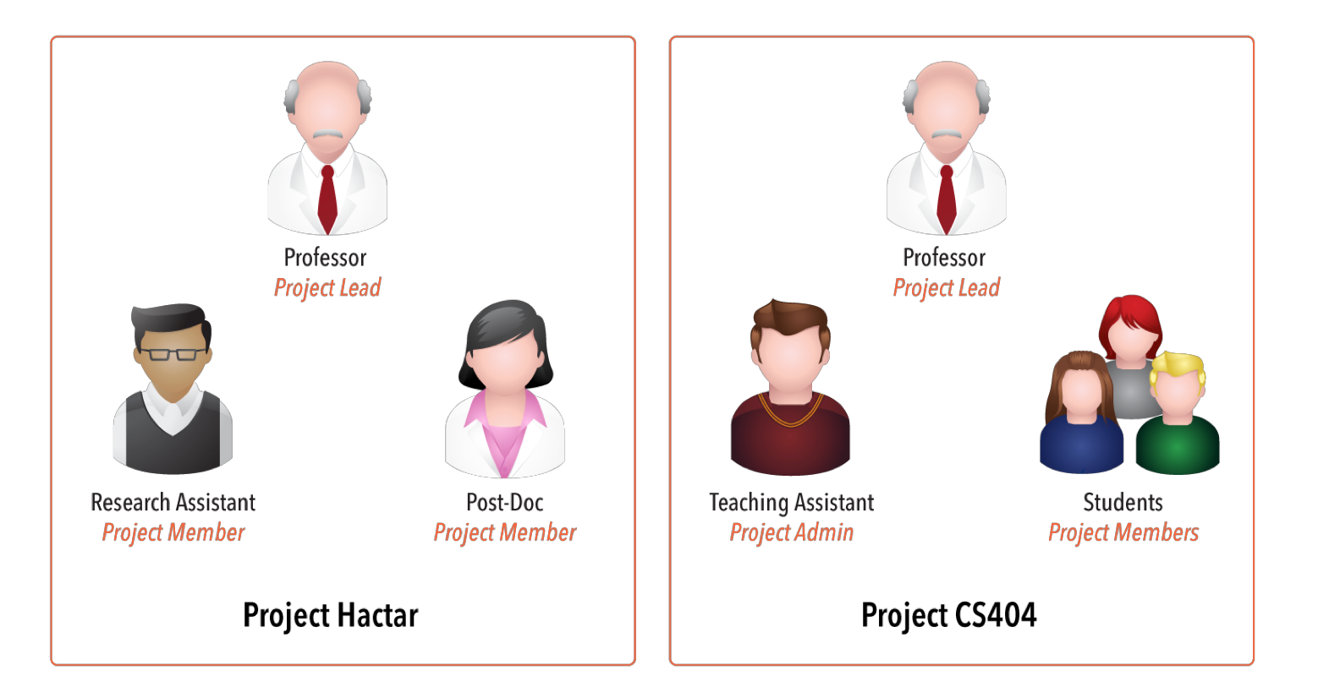

Project Membership example
Projects have 1 Lead and any number of Admins, Members, and Auditors
Expiration
Typical Class
http://groups.geni.net/geni/wiki/GENIConcepts#Project
Notes:
Calendar clipart: http://all-free-download.com/free-vector/vector-clip-art/table_calendar_clip_art_12117.html

Slide 13
Creating Projects
Only project leads can create projects.
  Only professors and senior technical staff can be a lead
  Request to be a lead and create projects from Home page
Project names are:
  public, unique and permanent
Projects have an optional expiration
(e.g. for classes, tutorials)
  Class projects should expire at the end of the class.
After creating a project, add TAs and other instructors to project as Admins
Typical Class
3.
Notes:
In general, only project leads can create projects.
Project names are: public, global and permanent (choose carefully)
A project can contain many experimenters. And experimenters can be in many projects.
Projects have an optional expiration which can be used to support classes and tutorials.

Slide 14
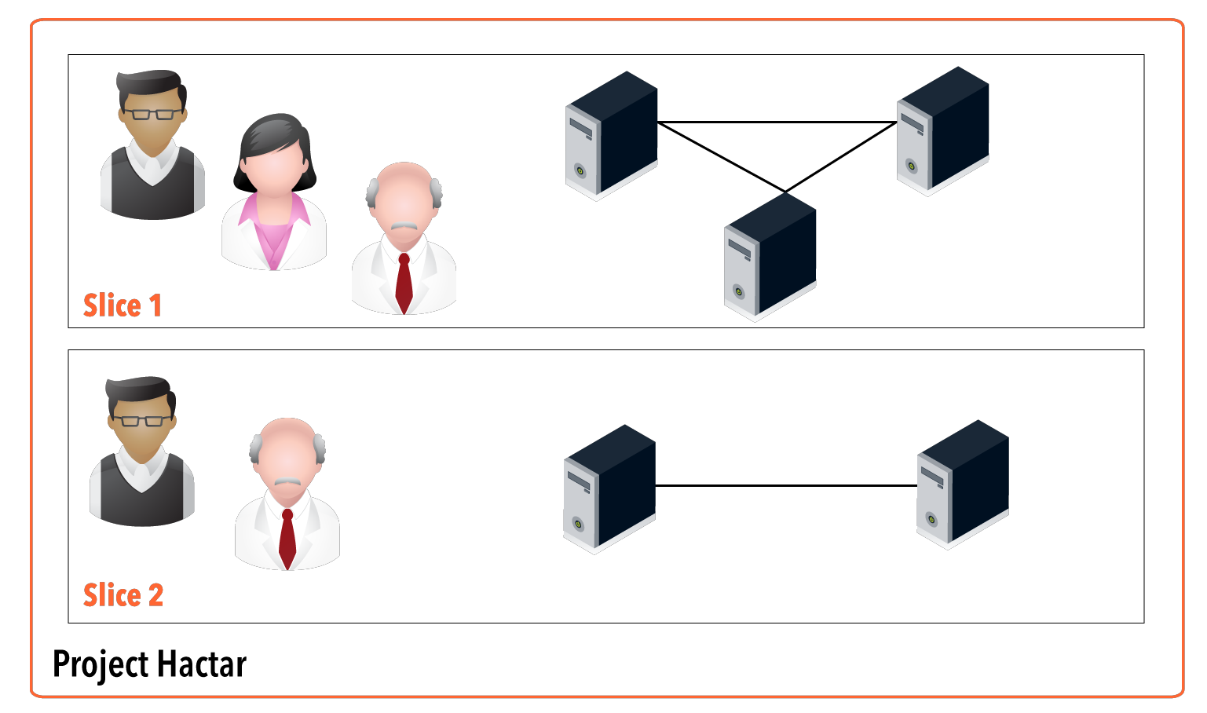
Projects Contain Slices
Professor
Slice Admin
Research Asst
Slice Lead
Post-Doc
Slice Member
Research Asst
Slice Lead
Professor
Slice Admin
One Slice Lead, any number of Admins, Members, and Auditors
Slice Lead defaults to the person who created the slice
Project Lead and Admins are added to all slices as Admins
http://groups.geni.net/geni/wiki/GENIConcepts#Slice

Slide 15
Project and Slice Roles
 |  | Create project | Modify project & manage membership | Create slice | View project
Project | Lead * | ✔ | ✔ | ✔ | ✔
 | Admin * |  | ✔ | ✔ | ✔
 | Member |  |  | ✔ | ✔
 | Auditor |  |  |  | ✔
 |  | Manage slice membership | Act on slice | View slice | Account/ keys loaded on slice
Slice | Lead ** | ✔ | ✔ | ✔ | ✔
 | Admin * | ✔ | ✔ | ✔ | ✔
 | Member |  | ✔ | ✔ | ✔
 | Auditor |  |  | ✔ | ✔
* By default, Project Lead/Admins are added to all slices as a Slice Admin
** The Slice Lead defaults to the person who created the slice

Slide 16
Join a project
Two options for adding experimenters to a project
  Admin-initiated:
  Project Lead or Admin bulk uploads experimenters
    Best for adding many people at the same time
    Typically used for Classrooms or Tutorials
  Member-initiated:
  Each experimenter requests to join the project and is individually approved
    Best for adding people one at a time
    Typically used for Research projects
Typical Class
3 & 7

Slide 17
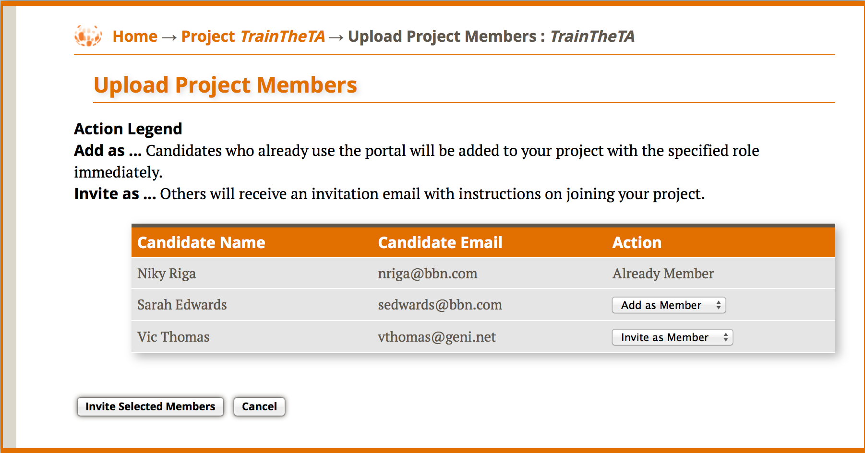
Admin-initiated; aka Bulk Upload
On Project page, the Lead or Admin clicks Bulk Add New Members
Upload a CSV file with one line for each student
CSV file format:
  email, name, [optional: role = Admin, Member(Default), Auditor]
Example
  nriga@bbn.com, Niky Riga, Member
  sedwards@bbn.com, Sarah Edwards
  vthomas@geni.net, Vic Thomas
Typical Class
Add to project immediately
Invite to join project

Slide 18
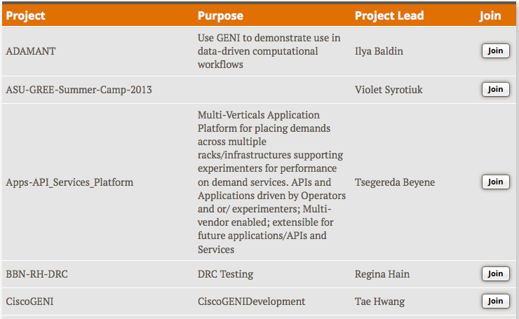
Member-initiated
On Home page, Experimenter selects “Join a Project” button
Pick a project to join and
The Lead/Admin approves the request

Slide 19

Available Exercises
List of sample assignments and tutorials:
  Use as they are
  Modify to meet your needs
Annotated:
  Type
  Purpose
  Resources needed
  Difficulty/Duration
http://groups.geni.net/geni/wiki/GENIEducation/SampleAssignments

Slide 20
Available Exercises
Each sample exercise has:
  Handouts / Instructions for students
  Further information about the instructors
  For solutions email help@geni.net
Instruction format:
  3 Steps based on standard experiment lifecycle

Slide 21
Create your own
Figure out GENI Resources
Test your exercise
Adjust writeup

Slide 22

Create your own: GENI Resources
Compute resources:
  Wired / Wireless exercise?
  Are VMs ok?
Networking requirements
Tools
  Flack, Omni, I&M
List per student/group:
GENI resources
Tools

Slide 23
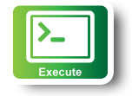
Create your own: Test
Run through the exercise
Automate:
  Install scripts (HowTo/WriteInstallScripts)
  Custom Image
RSpec for exercise
Install scripts
Custom image
http://groups.geni.net/geni/wiki/HowTo/WriteInstallScript

Slide 24

Create your own: WriteUp
Decide what students should hand in:
  Screenshots
  Commands
  Configuration
Should they leave the slice up?
  Login and test their environment
Online template for instructions
Remember to include clean up!
Please, send us your exercise!

Slide 25

Load Balance the students
Split students/groups between equivalent resources (e.g. racks) to avoid resource contention
If using scarce resources consider a rolling deadline
Regardless of who reserves the resources,
always load balance reservations across aggregates

Slide 26

Notify Resource GMOC
GMOC: GENI Meta-operation Center
Keeps track of outages
Notification system for resource reservation
GMOC Google Calendar keeps track of reservations/outages
4.
http://groups.geni.net/geni/wiki/HowTo/PreReserveGENIResources

Slide 27
Native Setup: Student’s laptop
Make a list of all tool requirements
(e.g. Flack needs Flash installed)
Ensure students can install/use all tools needed for exercise
(e.g. they can ssh to nodes)
Make sure they test it early in the class. LabZero is a good way to do this!
http://groups.geni.net/geni/wiki/GENIEducation/SampleAssignments/LabZero

Slide 28
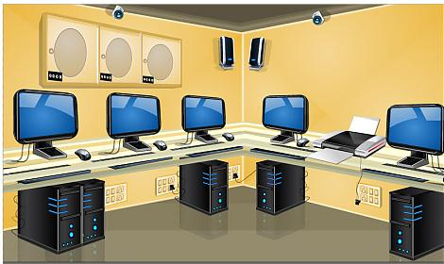
Native Setup: Lab Computers
Install and test tools on the machines
  Go through the exercises in the lab
If there are specific times the lab is open, stress-test the resources or split students

Slide 29

Setup using a VM
Create a VM in VirtualBox*:
install all tools
  Go through the exercises from the VM
students use VirtualBox to load the VM
*you can use any virtualization technology that is appropriate
  http://groups.geni.net/geni/wiki/HowTo/CreateTutorialVM

Slide 30
VM or not? How to choose
Use a VM if:
  Want to use Omni (NEW! Windows/MAC Beta binaries)
  Students not familiar with computer admin
  (e.g. offering a cross-discipline course)
  This is a one-time tutorial
  Uniform environment
  Easier to help students and write instructions
Use native setup if:
  Students will use GENI for research
  Students in class are future TAs
5 & 6

Slide 31
Timeline/Checklist
Early, at least two weeks in advance of class
1. Notify help@geni.net that you will be using GENI
2. Determine access to GENI
3. Create a project for the class
  request project lead permission in the portal
  create a project in the portal and set project expiration time!
  add other instructors/TAs to project and makes them Admins
4. Choose exercises and test them
  Create GMOC ticket reserving resources
5. Decide what machine/software the students should use
At least one week in advance of class
6. Email pre-work to students
  Invite students to login to the portal
    Students may need to request an account from the GENI IdP
  Setup their machine for the exercise
Before first exercise
7. bulk add students to the project
1x
1x
http://groups.geni.net/geni/wiki/GENIEducation/Resources

Slide 32
Useful Tips
  Setting up a slice
  Acting on a slice and logging into nodes
  Debugging Tips

Slide 33
Slice Setup: Student Setup Slice
Need to provide:
Resource Specification (aka RSpec):
  Students might create their own
  Provide one of: URL, File, or Upload it in the Portal
Specify aggregates for students to use
Preferred tool
  Flack, Omni, Portal
Research Asst
Slice Lead
Post-Doc
Slice Member
Professor
Slice Admin

Slide 34
Slice Setup: Premade slices
Why use pre-made slices?
Lab Exercises: Resource reservation might take time
Assignments: Resource reservation is complicated/unique or out of scope
How to pre-make a slice:
1. Create one slice per student/group
2. Make the student(s) members of the slice
Ensure they have keys (email us if needed)
3. Reserve resources from the Portal

Slide 35
Slice Access
Members of all slices in a project:
Project Leads (Professor)
Project Admins (TAs, Graders)
Research Asst
Slice Lead
Post-Doc
Slice Member
Professor
Slice Admin

Slide 36
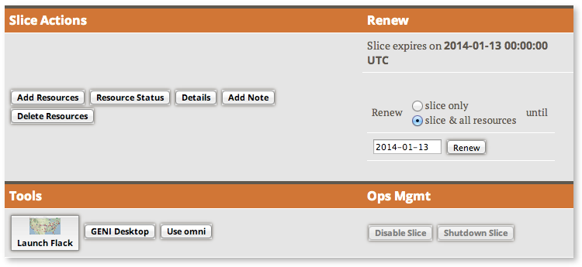
Slice Access
Being a member of a slice means you can act on a slice:
  Add resources
  Check status
  Delete resources
  Renew resources
With any tool!

Slide 37

Slice Access: Logging in to resources
Slice membership does not guarantee ability to login to resources!
  Option 1: Make resource reservation from Portal
    fix the membership of the slice
    Use the add resource button in the portal
  Option 2: Ensure common public key is loaded
    distribute common public key to students
    ask students to upload it in their profile
    use corresponding private key to login
Ability to login can help in debugging!
Notes:
Add options

Slide 38
Login to nodes using SSH
Login to all GENI compute resources using
ssh with a private key – no password
If you are ever prompted for a password during login to GENI nodes something is wrong

Slide 39


SSH Private/Public keys
Using key-pair with SSH:
  Public key: is public to everyone, loaded onto nodes
  Private key: kept private in your local machine, provided to SSH to verify it matches the loaded public key

Slide 40
SSH & CLI Challenges
Students might not be familiar with CLI
Students might not be familiar with public key cryptography
  Hard to distinguish between private and public
  Hard to distinguish between password and passphrase
Consider a brief SSH & CLI tutorial/intro
http://groups.geni.net/geni/wiki/HowTo/LoginToNodes

Slide 41

SSH from Windows
SSH with keys from Windows is non-trivial
  No standard ssh client that support keys (like openSSH)
Possible Solutions
  Pay software – eg SecureCRT
  Linux VM – make use of a slim OS
  Lab machine/campus resources
  cygwin
  FireSSH – javascript plugin for Firefox
  PuTTy (private key format different)
Need to address this early!
http://groups.geni.net/geni/wiki/HowTo/LoginToNodes
Notes:
Your university may have a license for the pay software.

Slide 42
General debug advice
Gather as much information as you can
  Ask students to be specific about what is not working
    Step-by-step run through usually helps
  Ask for what they see (screenshots, omni output errors)
  Setup information (slice name, tool used, rspec, etc)
Remember you have access to slices, check for yourself!
Contact help@geni.net for help
Register for resource mailing lists
  Better for you or your TA to triage questions before posting in a public forum

Slide 43
Ways to Get Help
Email help@geni.net
Use #geni IRC chatroom
Sign up for mailing lists
http://groups.geni.net/geni/wiki/GENIExperimenter/GetHelp

Slide 44
Online resources

Slide 45
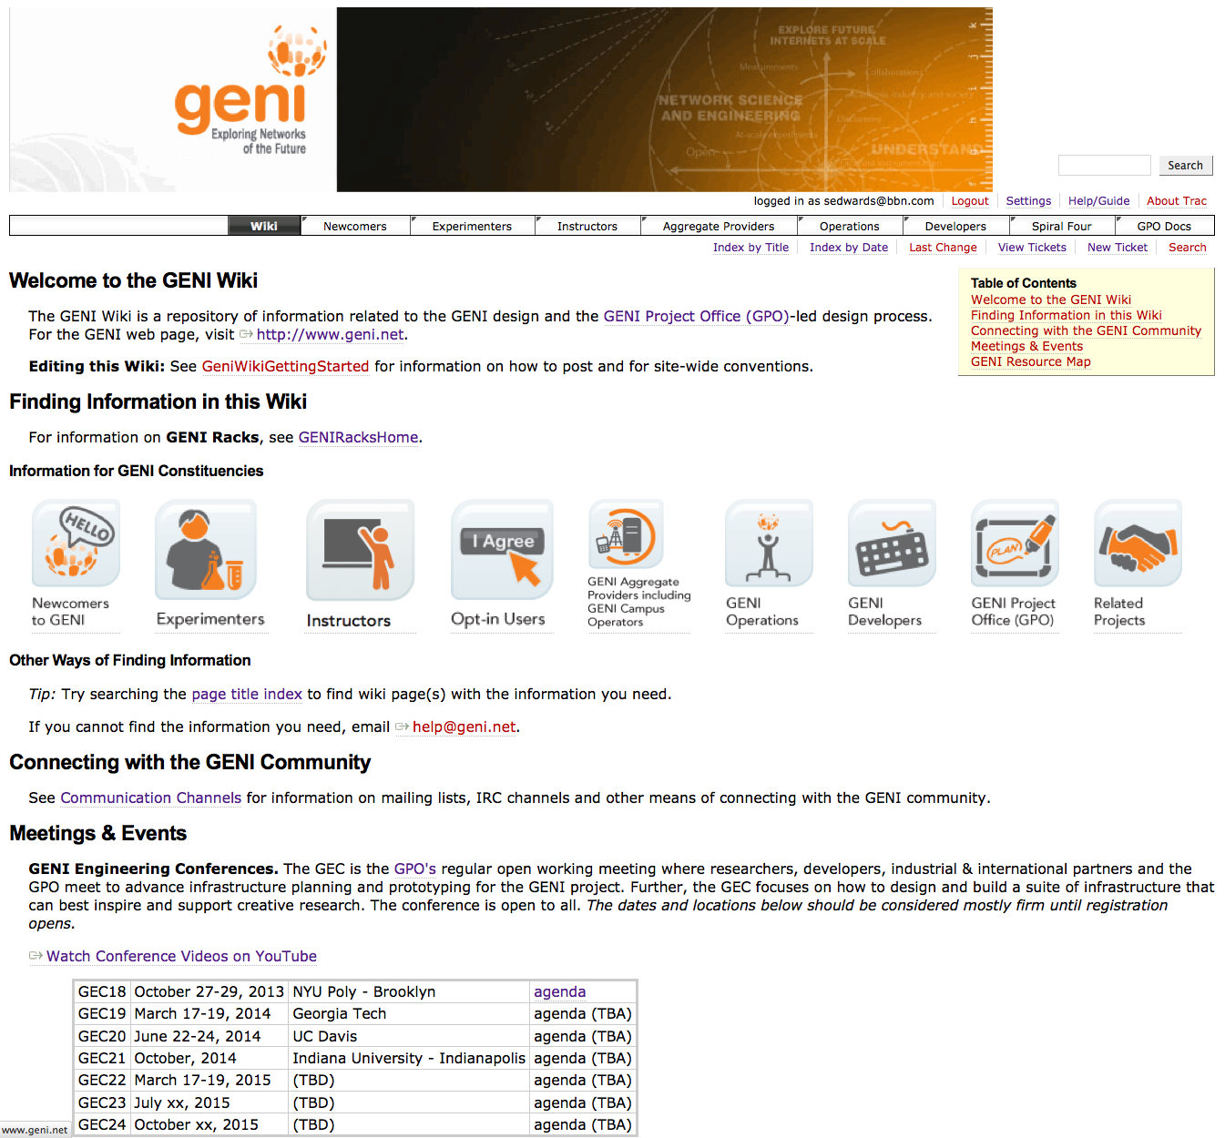
Finding other resources
GENI wiki
  Pages for Instructors and Experimenters
http://groups.geni.net/geni/wiki

Slide 46


Available Exercises and tutorials
Assignments under the Instructors tab on the wiki
http://groups.geni.net/geni/wiki/GENIEducation/SampleAssignments
Recommendation: Start with Lab Zero
http://groups.geni.net/geni/wiki/GENIEducation/SampleAssignments/LabZero
Second assignment: Understanding AM API
http://groups.geni.net/geni/wiki/GENIEducation/SampleAssignments/UnderstandAMAPI
Get solutions by e-mailing help@geni.net
Tutorials under the Experimenters tab on the wiki
http://groups.geni.net/geni/wiki/GENIExperimenter/ExampleExperiments

Slide 47
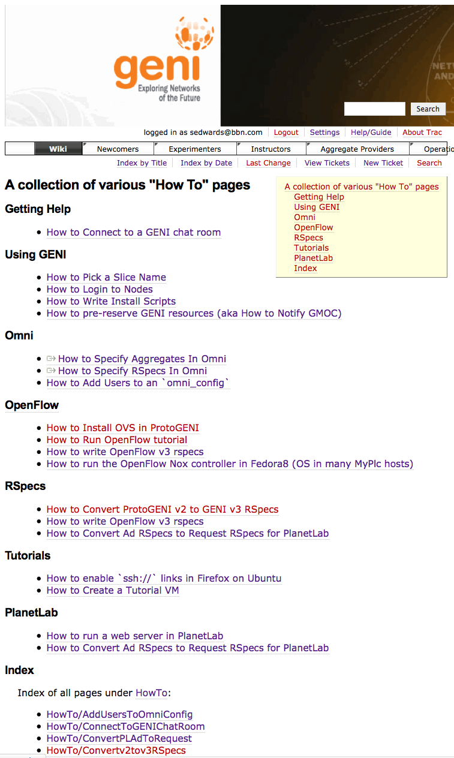
“How To” pages
Listed under the “Experimenters” section
Each “How To” is a short descriptions of how to do various tasks
New entries being added all the time

Slide 48

Tour of the Portal

Slide 49
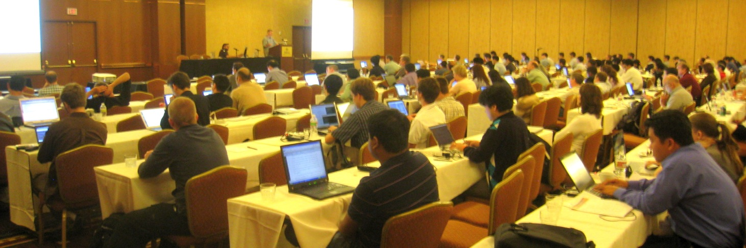
Ways to Learn More
GENI Engineering Conference (GEC) 3x a year
GREE Workshop in March 2013
GENI Camps for graduate students
GENI Online seminars
Notes:
49

Slide 50
Welcome to GENI!

Slide 51
BACKUP

Slide 52
Common Problems
  Can’t login to a node
  Can’t access aggregate
  Slice did not come up
  Omni is not working

Slide 53
Common Problems
Problem: Can’t login to a node
Possible causes:
  Wrong username
  Public key isn’t loaded / Private key is wrong or non-existing
  Private key has wrong permissions (it should have 0600)
  Slice/sliver expired
  Technical issue with node
Debug strategy:
  Try logging in to the node yourself
    If successful look for the student account
      cd ..; ls
    Look for loaded keys
      sudo cat <student_user_path>/.ssh/authorized_keys
  Ask them to use ‘-v’ option
    ssh –v foo@bar.example.net

Slide 54
Common Problems
Problem: Can’t access AMs
Possible causes:
  Firewall issues
  AM is down
Debug strategy:
  Check the GMOC calendars for planned/unplanned outages
    http://globalnoc.iu.edu/gmoc/index/support/gmoc-operations-calendars.html
  Verify access from campus (check the wireless!)
  Have the student try to telnet to the port:
    e.g. telnet www.emulab.net 12369
    http://groups.geni.net/geni/wiki/KnownGENIPorts

Slide 55
Common Problems
Problem: Slice did not come up
Possible causes:
  Student did not wait long enough
  Problem with rspec
Debug strategy:
  Check slice/sliver status yourself
  Ask students to tell you the exact steps and try to replicate it
  Use rspeclint on your rspecs
    http://www.protogeni.net/wiki/RSpecDebugging

Slide 56
Common Problems
Problem: Omni is not working
Possible causes:
  Computer is not connected to the internet/behind firewall
  PATH/PYTHONPATH is not correct
    Python error
  omni is not configured
Debug strategy:
  Check their PATH and PYTHONPATH variables:
    echo $PATH
    echo $PYTHONPATH
  Verify connectivity to:
    The internet (ping www.google.com)
    To the AMs (telnet ch.geni.net 8443, telnet

