Slide 1
Teaching GENI on a Massive Scale with a GENI MOOC
Shivendra Panwar, Thanasis Korakis, Max Ott,
Fraida Fund
Polytechnic Institute of NYU
NSF Workshop on GENI in Education
October 26, 2013

Slide 2
Project Goals
Previous and ongoing GENI in education projects have created materials for instructors who can use GENI in their classroom

Slide 3
Project Goals
GENI MOOC is for reaching students
  whose instructors are not interested in updating their curriculum to include GENI labs
  whose instructors have never heard of GENI
  who don’t typically take CS or EE classes, but are interested in learning about practical networking
  who aren’t college students (talented high school students, professionals)
Instructor buy-in is not required

Slide 4
Lessons Learned
Past experiences using GENI in education:
  Spring 2013: 8 students in pilot GENI WiMAX lab
  Fall 2013: 60+ students in GENI WiMAX lab
(more info, demo at WiMAX Dev meeting @ GEC18)
Great feedback - students love doing “real” experiments!

Slide 5
Lessons Learned
We’ve built robust systems for:
dynamically assigning resources to students as needed - not by giving each student or group of students a slice/node
monitoring health of resources, automatically taking down those that are not behaving and bringing up new ones as needed, to scale
Eliminates major points of friction in classroom use, but even so...

Slide 6
Lessons Learned
Students need a lot of guidance to work on GENI directly
  experimentation concepts and techniques new to many students
  Ratio of 1 TA : 8 students worked well for us
not scalable to MOOC format!

Slide 7
Major Goal
Keep it very simple -
highly accessible
to any student
with minimal
instructor guidance

Slide 8
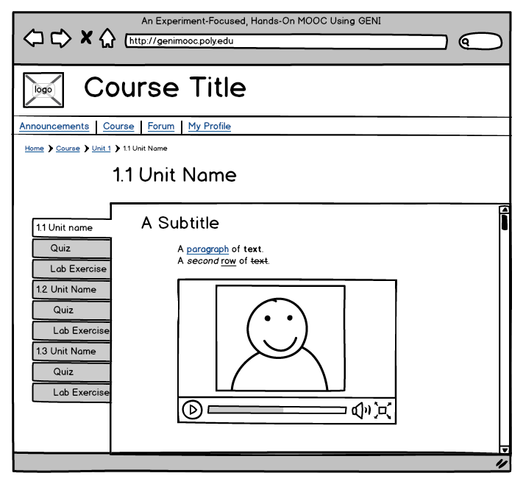
MOOC Format
Video content + quiz + interactive lab in small “nuggets”
Personalized guidance comes mainly from peers via forum, up-voted questions get response from TA or instructor
Planning a short class at the end of year 1 - about 4 units of content

Slide 9
Project Philosophy
Keep a low barrier to entry
  no per-student GENI account
  don’t show students any code or RSpec
  no previous networking background required
  don’t make students learn how to use a new interface

Slide 10
Project Philosophy
User-friendly topics motivated by students’ experiences using the Internet
  e.g., How does adaptive video streaming work?
Experiments serve to illustrate concepts in networking - filling a role similar to the interactive applets commonly used in a classroom.

Slide 11


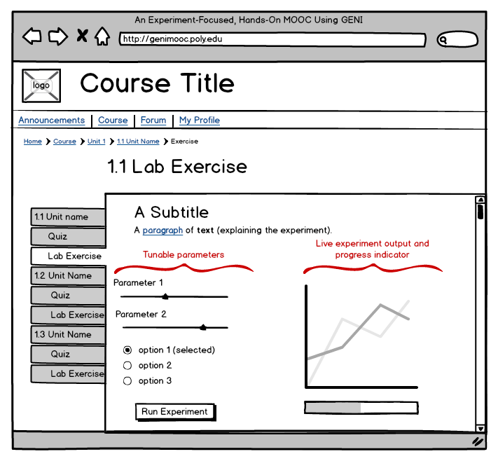
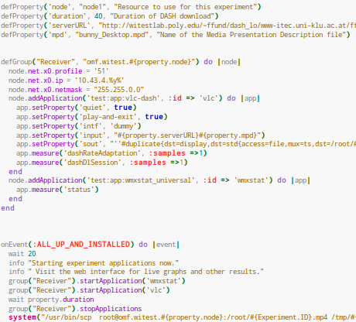
Project Philosophy
Show this:
Not this:

Slide 12
Thank you

