Slide 1
A Virtual Computer Networking Lab
Mike Zink, Jim Kurose, Max Ott, Jeannie Albrecht
NSF Workshop on GENI in Education,
October 26th 2013

Slide 2
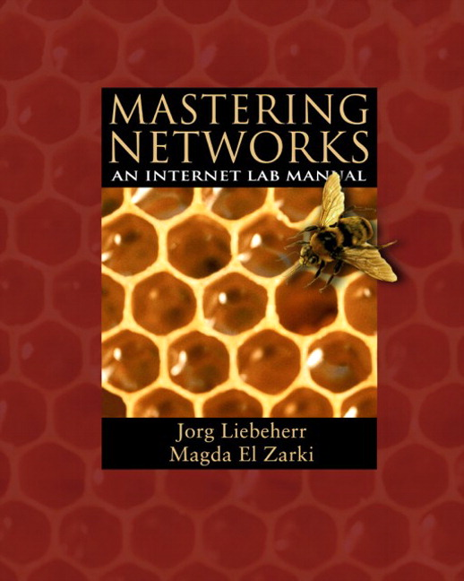
Computer Networking Labs

Slide 3
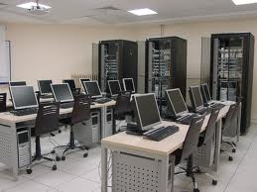
The “Traditonal” Networks Lab
Each institution requires a set of hardware (switches, routers, cables, computers)
Hardware outdates fairly quickly
Certain aspects are vendor specific
Equipment is unused for periods of time

Slide 4
The “Virtual” Networks Lab
Use GENI infrastructure to teach lab
Individual institutions don’t need hardware
“Guide” students as much as needed
Teach new technologies (e.g., OpenFlow)
Downside:
Students do not touch hardware

Slide 5
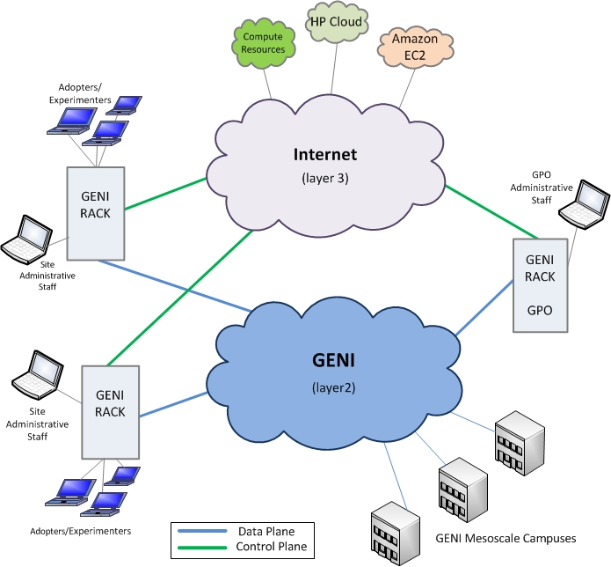
GENI Technology
GENI Portal
GENI APIs
GENI Racks
GIMI Tools

Slide 6
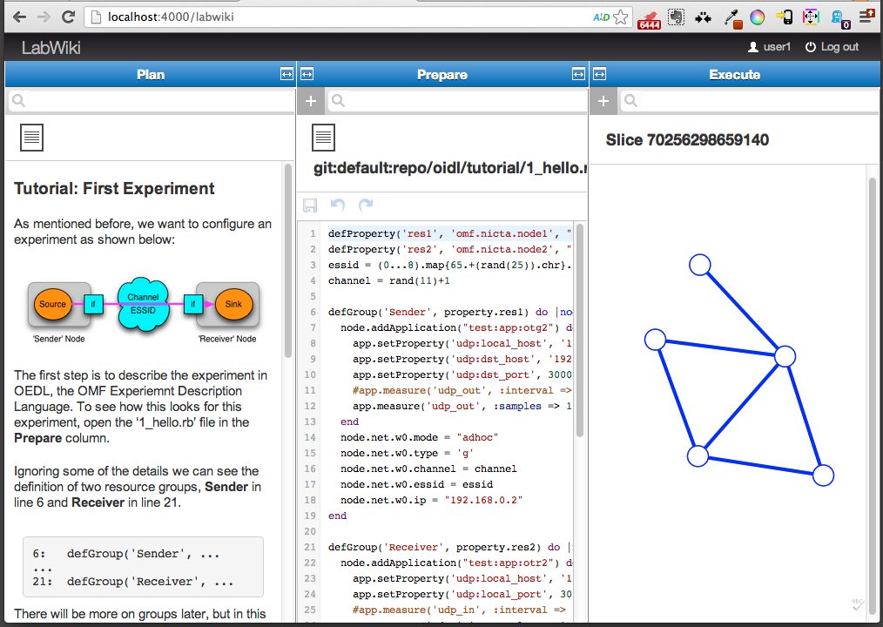
LabWiki as a Classroom Tool

Slide 7
LabWiki Architecture
LabWiki Core
Plan
Prepare
Execute
Plugin
Your Plugin
GENI
CH/AM
OMF
GIMI Services
iRODS
Your
Service

Slide 8

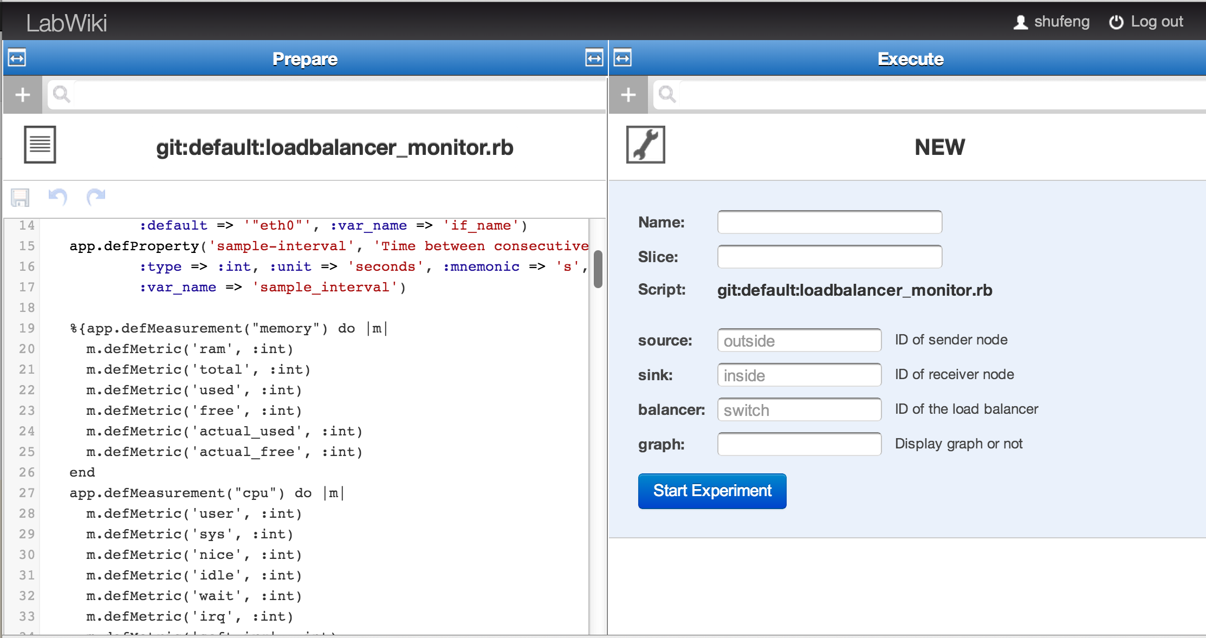
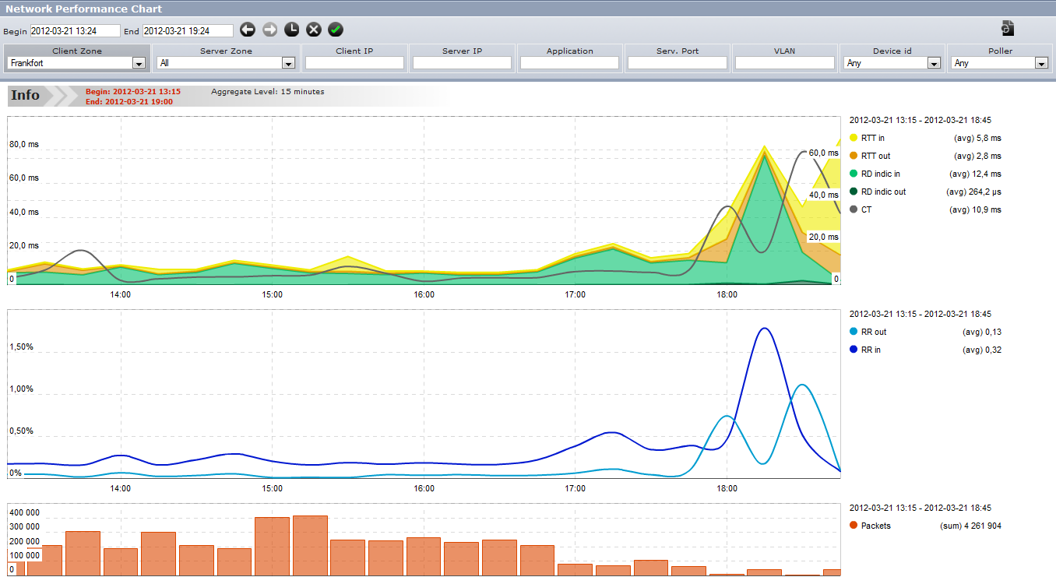
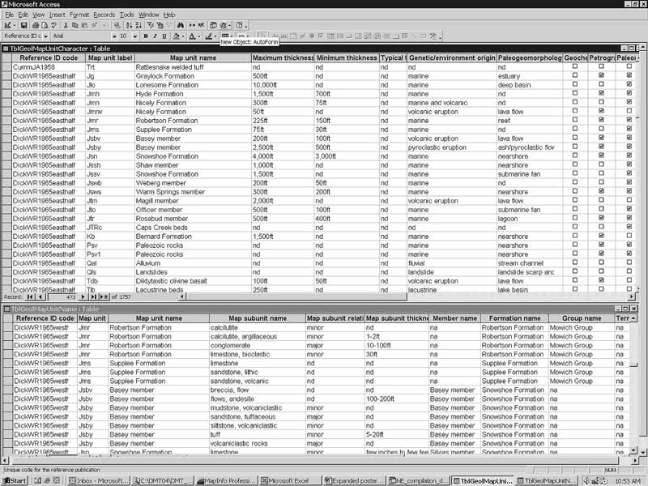
Environment
Experimenter
iRODS
Automated
6.Obtain
5.Save
5.Save
1.Instrument
LabWiki
4.Plot
4.Plot
OML
Server
0.Reserve
2.Run
2.Run
3.Collect
3.Collect
GENI
TestBed
OML Client

Slide 9
The “Virtual” Networks Lab
Lab | Title
1 | Beginners Lab
2 | Introductory Lab
3 | TCP & UDP
4 | Static & Dynamic IP Routing
5 | OpenFlow Lab
6 | OpenFlow-based routing
7 | Data Center
8 | Wireshark

Slide 10
Teaching Specific
Create an interface to course management system(s) (e.g., moodle)
Be able to “observe” student performance
Allow for easy new module development
Video clips

Slide 11
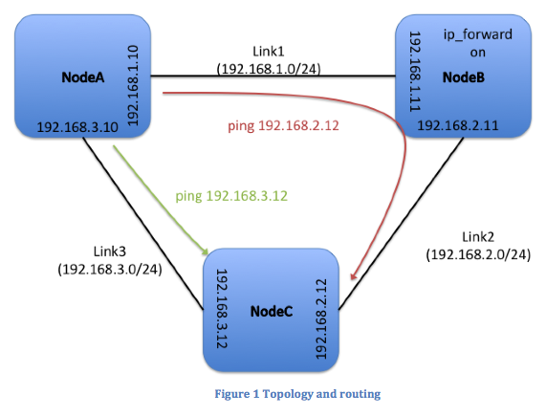
Example

