Slide 1
How to review scientific papers
Don Porter
Portions courtesy Samarjit Chakraborty

Slide 2
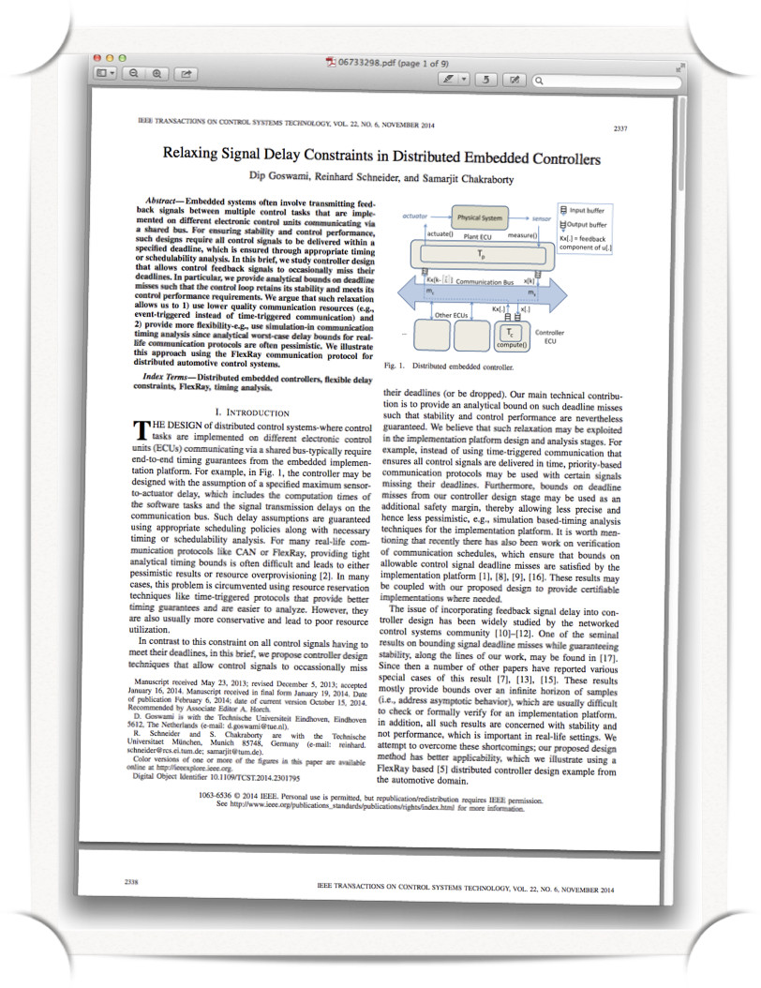

Why do we write papers?
Dissemination of research results to the scientific community
Get credits for our work (required for graduating, getting a job, promotion, tenure, etc.)

Slide 3
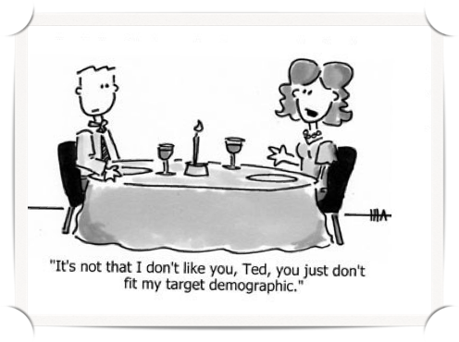
What is a review?
Vetting mechanism to judge the soundness and value of a paper
Done by a peer group (a set of established experts in that area)
The decision to “accept” or “reject” the paper depends on the reviews
© Copyrights of all pictures are held by the respective owners

Slide 4
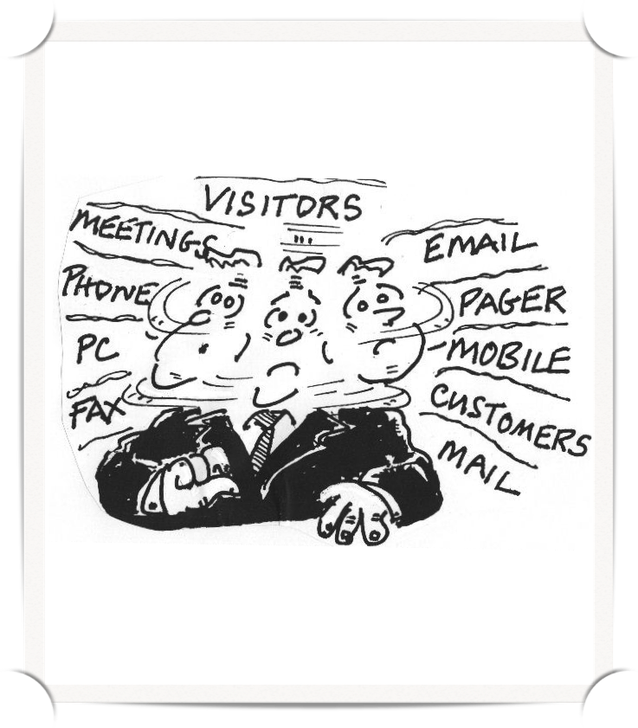
A typical reviewer
Time restrictions - not ideal, but this is reality
Voluntary service to the scientific community.
If there are 4 reviews per paper then you should review 4x the number of papers you write, for the system to be sustainable

Slide 5
Reviewing Mechanisms
Conferences:
  Typically a one-time program committee (PC)
  May meet in person (great networking)
    Shifting to zoom ($$ + CO2 footprint)
  Good conferences typically accept <20-30% of submissions
    Most of what you read will be worse than what you get in a grad seminar
Journals and books:
  Typically a smaller editorial board
  Solicits one-off, expert reviews
Grants: standing or one-time panels, depending on agency

Slide 6
Anonymity
Single-Blind Reviewing: Author names visible, reviewer names hidden (why?)
Double-Blind: Author and reviewer names hidden
Reviewer names usually visible to other reviewers (why/why not?)

Slide 7
Confidentiality
Material under review is confidential
NEVER:
  Share or redistribute a draft you review
  Borrow ideas from a submission
As a reviewer, you should also expect your identity to be held in confidence

Slide 8
Why do reviews? and do them well?
Trade volunteer work for credibility
  PC lists are the “cool kids club”
Social networking among PC members
  Waaaaay more face time with leaders in field than at a conference
  I get the most insight into how someone thinks from reading their reviews
Learn things!
Get better at writing papers
(i.e., better understand your audience - sound familiar?)

Slide 9
Start Practicing Now!
Reviewing is a key professional meta-skill
  Takes practice and feedback
Your advisor likely reviews papers - help them!
  I often invite my students to “shadow review”

Slide 10
Reviews Have 2 Goals
Your review needs to BOTH:
  Explain to the PC why the paper should be accepted or rejected
  Explain to the authors how to improve the paper
  (ideally, to the level you would argue for acceptance, or more strongly if you are already positive; occasionally, an idea is truly unfixable)

Slide 11
Giving Editorial Advice
If at all possible, try to give a clear accept or reject rating
And clearly explain why!
  Most conferences use a 5 point scale
    1 = Reject, 5 = Strong Accept
  Average paper review a 2.5, with variance .2 (made-up, “truthy” numbers). Why?
  Do such reviews contribute “signal”?
    “Strong Accept” == triple cheeseburger
“Confidential Comments” a good place to be blunt/clarify

Slide 12
Author Feedback
All papers have flaws
Follow the Golden Rule:
Write a review you would like to receive
  Be constructive - actionable suggestions >> complaints
For papers you want to reject:
What would it take to convince you?
Depersonalize criticism: “The paper” vs. “The authors”
Don’t ascribe motive to flaws (e.g., lazy authors)

Slide 13
Author Feedback (2)
Justify your criticisms
  Saying something is not novel requires a citation
Gut check: Can all of your requests fit in the space limit?
Is it clear what feedback is the most important and what are nits?

Slide 14
Author Responses
If authors have a response period:
  Explicitly list the “pivot questions” for the work, if possible (why?)

Slide 15
Tricky Issues
What if the paper is out of your area of expertise?
  Always rate your expertise
  As a representative member of community, you can still assess general interest level and clarity
  Editor/Chair needs to know if all reviews are low confidence (why?)
What if you don’t understand the paper at all?
  Ok to say so
  But consider reasons: writing vs your background?
    In principle, you can read more related work

Slide 16
Avoiding Cringe
What if a relevant paper doesn’t cite your work?
Should you review a paper on a topic you are working on?
What if you suspect a paper is written by a friend (or someone you find challenging)?

