Slide 1
Teaching Controversial Issues
Don Porter
Portions courtesy Fred Brooks, Jim Anderson, Samarjit Chakraborty

Slide 2
Why cover a controversial issue?
It is germane to the course
Hard to teach an AI course without talking about the impact of ChatGPT on education and work
Ethics of offensive security, responsible disclosure
To teach students to think and argue
C.f., debate teams
I routinely crap on Unix to break through the “halo effect”
Professional development
We would do our students a disservice not to discuss DEI
How to navigate toxic culture?
e.g., Linux kernel mailing list
How to effectively field non-friendly questions?

Slide 3
Why not cover a controversial issue?

Slide 4
Why (else) not cover a controversial issue?
It may undermine the learning objectives! How?
Students may not be on an even footing to disagree
Minority opinion among students
Power dynamics
Students may perceive their opinion affects grade
Your IQ is lowered when you are upset/stressed
By analogy: we let students take exams in a quiet room
Silence != assent
Proceed with caution

Slide 5
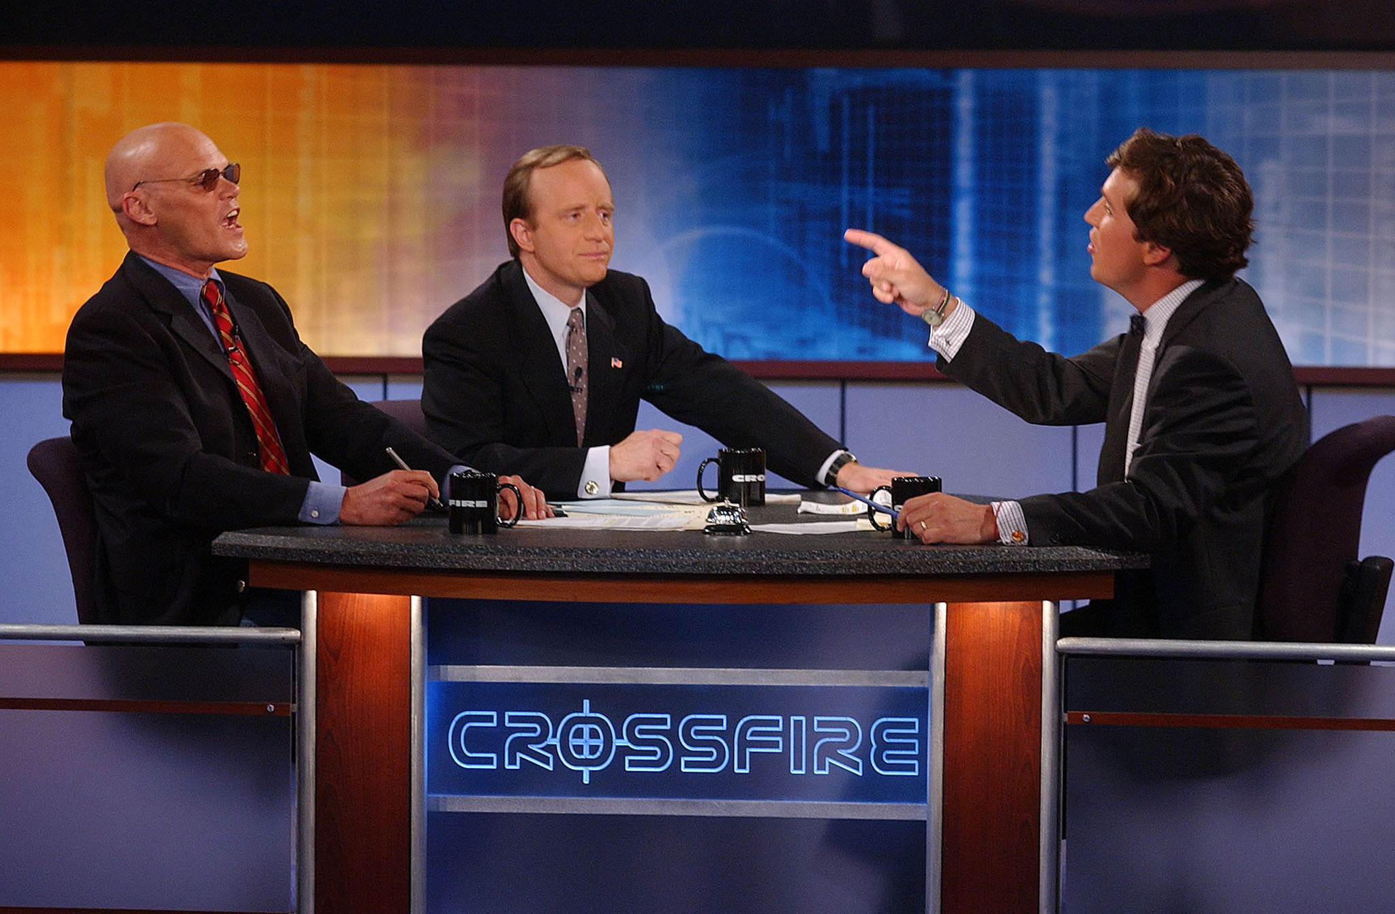
Many bad role models for disagreement

Slide 6
Advice 1: Plan
Have a crisp idea what you want to cover/ NOT cover
How are to bring it up?
How are to ensure civil dialog/ what are the ground rules?
Note that most students don’t have a lot of experience with conflict resolution that doesn’t involve an authority figure
How to end discussion if things get messy?
Consider timing: near the end of a lecture period

Slide 7
Moderating Student Discussion
Allow students to share their own perspectives
Acknowledge societal shortcomings and the need for improvement
Ensure civil behavior, no personal attacks
Try to stay rooted to the topic at hand
Link arguments to evidence and logic whenever possible

Slide 8
Social Controversy
Sincere question: Is it appropriate to comment on social issues / current topics?
“Processing” the 2016 or 2020 election results?
Google firing Timnit Gebru?
Nikole-Hannah Jones situation at UNC?

Slide 9
Advice 2: Tread Lightly on Social Issues
Choose your battles
I often avoid giving too many personal details/opinions
Interrogate your motives
Am I just looking to ventilate in a friendly environment?
Signaling importance matters
I look for opportunities to highlight DEI issues, briefly
Explicit delimiters around “test content” and “meta content”
Only open discussion if you want other opinions
Choose your words carefully:
Shorter excerpts may sound worse without context

Slide 10
Advice 3: Be prepared to argue both sides
My graduate architecture course involved many technical debates
When discussion got too unbalanced, instructor jumped in and argued the other position, vociferously
Even against instructor’s papers or prior positions!
Trying to predict instructor’s bias was a losing strategy
Heaped praise on lone dissenters
Again, you get the behavior you reward!

