Slide 1
COMP 915
Learning Styles and Course Planning
Don Porter
(Portions courtesy Samarjit Chakraborty)

Slide 2
Disclaimers
I am not an education or psychology expert
And some of the scholarly consensus has changed since I took a similar course
Lessons: Stay humble, stay curious

Slide 3
Bold Assertion: People are different

Slide 4
Bold Assertion: People are different
Hence: Many, many personality tests/types Most fun and no real scientific grounding
Big 5/OCEAN (actually scientifically validated): Openness: curious vs cautious Conscientiousness: organized vs. careless Extraversion: outgoing vs. reserved Agreeableness: compassionate vs. critical Neuroticism: sensitive vs. confident
Myers-Briggs (e.g., INTJ)

Slide 5
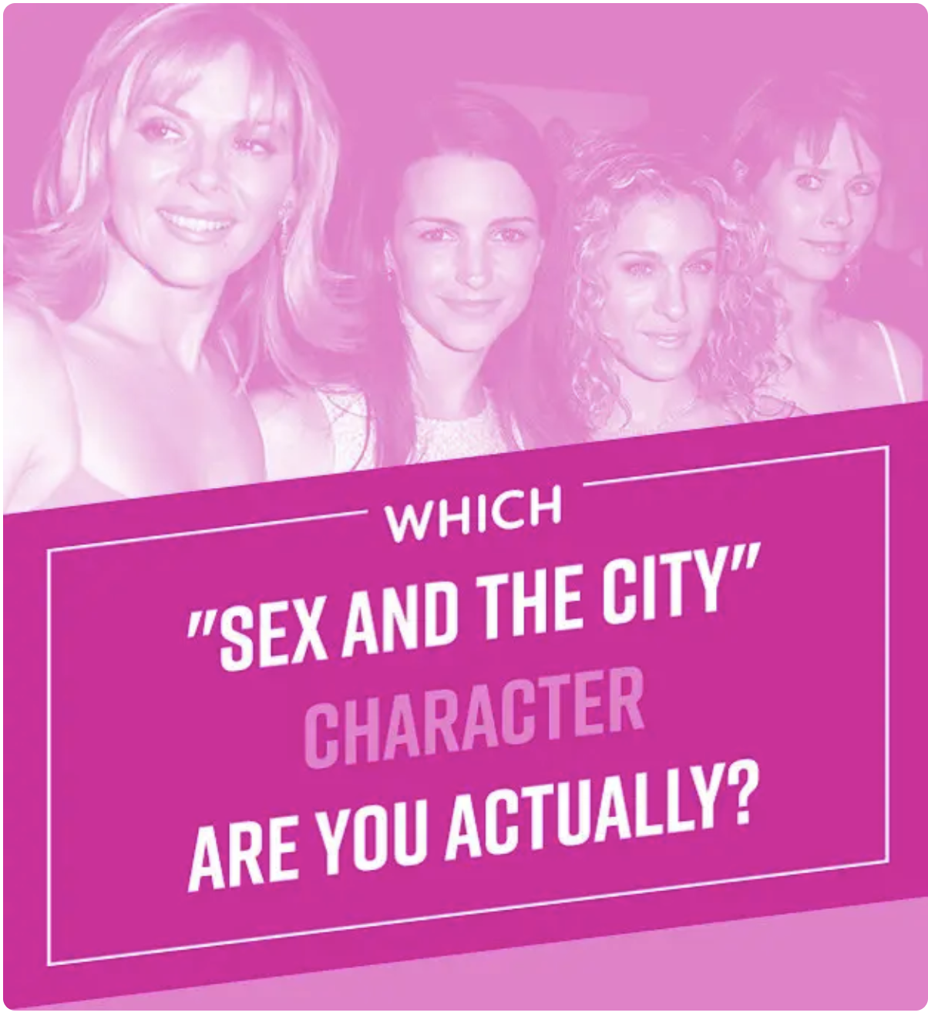
Bold Assertion: People are different
Hence: Many, many personality tests/types Most fun and no real scientific grounding
Big 5/OCEAN (actually scientifically validated): Openness: curious vs cautious Conscientiousness: organized vs. careless Extraversion: outgoing vs. reserved Agreeableness: compassionate vs. critical Neuroticism: sensitive vs. confident
Myers-Briggs (e.g., INTJ)
Silly quizzes are obv. Copyright buzzfeed

Slide 6
Lesson 1:
What worked for you to learn, will NOT work for all of your students
And, it is not the students’ shortcoming
Image stolen from The Simpsons, via google images

Slide 7
All models are wrong, Some are useful
My favorite: the Whole Brain Dominance Instrument
 | Left | Right
High | Analytical | Visionary
Low | Detail-Oriented | Empathetic
People have varying degrees of comfort in each area

Slide 8
Example: Bill Clinton
42nd President of the United States (1992—2000); spouse of Hillary Clinton
Only US President from my home state of Arkansas
Widely considered an exceptional speaker
Why?

Slide 9
The formula for a Clinton Speech
I feel your pain
Here is why you are experiencing your pain
I have a vision for a world without your pain
And a 12-point plan to accomplish it!
 | Left | Right
High | Analytical | Visionary
Low | Detail-Oriented | Empathetic

Slide 10
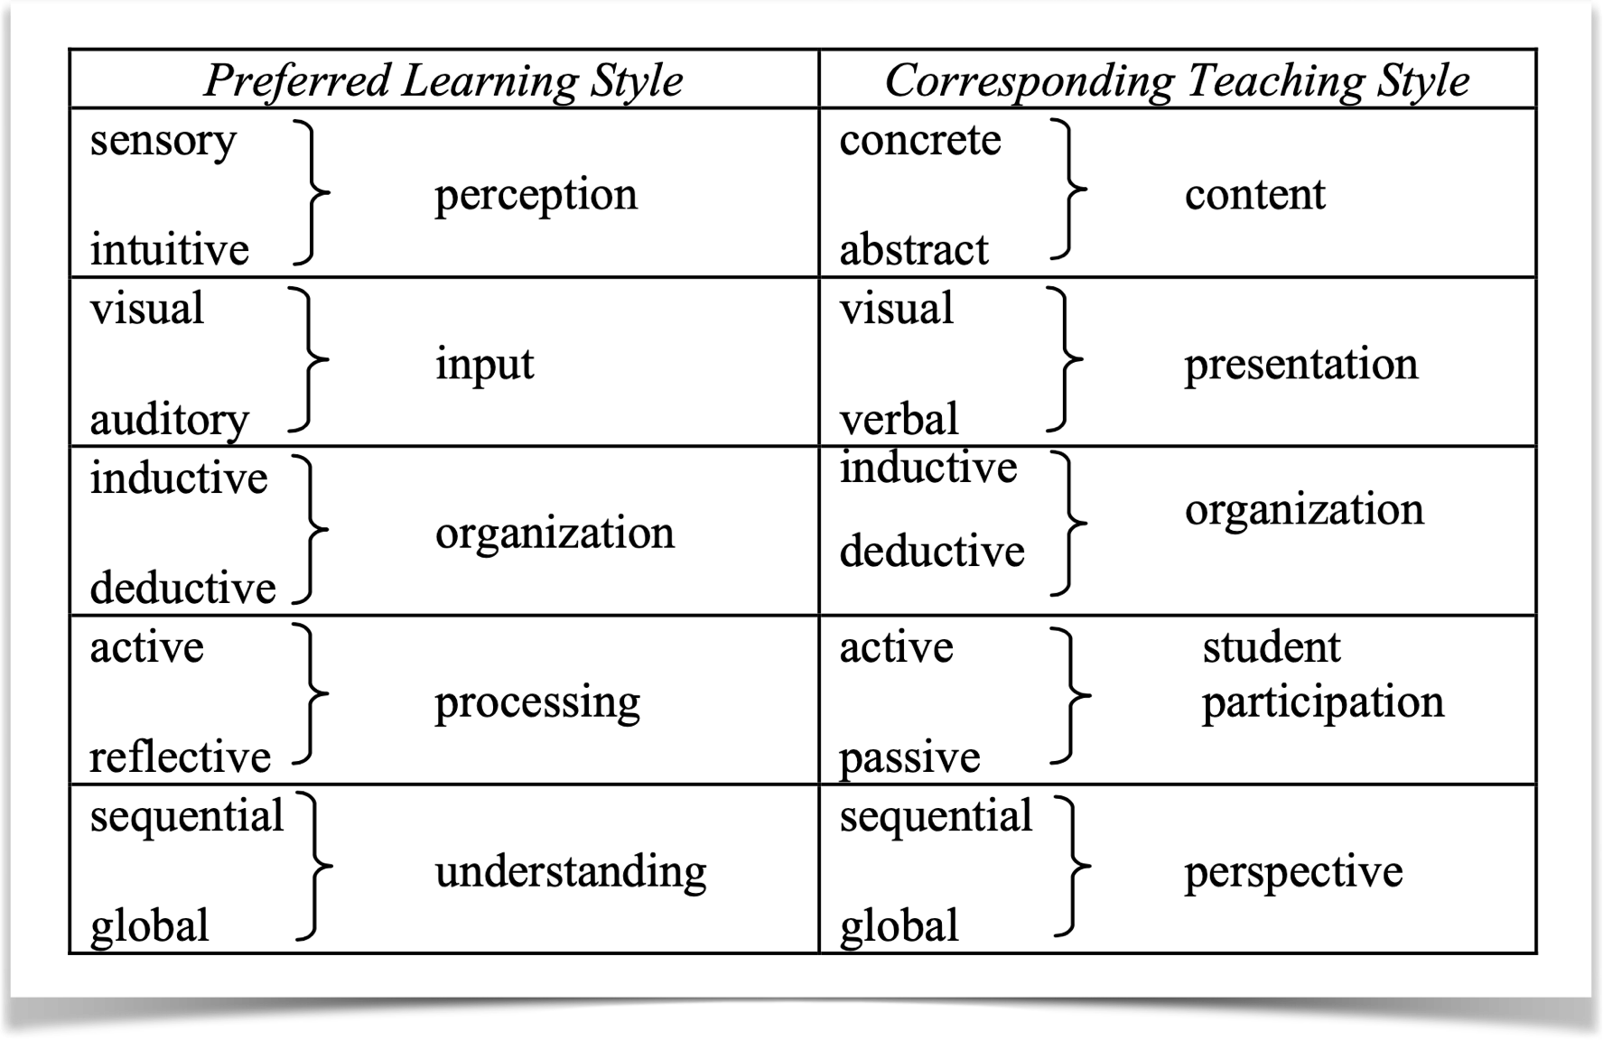
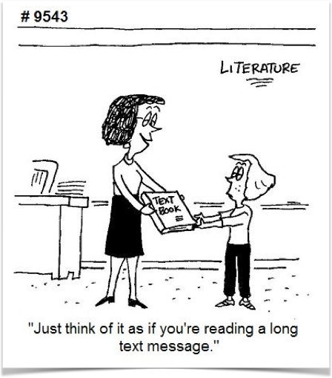
Learning Styles: A Teaching-Specific Model
There are multiple dimensions in learning and teaching styles
To account for all students, what should you do? Accommodate all the 32 styles?
©All Cartoons from Pinterest

Slide 11
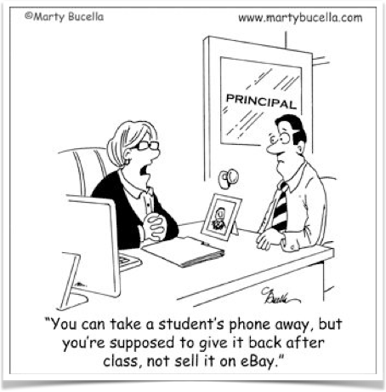
Sensing and Intuitive Learners
Gap between engineering education and what would be effective
E.g., sensors like data, facts vs intuitors like concepts
Ideas?

Slide 12
Sensing and Intuitive Learners
Gap between engineering education and what would be effective
E.g., sensors like data, facts vs intuitors like concepts
Solution: blend concrete information with abstract concepts

Slide 13
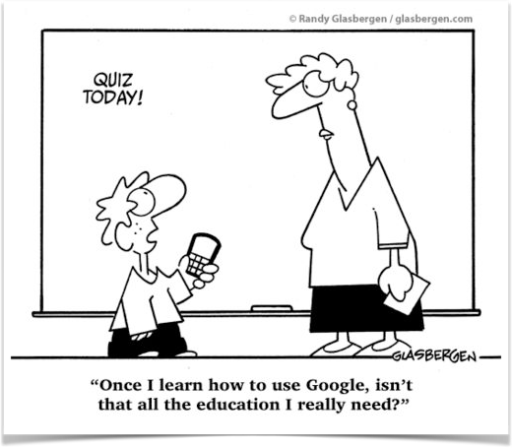
Visual and Auditory Learners
Visual vs Auditory vs Kinesthetic (taste, touch, smell)
Most college teaching is verbal
Result - serious learning/teaching style mismatch
Visual + auditory modalities reinforce learning for more students
Solution: blend figures, graphs, logic/information flow into the text

Slide 14
A Note on Kinesthetic Learning
My spouse teaches Montessori at the elementary level (6—11 yrs old)
They cover math topics through algebra
Introduced kinesthetically!
Then generalize to symbolic manipulation
Photo stolen from Maitland Montessori School Website

Slide 15
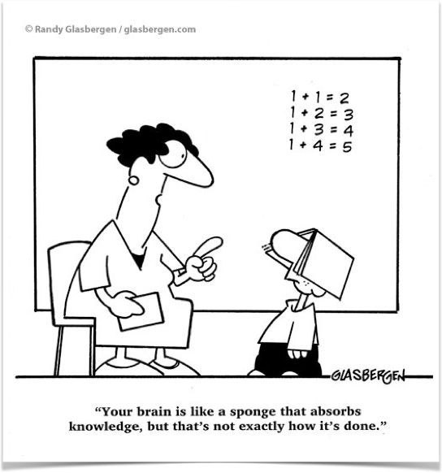
Inductive vs Deductive Learners
Induction - observations to laws/theory
E.g., Scientific method rooted in inductive reasoning
Deduction - theory to consequences
E.g., Mathematical proofs rooted in deductive reasoning
CS is a rare field where we get some of both!
Engineering education - “fundamentals” for sophomores “applications” later (if ever)
Research says that inductive teaching better promotes effective learning
Solution: First induction, then deduction. Let the students deduce the rules

Slide 16
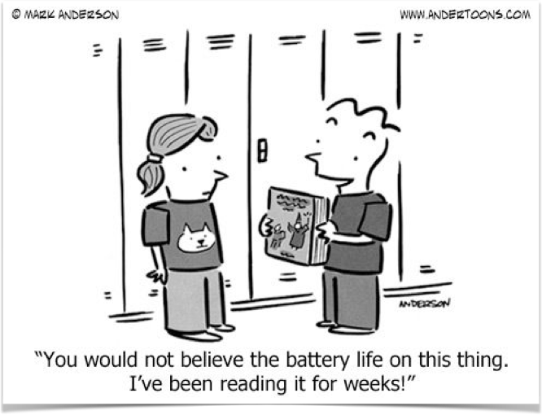
Active vs Reflective Learners
Active - doing something with the information
Reflective - examine information introspectively
Effective teaching strategy:
Interleave lectures with pauses for thought and discussions & problem solving
Emphasize both - fundamental understanding (reflective) & problem solving (active)

Slide 17
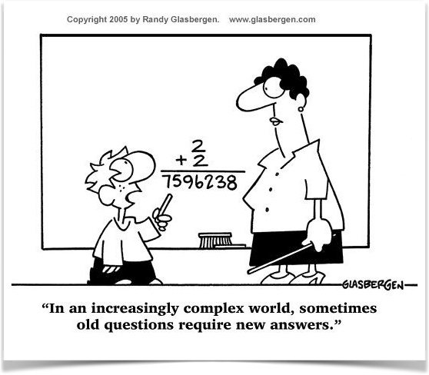
Sequential vs Global Learners
Sequential learners can work with material they understood partially/superficially
Global learners require a fuller picture
Standard curriculum follows sequential flow
Instructors should pay special attention to help global learners
How? Provide more context, relate to previous courses, assign creativity exercises, encourage alternative solutions
Challenge in COMP 530: No sequential path through an OS

Slide 18
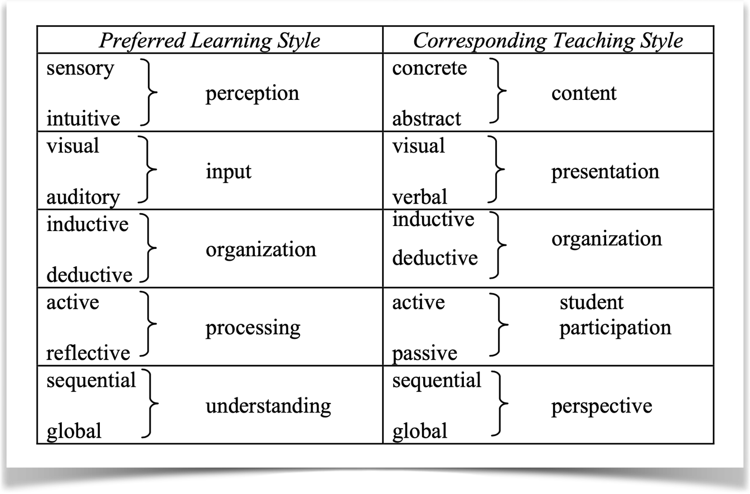
So how will you incorporate all the 32 styles?
You probably can’t all the time
But covering a few strategies (poles of each dimension) should help a very large section of students
Experiment and evolve …

Slide 19
Finding Science in Education
In OS research, the lag between idea and data is measured in years
In teaching, the lag between course meeting and assessment can be as short as days, or even minutes!

Slide 20
Disclaimer
Recent research has somewhat challenged learning styles as the absolute truth
Most people learn via most styles, and need all styles
Even if they have preferences
Again, “some models are useful”
And, these slides will likely need updates in future years, as humans collectively learn more about learning

Slide 21
Course Planning and Evaluation

Slide 22
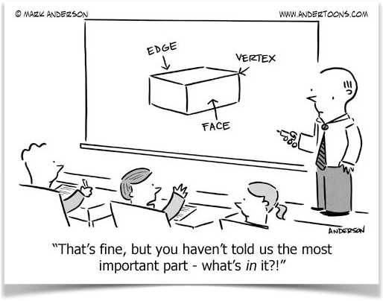
What is your first step towards preparing a talk or writing a report?
©All Cartoons from Pinterest

Slide 23
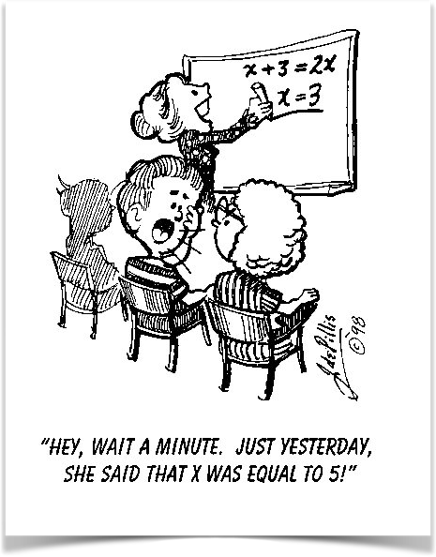
Why are you teaching this?
A new course
A talk at a conference
©All Cartoons from Pinterest

Slide 24
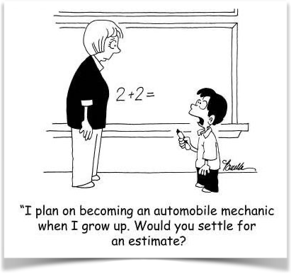
Why are you teaching this?
Goals tied to outcomes (e.g., what will the students be able to do?)
Your goals vs goals of the student (e.g., employment)
Listing the goals will serve as a basis for designing the course/talk
Evaluation will be easier - have you achieved those goals?
Methods of assessment - operational definition of your goals
©All Cartoons from Pinterest

Slide 25
Bloom’s Taxonomy (Revised by Anderson and Krathwohl 2001)
Bloom’s Taxonomy (levels of educational objectives)
Remember
Understand - interpret, infer
Apply
Analyze - how different components relate to each other
Evaluate - make judgements based on criteria
Create
My test questions:
Some simple definition questions
Some simple word problems
Some challenging problems
Some performance analysis
Some “what if?” questions

Slide 26
Bloom’s Taxonomy Lessons
Different learning objectives have different assessment methods
In courses, students realize different degrees of mastery
Good to measure at each level
Builds confidence, if nothing else!

