Slide 1
Course Planning, Part 2
Don Porter
Portions courtesy Fred Brooks, Jim Anderson, Samarjit Chakraborty

Slide 2
Course Planning
First, context: We can talk about planning w.r.t.
  the course you teach at UNC (less interesting),
  or a course you may teach in the “real world” (more interesting). Two possibilities:
    a teaching college;
    a research university.
  What are your expectations regarding teaching load?
  How long do you think it takes to prep a new class?

Slide 3
Course Planning
How to determine how much can be covered in a semester?
  Look at syllabi created by people you trust.
  Search the web and see what’s covered at other schools.
  Guess.
    I can guess pretty accurately based on slide count.
  Keep records.
    The first time you teach a class, you may not get it completely right.

Slide 4
Syllabus
Forces you to think about the practicalities of the course, it’s a contract
How much time – lectures, homework, studying …
Contents – schedule, special rules, evaluation criteria
More details, the better it is
Should help students understand what is expected from them
  UNC prescribes a lot of content

Slide 5
Course Policies
Parenting 101: You get the behavior you reward
So, what behavior do you want?
  Trying again on an assignment / learning from mistakes
    Gary Bishop would give half credit on a resubmitted assignment for all missed questions
  Self-management of minor scheduling conflicts
    I give 72 late hours with no penalty, raises threshold of issues I handle
  Students helping other students?
    Group assignments: (effective) bonus for working alone or not?

Slide 6
Textbook and Reading Materials
Textbook or not? What is the course?
Compile chapters from multiple textbooks
Cost of the textbook
  Consider older editions or delta in a newer revision
Assign reading materials judiciously

Slide 7
Course Planning
How many exams?
  One midterm is too stressful.
  Good to have first midterm by drop day.
  Avoid major religious holidays (and for graduate courses, perhaps major conference deadlines too).
    Specifically consider holy days of obligation
Make a plan in advance for missed exams
  My strategy:
    I usually ask for all conflicts by 2nd week of the class, possibly move on a big boo boo
    Ask students to make up exam early (why?)
    If a student doesn’t come at all, average other exams (why?)

Slide 8
Course Planning
Other issues:
  What can you assume about student background?
    Do you teach to the A students, the B students, the C students,… ?
  What are your goals?
    How do your goals affect planning?
  How does your course fit within the broader course sequence?
    Why would this be an issue?
    Advice: Teach the prereq course to your “usual” course
  Should a project be required?
  Powerpoint or white board?
  Record lectures / whiteboard contents or not?

Slide 9
A Basic Planning Model
From: Teaching at Carolina - A Handbook for Instructors
  What is the place of this course in the curriculum?
  What kinds of skills and levels of knowledge can you expect of students?
    Teaching at UNC is probably different from both MIT and App. State.
  How do you want students to be “different” by the end of the class?
    “Research has shown that factual content beyond the final exam is … lost within a few weeks.”
  What themes, fundamental principles, or synthesizing ideas does the course involve?
  What are the major instructional units which the course naturally divides?
  What kinds of learning experiences seems appropriate for students to master the course goals and objectives?
  How will you evaluate student achievement?

Slide 10
Topological Sort
Different topics invariably related by dependencies on some way.
Think hard about how to do a topological sort to create a linear ordering.
Think hard about the rate at which complexity should be exposed.
A
B
D
C
E
A
B
C
D
E

Slide 11
Controversial Issues
Topics that bring up:
  Competing values and interests, and/or,
  Strong emotional reactions
In CS, I usually see two families of controversial issues:
  Technical controversy
    Is fork() really a good idea?
  Social controversy / current issues
    What obligation do CS researchers have to address climate change?

Slide 12
Why cover a controversial issue?
It is germane to the course
  Hard to teach an AI course without talking about the impact of ChatGPT on education and work
  Ethics of offensive security, responsible disclosure
To teach students to think and argue
  C.f., debate teams
  I routinely crap on Unix to break through the “halo effect”
Professional development
  We would do our students a disservice not to discuss DEI
  How to navigate toxic culture?
    e.g., Linux kernel mailing list
  How to effectively field non-friendly questions?

Slide 13


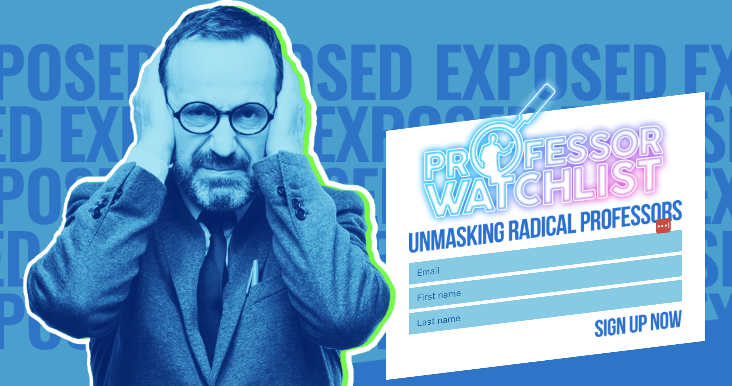
Why not cover a controversial issue?

Slide 14
Why (else) not cover a controversial issue?
It may undermine the learning objectives! How?
Students may not be on an even footing to disagree
  Minority opinion among students
  Power dynamics
Students may perceive their opinion affects grade
Your IQ is lowered when you are upset/stressed
  By analogy: we let students take exams in a quiet room
Silence != assent
  Proceed with caution

Slide 15
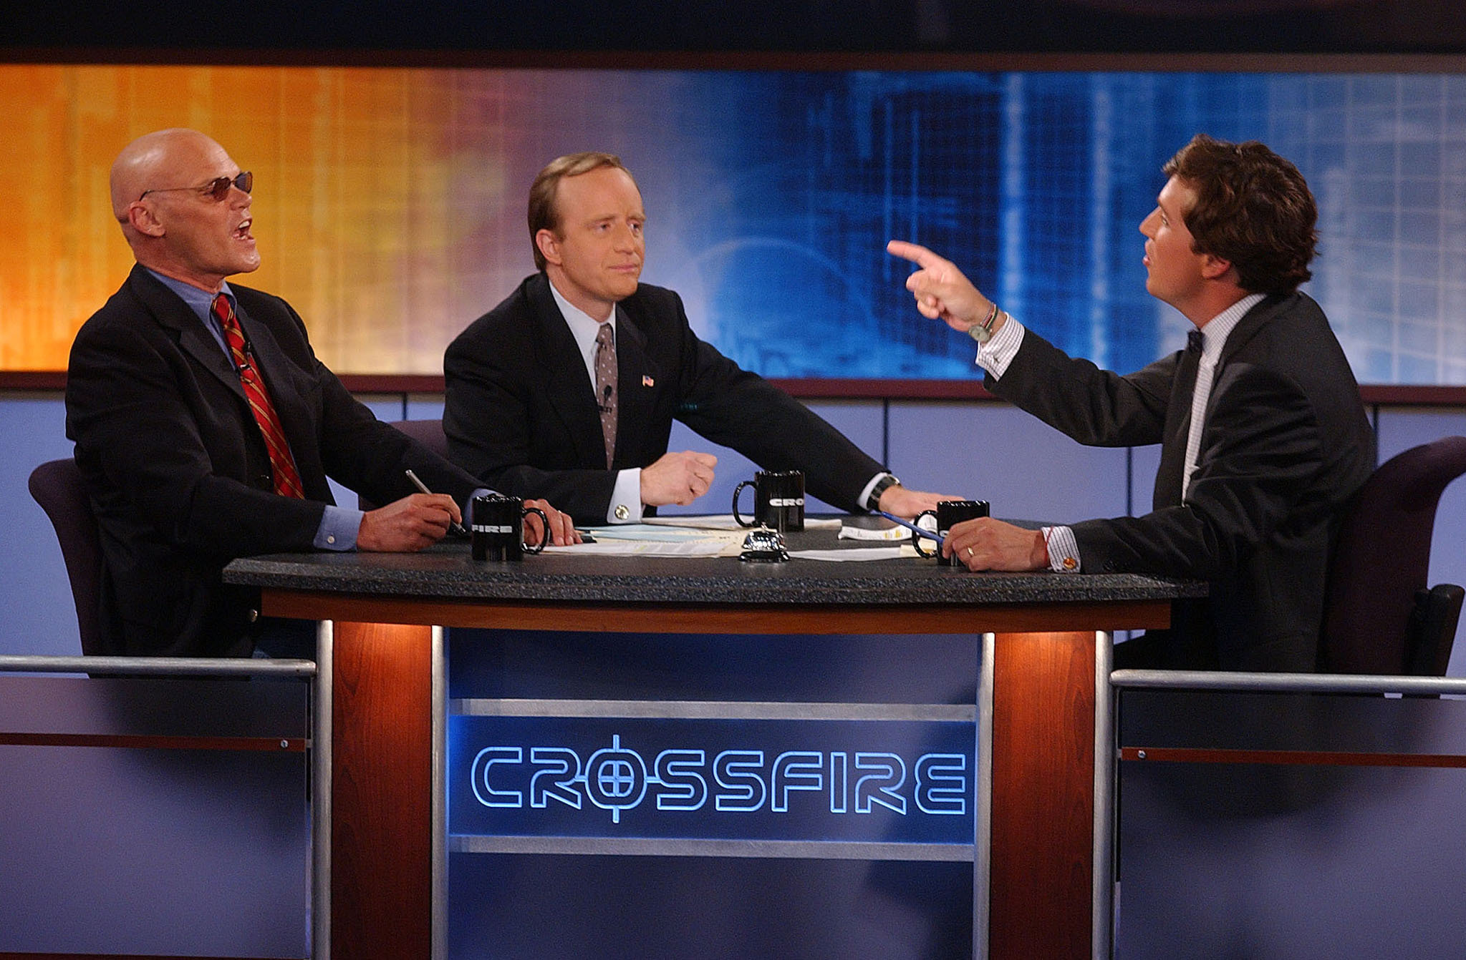
Many bad role models for disagreement

Slide 16
Advice 1: Plan
Have a crisp idea what you want to cover/ NOT cover
How are to bring it up?
How are to ensure civil dialog/ what are the ground rules?
  Note that most students don’t have a lot of experience with conflict resolution that doesn’t involve an authority figure
How to end discussion if things get messy?
  Consider timing: near the end of a lecture period

Slide 17
Moderating Student Discussion
Allow students to share their own perspectives
Acknowledge societal shortcomings and the need for improvement
Ensure civil behavior, no personal attacks
Try to stay rooted to the topic at hand
Link arguments to evidence and logic whenever possible

Slide 18
Social Controversy
Sincere question: Is it appropriate to comment on social issues / current topics?
  “Processing” the 2016 or 2020 election results?
  Google firing Timnit Gebru?
  Nikole-Hannah Jones situation at UNC?

Slide 19
Advice 2: Tread Lightly on Social Issues
Choose your battles
  I often avoid giving too many personal details/opinions
Interrogate your motives
  Am I just looking to ventilate in a friendly environment?
Signaling importance matters
  I look for opportunities to highlight DEI issues, briefly
Explicit delimiters around “test content” and “meta content”
Only open discussion if you want other opinions
Choose your words carefully:
  Shorter excerpts may sound worse without context

Slide 20
Advice 3: Be prepared to argue both sides
My graduate architecture course involved many technical debates
When discussion got too unbalanced, instructor jumped in and argued the other position, vociferously
  Even against instructor’s papers or prior positions!
  Trying to predict instructor’s bias was a losing strategy
Heaped praise on lone dissenters
  Again, you get the behavior you reward!

