Slide 1
Comp 110
Main & Console Input
Instructor: Jason Carter

Slide 2
Removing Training Wheels
Notepad
creates
ALoanPair Source Code
MainClass Source Code
ALoanPairInstance
reads
Compiler
getTotalLoan()
writes
calls
ALoanPair Object (byte) Code
MainClass Object Code
ObjectEditor
instantiates
main
calls
Interpreter

Slide 3
Main & Console Input
Programming without ObjectEditor
  Main Class
Programmer-Defined Overloading
Console Input
Programmer-Defined Library Class

Slide 4
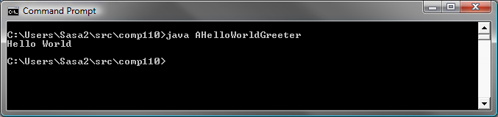
Hello World

Slide 5
Hello World
main header
List of user-supplied arguments
public class AHelloWorldGreeter {
public static void main (String[] args) {
System.out.println ("Hello World");
}
}

Slide 6

Main Arguments

Slide 7
Main Arguments
public class AnArgPrinter {
public static void main (String[] args) {
System.out.println (args[0]);
}
}
args[0]
1st Argument
args[1]
2nd Argument
…

Slide 8
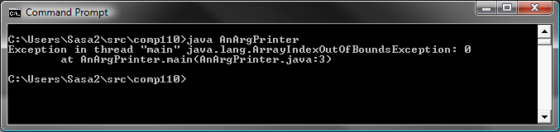
Main Arguments
Program refers to argument
public class AnArgPrinter {
public static void main (String[] args) {
System.out.println (args[0]);
}
}
User does not supply argument → Exception

Slide 9
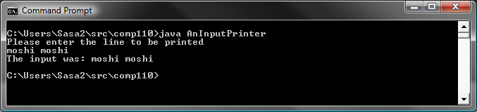
String Input

Slide 10
String Input
import java.io.BufferedReader;
import java.io.InputStreamReader;
public class AnInputPrinter {
public static void main (String[] args) {
System.out.println("Please enter the line to be printed");
System.out.println ("The input was: " + readString());
}
}

Slide 11
Reading a String
Wait for the user to enter a string (of digits) on the next line
In case the user terminates input before entring a string, return “” and print an error message
static BufferedReader inputStream =
new BufferedReader(new InputStreamReader(System.in));
public static String readString() {
try {
return inputStream.readLine();
}
catch (Exception e) {
System.out.println(e);
return "";
}
}

Slide 12
String Input
import java.io.BufferedReader;
import java.io.InputStreamReader;
public class AnInputPrinter {
public static void main (String[] args) {
System.out.println("Please enter the line to be printed");
System.out.println ("The input was: " + readString());
}
static BufferedReader inputStream = new BufferedReader(
new InputStreamReader(System.in));
public static String readString() {
try {
return inputStream.readLine();
}
catch (Exception e) {
System.out.println(e);
return "";
}
}
}
Global variables referred to by static readString must be static
static main() can call only static methods

Slide 13
Importing a Package
public class AnInputPrinter {
…
new BufferedReader (System.in)
…
}
Import declaration
import java.io. BufferedReader ;
Short name
package java.io;
public class BufferedReader {
….
}
public class AnInputPrinter {
…
new java.io. BufferedReader (System.in)
…
}
Full name

Slide 14
Try-Catch Block
Program fragment that can cause an exception
try {
return inputStream.readLine();
}
catch (Exception e) {
System.out.println(e);
return "";
}
Exception handler
Exception object

Slide 15
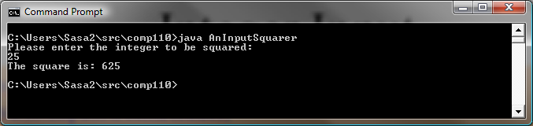
Integer Input

Slide 16
Integer Input
import java.io.BufferedReader;
import java.io.InputStreamReader;
public class AnInputSquarer {
public static void main (String[] args) {
System.out.println("Please enter the integer to be squared:");
int num = readInt();
System.out.println ("The square is: " + num*num);
}
}

Slide 17
readInt()
Wait for the user to enter a string (of digits) on the next line
Return the int represented by the string
In case the user makes an error or terminates input before entring a valid int, return 0 and print an error message
public static int readInt() {
try {
return Integer.parseInt(inputStream.readLine());
} catch (Exception e) {
System.out.println(e);
return 0;
}
}

Slide 18
readInt()
Wait for the user to enter a string (of digits) on the next line
Return the int represented by the string
In case the user makes an error or terminates input before entring a valid int, return 0 and print an error message
static BufferedReader inputStream =
new BufferedReader(new InputStreamReader(System.in));
public static int readInt() {
try {
return new Integer(inputStream.readLine()).intValue();
} catch (Exception e) {
System.out.println(e);
return 0;
}
}
Less efficient and not clear that parsing occurs

Slide 19
Integer Input
import java.io.BufferedReader;
import java.io.InputStreamReader;
public class AnInputSquarer {
public static void main (String[] args) {
System.out.println("Please enter the integer to be squared:");
int num = readInt();
System.out.println ("The square is: " + num*num);
}
static BufferedReader inputStream =
new BufferedReader(new InputStreamReader(System.in));
public static int readInt() {
try {
return Integer.parseInt(inputStream.readLine());
} catch (Exception e) {
System.out.println(e);
return 0;
}
}
}

Slide 20
Reading Other Primitive Values
new Double (inputStream.readLine()).doubleValue());
new Boolean (inputStream.readLine()).booleanValue());
new T (inputStream.readLine()).tValue());
General pattern for reading primitive value of type t

Slide 21
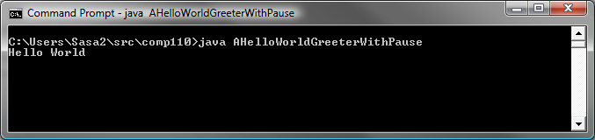
Pausing a Program to View Output in an Interactive Programming Environment

Slide 22
Pausing a Program to View Output in an Interactive Programming Environment
public class AHelloWorldGreeterWithPause {
public static void main (String[] args) {
System.out.println ("Hello World");
pause();
}
public static void pause() {
try {
System.in.read();
} catch (Exception e) {
}
}
}
Wait for the user to enter a character and return it
Legal?

Slide 23
Expression vs. Statement
Expression cannot be used as statement
public static void pause() {
try {
5 + 3;
}
catch (Exception e) {
System.out.println(
System.out.println(“hello”));
}
}
Statement cannot be used as expression

Slide 24
Four Kinds of Methods
procedure
public void setWeight (double newVal) {
weight = newVal;
}
setWeight(70);
→
function
pure function
public static double calculatBMI(
double weight, double height) {
return weight/(height*height);
}
calculateBMI(70, 1.77)
→ 24.57
…
calculateBMI(70, 1.77)
→ 24.57
impure function
public int getWeight() {
return weight;
}
getWeight()
→ 70
setWeight(77)
→
getWeight()
→ 77
impure function with side effects
getWeight()
→ 77
public static int readNextNumber() {
System.out.println(”Next Number:");
return Console.readInt();
}
5
readNextNumber ()
→ 5
4
readNextNumber ()
→ 4
1

Slide 25
Side Effects
Effect other than computing the return value
public int getWeight() {
System.out.println(“get Weight called” );
return weight;
}
Printing something
public static int readNextNumber() {
System.out.println(”Next Number:");
return new Console.readInt();
}
Reading input
public int increment() {
counter++;
return counter;
}
Changing global variable

Slide 26
Alternative to Changing a Global Variable
public int increment() {
counter++;
return counter;
}
public void incrementCounter() {
counter++;
}
public int getCounter() {
return counter;
}

Slide 27
Function Calls
Can be used as expression
Can be used as statement
  When return value is to be ignored
  Rarely happens
  Check program to see all return values being used as expressions
Other expressions not statements
Procedure calls never expressions

Slide 28
Pausing a Program to View Output in an Interactive Programming Environment
public class AHelloWorldGreeterWithPause {
public static void main (String[] args) {
System.out.println ("Hello World");
pause();
}
public static void pause() {
try {
System.in.read();
} catch (Exception e) {
}
}
}
Legal expression and statement
We do not care about the return value

Slide 29
Separate Class
Console
readInt
pause
readDouble
readBoolean
readChar
readString

Slide 30
Separate Class for Input
import java.io.BufferedReader;
import java.io.InputStreamReader;
public class Console {
static BufferedReader inputStream =
new BufferedReader(new InputStreamReader(System.in));
public static int readInt() {
try {
return Integer.parseInt(inputStream.readLine());
} catch (Exception e) {
System.out.println(e);
return 0;
}
}
public static String readString() {
try {
return inputStream.readLine();
} catch (Exception e) {
System.out.println(e);
return "";
}
}
... //other methods
}

Slide 31
Without Console
import java.io.BufferedReader;
import java.io.InputStreamReader;
public class AnInputPrinter {
public static void main (String[] args) {
System.out.println("Please enter the line to be printed");
System.out.println ("The input was: " + readString());
}
static BufferedReader inputStream =
new BufferedReader(new InputStreamReader(System.in));
public static String readString() {
try {
return inputStream.readLine();
}
catch (Exception e) {
System.out.println(e);
return "";
}
}
}

Slide 32
Using Console
public class AnInputPrinter {
public static void main (String[] args) {
System.out.println("Please enter the line to be printed");
System.out.println ("The input was: " + Console.readString());
}
}

Slide 33
Separation of Concerns
Make independent piece of code as separate method
Make independent set of methods as separate class
Use operation and data abstraction!

Slide 34
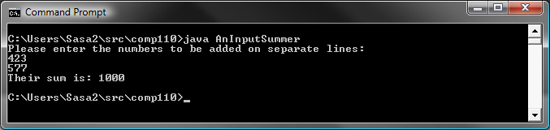
Multiple Integer Input

Slide 35
Multiple Integer Input
public class AnInputSummer {
public static void main (String[] args) {
System.out.println(
"Please enter the numbers to be added on separate lines:");
System.out.println (
"Their sum is: " + (Console.readInt() + Console.readInt()));
}
}

Slide 36
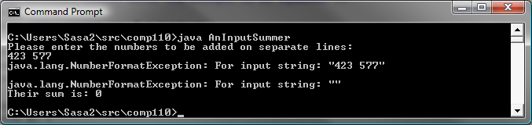
Multiple Integer Input
Entire line read as string and then parsed as int

Slide 37
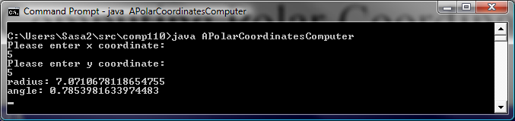
Computing Polar Coordinates

Slide 38
Computing Polar Coordinates
public class AMonolithicPolarCoordinatesComputer {
public static void main (String args[]) {
int x = readX();
int y = readY();
print (x, y, Math.sqrt(x*x + y*y), Math.atan(y/x));
Console.pause();
}
public static int readX() {
System.out.println("Please enter x coordinate:");
return Console.readInt();
}
public static int readY() {
System.out.println("Please enter y coordinate:");
return Console.readInt();
}
public static void print(int x, int y, double radius, double angle) {
System.out.println("radius: " + radius);
System.out.println("angle: " + angle);
}
}
Not reusing previous implementation

Slide 39
Computing Polar Coordinates
public class APolarCoordinatesComputer {
public static void main (String args[]) {
print(readPoint());
Console.pause();
}
public static Point readPoint() {
System.out.println("Please enter x coordinate:");
int x = Console.readInt();
System.out.println("Please enter y coordinate:");
return new ACartesianPoint(x, Console.readInt());
}
public static void print(Point p) {
/*
System.out.println("x: " + p.getX());
System.out.println("y: " + p.getY());
*/
System.out.println("radius: " + p.getRadius());
System.out.println("angle: " + p.getAngle());
}
}
Reusing previous implementation

Slide 40
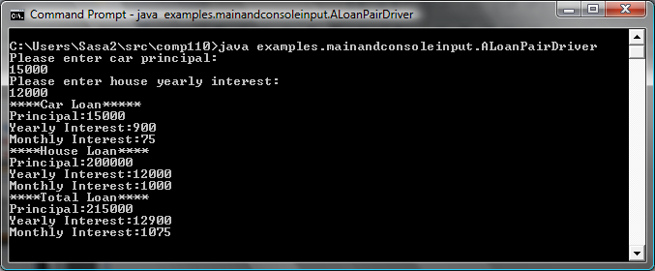
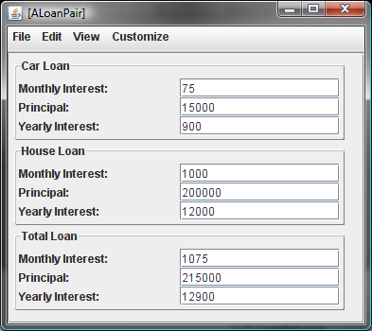
Equivalent User Interfaces

Slide 41
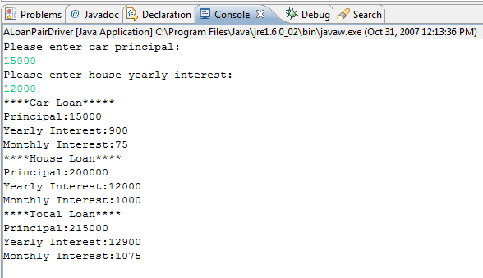
Equivalent User Interfaces

Slide 42
Algorithm (edit)

Slide 43
Algorithm
Create ALoanPair instance based on the two values entered by the user in the console window
Print the properties of the loan pair object in the console window

Slide 44
Main Method
public static void main (String[] args) {
LoanPair loanPair = new ALoanPair(
readCarLoan(), readHouseLoan());
print(loanPair);
bus.uigen.ObjectEditor.edit(loanPair);
pause();
}
Method chaining

Slide 45
Main Method Without Method Chaining
public static void main (String[] args) {
Loan carLoan = readCarLoan();
Loan houseLoan = readHouseLoan();
LoanPair loanPair = new ALoanPair(carLoan, houseLoan);
print (loanPair);
bus.uigen.ObjectEditor.edit(loanPair);
pause();
}
Undefined

Slide 46
readCarLoan()

Slide 47
readCarLoan()
Prompt user
Return an instance of ALoan constructed from the principal
public static Loan readCarLoan() {
System.out.println("Please enter car principal:");
return new ALoan(Console.readInt());
}

Slide 48
Printing a LoanPair

Slide 49
Printing a LoanPair
public static void print (LoanPair loanPair) {
System.out.println("****Car Loan*****");
print(loanPair.getCarLoan());
System.out.println("****House Loan****");
print(loanPair.getHouseLoan());
System.out.println("****Total Loan****");
print(loanPair.getTotalLoan());
}
Programmer-defined overloading
public static void print (Loan loan) {
System.out.println("Principal:" + loan.getPrincipal());
System.out.println("Yearly Interest:" + loan.getYearlyInterest());
System.out.println("Monthly Interest:" + loan.getMonthlyInterest());
}

Slide 50
ObjectEditor.edit
Full name of the ObjectEditor class
bus.uigen.ObjectEditor.edit(loanPair);
Displays an edit window for the object passed as parameter

Slide 51
Class-Level Decomposition
Monolithic Main Class
(Loan User Interface and Loan Computation)
ObjectEditor
Programmer-defined Class
(ALoanPair)
Driver
(ALoanPairDriver)

Slide 52
Multi-Level Algorithm/Code
main
readCarLoan
readHouseLoan
print(LoanPair)
Console.pause
Console.readInt
print(Loan)

Slide 53
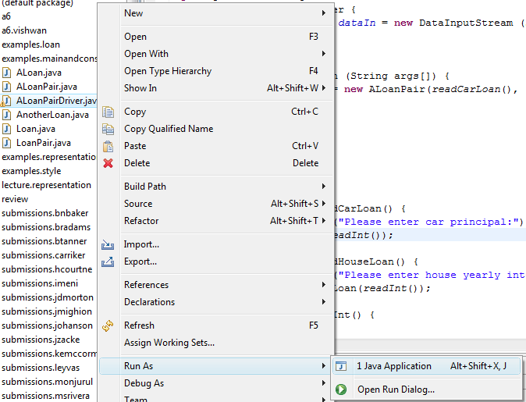
Running Main

Slide 54
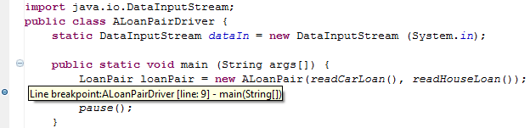
Inserting a Break Point

Slide 55
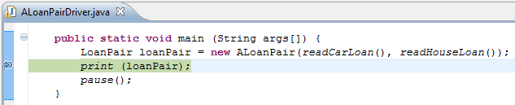
Single-Stepping

Slide 56
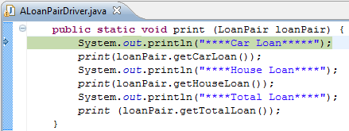
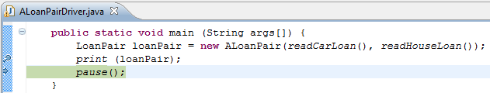
Step Into vs. Step Over

Slide 57
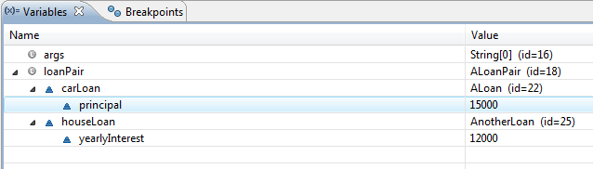
Inspecting Variables

Slide 58
Conditionals
printPassFailStatus(95)
Passed
printPassFailStatus(25)
Failed
public static void printPassFailStatus(int score) {
if (score < PASS_CUTOFF)
System.out.println("FAILED");
else
System.out.println("PASSED");
}

Slide 59
If-Else Statement
if ( <boolean expression> )
<statement 1>;
else
<statement 2>;

Slide 60
If-Else Statement
<boolean expression>
true
false
<statement 1>
<statement 2>

Slide 61
Compound Statement
public void fancyPrintGrade(int score)
{
if (score < PASS_CUTOFF)
    {
System.out.println("**************");
System.out.println("FAILED");
System.out.println("**************");
}
else
    {
System.out.println("**************");
System.out.println("PASSED");
System.out.println("Congratulations!");
System.out.println("**************");
}
}

Slide 62
Compound Statement – { } Convention
public void fancyPrintGrade(int score)
{
if (score < PASS_CUTOFF) {
System.out.println("**************");
System.out.println("FAILED");
System.out.println("**************");
} else {
System.out.println("**************");
System.out.println("PASSED");
System.out.println("Congratulations!");
System.out.println("**************");
}
}

Slide 63
Avoiding Code Duplication in If-Else (Edit)
public void fancyPrintGrade(int score)
{
if (score < PASS_CUTOFF)
    {
System.out.println("**************");
System.out.println("FAILED");
System.out.println("**************");
}
else
    {
System.out.println("**************");
System.out.println("PASSED");
System.out.println("Congratulations!");
System.out.println("**************");
}
}

Slide 64
Avoiding Code Duplication in If-Else
public void fancyPrintGrade(int score) {
System.out.println("**************");
if (score < PASS_CUTOFF)
System.out.println("FAILED");
else {
System.out.println("PASSED");
System.out.println("Congratulations!");
}
System.out.println("**************");
}

Slide 65
If Statement
if (score == MAX_SCORE)
System.out.println ("Perfect Score! Congratulations!");
if (<bool expr>)
<statement>;

Slide 66
If Statement
<boolean expression>
true
false
<statement 1>

Slide 67
Else-If
    public static char toLetterGrade (int score) {
      if (score >= A_CUTOFF)
      return 'A';
      else if (score >= B_CUTOFF)
      return 'B';
      else if (score >= C_CUTOFF)
      return 'C';
      else if (score >= D_CUTOFF)
      return 'D';
      else
      return 'F';
    }

Slide 68
Nested If-Else
    if (score >= A_CUTOFF)
    return 'A';
    else
      if (score >= B_CUTOFF)
      return 'B';
      else
        if (score >= C_CUTOFF)
        return 'C';
      else
        if (score >= D_CUTOFF)
        return 'D';
        else
return 'F';

Slide 69
Nested If-Else

Slide 70
Looping
printHello(2);
printHello(3);
hello
hello
hello
hello
hello

Slide 71
Loops
public static void printHello(int n) {
}
int counter = 0;
if (counter < n) {
counter = counter + 1;
System.out.println (“hello”);
}

Slide 72
Loops
public static void printHello(int n) {
}
int counter = 0;
while (counter < n) {
counter = counter + 1;
System.out.println (“hello”);
}

Slide 73
If vs. While Statement
if (<bool expr>)
<statement>;
while (<bool expr>)
<statement>;

Slide 74
If Statement
<boolean expression>
true
false
<statement>

Slide 75
While Statement
<boolean expression>
true
false
<statement>

Slide 76
While Loop
<statement>
<boolean expression>
true
false

Slide 77
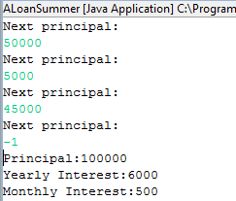
Sentinel-Based Folding

Slide 78
Adding Fixed Number of Loans
Loan loan1 = readLoan();
Loan loan2 = readLoan();
Loan loan3 = readLoan();
Loan loan4 = readLoan();
Loan sumLoan = ALoan.add( loan1,
ALoan.add(loan2,
ALoan.add(loan3, loan4))
);
print(sumLoan);

Slide 79
Generalizing to Variable Number of Loans
Loan loan1 = readLoan();
Loan loan2 = readLoan();
Loan loan3 = readLoan();
Loan loan4 = readLoan();
…
Loan loanN = readLoan();
Loan sumLoan = ALoan.add(loan1,
ALoan.add(loan2,
ALoan.add(loan3,
ALoan.add(loan4, ……(
ALoan.add(loanN-1, loanN)*;
print (sumLoan);
Variable Number of Statements
Loops and Arrays
Recursion
Variable Number of Subexpressions (function calls)

Slide 80
Space-Efficient Adding of Fixed Number of Loans
Loan loan1 = readLoan();
Loan loan2 = readLoan();
Loan sumLoan = ALoan.add(loan1, loan2);
loan1 = readLoan(); // 3rd loan
sumLoan = ALoan.add(sumLoan, loan1);
loan1 = readLoan(); // 4th loan
sumLoan = ALoan.add(sumLoan, loan1);
print (sumLoan);

Slide 81
More Space-Efficient Adding of Fixed Number of Loans
Loan sumLoan = readLoan(); //first loan
Loan nextLoan = readLoan(); //second loan
sumLoan = Aloan.add(nextLoan, sumLoan);
nextLoan = readLoan(); // 3rd loan
sumLoan = ALoan.add(sumLoan, nextLoan);
nextLoan = readLoan(); // 4th loan
sumLoan = ALoan.add(sumLoan, nextLoan);
print (sumLoan);

Slide 82
More Space-Efficient Adding of Variable Number of Loans
Loan sumLoan = readLoan(); //first loan
Loan nextLoan = readLoan(); //second loan
sumLoan = Aloan.add(nextLoan, sumLoan);
nextLoan = readLoan(); // 3rd loan
sumLoan = ALoan.add(sumLoan, nextLoan);
nextLoan = readLoan(); // 4th loan
sumLoan = ALoan.add(sumLoan, nextLoan);
nextLoan = readLoan(); //Nth loan
sumLoan = ALoan.add(sumLoan, nextLoan);
nextLoan = readLoan(); //sentinel
print (sumLoan);
N-1 Repetitions

Slide 83
While Loop
Loan sumLoan = readLoan(); //first loan
Loan nextLoan = readLoan(); //second loan
while (nextLoan().getPrincipal() >= 0) {
sumLoan = ALoan.add(nextLoan, sumLoan);
nextLoan = readLoan(); // next loan or sentinel
}
print (sumLoan);
Input
Result
-1
Program waits forever for second loan
Boundary Condition

Slide 84
Correct Solution
Loan sumLoan = new ALoan(0); //initial value
Loan nextLoan = readLoan(); //second loan
while (nextLoan().getPrincipal() >= 0) {
sumLoan = ALoan.add(nextLoan, sumLoan);
nextLoan = readLoan(); // next loan or sentinel
}
print (sumLoan);
ALoan.add(new ALoan(0), add(loan1, add (…., loanN)
Identity

Slide 85
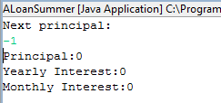
A Single Sentinel Value
Loan sumLoan = new ALoan(0); //initial value
Loan nextLoan = readLoan(); //second loan
while (nextLoan().getPrincipal() >= 0) {
sumLoan = ALoan.add(nextLoan, sumLoan);
nextLoan = readLoan(); // next loan or sentinel
}
print (sumLoan);

Slide 86
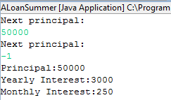
A Single Loan
Loan sumLoan = new ALoan(0); //initial value
Loan nextLoan = readLoan(); //second loan
while (nextLoan().getPrincipal() >= 0) {
sumLoan = ALoan.add(nextLoan, sumLoan);
nextLoan = readLoan(); // next loan or sentinel
}
print (sumLoan);

Slide 87
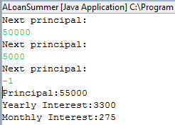
Two Loans
Loan sumLoan = new ALoan(0); //initial value
Loan nextLoan = readLoan(); //second loan
while (nextLoan().getPrincipal() >= 0) {
sumLoan = ALoan.add(nextLoan, sumLoan);
nextLoan = readLoan(); // next loan or sentinel
}
print (sumLoan);

Slide 88
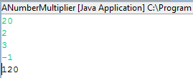
Multiplying Numbers (Edit)
public class ANumberMultiplier {
public static void main(String[] args) {
int product = 1;
int nextInt = Console.readInt();
while (nextInt >= 0) {
product = product * nextInt;
nextInt = Console.readInt();
}
System.out.println(product);
}
}

Slide 89
Multiplying Numbers
    int product = 1;
    int num = Console.readInt();
    while (num >= 0) {
    product = product*num;
    num = Console.readInt();
    }
    print (product);
1 * 20 * 2 * 3
Identify

Slide 90
Comparing Two Solutions
result
    int product = 1;
    int num = Console.readInt();
    while (num >= 0) {
    product = product*num;
    num = Console.readInt();
    }
    print (product);
Read first value
Read other value
nextVal
Identity
Binary folding function
!isSentinel(nextVal)
Loan sumLoan = new ALoan(0); //initial value
Loan nextLoan = readLoan(); //second loan
while (nextLoan().getPrincipal() >= 0) {
sumLoan = ALoan.add(nextLoan, sumLoan);
nextLoan = readLoan(); // next loan or sentinel
}
print (sumLoan);

Slide 91
Generalized Folding of a Sentinel-Terminated List
a¹
a²
a³
a^{n}
a¹
a¹
f: T, T → T
a¹
F(x, I) → x

Slide 92
Generalized Folding Function
Loan, int
new ALoan(0), 1
    T result = I;
    T nextValue = getNextValue()
    while (!isSentinel(nextValue)) {
    result = f(result, nextValue);
    nextValue = getNextValue(..);
    }
ALoan.add(), *
≥ 0

Slide 93
Comparing Two Solutions (Comments)
    int product = 1; //identity
    int num = Console.readInt(); // read next list value
    while (num >= 0) { // sentinel checking
    product = product*num; // binary folding function
    num = Console.readInt(); // read next value
    }
print (product);// print value
Loan sumLoan = new ALoan(0); //identity
Loan nextLoan = readLoan(); // read next list value
while (nextLoan().getPrincipal() >= 0) {// sentinel checking sumLoan = Aloan.add(nextLoan, sumLoan); // binary folding function
nextLoan = readLoan(); // read next list value
}
print (sumLoan); // print value

