Slide 1
Comp 110 More Types
Instructor: Jason Carter

Slide 2
Primitive Types
int, double, boolean, long, short, float, byte
char

Slide 3
Primitive Types
Constants (Literals & Named Constants)
Operations with Invocation Syntax

Slide 4
char Constants
16 bits
char {letters, digits, operations, … }
‘1’
‘\n’
‘a’
‘’’
‘ ’
‘\’
‘<’
‘
‘A’
‘ \’’
‘ ’
‘\\’
Escape Sequence
newline character

Slide 5
Useful Escape Sequences
Escape Sequence | Character Denoted
\’ | ’
\n | new line
\b | back space
\\ | \
\t | tab
\” | ”

Slide 6
Ordering Characters
‘’
…
‘a’
…
Ordinal number(integer code)
Position in ordered character list

Slide 7
Ordering Characters
‘’
…
‘a’
‘b’
‘c’
…
‘’
…
‘A’
‘B’
‘C’
…
‘’
…
‘0’
‘1’
‘2’
…
‘a’ > ‘b’
false
‘a’ > ‘A’
???
‘B’ > ‘A’
true
‘a’ > ‘0’
???
‘4’ > ‘0’
true
‘0’ > ‘’
true

Slide 8
Converting Between Characters and Their Ordinal Numbers
(int) ‘a’
Ordinal number of ‘a’
Character whose ordinal number is 55
Implicit conversion to wider type
(char) 55
(int) ‘’
0
(int) ‘c’ – (int) ‘a’
2
(char) 0
‘’
‘c’ – ‘a’
2
(int) ‘d’
???
(char) (‘c’ - 2)
‘a’
(char) 1
???
(char) (‘A’ + 2)
‘C’
(char) -1
(char) (‘C’ - ‘A’ + ‘a’)
‘c’

Slide 9
A Useful Character Operation
Character.isLetter(c)
true if c is a letter
Character.isLetter(‘c’)
true
Character.isLetter(‘A’)
true
Character.isLetter(‘1’)
false
Character.isLetter(‘ ’)
false

Slide 10
String Constants
Object Type
Variable size
String {sequences of characters}
“hello”
‘a’
“hello 123”
“hello\n\n123”
“123”
“”
“a”
“\”
“\\”

Slide 11
Accessing String Components
Index
String s = “hello world”;
s.charAt(0)
‘h’
s.charAt(1)
‘e’
s.getFirstChar()
s.charAt(-1)
s.getSecondChar()
s.charAt(11)
StringIndexBounds Excepion
s.length()
11
“ ”.length()
1
“”.length()
0

Slide 12
Accessing Substring
public String substring (int beginIndex, int endIndex)
s.substring(beginIndex, endIndex)
→ s.charAt(beginIndex) .. s.charAt(endIndex-1)
“hello world”.substring(4,7)
“o w”
“hello world”.substring(4,4)
“”
“hello world”.substring(7,4)
StringIndexBounds Exception

Slide 13
Changing Strings?
Stings are read-only (immutable)
“hello” + “world”
“hello world”
Three different instances

Slide 14
Useful String Operations
s.toLowerCase()
copy of s with letters converted to lower case
s.toUpperCase()
copy of s with letters converted to upper case
“Hello World”.toLowerCase()
“hello world”
“Hello World”.toUpperCase()
“HELLO WORLD”

Slide 15
Classifying a Person by Race
African Indian
American Indian
Asian
Native Hawaiian
White
Some Other Race
Data type to store a value capturing the race of a person?

Slide 16
Classifying a Person by Race
int race = AFRICAN_AMERICAN;
public int getRace() {
return race;
}
public void setRace (int newVal) {
race = newVal;
}

Slide 17
Classifying a Person by Race
public static int AFRICAN_AMERICAN = 0;
public static int AMERICAN_INDIAN = 1;
public static int ASIAN = 2;
public static int NATIVE_HAWAIIAN = 4;
public static int WHITE = 4;
public static int SOME_OTHER_RACE = 5;

Slide 18
Errors Possible
public static int AFRICAN_AMERICAN = 0;
public static int AMERICAN_INDIAN = 1;
public static int ASIAN = 2;
public static int NATIVE_HAWAIIAN = 4;
public static int WHITE = 4;
public static int SOME_OTHER_RACE = 5;

Slide 19
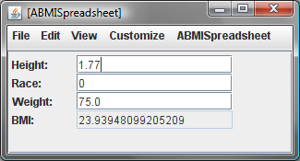
Errors Possible
Programming environment does not know the relationship among constants!

Slide 20
Classifying a Person by Race
String race = AFRICAN_AMERICAN;
public int getRace() {
return race;
}
public void setRace (int newVal) {
race = newVal;
}

Slide 21
Classifying a Person by Race
public static String AFRICAN_AMERICAN = "African American";
public static String AMERICAN_INDIAN = "American Indian";
public static String ASIAN = "Asian";
public static String NATIVE_HAWAIIAN = "Native Hawaiian";
public static String WHITE = "White";
public static String SOME_OTHER_RACE = "Some Other Race";

Slide 22
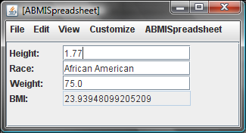
Errors Possible
User or programmer can make mistake!
String type is space inefficient!

Slide 23
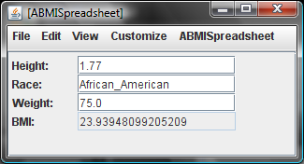
Errors Possible
User or programmer can make mistake!

Slide 24
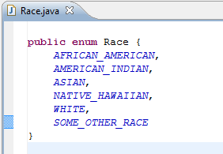
Declaring an enum
Like class or an interface, an enum is declared in its own file

Slide 25
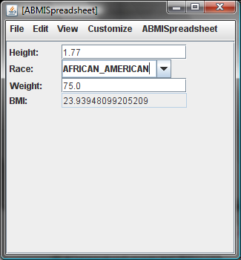
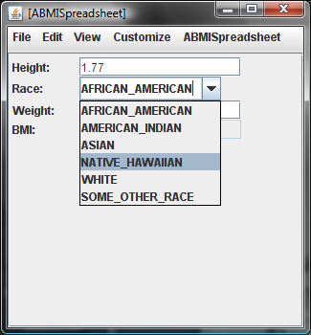
Displaying an Enum

