Slide 1
Comp 110 Loops
Instructor: Jason Carter

Slide 2
Loops
More loops
Off-by-one errors
Infinite loops
Nested Loops
Animations
Concurrency
Synchronized methods
Property changes

Slide 3
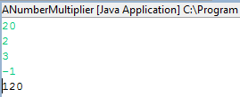
Multiplying Numbers
int product = 1;
int nextNum = Console.readInt();
while (nextNum >= 0) {
product = product* nextNum;
nextNum = Console.readInt();
}
print (product);

Slide 4
Cumulative Assignment
int product = 1;
int nextNum = Console.readInt();
while (nextNum >= 0) {
product *= nextNum;
nextNum = Console.readInt();
}
print (product);
product *= nextNum;
product = product * nextNum;
<var> <operator>= <expr>
<var> = <var> <operator> <expr>
sum += num
sum = sum+num

Slide 5
Multiplying Positive Numbers
int product = 1;
int nextNum = Console.readInt();
while (nextNum >= 0) {
product *= nextNum;
nextNum = Console.readInt();
}
print(product);

Slide 6
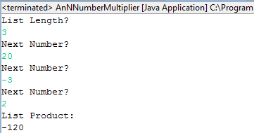
Multiplying N Numbers (Edit)
int product = 1;
int nextNum = Console.readInt();
while (nextNum >= 0) {
product *= nextNum;
nextNum = Console.readInt();
}
print(product);

Slide 7
Multiplying N Numbers
int product = 1;
int nextNum = Console.readInt();
while (nextNum >= 0) {
product *= nextNum;
nextNum = Console.readInt();
}
print (product);
int listLength = readListLength();
int counter = 0;
int nextNum;
int product = 1;
while (counter < listLength) {
counter += 1;
nextNum = readNextNumber();
product *= nextNum;
}
print (product);

Slide 8
Multiplying First N Numbers: N! (Edit)
1*2*3*4*…*n
Factorial(n) = n!

Slide 9
Multiplying First N Numbers: N!
int product = 1;
int n = 2;
int counter = 0;
while (counter < n) {
product *= counter;
counter += 1;
}
System.out.println (product);
1*0*1
1*2*3*4*…*n

Slide 10
Multiplying First N Numbers: N!
int product = 1;
int n = ???;
int counter = 0;
while (counter < n) {
product *= counter;
counter += 1;
}
System.out.println (product);
1*0*1*2*3*4*…*n-1
1*2*3*4*…*n
Off by one

Slide 11
Multiplying First N Numbers: N!
int product = 1;
int n = ???;
int counter = 1;
while (counter < n) {
product *= counter;
counter += 1;
}
System.out.println (product);
1*1*2*3*4*…*n-1
1*2*3*4*…*n
Off by one

Slide 12
Multiplying First N Numbers: N!
int product = 1;
int n = ???;
int counter = 1;
while (counter <= n) {
product *= counter;
counter += 1;
}
System.out.println (product);
1*1*2*3*4*…*n-1*n
1*2*3*4*…*n

Slide 13
Better Name
int product = 1;
int n = ???;
int nextMultiplier = 1;
while (nextMultiplier <= n) {
product *= nextMultiplier;
nextMultiplier += 1;
}
System.out.println (product);
1*1*2*3*4*…*n-1*n
1*2*3*4*…*n

Slide 14
Better Name
int product = 1;
int n = ???;
int nextMultiplier = 0;
while (nextMultiplier <= n) {
product *= nextMultiplier;
nextMultiplier += 1;
}
System.out.println (product);
1*1*2*3*4*…*n-1*n
1*2*3*4*…*n
Easier to spot off-by-one errors

Slide 15
Incrementing Counter Before Operation
int product = 1;
int n = ???;
int prevMultiplier = 0;
while (prevMultiplier <= n) {
prevMultiplier += 1;
product *= prevMultiplier;
}
System.out.println (product);
1*1*2*3*4*…*n-1*n*n+1
1*2*3*4*…*n
Off by one

Slide 16
Incrementing Counter Before Operation
int product = 1;
int n = ???;
int prevMultiplier = 0;
while (prevMultiplier < n) {
prevMultiplier += 1;
product *= prevMultiplier;
}
System.out.println (product);
1*1*2*3*4*…*n-1*n
1*2*3*4*…*n

Slide 17
Checking of Non Equality
int product = 1;
int n = ???;
int prevMultiplier = 0;
while (prevMultiplier != n) {
prevMultiplier += 1;
product *= prevMultiplier;
}
System.out.println (product);
1*2*3*4*…*n

Slide 18
Checking of Non Equality
int product = 1;
int n = -5;
int prevMultiplier = 0;
while (prevMultiplier != n) {
prevMultiplier += 1;
product *= prevMultiplier;
}
System.out.println (product);
1*2*3*4*…*n

Slide 19
Checking of Non Equality
int product = 1;
int n = -5;
int prevMultiplier = 0;
while (prevMultiplier != n) {
prevMultiplier += 1;
product *= prevMultiplier;
}
System.out.println (product);
-5*-4*-3*-2*-1*0*1*2...
1*2*3*4*…*n
Infinite loop

Slide 20
Counter Not Changed
int product = 1;
int n = ???;
int prevMultiplier = 0;
while (prevMultiplier < n) {
product *= prevMultiplier;
}
System.out.println (product);
1*0*0*0*…
1*2*3*4*…*n
Infinite loop

Slide 21
Counter Changed in the Wrong Direction
int product = 1;
int n = ???;
int prevMultiplier = 0;
while (prevMultiplier < n) {
prevMultiplier -= 1;
product *= prevMultiplier;
}
System.out.println (product);
1*0*-1*-2*…
1*2*3*4*…*n
Infinite loop

Slide 22
Guarding Against Infinite Loops
Update variable(s) in loop expression
Expression must converge to false

Slide 23
Decrementing Solution
int product = 1;
while (n > 0) {
product *= n;
n -= 1;
}
System.out.println(product);
1*n*n-1*n-2*..1
1*2*3*4*…*n
Backwards multiplication

Slide 24
Decrementing Solution
int product = 1;
while (n > 0) {
product *= n;
n--;
}
System.out.println(product);
n-- → n = n - 1
n++ → n = n + 1

Slide 25
Counter-Controlled vs. Event-Controlled
int product = 1;
int nextNum = Console.readInt();
while (nextNum >= 0) {
product *= nextNum;
nextNum = Console.readInt();
}
print (product);
Event-controlled
int product = 1;
int n = readNumElements();
int counter = 0;
while (counter < n) {
int nextNum = readNum();
product *= nextNum;
counter += 1;
}
Counter-controlled

Slide 26
Counter-Controlled vs. Event-Controlled
Number of loop iterations (executions of loop body) known before loop executed
initialize counter to some value
increment/decrement counter by fixed step beginning/end of body
exit when counter reaches limit
Limit not known before loop starts
Test one more events (e.g. reading of input) occurring while loop executes
Terminate when events make loop condition false

Slide 27
Counter-Controlled vs. Event-Controlled
Counting until 10 in Hide & Seek
Counter-controlled
Searching for others in Hide & Seek
Event-controlled
Grading Comp14 exams
Counter-controlled
Fishing for the right answer from students
Event-controlled & counter-controlled
Counting the days until it is vacation
Counter-controlled
Counting # of candies in a jar
Event-controlled

Slide 28
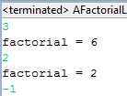
Factorial List (Edit)
int n = ???;
int product = 1;
while (n > 0) {
product *= n;
n -= 1;
}
return product;

Slide 29
Factorial List
public static int factorial (int n) {
int product = 1;
while (n > 0) {
product *= n;
n -= 1;
}
return product;
}
public static void main (String[] args) {
int newVal = Console.readInt();
while (newVal >= 0) {
System.out.println(“factorial =“ + factorial(newVal));
newVal = Console.readInt();
}
}

Slide 30
Removing Code Duplication (Edit)
public static int factorial (int n) {
int product = 1;
while (n > 0) {
product *= n;
n -= 1;
}
return product;
}
public static void main (String[] args) {
int newVal = Console.readInt();
while (newVal >= 0) {
System.out.println(“factorial =“ + factorial(newVal));
newVal = Console.readInt();
}
}

Slide 31
Break Statement
public static int factorial (int n) {
int product = 1;
while (n > 0) {
product *= n;
n -= 1;
}
return product;
}
public static void main (String[] args) {
while (true) { // loop condition never false
int newVal = Console.readInt();
if (newVal < 0) {
break;
}
System.out.println(“factorial =“ + factorial(newVal);
}
}

Slide 32
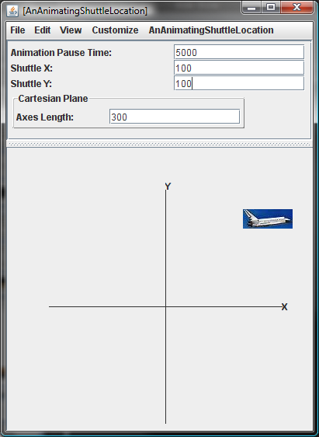
Animated Shuttle

Slide 33
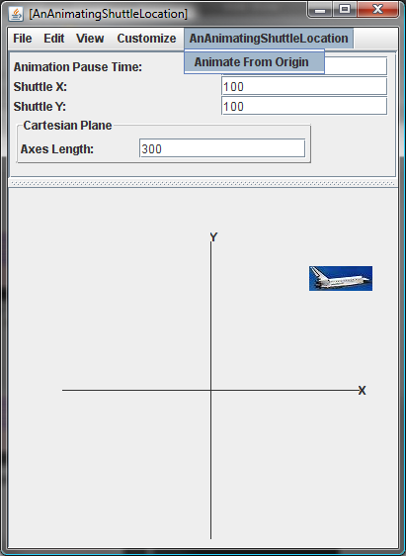
Animated Shuttle

Slide 34
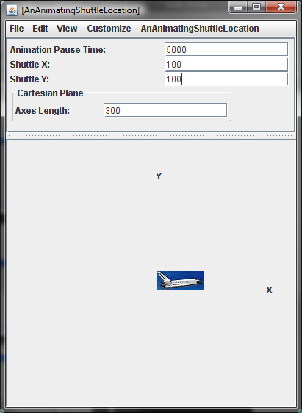
Animated Shuttle

Slide 35
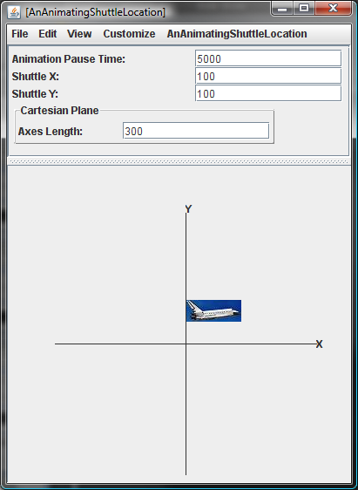
Animated Shuttle

Slide 36
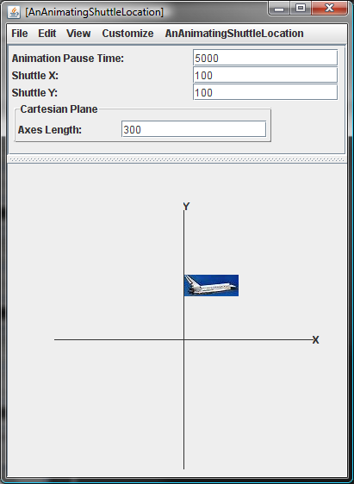
Animated Shuttle

Slide 37
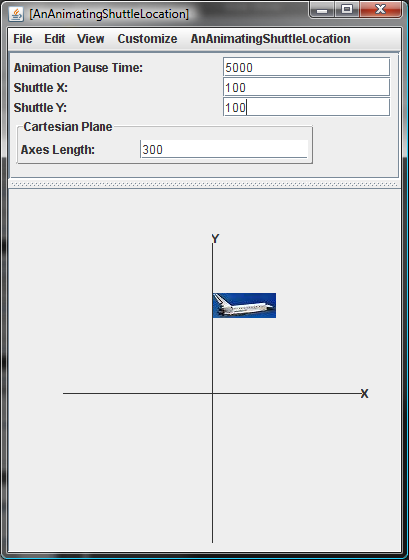
Animated Shuttle

Slide 38
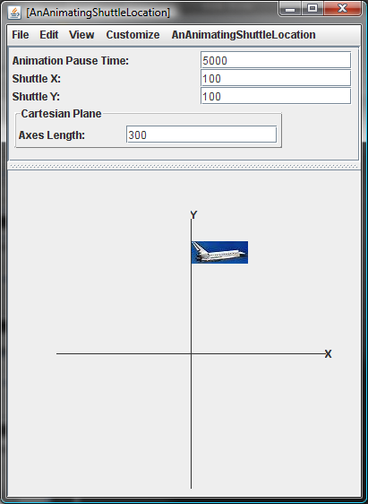
Animated Shuttle

Slide 39
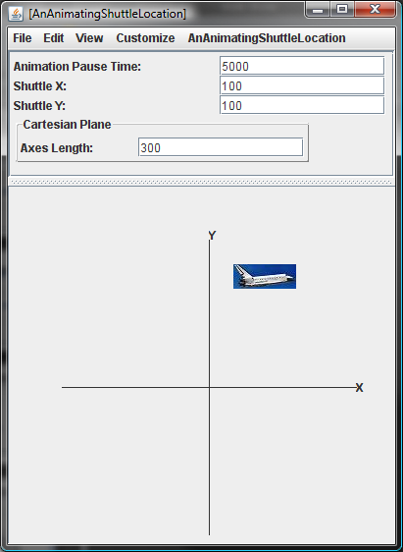
Animated Shuttle

Slide 40
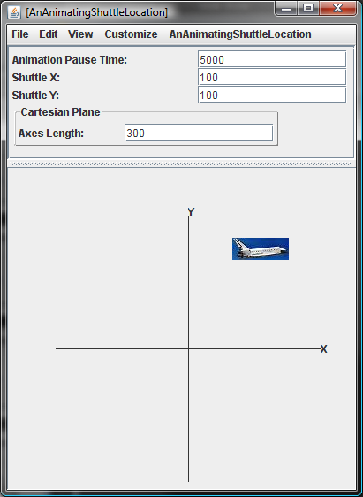
Animated Shuttle

Slide 41
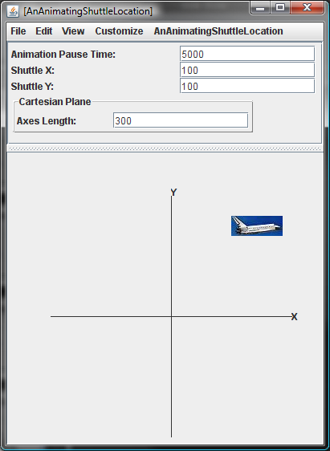
Animated Shuttle

Slide 42
Animated Shuttle

Slide 43
AnimateFromOrigin Semantics (Edit)
Basic Idea: Should animate from origin to current location

Slide 44
AnimateFromOrigin Semantics
Basic Idea: Should animate from origin to current location
Should move to origin
Should animate first in Y direction to current Y
Next should animate in X direction to current X

Slide 45
Animating to a Destination Location
Should move a constant distance in straight line to destination
Go back to 1 if location not reached

Slide 46
Animating to a Destination Location
Should move a constant distance in straight line to destination
Should pause for time defined by animationPauseTime property
Go back to 1 if location not reached

Slide 47
Pausing Program
void sleep (int pauseTime) {
int numberOfAssignments = pauseTime; //ASSIGNMENT_TIME;
for (int i = 0; i < numberOfAssignments; i++) {
int dummy = 0; // nonsense assignment
}
ASSIGNMENT_TIME different on different computers!
Unnecessarily using the CPU (Busy Waiting)
Need the OS to suspend to put to sleep program for pause time

Slide 48
Pausing Program
void sleep(int pauseTime) {
try {
// OS suspends program for pauseTime
Thread.sleep(pauseTime);
} catch (Exception e) {
// program may be forcibly interrupted while sleeping
e.printStackTrace();
};
}

Slide 49
Pause Time Property (Edit)

Slide 50
Pause Time Property
int animationPauseTime;
public int getAnimationPauseTime() {
return animationPauseTime;
}
public void setAnimationPauseTime(int newVal) {
animationPauseTime = newVal;
}

Slide 51
Animating Code (Edit)
public void animateFromOrigin() {
}

Slide 52
Animating Code
public synchronized void animateFromOrigin() {
int curX = 0;
int curY = 0;
setLabelX(windowX(nextX));
setLabelY(windowY(nextY));
// make sure we don’t go past final Y position
while (curY < getShuttleY()) {
sleep(getAnimationPauseTime());
curY += ANIMATION_STEP;
setLabelY(windowY(curY));
}
// move to final Y position
setLabelY(windowY(getShuttleY()));
while (curX < getShuttleX()) {
sleep(getAnimationPauseTime());
curX += ANIMATION_STEP;
setLabelX(windowX(curX));
}
setLabelX(windowX(getShuttleX()));
}

Slide 53
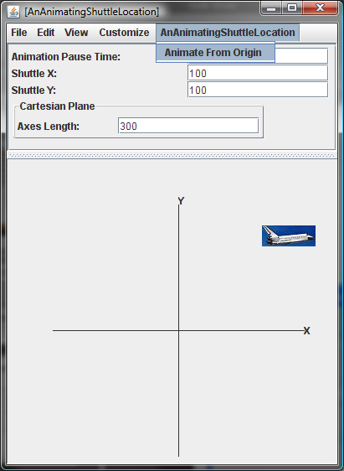
Why Synchronized?
For a non-synchronized method ObjectEditor waits for invoked method to finish before taking the next step of updating the display
If animateFromOrigin was non-synchronized
would only see the final position
menu is frozen until method finishes, cannot execute another activity

Slide 54
Animation Requires Concurrent Threads
During animation two interleaved activities must take place
animateFromOrigin moves current X and Y
Object editor displays intermediate X and Y positions
ObjectEditor cannot wait for method to finish
It must create a new thread or activity for animateFromOrigin
The keyword synchronized tells ObjectEditor to do so

Slide 55
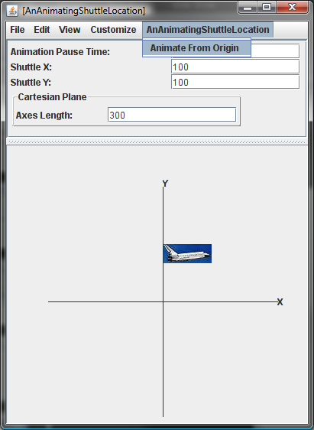
Concurrency
In the case of synchronized method, we can ask ObjectEditor to invoke another method while previous one is executing

Slide 56
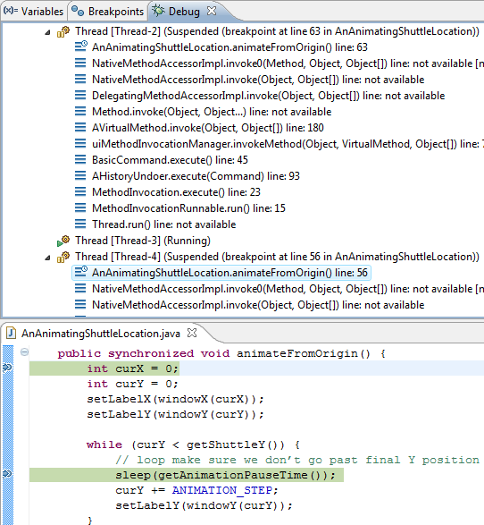
Concurrency
Can have two animateFromOrigin executed concurrently by two different threads (Thread-3 and Thread-4)!
Other threads?
UI processing
Garbage collection
…

Slide 57
Concurrency
Can have two animateFromOrigin executed concurrently by two different threads (Thread-3 and Thread-4)!
Second one can interfere with first one
Can reset label position

Slide 58
Concurrency
The keyword synchronized tells Java that only one thread should execute the method at one time
Thread-4 is suspended at first statement until Thread-3 completes method
Cannot reset shuttle location set by Thread-3

Slide 59
The Role of Synchronized
The keyword synchronized tells
ObjectEditor that a new thread should be created for executing the method.
Java that only one thread should execute the method at one time
Extra thread needed and keyword needed even if we don’t use ObjectEditor and create our own display-engine for animating
So requiring animating methods to be synchronized is not a special ObjectEditor requirement

Slide 60
When is Display Updated
Normally ObjectEditor updates display at the end of the execution of each method
Does not work for animating method
Need to update after each change
Must explicitly tell ObjectEditor that change occurred. How?

Slide 61
ObjectEditor Observer Protocol
ObjectEditor implements the standard PropertyChangeListener interface
public interface PropertyChangeListener {
public void propertyChange(PropertyChangeEvent arg)
}
public class ObjectEditor implements PropertyChangeListener {
public void propertyChange(PropertyChangeEvent arg) {
...
}
}

Slide 62
ObjectEditor Observer Protocol
If the class of a displayed object defines the standard method:
public void addPropertyChangeListener (PropertyChangeListener l)
ObjectEditor calls the method to register itself as an observer
Method should store a reference to ObjectEditor and other observers
public class ACartesianPoint implements Point {
…
public void addPropertyChangeListener(PropertyChangeListener l) {
observers.addElement(l);
}
}

Slide 63
ObjectEditor Observer Protocol
A property changing method can now call the propertyChange(PropertyChangeEvent arg) defined by PropertyChangeListener to inform ObjectEditor and other observers about change
public void notifyAllListeners(PropertyChangeEvent e) {
for (int index = 0; index++; index < observers.size() {
observers.elementAt(i).propertyChange(e);
}
public void setX (int newVal) {
int oldVal = x;
x = newVal;
notifyAllListeners(new PropertyChangeEvent(
this, “x”, oldVal, newVal);
}

Slide 64
Applying These Concepts
How should the class AnAnimatingShuttleLocation be changed?

Slide 65
ObjectEditor Observer Protocol
The implementation of this method in ObjectEditor updates the display
public class ObjectEditor implements java.beans.PropertyChangeListener {
public void propertyChange (PropertyChangeEvent arg) {
// update display of property arg.getPropertyName()
// to show arg.getNewValue()
…
}
}

Slide 66
Animating Code
public synchronized void animateFromOrigin() {
int curX = 0;
int curY = 0;
setLabelX(windowX(nextX));
setLabelY(windowY(nextY));
// make sure we don’t go past final Y position
while (curY < getShuttleY()) {
sleep(getAnimationPauseTime());
curY += ANIMATION_STEP;
setLabelY(windowY(curY));
}
// move to final Y position
setLabelY(windowY(getShuttleY()));
while (curX < getShuttleX()) {
sleep(getAnimationPauseTime());
curX += ANIMATION_STEP;
setLabelX(windowX(curX));
}
setLabelX(windowX(getShuttleX()));
}

Slide 67
Animating Code
void setLabelX(int x) {
Point oldLocation = shuttleLabel.getLocation();
Point newLocation = new ACartesianPoint(x, oldLocation.getY());
shuttleLabel.setLocation(newLocation);
}

Slide 68
Class ALabel
public void setLocation(Point newVal) {
location = newVal;
}

Slide 69
Make ALabel a Model
public class ALabel implements Label {
PropertyChangeListenerHistory observers =
new APropertyChangeListenerHistory();
public void addPropertyChangeListener(PropertyChangeListener l) {
observers.addElement(l);
}
}
public void notifyAllListeners(PropertyChangeEvent e) {
for (int index = 0; index++; index < observers.size() {
observers.elementAt(i).propertyChange(e);
}
Property-independent code

Slide 70
Class ALabel (Edit)
public void setLocation(Point newVal) {
location = newVal;
}

Slide 71
Class ALabel
public void setLocation(Point newVal) {
Point oldVal = location;
location = newVal;
notifyAllListeners(new PropertyChangeEvent(
this, “Location”, oldVal, newVal);
}

Slide 72
Animation Steps
Animation consists of one or more animation steps
An animation step updates one or more animating graphical properties such as size, location, and icon of one or more graphical objects and then pauses execution

Slide 73
Pausing Execution
Execution can be paused using busy waiting or a sleep call provided by the operating system
Busy waiting has the problem that it is platform-specific and does not allow other activity to proceed while the animation is paused
Therefore using the sleep call is preferable

Slide 74
Incremental Updates
After each animation step, all displays of the animation must be updated
The observable-observer concept can be used to ensure these updates are made
for each graphical property changed by the animation, the class of the property should allow observers to be registered and the setter of the property informs the observers about the update
ObjectEditor requires the JavaBeans observer-observer approach based around the PropertyChangeListener interface

Slide 75
Threads
An animating method should be executed in a separate thread as otherwise the user-interface thread will wait for it to finish execution before performing any screen update
This means that it is possible to start multiple executions of the method concurrently
We should use the keyword synchronized in the declaration of the method to ensure that is it is executed serially by the thread
The keyword synchronized also tells ObjectEditor to start a new thread to execute the method

Slide 76
Animating vs. Updating Classes
In general, a method that performs the animation steps and a method that changes the value of some animating property may be in different classes:
AnAnimatingShuutleLocation
ALabel

