Slide 1
Comp 110
Arrays
Instructor: Jason Carter

Slide 2
Outline
for loops
Arrays

Slide 3
Strings = Char Sequences
String {sequences of characters}
J
o
h
n
F
.
K
e
n
n
e
d
y
h
e
l
l
o
1
4
3
2
0

Slide 4
String Processing
    int i = 0;
    while (i < s.length()) {
    System.out.println(s.charAt(i));
    i++;
    }
Prints each character on a separate line

Slide 5
Dissecting a Loop
Loop Condition
    int i = 0;
    while (i < s.length()) {
    System.out.println(s.charAt(i));
    i++;
    }
Loop Body

Slide 6
Finger-grained Dissection
    // String s declared and initialized earlier
    int i = 0;
    while (i < s.length()) {
    System.out.println(s.charAt(i));
    i++;
    }
Loop Condition
Initializing Loop Variable
Loop Body
Resetting Loop Variable
    for (int i=0; i<s.length(); i++)
    System.out.println(s.charAt(i));

Slide 7
Meaning of For Loop
for (S1; E; S2)
S3
for (; E; S2)
S3
for (; E;)
S3
for (;;)
S3
S1;
while (E) {
S3;
S2;
}
while (E) {
S3;
S2;
}
while (E) {
S3;
}
S1;
while (true) {
S3;
S2;
}

Slide 8
Other Predefined Types as Sequences
IntSequence {sequences of integers}
100
98
99
100
90
80
60
40
50
DoubleSequence {sequences of doubles}
3.8
3.1
3.7
3.1
3.6
3.9
StringSequence {sequences of string}
JFK
FDR
JC
BC
RR
GB

Slide 9
Sequences of Programmer-Defined Types
LoanSequence
Loan[]
Array Types
loan1
loan2
loan3
Arrays
TemperatureSequence
Temperature []
temperature1
temperature2
temperature3
temperature1
temperature2
Array Element

Slide 10
Other Sequences as Array Types
int[]
100
98
99
100
90
80
60
40
50
double[]
3.8
3.1
3.7
3.1
3.6
3.9
String[]
JFK
FDR
JC
BC
RR
GB

Slide 11
Initializing Array Declaration
Array Type
int[] assignmentScores = {100, 98, 99, 100, 90, 80};
Array Literal
ElementType
100
98
99
100
90
80
Array Variable
double[] gpas = {3.8, 3.1, 3.7, 3.1, 3.6, 3.9};
3.8
3.1
3.7
3.1
3.6
3.9
String[] initials = {“JFK, “FDR”, “JC”, “BC”, “RR”, “GB”};
JFK
FDR
JC
BC
RR
GB

Slide 12
Initializing Array Declaration Syntax
<ElementType> [] <arrayVariable> = {<element1>, …, <elementN>}
Loan [] loans = {new ALoan(100000), new AnotherLoan (100)};

Slide 13
Array Types Have Variable Size
int[]
100
98
99
100
90
80
60
40
50
int[] assignmentScores = {100, 98, 99, 100, 90, 80};
assignmentScores = {60, 40, 50};
assignmentScores
100
98
60
99
40
100
50
90
80

Slide 14
Array Operations
String[] initials = {“JFK, “FDR”, “JC”, “BC”, “RR”, “GW”, “WW”};
HT
JFK
FDR
JC
BC
RR
GW
WW
public named constant
initials.length
6
Array instance size fixed!
initials[0]
JFK
initials[initials.length-1]
WW
initials[initials.length]
ArrayIndexOutOfBounds Exception
initials[0] = “HT”
initials[initials.length] = “HT”
ArrayIndexOutOfBounds Exception

Slide 15
Uninitializing Array Declaration
int[] assignmentScores;
assignmentScores = {60, 40, 50};
assignmentScores
60
null
40
50

Slide 16
Array Elements Uninitialized
int[] assignmentScores = new int[3];
assignmentScores
0
0
0

Slide 17
Object Array Elements Uninitialized
String[] initials = new String[3];
initials
null
null
null

Slide 18
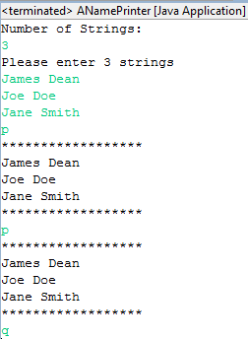
Example

Slide 19
getStrings()
static String[] getStrings() {
System.out.println("Number of Strings:");
int numElements = Console.readInt();
System.out.println("Please enter " + numElements + " strings");
String[] strings = new String[numElements];
for (int elementNum = 0; elementNum < numElements; elementNum++)
strings[elementNum] = Console.readString();
return strings;
}
Variable

Slide 20
print()
String array of arbitrary dimension
static void print(String[] strings) {
System.out.println("******************");
for ( int elementNum = 0; elementNum < strings.length; elementNum++)
System.out.println(strings[elementNum]);
System.out.println("******************");
}

Slide 21
main()
Must test that length is at least 1 before accessing char at position 0
public static void main(String[] args){
String[] names = getStrings();
String command = Console.readString();
while (command.length() > 0 && command.charAt(0) != ‘q’) {
if (command.charAt(0) == 'p')
print(names);
command = Console.readString();
}
}
No need to test length here

Slide 22
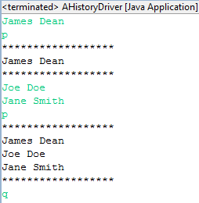
Another Example

Slide 23
Variable-Size Collection
unfilled part
maximum size
filled part
current size

Slide 24
Variable-Size Collection
size
array
3
James Dean
filled part
current size
Joe Doe
Jane Smith
maximum size
unfilled part

Slide 25
Variable-Size Collection
public class <ClassNeedingVariableSizeCollection> {
…
    final static int A_MAX_SIZE = 50;
    String[] a = new String[A_MAX_SIZE];
    int aSize = 0;
    …
    //process a
    for (int index = 0; index < aSize; index++)
System.out.println(a[index]);
    …
    final int B_MAX_SIZE = 50;
    String[] b = new String[B_MAX_SIZE];
    int bSize = 0;
    …
//process b
…
}

Slide 26
Special Type
public class <ClassNeedingVariableSizeCollection> {
...
AVariableSizeCollection a = new AVariableSizeCollection();
...
for (int index = 0; index < a.size; index++)
System.out.println(a.contents[index]);
…
AVariableSizeCollection b = new AVariableSizeCollection();
...
}
Size Not Updated
a.contents[a.size] = Console.readString();
public class AVariableSizeCollection {
public static final int MAX_SIZE = 50;
    public String[] contents = new String [MAX_SIZE];
    public int size = 0;
}
No Encapsulation

Slide 27
Supporting Encapsulation
public interface …. {
public static final int MAX_SIZE = 50;
    public void addElement(String element);
    public void print();
}
User-specific
Implementation-specific

Slide 28
History
public interface StringHistory {
    public void addElement(String element);
    public int size();
    public String elementAt(int index);
}

Slide 29
Implementing A History
public class AStringHistory implements StringHistory {
  public final int MAX_SIZE = 50;
  String[] contents = new String[MAX_SIZE];
  int size = 0;
  public int size() { return size;}
  public String elementAt (int index) { return contents[index]; }
  boolean isFull() { return size == MAX_SIZE; }
  public void addElement(String element) {
  if (isFull())
    System.out.println("Adding item to a full history");
  else {
    contents[size] = element;
    size++;
    }
}
}

Slide 30
Using a History
public static void main(String[] args) {
StringHistory names = new AStringHistory();
while (true) {
String input = Console.readString();
  if (input.length() > 0)
if (input.charAt(0) == 'q') break;
else if (input.charAt(0) == 'p' )
print(names);
  else
names.addElement(input);
}
}
Exits from the loop

Slide 31
Printing a History
static void print(StringHistory strings) {
System.out.println("******************");
for ( int elementNum = 0; elementNum < strings.size(); elementNum++)
System.out.println(strings.elementAt(elementNum));
System.out.println("******************");
}

Slide 32
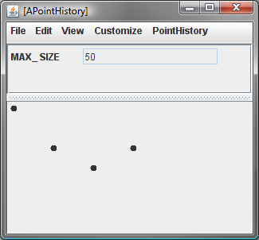
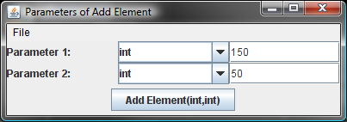
APointHistory
Variable-sized Collection
History
Elements accessed by ObjectEditor
Conventions for exporting elements

Slide 33
Conventions for Variable-Sized Collection
Write Method
public interface PointHistory {
  public void addElement (int x, int y);
  public Point elementAt (int index);
  public int size();
}
Read Methods
Arbitrary Type

Slide 35
Extra Slides

Slide 36
loans
null
Loan[]
Loan
loans
ALoan(10000)
AnotherLoan(100)
null
null

