Slide 1
Comp 110
Model-View-Controller
MVC
Instructor: Jason Carter

Slide 2
User-Interface objects
How to reuse code among different user interfaces?
How to simultaneously create multiple user interfaces to same object?
  Different views for same user
    Slide sorter vs. Outline
  How to create same or different view for each user sharing an object
    Distributed presentation

Slide 3
Counter
Can add arbitrary positive/negative value to an integer
Different user interfaces

Slide 4
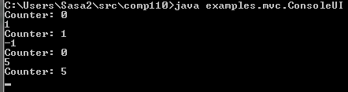
Console Input and Output

Slide 5
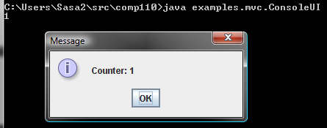
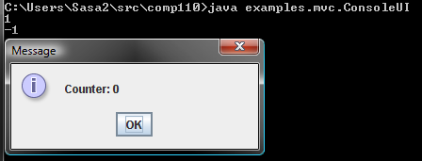
Console Input and JOption Output

Slide 6
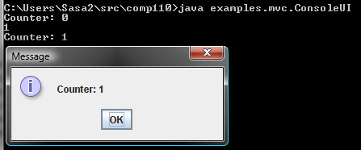
Console Input,Output and JOption Output

Slide 7
Implementation Constraint
Re-use as much code as possible in the three implementations

Slide 8
Pattern-free Implementation
public class ConsoleUI {
static int counter = 0;
public static void main(String[] args) {
System.out.println("Counter: " + counter);
while (true) {
int nextInput = Console.readInt();
if (nextInput == 0) break;
counter += nextInput;
System.out.println("Counter: " + counter);
}
}
}

Slide 9
Pattern-free Implementation
import javax.swing.JOptionPane;
public class ConsoleUI {
static int counter = 0;
public static void main(String[] args) {
while (true) {
int nextInput = readInt();
if (nextInput == 0) break;
counter += nextInput;
JOptionPane.showMessageDialog(
null, “Counter: ” + counterValue);
}
}
}
Counter code is duplicated

Slide 10
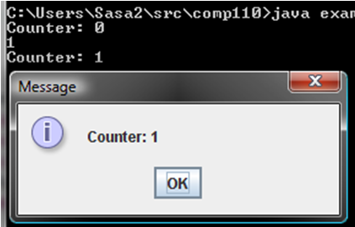
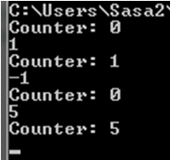
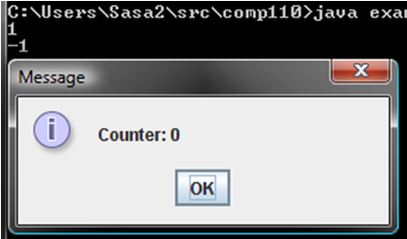
Model/Interactor Separation
Interactor
Model
Interactor
AConsoleUI
Counter
AMultipleUI
AMixedUI
Interactor
Model has no UI code and only semantics!

Slide 11
Composing Model and Interactor
public static void main (String args[]) {
(new AConsoleUI()).edit (new ACounter());
}

Slide 12
Counter Model
public class ACounter implements Counter {
int counter = 0;
public void add (int amount) {
counter += amount;
}
public int getValue() {
return counter;
}
}
Code Reusability
Less Duplication
Fewer Changes

Slide 13
Console Interactor
public class AConsoleUI implements ConsoleUI {
public void edit (Counter counter) {
System.out.println("Counter: " + counter);
while (true) {
int nextInput = Console.readInt();
if (nextInput == 0) return;
counter.add(nextInput);
System.out.println("Counter: " + counter.getValue());
}
}
}
Shared Model Code
Input
Output

Slide 14
Mixed Interactor
public class AMixedUI implements ConsoleUI {
public void edit (Counter counter) {
while (true) {
int nextInput = Console.readInt();
if (nextInput == 0) break;
counter.add(nextInput);
JOptionPane.showMessageDialog(null,
"Counter: " + counter.getValue());
}
}
}
Shared Model Code
Input
Output

Slide 15
Multiple Interactor
public class AMultipleUI implements ConsoleUI {
public void edit (Counter counter) {
System.out.println("Counter: " + counter);
while (true) {
int nextInput = Console.readInt();
if (nextInput == 0) break;
counter.add(nextInput);
System.out.println("Counter: " + counter.getValue());
JOptionPane.showMessageDialog(null,
"Counter: " + counter.getValue());
}
}
}
Shared Model Code
Input
Output

Slide 16
Drawbacks of Monolithic UI
AConsoleUI
Duplicated Input Code
Counter
AMixedUI
Duplicated Output Code
AMultipleUI

Slide 17
Model/Interactor Pattern
Interactor
UI Code
Arbitrary UI unaware methods
Model
Computation Code

Slide 18
MVC Pattern
Controller
View
Performs Input
Performs Output
Model
Write Methods
Read Methods

Slide 19
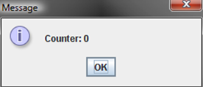
MVC Pattern in Counter
Controller
View
Performs Input
Performs Output
Model
add()
getValue()

Slide 20
Multiple Views and Controllers
Controller 1
View 1
Controller 2
Model
View 2
Controller 3
View 3
Controller 4
View 4

Slide 21
Syncing Controllers & View
Controller 1
View 1
Controller 2
Model
View 2
Controller 3
View 3
Controller 4
View 4

Slide 22
Observer/Observable Pattern
Observable
Observers
Controller 1
View 1
Controller 2
Model
View 2
Controller 3
Changed model notifies views
View 3
Controller 4
View 4

Slide 23
Observer/Observable Pattern
Observer 1
Observable 1
Observer 2
Observable 2
Observer 3
Observer N

Slide 24
Observer with multiple Observables
A single battle simulation view observing
  Multiple planes
  Multiple tanks

Slide 25
Notification Scheme
Each observer is registered with observable
Each write method in observable calls a notification method in each observer
Observer 1
Notification method in observer reads model
Observable 1
Observer 2
Observable 2
Observer 3
Each student is registered with professor’s listserv
When web page is updated mail sent to students
Observer N
Student reads web page

Slide 26
General Notification Scheme
Observers may have multiple observerables with common notification method
Observer 1
Notification method parameter indicates which observable
Observable 1
Observer 2
Observable 2
Observer 3
Observer N

Slide 27
MVC Pattern
Controller
View
Performs Input
Performs Output
Notification Method
Model
add()
getValue()

Slide 28
Implementation dependent issues
How does controller know about model?
  Model connection method invoked on it
  By model or some other program
    Main
How is observable registered with observer
  It registers itself if it knows about observable
  Model registers it if it knows about observer
  Some other code registers it
    Main

Slide 29
Model, View and Controller (MVC)
Model Connection Method
Controller
View
Performs Input
Performs Output
Notification Method
Model
add()
getValue()
Observer Registration Method

Slide 30
Counter Observable and Observer?
public interface ObservableCounter {
public void add (int amount) ;
public int getValue() ;
// additional methods?
}
public interface CounterObserver {
}

Slide 31
Counter Observable and Observer
Console View, JOption View
public interface ObservableCounter {
public void add (int amount) ;
public int getValue() ;
public void addObserver(CounterObserver observer);
public void removeObserver(CounterObserver observer);
}
public interface CounterObserver {
public void update(ObservableCounter counter);
}
Called whenever model is updated
Updated model

Slide 32
Counter Model
public class AnObservableCounter implements ObservableCounter {
int counter = 0;
ObserverHistory observers = new AnObserverHistory();
public void add (int amount) {
counter += amount;
notifyObservers();
}
public int getValue() {
return counter;
}
public void addObserver(CounterObserver observer) {
observers.addElement(observer);
observer.update(this);
}
public void removeObserver(CounterObserver observer) {
observers.removeElement(observer);
}
void notifyObservers() {
for (int observerNum = 0; observerNum < observers.size();
observerNum++)
observers.elementAt(observerNum).update(this);
}
}
Give this observable initial value
Each write method notifies all!

Slide 33
Console View
public class ACounterConsoleView implements CounterObserver {
public void update(ObservableCounter counter) {
System.out.println("Counter: " + counter.getValue());
}
}

Slide 34
JOption View
import javax.swing.JOptionPane;
public class ACounterJOptionView implements CounterObserver {
public void update(ObservableCounter counter) {
JOptionPane.showMessageDialog(
null, "Counter: " + counter.getValue());
}
}

Slide 35
Console Controller Interface
public interface CounterController {
public void setModel(ObservableCounter theCounter);
public void processInput();
}

Slide 36
Console Controller
public class ACounterController implements CounterController {
ObservableCounter counter;
public void setModel(ObservableCounter theCounter) {
counter = theCounter;
}
public void processInput() {
while (true) {
int nextInput = Console.readInt();
if (nextInput == 0) break;
counter.add(nextInput);
}
}
}

Slide 37
Console Main
public static void main (String args[]) {
ObservableCounter model = new AnObservableCounter();
model.addObserver(new ACounterConsoleView());
CounterController controller = new ACounterController();
controller.setModel(model);
controller.processInput();
}

Slide 38
Console and JOption Main
public static main (String args[])
ObservableCounter model = new AnObservableCounter();
model.addObserver (new ACounterJOptionView());
CounterController controller = new ACounterController();
controller.setModel(model);
controller.processInput();
}
Shared input code

Slide 39
Mixed UI Main
public static main (String args[])
ObservableCounter model = new AnObservableCounter();
model.addObserver(new AConsoleJOptionView());
model.addObserver (new ACounterConsoleView());
CounterController controller = new ACounterController();
controller.setModel(model);
controller.processInput();
}

Slide 40
Observers that are not views
Spreadsheet cell observes cells on which it depends
Monitoring of appliance usage
  Each time I do setChannel() on TV event logged
Any big brother app!
Counter observer?

Slide 41
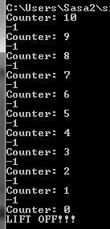
Rocket Observer
View added before rocket observer

Slide 42
Instances created and composed
AnObservable
Counter
ACounterConsoleView
Controller
ARocketLaunchingCounterObserver
ARocketLauncher

Slide 43
Rocket Launcher
public class ARocketLaunchingCounterObserver
implements CounterObserver {
public void update(ObservableCounter counter) {
if (counter.getValue() == 0)
launch();
}
private void launch() {
System.out.println("LIFT OFF!!!");
}
}

Slide 44
Rocket Launching Main
public static void main (String args[]) {
ObservableCounter model = new AnObservableCounter();
model.addObserver (new ACounterConsoleView());
model.addObserver(new ARocketLaunchingCounterObserver());
CounterController controller = new ACounterController();
controller.setModel(model);
controller.processInput();
}

Slide 45
More on Observers
Different forms of observers are provided by Java software
Some differences in syntax
  Using term “Listener” instead of “Observer”
Some differences in amount of information conveyed to observer about change

Slide 46
Basic Notification
public interface CounterObserver {
public void update(ObservableCounter counter);
}
Called when observer is updated
Updated Observable

Slide 47
Implicit Observer
Updated Observable
public interface CounterObserver {
public void setObservable(ObservableCounter counter);
public void update();
}
What if observer is in USA and observable in China?
Update must make a “long distance” call to read method (getValue()) to update counter state

Slide 48
Notification with Change Description
No need to call read method after notification
package models;
public interface CounterObserver {
public void update(ObservableCounter counter, int newCounterVal);
}

Slide 49
Java java.util.Observer
public interface java.util.Observer {
public void update(Observable o, Object arg);
}
“Standard” observer interface talking arbitrary change Object argument
Will learn more about Object after inheritance

Slide 50
Notification with Changed Value
New value of observable attribute
public interface CounterObserver {
public void update(ObservableCounter counter, int newCounterVal);
}

Slide 51
Notification with Change
Difference between new and old value of observable attribute
public interface CounterObserver {
public void update(ObservableCounter counter,
int counterIncrement);
}
Observer may display change to user
Observer interested in change does not need to keep old value to determine change
Observer interested in absolute value must keep old value

Slide 52
Notification with New and Old Value
Old and new value of observable attribute
public interface CounterObserver {
public void update (ObservableCounter counter,
int oldCounterValue, int newCounterValue);
}
Observer interested in change does not need to keep old value to determine change
Observer interested in absolute value need not keep old value
Makes observer harder to code

Slide 53
Notification with Single Event Object
Easy to pass single object to different methods handling event
Can make event info very elaborate
  Time when event occurred
  Unique ID for event
  ….
Don’t have to declare parameters for event information fields not of interest
Can return object from a function
public interface CounterObserver {
public void update(
CounterChangeEvent event);
}
public interface CounterChangeEvent {
ObservableCounter getCounter();
int getOldCounterValue();
int getNewCounterValue();
}

Slide 54
Java ActionEvent
import java.awt.Event;
public interface java.awt.ActionListener {
public void actionPerformed(ActionEvent e);
}

Slide 55
Observing Multiple Properties
public interface BMISpreadsheet {
public double getHeight();
public void setHeight(int newVal);
public double getWeight();
public void setWeight(int newWeight) ;
public double getBMI();
}

Slide 56
Single Coarse-Grained Update
public interface BMISpreadsheet {
public double getHeight();
public void setHeight(int newVal);
public double getWeight() ;
public void setWeight(int newWeight) ;
public double getBMI();
}
public interface BMIObserver {
public void update(
BMISpreadsheet bmiSpreadsheet);
}
Coarse grained updated
Each setter sends the whole object
Observer must determine which property changed

Slide 57
Multiple fine-grained updates
public interface BMISpreadsheet {
public double getHeight();
public void setHeight(int newVal);
public double getWeight() ;
public void setWeight(int newWeight) ;
public double getBMI();
}
public interface BMIObserver {
public void updateHeight (
BMISpreadsheet bmi, int oldHeight, int newHeight);
public void updateWeight(
BMISpreadsheet bmi, int oldWeight, int newWeight);
public void updateBMI(
BMISpreadsheet bmi, double oldBMI, double newBMI);
}

Slide 58
Single fine-grained update method
public interface BMISpreadsheet {
public double getHeight();
public void setHeight (int newVal);
public double getWeight();
public void setWeight(int newWeight) ;
public double getBMI();
}
public interface BMIObserver {
public void update(
BMISpreadsheet bmi, String propertyName,
Object oldValue, Object newValue);
}
“Wght”
“One”
New methods not needed as new properties added
Different setters calls the same update method with different types of values.
Can be used for arbitrary property values
Can make mistakes

Slide 59
Property Changes
public interface java.beans.PropertyChangeListener {
public void propertyChange (PropertyChangeEvent evt);
}
public class java.beans.PropertyChangeEvent extends java.util.EventObject {
public PropertyChangeEvent (Object source, String propertyName,
Object oldValue, Object newValue) {…}
public Object getNewValue() {…}
public Object getOldValue() {…}
public String getPropertyName() {…}
….
}

Slide 60
Property Changes
If a displayed object defines
  addPropertyChangeListener(PropertyChangeListener l) { …}
ObjectEditor automatically calls it to register itself
Setter method can can now notify listeners
  public void propertyChange(PropertyChangeEvent evt)
ObjectEditor reacts by updating display of property
  Does not have to do polling refresh by calling all getter methods when a setter is invoked.
  Can disable this polling refresh by invoking View→Auto Refresh command
More on this when we discuss animation when it will be a crucial feature

