Slide 1
Comp 110
Objects
Instructor: Jason Carter

Slide 2

Computer vs. Program Model
Processor
?
Program (source code)
Compiler

Slide 3
Outline
Intuitive Explanation
Two Concrete Examples
Calculators
  square
  BMI
Basic Java program elements, programming styles, error handling
Running and interacting with a Java program

Slide 4
Structuring in Scripts
Script
Follows
Theater
Performer

Slide 5
Structuring in Scripts
Script
Introduction
Body
Conclusion
Script components are abstract.
Paragraph 1
Paragraph 2
So are program components!
Sentence 1
Sentence 2

Slide 6



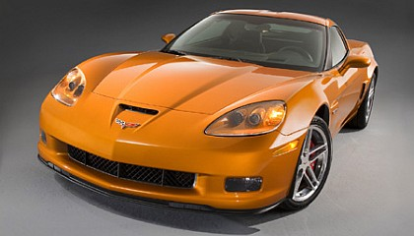
Program Components ~ Physical Objects
Natural Objects
Manufactured Objects
~ Program Components

Slide 7

Program Objects ~ Manufactured Objects
Operations
manufactured
by
accelerate
perform
brake
Class
Methods
Program Object
instance of
execute invoke call
add
Program Object
subtract

Slide 8
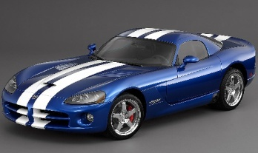
Classification Through Factories
manufactured
by
manufactured
by

Slide 9
Classification Through Factories
ASquareCalculator
instance of
ASquareCalculator Instance
ASquareCalculator Instance
ABMICalculator
instance of
ABMICalculator Instance
ABMICalculator Instance

Slide 10
A Simple Class: ASquareCalculator
public class ASquareCalculator
{
  public int square(int x)
  {
return x*x;
  }
}

Slide 11
Nature of a Function
Domain
Range
Parameter Values
Result Values
1
1
2
4
3
9
…
…
Mapping

Slide 12
Mathematics vs. Java Function Syntax
Mathematics
square: I → I
square(x) = x²
Java
public int square(int x)
{
return x*x;
}

Slide 13
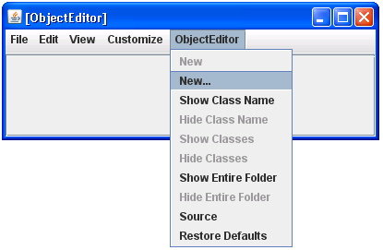
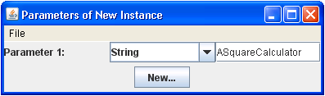
Instantiating ASquareCalculator

Slide 14
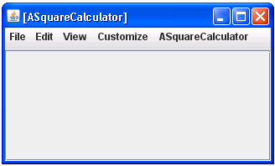
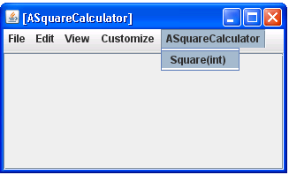
ASquareCalculator Instance

Slide 15
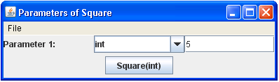
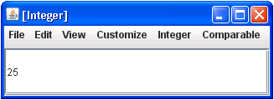
Invoking a Method And Viewing the Result

Slide 16
ObjectEditor vs. ASquareCalculator
Two objects with different methods

Slide 17
Another Simple Class: ABMICalculator
ASquareCalculator
ABMICalculator
Specification:
Given an integer x, calculate the square of x.
Specification:
Given the weight (kg) and height (m) of a person, calculate the person’s body mass index a.k.a. BMI.
public class ASquareCalculator
{
  public int square(int x)
  {
return x*x;
  }
}
?
How do we modify the ASquareCalculator code to meet the BMI calculator specification?

Slide 18
ASquareCalculator vs. ABMICalculator
public class ASquareCalculator
{
  public int square(int x)
  {
return x*x;
  }
}
int weight, int height
ABMICalculator
public class ASquareCalculator
{
  public int square(int x)
  {
return x*x;
  }
}
calculateBMI
return weight/(height*height)

Slide 19
ABMICalculator
public class ABMICalculator
{
  public int calculateBMI(int weight, int height)
  {
return weight/(height*height);
  }
}
Parameter and return types are integers
But height (m) and weight (kg) are expressed as decimals
How do we solve the discrepancy?

Slide 20
ABMICalculator
double
public class ABMICalculator
{
  public int calculateBMI(int weight, int height)
  {
return weight/(height*height);
  }
}

Slide 21
ABMICalculator
public class ABMICalculator
{
  public double calculateBMI(double weight, double height)
  {
return weight/(height*height);
  }
}

Slide 22
Developing BMI Calculator
Use Eclipse

Slide 23
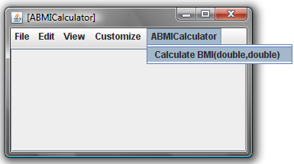
Interacting with ObjectEditor
Run the calculateBMI function in ABMICalculator

Slide 24
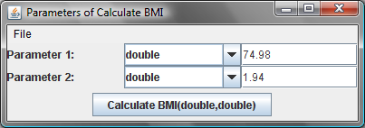
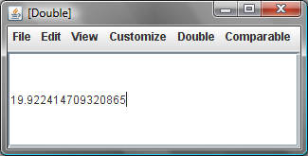
Interacting with ObjectEditor
Fill out the parameters of the calculateBMI function
Press the “Calculate BMI(double,double)” button to see the result

Slide 25
Program Development Process
Eclipse
creates
ABMICalculator Source Code
ABMICalculator Instance
reads
Compiler
calculateBMI
writes
calls
ABMICalculator Object (byte) Code
ObjectEditor
instantiates
main
calls
Interpreter

Slide 26
Anatomy of a Class
Class Header
Class Body
Method Header
Method Body
Parameter Type
Parameter Name
1: public class ABMICalculator
2: {
3: public double calculateBMI (double weight, double height)
4: {
5: return weight/(height*height);
6: }
7: }
Access Specifier
Return Type
Return Statement
Return Expression

Slide 28
Structuring in Scripts
Script
Introduction
Body
Conclusion
Script components are abstract.
Paragraph 1
Paragraph 2
So are program components!
Sentence 1
Sentence 2

Slide 29

Program Objects ~ Manufactured Objects
Operations
manufactured
by
accelerate
perform
brake
Class
Methods
Program Object
instance of
execute invoke call
add
Program Object
subtract

Slide 30
Java vs. Real-world
Java | Real-world
Class | Factory
Computer Object | Manufactured Physical Object
Method | Operation
Invoking/Executing a Method | Performing an Operation
Instance of a Class | Manufactured by a Factory
Defining/Declaring a Class | Constructing a Factory
Instantiating a Class | Manufacturing an Object

Slide 31
Anatomy of a Class
Class Header
Class Body
Method Header
Method Body
Parameter Type
Parameter Name
1: public class ABMICalculator
2: {
3: public double calculateBMI (double weight, double height)
4: {
5: return weight/(height*height);
6: }
7: }
Access Specifier
Return Type
Return Statement
Return Expression

Slide 32
Formal vs. Actual Parameters
public class ABMICalculator
{
  public double calculateBMI(double weight, double height)
  {
return weight/(height*height);
  }
}
Parameters
Formal Parameters
Invoke calculateBMI
assigned
variables
memory
weight
0
74.98
height
0
1.94
Parameters
Actual Parameters

Slide 33
One More Simple Class: AnAverageCalculator
AnAverageCalculator
Specification:
Given two real numbers, return their average (as a real number).
1:
2:
3:
4:
5:
6:
7:
public class AnAverageCalculator
{
public double calculateAverage(double num1, double num2)
{
return (num1+num2)/2;
}
}

Slide 34
Errors
class ABMICalculator
{
  double calculateBMI(double weight, double height)
  {
return (height*heigh)/weight
  }
Logic Error
Syntax Error
Access Error
Semantics Error

Slide 35
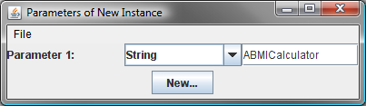
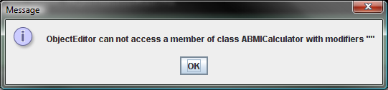
Class Access Error
While instantiating a ABMICalculator object
you get the following error:
Reasons
  ABMICalculator class is not public

Slide 36
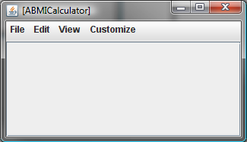
Method Access Error
You instantiate a ABMICalculator object
but there is no ABMICalculator menu item
Reason
  You have not defined any public methods in ABMICalculator

Slide 37
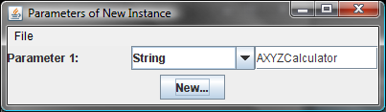
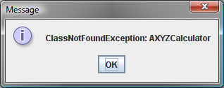
User Error
While instantiating a AXYZCalculator object
you get the following error
Reason
  AXYZCalculator class does not exist

Slide 38
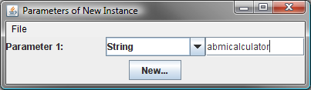
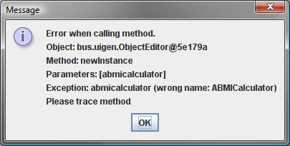
User Error
While instantiating a abmicalculator object
you get the following error
Reason
  Class name is spelled with incorrect case

Slide 39
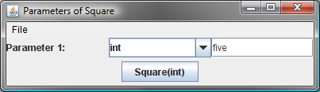
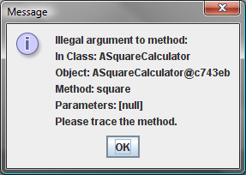
User Error
When invoking the Square method in ASquareCalculator
you get the following error
Reason
  Parameter value is not in the function domain (set of allowed parameter values)

Slide 40
javac Error Reporting
ABMICalculator.java (3,3) : error J0232: Expected '{' or ';'
ABMICalculator.java (3,3) : error J0021: Expected type specifier
ABMICalculator.java (3,3) : error J0019: Expected identifier
ABMICalculator.java (5,1) : error J0020: Expected 'class' or 'identifier'
Line Number
Character Number

Slide 41
Case Conventions
Start Class Names With Upper Case Letters
aBMICalculator
ABMICalculator
Start Variable and Method Names With Lower Case Letters
weight
Weight
Square
square
Start Variable and Method Names With Lower Case Letters
Each New Word in the Name Starts with a Capital Letter
converttoinches
convertToInches
ABMICalculator
aBMICalculator

Slide 42
ObjectEditor Changes Case
Method name starts with capital letter
Adds spaces to names
Different conventions for programmers and end users.

Slide 43
Identifiers
Reserved Words
(Keywords)
Program-defined Names
int, double, class, return, public
Variable names, method names, class names
boldface
Must begin with a letter
Other characters can be letters, digits, or underscore “_”
calculate_bmi2
calculateBMI3

Slide 45
Extra Slides

Slide 47
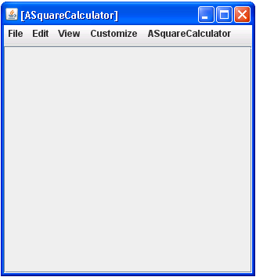
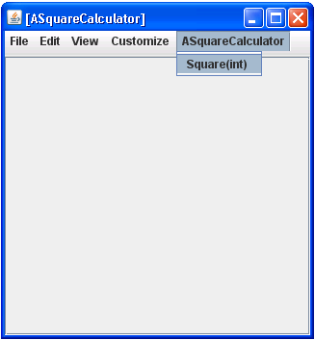

Slide 49
A Simple Class
public class ABMICalculator {
public int calculateBMI (
int weight, int height)
{
return weight/(height*height);
}
}
public class ABMICalculator {
public double calculateBMI (
double weight, double height)
{
return weight/(height*height);
}
}

Slide 50
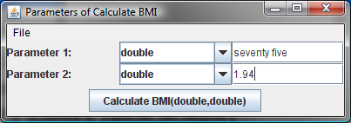
User Error

Slide 51
