Slide 1
Comp 110 State
Instructor: Jason Carter

Slide 2
Outline
Instance Variables
Procedures
Properties
Print Statements
Println vs. Print
Overloading

Slide 3
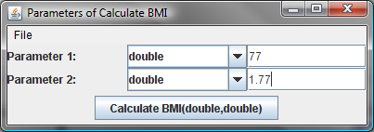
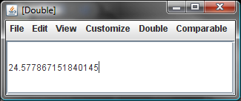
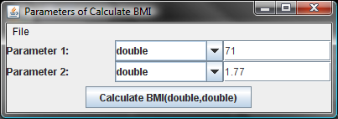
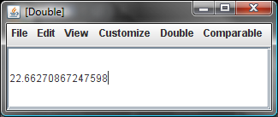
“What if” BMI Calculations With General Purpose Calculator
Must re-enter height each time!

Slide 4
“What if” BMI Calculations With Specialized Calculator
public double calculateMyBMI(double weight) {
final double MY_HEIGHT = 1.77;
return (new ABMICalculator).calculateBMI(weight, MY_HEIGHT);
}
Must only enter the weight
But the height is hardwired! Must create a separate class for each user!
General purpose solution that does not require re-entry of height each time?

Slide 5
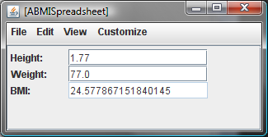
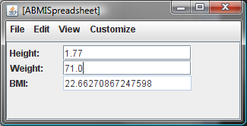
BMI Spreadsheet
Caculate two BMIs using one instance of ABMISpreadsheet and changing only the weight
State: Data remembered by an object between computations

Slide 6
Instance Variables
ABMICalculator Instance
ABMISpreadsheet Instance
calculateBMI
getBMI
Body
Body
accesses
accesses
Instance
Variables
Parameters
Belong to a single method
Belong to all methods of an instance
Local variable
Global variable

Slide 7
State-less vs. State-full Objects
Identical Instances ~ car radios with no presets
Different Instances ~ car radios with presets

Slide 8
Declaring Instance Variables
Instance Variables
public class ABMISpreadsheet {
double height;
...
double weight;
...
public double getBMI() {
return weight/(height*height);
}
…
}
Missing Code
No Parameters

Slide 9
Object Access to a Class
public class ABMISpreadsheet {
double height;
...
double weight;
...
public double getBMI() {
return weight/(height*height);
}
…
}
Variables should not be public
Outside Access:
ObjectEditor
But ObjectEditor needs their values

Slide 10
Accessing Instance Variables via Public Methods
ABMISpreadsheet Instance
weight
height
reads
writes
reads
writes
reads
getWeight()
setWeight()
getHeight()
setHeight()
getBMI()
calls
calls
calls
calls
new weight
new height
weight
height
ObjectEditor

Slide 11
Coding Getter and Setter Methods
ABMISpreadsheet Instance
weight
reads
writes
getWeight()
setWeight()
calls
calls
new weight
weight
ObjectEditor

Slide 12
Function vs. Procedure
procedure: deposit
function: withdraw

Slide 13
Coding Getter and Setter Methods
ABMISpreadsheet Instance
public double getWeight()
{
return weight;
}
weight
reads
writes
public void setWeight(double newWeight)
{
weight = newWeight;
}
getWeight()
setWeight()
calls
calls
procedure – returns nothing
function
new weight
weight
ObjectEditor

Slide 14
Getter and Setter Methods
public class ABMISpreadsheet {
double height;
public double getHeight() {
return height;
}
public void setHeight(double newHeight) {
height = newHeight;
}
double weight;
public double getWeight() {
return weight;
}
public void setWeight(double newWeight) {
weight = newWeight;
}
public double getBMI() {
return weight/(height*height);
}
}
function
procedure – returns nothing

Slide 15
Assignment Statement
public void setHeight(double newHeight) {
height = newHeight;
}
setHeight(1.77)
Code that yields a value
variables
memory
<variable>
=
<expression>
new
height
0.0
1.77
height
0.0
height
1.77
1.75*height
weight
0.0
LHS
RHS

Slide 16
Properties
public class ABMISpreadsheet {
double height;
public double getHeight() {
return height;
}
public void setHeight(double newHeight) {
height = newHeight;
}
double weight;
public double getWeight() {
return weight;
}
public void setWeight(double newWeight) {
weight = newWeight;
}
public double getBMI() {
return weight/(height*height);
}
}

Slide 17
Read-only and Editable Properties
Typed, Named Unit of Exported Object State
public class C
{
Name P
Type T
Bean
public T getP() {
...
}
Read-only
Editable
public void setP(T newValue) {
...
}
Getter method
Setter method
Bean convention:
For humans and tools
}
obtainP
Violates Bean convention
newP

Slide 18
Properties
public class ABMISpreadsheet {
double height;
public double getHeight() {
return height;
}
public void setHeight(double newHeight) {
height = newHeight;
}
double weight;
public double getWeight() {
return weight;
}
public void setWeight(double newWeight) {
weight = newWeight;
}
public double getBMI() {
return weight/(height*height);
}
}
Height
Weight
BMI

Slide 19
Properties Classification
public class ABMISpreadsheet {
double height;
public double getHeight() {
return height;
}
public void setHeight(double newHeight) {
height = newHeight;
}
double weight;
public double getWeight() {
return weight;
}
public void setWeight(double newWeight) {
weight = newWeight;
}
public double getBMI() {
return weight/(height*height);
}
}
Height
Editable
Independent
Editable
Weight
Independent
Read-only
BMI
Dependent

Slide 20
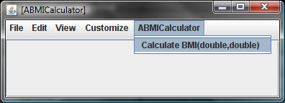
Properties Classification
public class ABMICalculator {
public double calculateBMI (double weight,
double height) {
return weight/ (height * height);
}
}
No Properties

Slide 21
Calling Getter and Setter Methods
public class ABMISpreadsheet {
double height;
public double getHeight() {
return height;
}
public void setHeight(double newHeight) {
height = newHeight;
}
double weight;
public double getWeight() {
return weight;
}
public void setWeight(double newWeight) {
weight = newWeight;
}
public double getBMI() {
return weight/(height*height);
}
}

Slide 22
Tracing Method Calls
public class ABMISpreadsheet {
double height;
public double getHeight() {
System.out.println(“getHeight Called”);
return height;
}
public void setHeight(double newHeight) {
System.out.println(“setHeight Called”);
height = newHeight;
}
double weight;
public double getWeight() {
System.out.println(“getWeight Called”);
return weight;
}
public void setWeight(double newWeight) {
System.out.println(“setWeight Called”);
weight = newWeight;
}
public double getBMI() {
System.out.println(“getBMI Called”);
return weight/(height*height);
}
}

Slide 23
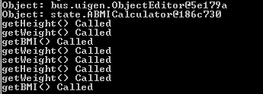
Actual Trace
Load
Change weight
Extra getWeight() call made by the undo-redo mechanism in ObjectEditor

Slide 24
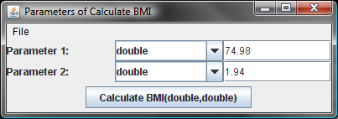
Print Line
System.out.println(“setWeight Called”);
Programmed Call
Target Object
Method Name
Actual Parameters
Interactive Call

Slide 25
Actual Trace

Slide 26
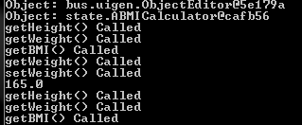
Printing Weight
System.out.println(“setWeight called”);
System.out.println(newWeight);

Slide 27
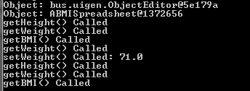
Printing Weight
System.out.print(“setWeight called: ”);
System.out.println(newWeight);

Slide 28
Printing Weight
System.out.println(“setWeight called: ” + newWeight);

Slide 29
print vs. + (Edit)
Cannot use + instead of print()
public void setWeight(double newWeight) {
System.out.print (“old weight = “ + weight);
weight = newWeight;
System.out.println(“ new weight = “ + weight);
}
public void setWeight(double newWeight) {
System.out.println(
“old weight = “ + weight + “ new weight = “ + newWeight
);
weight = newWeight;
}

Slide 30
print vs. +
Cannot use + instead of print()
public void setWeight(double newWeight) {
System.out.print (“old weight = “ + weight);
weight = newVal;
System.out.println(“ new weight = “ + weight);
}
public void setWeight(double newWeight) {
System.out.println(
“old weight = “ + weight +
“ new weight = “ + newWeight);
weight = newVal;
}
We will later see examples when you cannot use +

Slide 31
Recapping the Story: Class Declaration
Class ABMISpreadsheet
File Name:
Class XyZ must be stored in XyZ.java
<class header>
public class ABMISpreadsheet
Spelling and use of upper and lower case letters is important!
<class body>
Class Header Info:
Is this a class?
Is it accessible to other classes?
What is the name of the class?

Slide 32
Recapping the Story: Class Body
Class ABMISpreadsheet
Class Body Info:
How can the class be used?
(i.e. methods)
Instance variables
<class header>
public class ABMISpreadsheet
<class body>
{
double height;
...
double weight;
...
public double setBMI() {
…
}
}
Curly braces after class header declare start of class body
Curly braces at the very end declare end of class body

Slide 33
Recapping the Story: Declarations
<class body>
Declarations:
double height;
public double getHeight() {
return height;
}
public void setHeight(double newHeight) {
height = newHeight;
}
double weight;
public double getWeight() {
return weight;
}
public void setWeight(double newWeight) {
weight = newWeight;
}
public double getBMI() {
return weight/(height*height);
}
Declaring instance variables
Declaring methods
Declaration order:
Does not matter:
e.g. declare a method before or after any instance variables it accesses
e.g. can declare height and weight instance variables at the bottom of the class
- e.g. declare methods in any order
Declaration terminator:
Instance variables: “;”
Methods: end of method body

Slide 34
Recapping the Story: Variables
<class body>
Kinds of variables:
double height;
public double getHeight() {
return height;
}
public void setHeight(double newHeight) {
height = newHeight;
}
double weight;
public double getWeight() {
return weight;
}
public void setWeight(double newWeight) {
weight = newWeight;
}
public double getBMI() {
return weight/(height*height);
}
Formal parameter
Internal method variable
Named constant
Instance variable
Usefulness of each kind of variable?
Variable declaration:
Must have variable type and variable name

Slide 35
Recapping the Story: Methods
<class body>
Kinds of methods:
double height;
public double getHeight() {
return height;
}
public void setHeight(double newHeight) {
height = newHeight;
}
double weight;
public double getWeight() {
return weight;
}
public void setWeight(double newWeight) {
weight = newWeight;
}
public double getBMI() {
return weight/(height*height);
}
Functions
Procedures
Method header info:
Is it accessible to other objects?
Return type
Name
Parameter list
Parameter list:
Enclosed in brackets
Comma separated list of formal parameters

Slide 36
Recapping the Story: Method Body
<class body>
Method body:
double weight;
…
public double getWeight() {
return weight;
}
…
public void setWeight(double newWeight) {
System.out.print (
“old weight = “ + weight);
weight = newVal;
System.out.println(
“ new weight = “ + weight);
}
Sequence of one or more “;” terminated statements
Curly braces after class header declare start of class body
Curly braces at the very end declare end of class body

Slide 37
Recapping the Story: Statements
<class body>
Statements order:
double weight;
…
public double getWeight() {
return weight;
}
…
public void setWeight(double newWeight) {
System.out.print (
“old weight = “ + weight);
weight = newVal;
System.out.println(
“ new weight = “ + weight);
}
Order matters:
Statements executed in sequence
Statements is a:
An instruction that the computer must execute
Kinds of statements :
Return statements
Assignment statements
Print statements

Slide 38
Recapping the Story: Statements
<class body>
Return statement:
double weight;
…
public double getWeight() {
return weight;
}
…
public void setWeight(double newWeight) {
System.out.print (
“old weight = “ + weight);
weight = newVal;
System.out.println(
“ new weight = “ + weight);
}
return <expression>;
Assignment statement :
<variable> = <expression>;
Print statement :
System.out.println( <expression>);

Slide 39
Recapping the Story: Expressions vs. Statements
Expression: Piece of code yielding value
5
“setWeight Called”
newHeight
x*x
weight/(height*height)
Statement: computer instruction executed autonomously
System.out.println(“ setWeight called”);
return x*x
bmi = weight/(height*height);
Expression always evaluated as part of some statement.

Slide 40
Recapping the Story: Evaluating Expressions
Mathematical expression
X = (a+b) + (c*(d+e)/(f+g))
Look for a closing brace and evaluate the sub-expression
(a+b)
+
c *
(d+e)
/
(f+g)

Slide 41
Recapping the Story: Evaluating Expressions
APoundInchBMICalculator
public class APoundInchBMICalculator {
public double calculateBMI(
double weightInLbs, double heightInInches) {
return (new ABMICalculator()).calculateBMI(
toKgs(weightInLbs), toMetres(heightInInches));
}
public double toMetres(double heightInInches) { … }
public double toKgs(double weightInLbs) { … }
}
(new ABMICalculator )
( )
calculateBMI( , )
toKgs
toMetres
(weightInLbs)
(heightInInches)

Slide 42
Recapping the Story: Internal vs. External Method Calls
APoundInchBMICalculator
public class APoundInchBMICalculator {
public double calculateBMI(
double weightInLbs, double heightInInches) {
return (new ABMICalculator()).calculateBMI(
toKgs(weightInLbs), toMetres(heightInInches));
}
public double toMetres(double heightInInches) { … }
public double toKgs(double weightInLbs) { … }
}
Actual parameters:
<expression>
External
Internal
Caller and callee methods are in different objects
Caller and callee methods are in the same object
Must specify target object
Target object is implicit (this)

Slide 43
Overloading
Two different words with the same name
Look at that plane fly.
The fly is bothering me.
Operation Definitions
Context of actual parameters
Two different operations with the same name
String
double
public void println(String val) {…}
System.out.println(“setWeight called”);
public void println(double val) {…}
System.out.println(newWeight);

Slide 44
Ambiguous Context
Time flies like an arrow.
Fruit flies like an orange.
Operation Definitions
Java cannot use context to disambiguate
public void println(String val) {…}
System.out.println(“setWeight called”);
public void println(String val) {…}
System.out.println(newWeight);
Defining two versions of a method ?
Why is overloading useful?

Slide 45
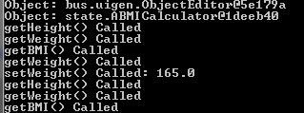
Printing Multiple Values on One Line
Operator Overloading
System.out.println(“setWeight called”);
System.out.println(newWeight);
System.out.println(“setWeight called” + newWeight);
5 + 6

Slide 46
Variable Declaration Errors
public class ABMISpreadsheet {
double height;
public double getHeight() {
return height;
}
public void setHeight(double newHeight) {
height = newHeight;
}
double weight;
public double getWeight() {
return weight;
}
public void setWeight(double newWeight) {
weight = newWeight;
}
public double getBMI() {
return weight/(height*height);
}
}

Slide 47
Variable Declaration Errors
public class ABMISpreadsheet {
public double getHeight() {
return height;
}
public void setHeight(double newHeight) {
height = newHeight;
}
double weight;
public double getWeight() {
return weight;
}
public void setWeight(double newWeight) {
weight = newWeight;
}
public double getBMI() {
return weight/(height*height);
}
}
Undefined variable

Slide 48
Variable Declaration Errors
public class ABMISpreadsheet {
double weight;
public double getHeight() {
return height;
}
public void setHeight(double newHeight) {
height = newHeight;
}
double weight;
public double getWeight() {
return weight;
}
public void setWeight(double newWeight) {
weight = newWeight;
}
public double getBMI() {
return weight/(height*height);
}
}
Multiply defined variable

Slide 49
Pure vs. Impure Functions
ABMICalculator Instance
ABMISpreadsheet Instance
calculateBMI
getWeight
Body
accesses
Body
accesses
weight
weight
height
setWeight(77)
calculateBMI(77,1.77)
24.57
getWeight()
77
setWeight(71)
...
...
calculateBMI(77,1.77)
24.57
getWeight()
71

Slide 50
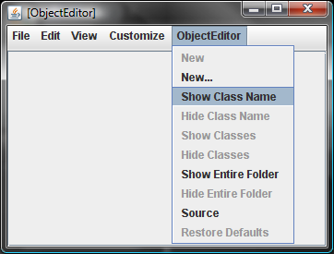
State-less ObjectEditor

Slide 51
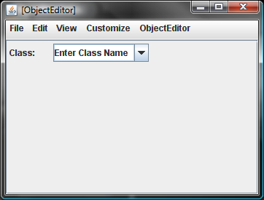
State-full ObjectEditor

Slide 52
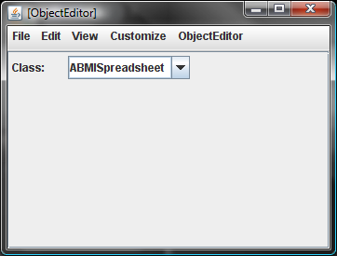
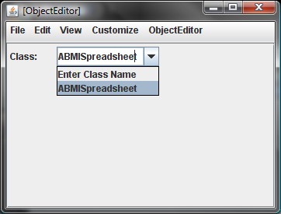
State-full ObjectEditor

Slide 53
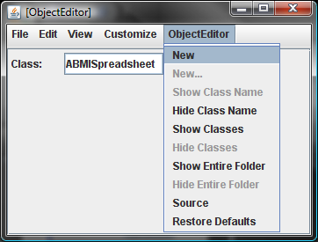
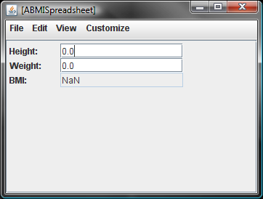
State-full ObjectEditor

Slide 54
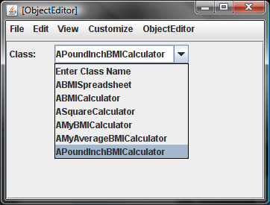
Getting all Classes in Current Directory

Slide 55
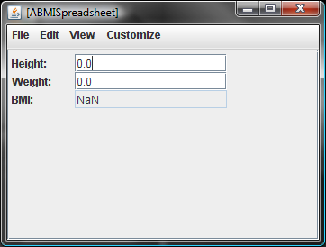
Inconsistent BMI State
(new ABMISpreadsheet());

Slide 56
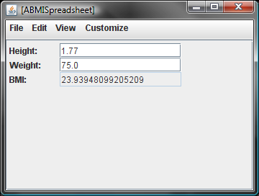
Fixing Inconsistent BMI State
ABMISpreadsheet aBMISpreadsheet = new ABMISpreadsheet();
aBMISpreadsheet.setHeight(1.77);
aBMISpreadsheet.setWeight(75.0);

Slide 57
Consistent BMI State
ABMISpreadsheet aBMISpreadsheet = new ABMISpreadsheet(
1.77, 75.0);

Slide 58
Constructor
public class ABMISpreadsheet {
double height, weight;
public ABMISpreadsheet(
double theInitialHeight, double theInitialWeight) {
setHeight(theInitialHeight);
setWeight(theInitialWeight);
}
public double getHeight() {
return height;
}
public void setHeight(double newHeight) {
height = newHeight;
}
public double getWeight() {
return weight;
}
public void setWeight(double newWeight) {
weight = newWeight;
}
public double getBMI() {
return weight/(height*height);
}
}
Calling setter methods instead of modifying variable directly makes debugging easier

Slide 59
Constructor
public class ABMISpreadsheet {
double height, weight;
public ABMISpreadsheet(
double theInitialHeight, double theInitialWeight) {
setHeight(theInitialHeight);
setWeight(theInitialWeight);
}
public double getHeight() {
return height;
}
public void setHeight(double newHeight) {
height = newHeight;
}
public double getWeight() {
return weight;
}
public void setWeight(double newWeight) {
weight = newWeight;
}
public double getBMI() {
return weight/(height*height);
}
}
Constructor name must be the name of the class
Constructor name is also the type of object returned

Slide 60
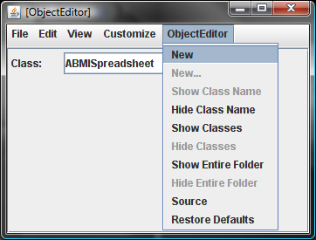
Instantiating a Class with a Constructor

Slide 61
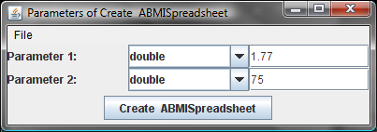
Setting the Constructor Parameters

Slide 62
Initialized Object State

Slide 63
Every Class has a Constructor
public class ABMISpreadsheet {
double height, weight;
public double getHeight() {
return height;
}
public void setHeight(double newHeight) {
height = newHeight;
}
public double getWeight() {
return weight;
}
public void setWeight(double newWeight) {
weight = newWeight;
}
public double getBMI() {
return weight/(height*height);
}
}

Slide 64
Equivalent Class Created by Java
public class ABMISpreadsheet {
double height, weight;
public ABMISpreadsheet() { }
public double getHeight() {
return height;
}
public void setHeight(double newHeight) {
height = newHeight;
}
public double getWeight() {
return weight;
}
public void setWeight(double newWeight) {
weight = newWeight;
}
public double getBMI() {
return weight/(height*height);
}
}
Inserted In Object Code not in Source Code
If Programmer Specifies no Constructor, Java inserts a null constructor

Slide 65
Overloading the Constructor
public class ABMISpreadsheet {
double height, weight;
public ABMISpreadsheet() { }
public ABMISpreadsheet(
double theInitialHeight, double theInitialWeight) {
setHeight(theInitialHeight);
setWeight(theInitialWeight);
}
…
}
Null constructor has been manually added

Slide 66
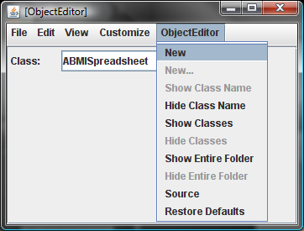
Instantiating a Class with Multiple Constructors

Slide 67
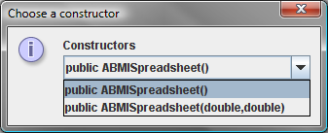
Instantiating a Class with Multiple Constructors

Slide 68
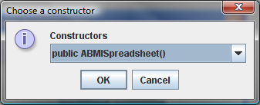
Instantiating a Class with Multiple Constructors

Slide 69
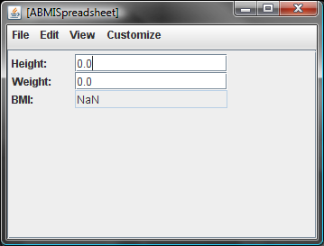
Instantiating a Class with Multiple Constructors

Slide 70
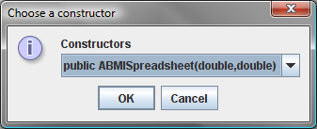
Instantiating a Class with Multiple Constructors

Slide 71
Instantiating a Class with Multiple Constructors

Slide 72
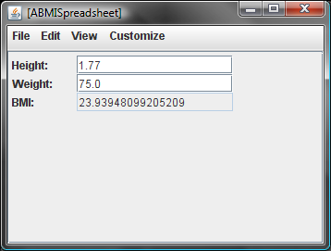
Instantiating a Class with Multiple Constructors

