Slide 1
Comp 110
Types
Instructor: Jason Carter

Slide 2
Objects vs. Primitive Types
Instances of classes and interfaces are objects
All other values are primitives
Primitive types are used to construct objects
~Atoms vs. molecules

Slide 3
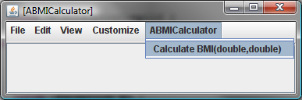
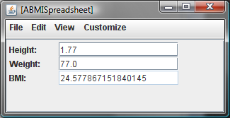
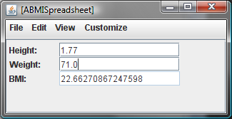
Object Types
ABMICalculator
ABMISpreadsheet

Slide 4
Primitive Types
int
String
3 + 4
“three” + “four”
3 – 4
“three” – “four”
…
Overloaded operator
int and String are different types

Slide 5
Primitive Types
int
double
3 / 4 = 0
3.0 / 4.0 = 0.75
Overloaded arithmetic operator

Slide 6
Kinds of Types
types
Object types
Primitive types
String
ABMICalculator
double
ABMISpreadsheet
int
AnotherBMISpreadsheet
BMISpreadsheet
Lower case
(by convention)
Upper case
(by convention)

Slide 7
Abstract Value vs. Syntax
Representing the abstract value 2.2
2.2
02.2
0.22+E1
LBS_IN_KGS

Slide 8
Syntax for Invoking Abstract Operation
binary, infix
profit - earnings
uniary, prefix
- earnings
arbitrary, method invocation
Math.round(bmi)

Slide 9
Type Rules Regarding Assignment
double height = 1.77;
int weight = 70;
Type rules define which of these are legal.
double height = 2;
int weight = 70.0;
double weight = “seventy”;

Slide 10
Primitive Types
Each primitive type defines:
  Range of abstract values of the type
  Constants (literals & named constants) denoting their values
  Operations (with invocation syntax) that can be invoked on the values of that type
  What types can be assigned to variables of the type

Slide 11
int Range & Constants
32 bits
Mathematical Integers {-∞ … +∞}
int {-2³¹ … +2³¹ - 1}
0
02
Integer.MIN_VALUE
-2
+2
Integer.MAX_VALUE
2
There are only 10 types of people in this world:
those who read binary and those who don’t.

Slide 12
double Range & Constants
64 bits
Mathematical Real Numbers
double
2.2
0.22
2
02.20
2.
.2
Double.MIN_VALUE
0.22E+1
0.22E0
Double.MAX_VALUE
.22E1
.22E-1
eXy = x*10^{y}
mantissa
exponent
standard

Slide 13
Other Integer Subsets
Mathematical Integers {-∞ … +∞}
byte
{-2⁷ .. 2⁷ - 1}
8 bits
Byte.MIN_VALUE
Byte.MAX_VALUE
short
{-2¹⁵ .. 2¹⁵ - 1}
16 bits
Short.MIN_VALUE
Short.MAX_VALUE
long
{-2⁶³ .. 2⁶³ - 1}
64 bits
Long.MIN_VALUE
Long.MAX_VALUE

Slide 14
float Size & Constants
32 bits
Mathematical Real Numbers
float {-2³¹ … +2³¹ - 1}
Float.MIN_VALUE
.2
Float.MAX_VALUE

Slide 15
Mixed Assignment
int
long l = 70;
int  long
Safe and automatically converted
double d = 70;
int  double
double d = 70.0;

Slide 16
Cast
cast
int  double
Not automatically converted
int i = 70.6;
(int)
int i = 70;
float  double
float f = 70.6;
(float)

Slide 17
Assignment Rules
Narrower than
v
T^{V}
e
T^{E}
T^{E}  T^{V}
v = e
! (T^{E}  T^{V} || T^{E}  T^{V})
double d = 5;
Wider
than
v = (T^{V}) e
T^{E}  T^{V}
bool b = (bool) 5;
v = (T^{V}) e
int i = (int) 5.7;

Slide 18
Assignment Rules for Primitive Types
If T1 narrower than T2 (Set of instances of T1 ⊆ Set of instances of T2)
Expression of type T1 can be assigned to Variable of type T2
Expression of type T2 can be assigned to Variable of type T1 with cast

Slide 19
Actual Parameter Assignment
  double weight;
  public void setWeight(double newWeight) {
  weight = newWeight;
  }
setWeight(70);
Implicit assignment
double newWeight = 70.0;

Slide 20
Actual Parameter Assignment
  int weight;
  public void setWeight(int newWeight) {
  weight = newWeight;
  }
setWeight(70.6);
Implicit assignment
int newWeight = 70.6;

Slide 21
Actual Parameter Assignment
  int weight;
  public void setWeight(int newWeight) {
  weight = newWeight;
  }
setWeight((int)70.6);

Slide 22
Returning a Value
  double weight;
  public int getIntWeight() {
  return weight;
  }

Slide 23
Translated into Assignment
  double weight;
  public int getIntWeight() {
  int getIntWeight = weight;
  return getIntWeight;
  }
Internal variable

Slide 24
Translated into Assignment
  double weight;
  public int getIntWeight() {
  return (int) weight;
  }

Slide 25
Primitive Types
Constants (Literals & Named Constants)
Assignment Rules
Operations with Invocation Syntax

Slide 26
int Arithmetic Operations
Name | Action | Operand & Result Type (Signature)
+ | add | int, int → int
- | subtract | int, int → int
- | negate | int → int
* | multiply | int, int → int
/ | int quotient | int, int → int
% | int remainder | int, int → int
5/2 → 2
5%2 → 1
x == (x/y)*y
x == (x/y)*y + (x%y)

Slide 27
double Arithmetic Operations
Name | Action | Operand & Result Type (Signature)
+ | add | double, double→ double
- | subtract | double, double→ double
- | negate | double→ double
* | multiply | double, double→ double
/ | int quotient | double, double→ double
5.0/2.0 → 2.5

Slide 28
Overflow
Integer.MAX_VALUE + 1
→
Integer.MAX_VALUE
Integer.MIN_VALUE - 1
→
Integer.MIN_VALUE
(double) Integer.MIN_VALUE - 1.0
→
(double) (Integer.MIN_VALUE - 1.0)
Double.MAX_VALUE + 1
→
Double.MAX_VALUE
Double.MIN_VALUE - 1
→
Double.MIN_VALUE

Slide 29
Overflow
10/0
→
Exception
-10/0
→
Exception
10.0/0
→
Double.POSITIVE_INFINITY
-10.0/0
→
Double.NEGATIVE_INFINITY
0/0
→
Exception
0.0/0.0
→
Double.NaN

Slide 30
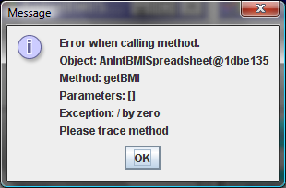
int Overflow

Slide 31
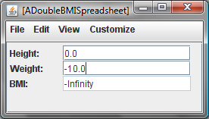
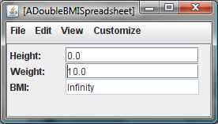
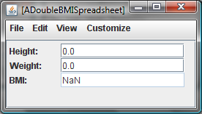
double Overflow

Slide 32
Mixed Operations
Narrower type converted
5/2.0
→
5.0/2.0
int i = (int) (5/2.0)
doube d = 5/(int)2.0
int i = (int) (5.0/2.0)
double d = 5/2
int i = (int) (2.5)
double d = 2
int i = 2
double d = 2.0

Slide 33
Strong vs. Weak Typing
“hello” - 1
Legal under weak typing
“anything goes”
Illegal under strong typing
“strict type rules”
int minus

Slide 34
Miscellaneous Math Operations
Operations (invoked on Math) | Signature
abs() | double → double, int → int
acos(), asin(), atan() cos(), sin(), tan() | double → double
pow() | double, double → double
exp(), log() | double → double
round() | double → long
random(), pi() | → double
sqrt() | double → double
Math.pi() → π
Math.pow(5, 3) → 5³
Math.round(5.9) → 6
(int) 5.9 →
5
int i = (int) Math.Round(5.9) →
6

Slide 35
boolean Constants
boolean
true
false

Slide 36
Relational Operations
Name | Action | Signature of int Implementation | Signature of double Implementation
== | equal? | int, int → boolean | double, double → boolean
!= | not equal? | int, int → boolean | double, double → boolean
> | greater than? | int, int → boolean | double, double → boolean
< | less than? | int, int → boolean | double, double → boolean
>= | greather than or equal? | int, int → boolean | double, double → boolean
<= | less than or equal? | int, int → boolean | double, double → boolean
5 == 5
→ true
5 != 5
→ false
5 == 4
→ false
5 != 4
→ true
5 >= 4
→ true
5 <= 4
→ false

Slide 37
boolean Operations
Name(s) | Action | Signature
! | not | boolean → boolean
&&, & | and | boolean, boolean → boolean
||, | | or | boolean, boolean → boolean
!true
→ false
!false
→ true
true || true
→ true
true && true
→ true
true || false
→ true
true && false
→ false
false || true
→ true
false && true
→ false
false || false
→ false
false && false
→ false

Slide 38
Short-Circuit Evaluation
Name(s) | Action | Signature
! | not | boolean → boolean
&&, & | and | boolean, boolean → boolean
||, | | or | boolean, boolean → boolean
Short-circuit evaluation
false && (9654.34/323.13 > 32.34)
→ false
true || (9654.34/323.13 > 32.34)
→ false
Second operand not evaluated
Regular evaluation
false & (9654.34/323.13 > 32.34)
→ false
true| (9654.34/323.13 > 32.34)
→ false
Second operand evaluated

Slide 39
Short-Circuit Evaluation
Name(s) | Action | Signature
! | not | boolean → boolean
&&, & | and | boolean, boolean → boolean
||, | | or | boolean, boolean → boolean
false && (10/0)
→ false
false & (10/0)
An error in some programming languages

Slide 40
Complex Expressions
Sub-expression
false && ( 10 / 0 )
false && ( 10 / 0 )
Operator evaluation order?

Slide 41
boolean vs. Number Expressions
boolean overWorked =
hoursWorked > MAX_HOURS
True if hoursWorked is greater than MAX_HOURS and false otherwise
int earnings = hourlyWage*hoursWorked + BONUS

Slide 42
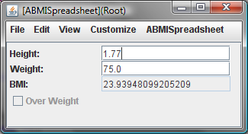
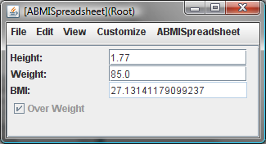
boolean Property

Slide 43
boolean Property Code
public boolean isOverWeight() {
}

Slide 44
boolean Property Code (Edit)
final double HIGH_BMI = 28;
public boolean isOverWeight() {
return getBMI() > HIGH_BMI;
}

Slide 45
boolean Property Code
private final double HIGH_BMI = 25;
public boolean isOverWeight() {
return getBmi() > HIGH_BMI;
}

Slide 46
boolean Property Code
// declare in interface
private final double HIGH_BMI = 25;
public boolean isOverWeight() {
return getBmi() > HIGH_BMI;
}

Slide 47
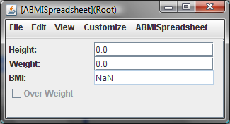
Preventing Invalid BMI

Slide 48
Assertions
Assert <Boolean Expression>
  Statement can be inserted anywhere to state that some condition should be true
  If condition is false, Java stops program and gives error message
  Some products fail with message “internal assertion failed”

Slide 49
How Should We Change the Class?
public class ABMISpreadsheet {
double height, weight;
public ABMISpreadsheet(
double theInitialHeight, double theInitialWeight) {
setHeight ( theInitialHeight);
setWeight( theInitialWeight);
}
public double getHeight() { return height; }
public void setHeight(double newHeight) { height = newHeight; }
public double getWeight() { return weight; }
public void setWeight(double newWeight) { weight = newWeight; }
public double getBMI() { return weight/(height*height); }
}

Slide 50
Checking Preconditions
public class ABMISpreadsheet {
double height, weight;
public ABMISpreadsheet(
double theInitialHeight, double theInitialWeight) {
setHeight ( theInitialHeight);
setWeight( theInitialWeight);
}
…
public boolean preGetBMI() {
return weight > 0 && height > 0;
}
public double getBMI() {
assert (preGetBMI());
return weight/(height*height);
}
}
Precondition of method M() is preM()

Slide 51
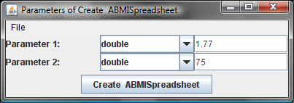
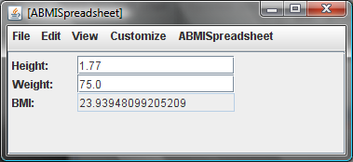
ObjectEditor Uses Precondition

Slide 52
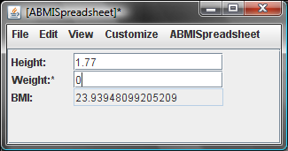
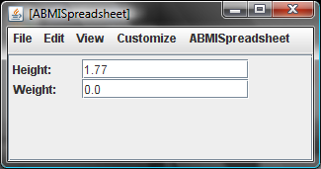
ObjectEditor Uses Precondition

Slide 53
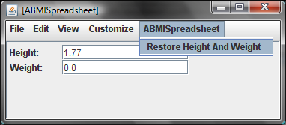
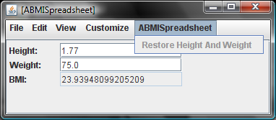
ObjectEditor Uses Precondition
A method is disabled when its precondition not met

Slide 54
Original Class
public class ABMISpreadsheet {
double height, weight;
public ABMISpreadsheet(
double theInitialHeight, double theInitialWeight) {
setHeight ( theInitialHeight);
setWeight( theInitialWeight);
}
…
public boolean preGetBMI() {
return weight > 0 && height > 0;
}
public double getBMI() {
assert (preGetBMI());
return weight/(height*height);
}
}

Slide 55
Original Class (Edit)
public class ABMISpreadsheet {
double height, weight;
double iH, iW;
public ABMISpreadsheet(
double theInitialHeight, double theInitialWeight) {
setHeight ( theInitialHeight);
setWeight( theInitialWeight);
iH = theInitialHeight;
iW = theInitialWeight;
}
…
public boolean preGetBMI() {
return weight > 0 && height > 0;
}
public double getBMI() {
assert (preGetBMI());
return weight/(height*height);
}
public boolean preRestoreHeightAndWeight() {
return height != iH || weight != iW;
}
public void restoreHeightAndWeight() {
setHeight(iH);
setWeight(iW);
}
}

Slide 56
New Class
public class ABMISpreadsheet {
double height, weight;
double initialHeight, initialWeight;
public ABMISpreadsheet(
double theInitialHeight, double theInitialWeight) {
setHeight ( theInitialHeight);
setWeight( theInitialWeight);
initialHeight = theInitialHeight;
initialWeight = theInitialWeight;
}
…
public boolean preGetBMI() { return weight > 0 && height > 0; }
public double getBMI() {
assert preGetBMI(); return weight/(height*height); }
public boolean preRestoreHeightAndWeight() {
return height != initialHeight || weight != initialWeight; }
public void restoreHeightAndWeight() {
assert preRestoreHeightAndWeight();
height = initialHeight;
weight = initialWeight;
}
}

Slide 57
Preconditions of Other Methods
    public class ABMISpreadsheet {
    …
    public double getWeight() {
    return weight;
    }
    public void setWeight(double newWeight) {
    weight = newWeight;
    }
    …
    }

Slide 58
Preconditions of Other Methods (Edit)
    public class ABMISpreadsheet {
    …
    public boolean preGetWeight() {
    return weight > 0;
    }
    public double getWeight() {
    return weight;
    }
    public boolean preSetWeight(double newWeight) {
    return newWeight > 0;
    }
    public void setWeight(double newWeight) {
    assert (preSetWeight(newWeight));
    weight = newWeight;
    }
    …
    }

Slide 59
Preconditions of Other Methods
    public class ABMISpreadsheet {
    …
    public double preGetWeight() {return weight > 0;}
    public double getWeight() {
    assert preGetWeight();
    return weight;
    }
    public boolean preSetWeight (double newWeight) {
    return newWeight > 0;
    }
    public void setWeight(double newWeight) {
    assert preSetWeight(newWeight);
    weight = newWeight;
    }
    …
    }
Prevention of getter not needed if setter and constructor prevent assignment of illegal values

Slide 60
Equivalent Class
    public class ABMISpreadsheet {
    …
    public double getWeight() {
    return weight;
    }
    public boolean preSetWeight (double newWeight) {
    return newWeight > 0;
    }
    public void setWeight(double newWeight) {
    assert preSetWeight(newWeight);
    weight = newWeight;
    }
    …
    }
Prevention of getter not needed if setter and constructor prevent assignment of illegal values

Slide 61
Precondition Style Rule
If there are constraints on the input of a method M(…) that may not be met, write a precondition boolean method, preM(…) for it
Call the precondition method in an assert statement as the first statement of M(..)
To keep examples short, preconditions will not be shown in future examples

Slide 62
Operator Precedence
Unary
Cast
! - (T)
* / &
+ -
< > <= >=
== !=
&
|
&&
||
false && 10 / 0
→ false && 10 / 0
- 5 - 4
→ - 5 - 4
!true && false
→ !true && false
5 / 4 * 3
→ 5 / 4 * 3
true || false ==
false || true
true || false ==
false || true
(int) 5 / 2.0
→ (int) 5 / 2.0

Slide 63
Operator Precedence (Edit)
Unary
Cast
! - (T)
* / &
+ -
< > <= >=
== !=
&
|
&&
||
false && 10 / 0
→ false && (10 / 0)
- 5 - 4
→ (- 5) - 4
!true && false
→ (!true) && false
5 / 4 * 3
→ (5 / 4) * 3
true || false ==
false || true
true || ( false ==
false ) || true
(int) 5 / 2.0
→ (int) 5 / 2.0

Slide 64
Operator Precedence
Unary
Cast
! - (T)
* / &
+ -
< > <= >=
== !=
&
|
&&
||
false && 10 / 0
→ false && ( 10 / 0 )
- 5 - 4
→ ( - 5 ) - 4
!true && false
→ ( !true ) && false
5 / 4 * 3
→ ( 5 / 4 ) * 3
true || false ==
false || true
true || ( false ==
false ) || true
(int) 5 / 2.0
→ ( (int) 5 ) / 2.0

Slide 65
Printing Arbitrary Expressions
System.out.println (2)
Output: 2
System.out.println (2.0)
Output: 2.0
System.out.println ((int) 2.0)
Output: 2
System.out.println (5 > 0)
Output: true

