Slide 1
Comp 110
Representation
Instructor: Jason Carter

Slide 2
More on Objects
Testing objects and writing stubs
Calling getters/setters from programs
Two-way dependencies
Representations with errors
Default values of variables
Null value
Class variables/methods
Polymorphism vs. overloading
Structure vs. atomic types
Physical vs. logical structure
Graphics types
Top-down, bottom-up, middle-out programming

Slide 3
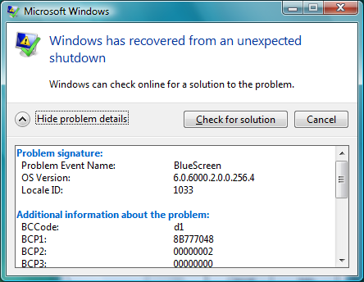
Importance of Testing
Experienced programmers make errors
Important to test programs

Slide 4
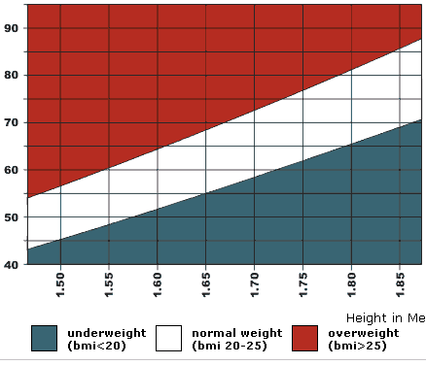
Testing BMI Spreadsheet

Slide 5
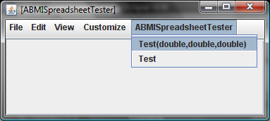
Testing BMI Spreadsheet

Slide 6
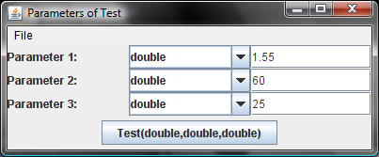
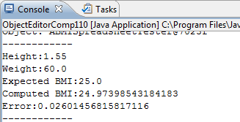
Testing BMI Spreadsheet

Slide 7
Corvette vs. BMI Spreadsheet Usage
Test new Corvette for mileage
Get car from Corvette factory
Drive car
Compare actual and advertised mileage
Test BMISpreadsheet for correctness
Instantiate class ABMISpreadsheet
Give values to height and weight
Compare actual and computed BMI
How to do this in a programmed method such as test ?

Slide 8
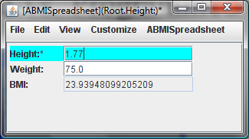
Interactive vs. Programmed Setter
bmiSpreadsheet.setHeight(1.77);

Slide 9
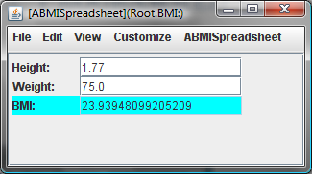
Interactive vs. Programmed Getter
double computedBMI = bmiSpreadsheet.getBMI();

Slide 10
BMI Tester
public class ABMISpreadsheetTester {
public void test (
double theHeight, double theWeight, double theCorrectBMI)
{
}
}

Slide 11
BMI Tester (Edit)
public class ABMISpreadsheetTester {
public void test (
double theHeight, double theWeight, double theCorrectBMI)
{
ABMISPreadsheet bmiS = new ABMISpreadsheet(theHeight,theWeight);
double computedBMI = bmiS.betBMI();
…
System.out.println(theCorrectBMI – computedBMI);
}
}

Slide 12
BMI Tester (Edit)
public class ABMISpreadsheetTester {
public void test (
double theHeight, double theWeight, double theCorrectBMI)
{
BMISpreadsheet bmiS = new ABMISpreadsheet();
bmiS.setHeight(theHeight);
bmiS.setWeight(theWieght);
double computedBMI = bmiS.betBMI();
…
System.out.println(theCorrectBMI – computedBMI);
}
}

Slide 13
Testing Multiple Values

Slide 14
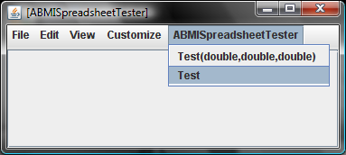
Testing BMI Spreadsheet

Slide 15
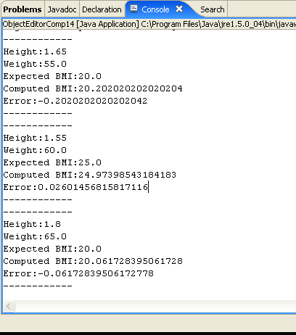
Testing BMI Spreadsheet
Steps taken by ABMISpreadsheetTester?

Slide 16
BMI Tester
public class ABMISpreadsheetTester {
public void test (
double theHeight, double theWeight, double theCorrectBMI)
{
BMISpreadsheet bmiSpreadsheet = new
ABMISpreadsheet(theHeight, theWeight);
double computedBMI = bmiSpreadsheet.getBMI();
System.out.println("------------");
System.out.println("Height:" + theHeight);
System.out.println("Weight:" + theWeight);
System.out.println("Expected BMI:" + theCorrectBMI);
System.out.println("Computed BMI:" + computedBMI);
System.out.println(
"Error:" + (theCorrectBMI - computedBMI));
System.out.println("------------");
}
public void test () {
test(1.65, 60, 20);
test(1.55, 60, 25);
test(1.8, 65, 20);
}
}

Slide 17
BMI Tester (Edit)
public class ABMISpreadsheetTester {
public void test (
double theHeight, double theWeight, double theCorrectBMI)
{
BMISpreadsheet bmiSpreadsheet = new
ABMISpreadsheet(theHeight, theWeight);
double computedBMI = bmiSpreadsheet.getBMI();
System.out.println("------------");
System.out.println("Height:" + theHeight);
System.out.println("Weight:" + theWeight);
System.out.println("Expected BMI:" + theCorrectBMI);
System.out.println("Computed BMI:" + computedBMI);
System.out.println(
"Error:" + (theCorrectBMI - computedBMI));
System.out.println("------------");
}
public void test () {
}
}

Slide 18
BMI Tester
public class ABMISpreadsheetTester {
public void test (
double theHeight, double theWeight, double theCorrectBMI)
{
BMISpreadsheet bmiSpreadsheet = new
ABMISpreadsheet(theHeight, theWeight);
double computedBMI = bmiSpreadsheet.getBMI();
System.out.println("------------");
System.out.println("Height:" + theHeight);
System.out.println("Weight:" + theWeight);
System.out.println("Expected BMI:" + theCorrectBMI);
System.out.println("Computed BMI:" + computedBMI);
System.out.println(
"Error:" + (theCorrectBMI - computedBMI));
System.out.println("------------");
}
public void test () {
test(1.65, 55, 2.0);
test(1.55, 60, 25);
test(1.80, 65, 20);
}
}
Actual Parameters
Formal Parameters

Slide 19
Traditional Approach
Code the complete object to be tested
Write and use test object
Recode and retest if necessary
Testing is an afterthought
All methods tested together – hard to pinpoint bugs
Tested Code
ABMISpreadsheet
Tester
ABMISpreadsheetTester

Slide 20
Incremental Testing
Tested Code
ABMISpreadsheet
Tested code and tester could evolve concurrently
getBMI() cannot be tested until it has been written
Tester
ABMISpreadsheetTester

Slide 21
Test-First
Stubs for Tested Code
ABMISpreadsheet with Stubs
Write the complete tester, defining the expected behavior of the tested object
Code the object with only stubs
Test, implement a stub and retest
Tester
ABMISpreadsheetTester
Implement or change the stub
ABMISpreadsheet with a stub (re) implemented

Slide 22
Steps in Creating and Testing a New Class
Write the interface
Create a class with stubs for each interface method and constructor
  If method is procedure method does nothing
  If method is function, it returns 0 or null value
  No variables need be declared as this point!
Write a tester for it
Write/rewrite in one or more stub methods
Use tester and ObjectEditor
If tester results and ObjectEditor results not correct, go back to 4
Steps may be combined for simple classes!

Slide 23
Writing the Interface
public interface BMISpreadhsheet {
public double getHeight() ;
public void setHeight (double newHeight) ;
public double getWeight() ;
public void setWeight(double newWeight) ;
public double getBMI() ;
}

Slide 24
Stubs
public class ABMISpreadsheet implements BMISpreadhsheet {
public ABMISpreadsheet(
double theInitialHeight, double theInitialWeight) {}
public ABMISpreadsheet() {}
public double getHeight() {}
public void setHeight (double newHeight) {}
public double getWeight() {}
public void setWeight(double newWeight) {}
public double getBMI() {}
}
No variables!

Slide 25
Stubs (Edit)
public class ABMISpreadsheet implements BMISpreadhsheet {
public ABMISpreadsheet(
double theInitialHeight, double theInitialWeight) {}
public ABMISpreadsheet() {}
public double getHeight() {return 0;}
public void setHeight (double newHeight) {}
public double getWeight() {return 0;}
public void setWeight(double newWeight) {}
public double getBMI() {return 0;}
}
No variables!

Slide 26
Stubs
public class ABMISpreadsheet implements BMISpreadhsheet {
public ABMISpreadsheet(
double theInitialHeight, double theInitialWeight) {}
public ABMISpreadsheet() {}
public double getHeight() { return 0; }
public void setHeight (double newHeight) {}
public double getWeight() { return 0; }
public void setWeight(double newWeight) {}
public double getBMI() { return 0; }
}
No variables!

Slide 27
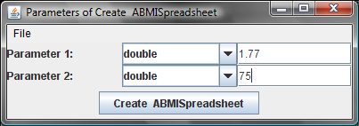
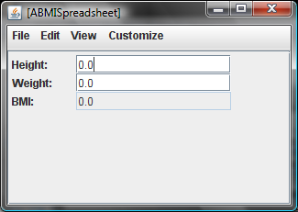
Using ObjectEditor

Slide 28
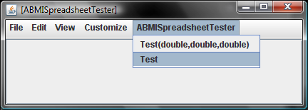
Using Tester

Slide 29
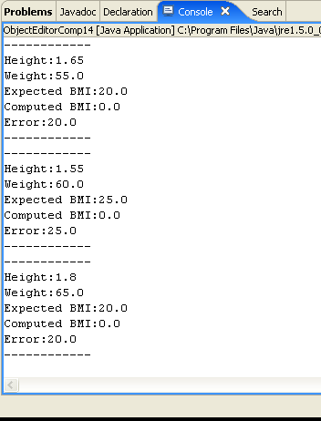
Using Tester
We know what the correctness criteria are!

Slide 30
After All Stubs are Filled

Slide 31
BMI Tester
public class ABMISpreadsheetTester {
public void test (
double theHeight, double theWeight, double theCorrectBMI)
{
BMISpreadsheet bmiSpreadsheet = new
ABMISpreadsheet(theHeight, theWeight);
double computedBMI = bmiSpreadsheet.getBMI();
System.out.println("------------");
System.out.println("Height:" + theHeight);
System.out.println("Weight:" + theWeight);
System.out.println("Expected BMI:" + theCorrectBMI);
System.out.println("Computed BMI:" + computedBMI);
System.out.println(
"Error:" + (theCorrectBMI - computedBMI));
System.out.println("------------");
}
public void test () {
}
}
Interface as type
Calling constructor
Calling getter

Slide 32
Calling Parameterless Constructor and Setters
public class ABMISpreadsheetTester {
public void test (
double theHeight, double theWeight, double theCorrectBMI)
{
BMISpreadsheet bmiSpreadsheet = new ABMISpreadsheet();
bmiSpreadsheet.setHeight(theHeight);
bmiSpreadsheet.setWeight(theWeight);
double computedBMI = bmiSpreadsheet.getBMI();
System.out.println("------------");
System.out.println("Height:" + theHeight);
System.out.println("Weight:" + theWeight);
System.out.println("Expected BMI:" + theCorrectBMI);
System.out.println("Computed BMI:" + computedBMI);
System.out.println(
"Error:" + (theCorrectBMI - computedBMI));
System.out.println("------------");
}
}
Parameterless constructor
Calling setter
Constructors with parameters make code more compact

Slide 33
Object vs. Primitive Variable
public class ABMISpreadsheetTester {
public void test (
double theHeight, double theWeight, double theCorrectBMI)
{
BMISpreadsheet bmiSpreadsheet =
new ABMISpreadsheet(theHeight, theWeight);
double computedBMI = bmiSpreadsheet.getBMI();
System.out.println("------------");
System.out.println("Height:" + theHeight);
System.out.println("Weight:" + theWeight);
System.out.println("Expected BMI:" + theCorrectBMI);
System.out.println("Computed BMI:" + computedBMI);
System.out.println(
"Error:" + (theCorrectBMI - computedBMI));
System.out.println("------------");
}
}
Primitive Variable
Primitive Variable
Object Variable
Object Variable

Slide 34
Uninitialized Variables
public class ABMISpreadsheetTester {
public void test (
double theHeight, double theWeight, double theCorrectBMI)
{
BMISpreadsheet bmiSpreadsheet;
double computedBMI ;
System.out.println("------------");
System.out.println("Height:" + theHeight);
System.out.println("Weight:" + theWeight);
System.out.println("Expected BMI:" + theCorrectBMI);
System.out.println("Computed BMI:" + computedBMI);
System.out.println(
"Error:" + (theCorrectBMI - computedBMI));
System.out.println("------------");
}
}
Uninitialized Primitive Variable
Uninitialized Object Variable

Slide 35
Default Values for Variables
Primitive Variables
variables
memory
Legal double values
double computedBMI;
computedBMI;
0.0
double weight;
weight;
0.0
Object Variables
BMISpreadsheet bmiSpreadsheet;
bmiSpreadsheet;
null
Illegal BMISpreadsheet value

Slide 36
Invoking Methods on null
bmiSpreadsheet.getBMI()
  null pointer exception
  Exception is an unexpected event (error)
  Guilty method will be terminated and exception reported
  Will see other exceptions later

Slide 37
Mathematical Point
X
.
R
Y
θ
.

Slide 38
Java Coordinate System
(3,2)
(0,0)
X
pixels
X and Y coordinates must be int values
Radius and Angle can be double
Y
Angle is a decimal value between 0 and 2π

Slide 39
Point Interface
public interface Point {
public int getX();
public int getY();
public double getAngle();
public double getRadius();
}
Read-only properties defining immutable object!

Slide 40
Point Representations
X, Y (Cartesian Representation)
Radius, Angle (Polar Representation)
X, Radius
X, Y, Radius, Angle
…

Slide 41
Stubs for ACartesianPoint
public class ACartesianPoint implements Point {
public ACartesianPoint(int theX, int theY) { }
public int getX() {
return 0;
}
public int getY() {
return 0;
}
public double getAngle() {
return 0;
}
public double getRadius() {
return 0;
}
}

Slide 42
ACartesianPoint Tester
public class ACartesianPointTester {
public void test (int theX, int theY,
double theCorrectRadius, double theCorrectAngle) {
Point point= new ACartesianPoint (theX, theY);
double computedRadius = point.getRadius();
double computedAngle = point.getAngle();
System.out.println("------------");
System.out.println(“X:" + theX);
System.out.println(“Y:" + theY);
System.out.println("Expected Radius:" + theCorrectRadius);
System.out.println("Computed Radius:" + computedRadius);
System.out.println(“Radius Error:"
+ (theCorrectRadius - computedRadius));
System.out.println("Expected Angle:" + theCorrectAngle);
System.out.println("Computed Angle:" + computedAngle);
System.out.println(“Angle Error:" +
(theCorrectAngle - computedAngle));
System.out.println("------------");
}
public void test () {
test (10, 0, 10.0, 0); // 0 degree angle
test (0, 10, 10.0, Math.PI / 2); // 90 degree angle
}
}

Slide 43
Algorithms
Cartesian Representation
R = sqrt (X² * Y²)
X
θ = arctan (Y/X)
.
R
Y
Polar Representation
θ
X = R*cos(θ)
.
Y = R*sin(θ)

Slide 44
Class: ACartesianPoint
public class ACartesianPoint implements Point {
int x, y;
public ACartesianPoint(int theX, int theY) {
x = theX;
y = theY;
}
public int getX() {
return x;
}
public int getY() {
return y;
}
public double getAngle() {
return Math.atan((double) y/x);
}
public double getRadius() {
return Math.sqrt(x*x + y*y);
}
}

Slide 45
Class: APolarPoint
public class APolarPoint implements Point {
double radius, angle;
public APolarPoint(double theRadius, double theAngle) {
radius = theRadius ;
angle = theAngle;
}
public int getX() {
return (int) (radius*Math.cos(angle));
}
public int getY() {
return (int) (radius*Math.sin(angle));
}
public double getAngle() {
return angle;
}
public double getRadius() {
return radius;
}
}

Slide 46
Using the Interface and Its Implementations
Point point1 = new ACartesianPoint (50, 50);
Point point2 = new APolarPoint (70.5, Math.pi()/4);
point1 = point2;
Constructor chooses implementation
Constructor cannot be in interface

Slide 47
Representing Geometric Objects
Geometric example to show multiple useful implementations of an interface
Most geometric objects have multiple representations

Slide 48
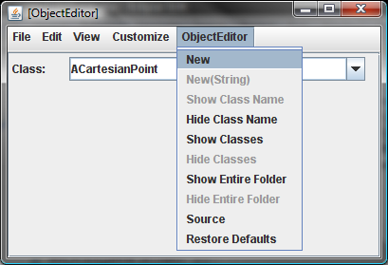
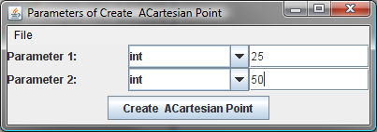
Using ObjectEditor

Slide 49
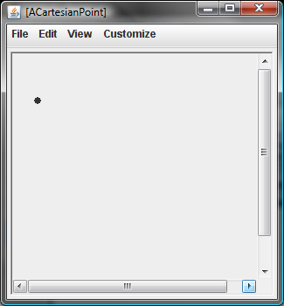
Using ObjectEditor

Slide 50
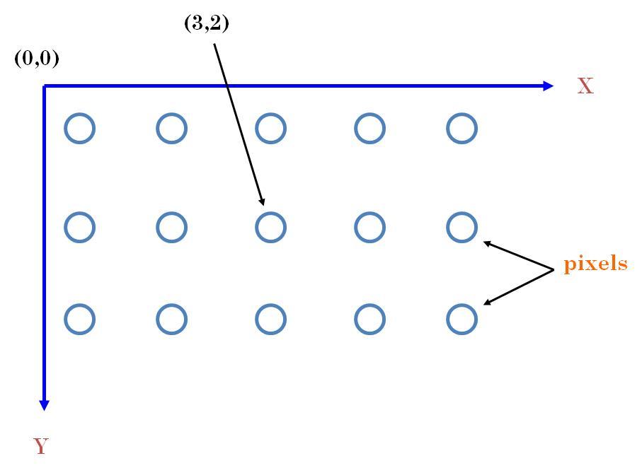
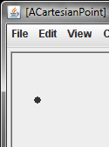
Java Graphics
Y
X

Slide 51
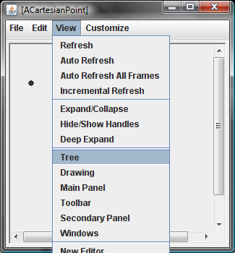
Adding Tree View

Slide 52
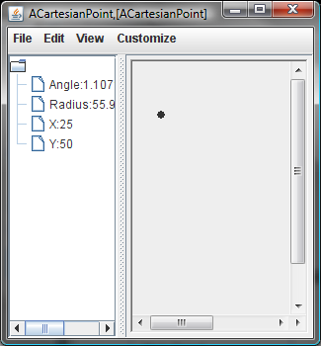
Tree View

Slide 53
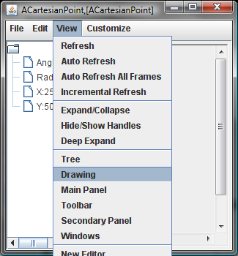
Removing Graphics View

Slide 54
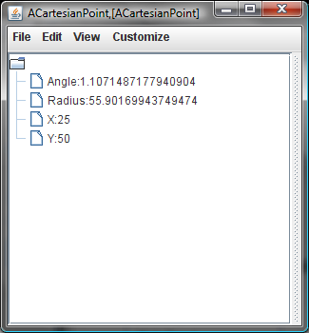
Tree-only View

Slide 55
ObjectEditor Graphics
Can automatically display objects representing points, rectangles, ovals, and lines as corresponding graphics
  Java provides libraries to manually display graphics
Has rules for recognizing these objects
Rules based on Java graphics standards
  Inverted coordinate system
  Cartesian coordinates for points
  Bounding rectangles for lines, rectangles, ovals
Plus naming conventions

Slide 56
ObjectEditor Point Rules
An object is recognized as a point representation if:
  Its interface or class name has the string “Point” in its name
  It has readable int properties, x and y, representing Cartesian coordinates
  Can have additional properties
public interface Point {
public int getX();
public int getY();
public double getAngle();
public double getRadius();
}

Slide 57
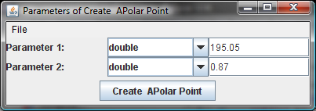
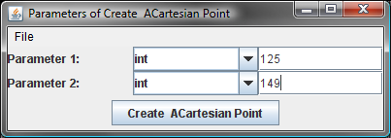
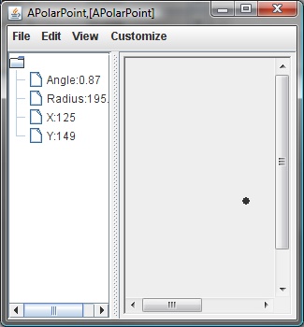
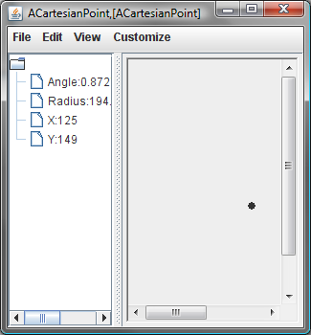
Equivalent Representations
Stored
Computed
Computed
Stored

Slide 58
Reason for Error
public int getX() {
return (int) (radius*Math.cos(angle));
}
Calculated X and Y values are truncated when converted to int
Conversion back to Radius and Angle yields different values

Slide 59
What is in a Representation?
Representation determines
  Space efficiency
  Time efficiency
  Precision of various properties

Slide 60
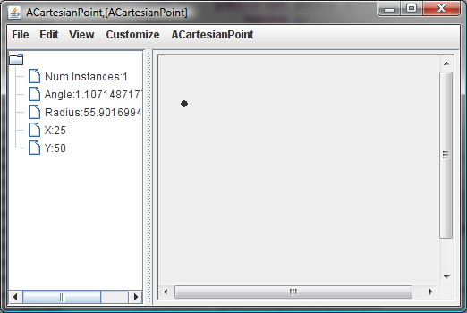
Counting Instances of ACartesianPoint

Slide 61

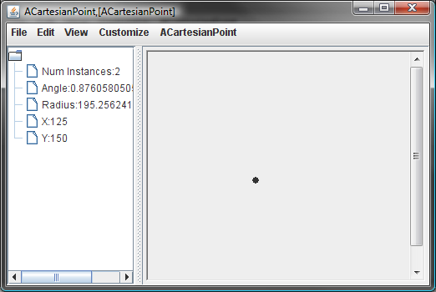
Incremented Number of Instances

Slide 62
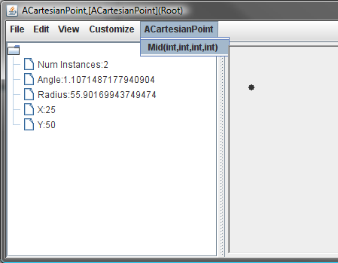
Creating MidPoint

Slide 63
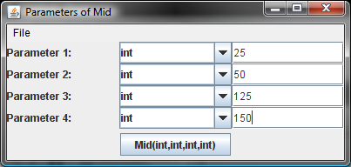
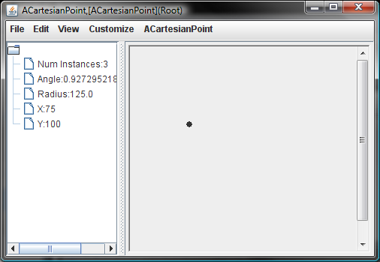
Specifying Two End Points

Slide 64
Type of Methods
Difference between method returning number of instances and other methods seen so far?
Difference between mid and other methods seen so far?

Slide 65

Real-World Analogy
numCarsProduced();
101234
new ACorvette(silver)
new ACorvette(red)
getMileage()
64000
blend(silverCar, redCar);

Slide 66
O-O World
3
numInstances()
Point1
new ACartesianPoint( 25, 50)
Point2
ACartesianPoint
new ACartesianPoint( 125, 150)
59
getRadius()
mid(25,50, 125,150);
mid(point1x,point1y,
point2x,point2y);

Slide 67
Class Methods
Methods can be invoked on class itself
Called class or static methods
Declared in class on which they are invoked
Keyword static in header
Accesses no instance variable
Header cannot appear in interface

Slide 68
Programmer-Defined Mid
Instance Method
Access instance variables
public getRadius (){
return Math.sqrt(x*x + y*y);
}
Class Method
public static Point mid (int x1, int y1, int x2, int y2 ) {
return new ACartesianPoint(x1 + (x2 - x1)/2, y1 + (y2 - y1)/2);
}
Access no instance variable

Slide 69
External Call of Class Method
ACartesianPoint.mid(x1, y1, x2, y2)
Class as target
Math.sqrt(x*x + y*y);

Slide 70
numInstances Algorithm
Declare variable, numInstances initialized to zero
Increment numInstances each time a new instance is created
getNumInstances() returns numInstances

Slide 71
Returning numInstances
public static int getNumInstances() {
return numInstances;
}
Class property
numInstances() returns numInstances

Slide 72
Incrementing numInstances
Increment numInstances each time a new instance is created

Slide 73
Incrementing numInstances (edit)
Increment numInstances each time a new instance is created

Slide 74
Incrementing numInstances (Solution)
public ACartesianPoint(int theX, int theY) {
x = theX;
y = theY;
numInstances++;
}
Increment numInstances each time a new instance is created

Slide 75
Declaring numInstances
Declare variable, numInstances initialized to zero
static int numInstances = 0;
// class variable

Slide 76
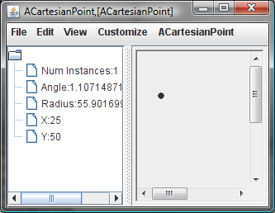
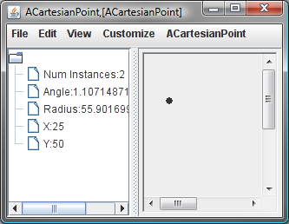
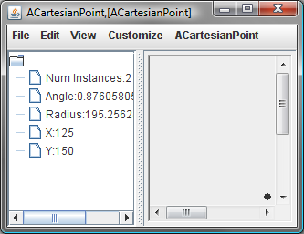
Tracing Execution
variables
memory
numInstances;
1
2
0
x;
25
0
y;
0
50
x;
125
0
y;
0
150
public ACartesianPoint(int theX, int theY) {
x = theX;
y = theY;
numInstances++;
}

Slide 77
Instance vs. Class Members
Class Members
  Class method
  Class variables
Instance Members
  Instance methods
  Instance variables

Slide 78
Scope of Class and Instance Members
Class Members
  visible to other class members
  visible to all instance members
    class & instance methods can access class variables
    class and instance methods can call class methods
Instance Members
  visible to other instance members
  not visible to class members
    which of (zero to many) copies of an instance variable should a class member refer to?

Slide 79
Legal & Illegal Access
static int numInstances = 0;
public static int getNumInstances() {
System.out.println(x);
return numInstances;
}
int x, y;
public ACartesianPoint(int theX, int theY) {
x = theX; y = theY;
numInstances = numInstances + 1;
System.out.println(getNumInstances());
}
public double getRadius() {
return Math.sqrt(x*x + y*y);
}

Slide 80
Instance vs. Class Named Constant
public class AnotherBMISpreadsheet implements BMISpreadsheet{
double height, weight, bmi;
...
public static final
double LBS_IN_KG = 2.2;
public static final
double CMS_IN_INCH = 2.54;
double calculateBMI() {
return (weight/LBS_IN_KG) / (height*CMS_IN_INCH/100*height*CMS_IN_INCH/100);
}
}
variables
memory
LBS_IN_KGS;
2.2
new AnotherBMISpreadsheet()
new AnotherBMISpreadsheet()
AnotherBMISpreadsheet.LBS_IN_KGS;

Slide 81
Instance vs. Class Named Constant
public class AnotherBMISpreadsheet implements BMISpreadsheet{
double height, weight, bmi;
...
final
double LBS_IN_KG = 2.2;
public static final
double CMS_IN_INCH = 2.54;
double calculateBMI() {
return (weight/LBS_IN_KG) / (height*CMS_IN_INCH/100*height*CMS_IN_INCH/100);
}
}
variables
memory
LBS_IN_KGS;
2.2
public final
LBS_IN_KGS;
2.2
new AnotherBMISpreadsheet()
new AnotherBMISpreadsheet()
(new AnotherBMISpreadsheet()).LBS_IN_KGS;

Slide 82
Class vs. Instance Constant
Should be class constant
  one copy
  easy to refer (require no instance creation)
Unless some good reason for hiding named constants from static methods
See inheritance-based exception later

Slide 83
Class vs. Instance Methods
Class Method
public static Point mid (int x1, int y1, int x2, int y2 ) {
return new ACartesianPoint(x1 + (x2 - x1)/2, y1 + (y2 - y1)/2);
}
ACartesianPoint.mid(25, 50, 125, 150)
Accesses no instance variable
Math.round(5.7)
Instance Method
public Point mid (int x1, int y1, int x2, int y2 ) {
return new ACartesianPoint(x1 + (x2 - x1)/2, y1 + (y2 - y1)/2);
}
(new ACartesianPoint(25, 50)).mid(25, 50, 125, 150)
(new Math()).round(5.7)

Slide 84
Class vs. Instance Method
Instance method has all the privileges of a class method
Any class method can be made an instance method
Bad style to have instance method that does not access any instance variable
  They belong to the class
  Violate least privilege principle
  Require needless instantiation

Slide 85
Class vs. Instance Constant/Method
Named constants should be static
  Unless some good reason for hiding named constants from static methods
  See inheritance-based exception later
Methods not accessing instance variables should be static
  Unless need to be listed in interface
  See inheritance-based exception later

Slide 86
Mid with Point Arguments
public static Point mid (int x1, int y1, int x2, int y2 ) {
return new ACartesianPoint(x1 + (x2 - x1)/2, y1 + (y2 - y1)/2);
}
public static Point mid (Point p1, Point p2 ) {
}

Slide 87
Mid with Point Arguments (Edit)
public static Point mid (int x1, int y1, int x2, int y2 ) {
return new ACartesianPoint(x1 + (x2 - x1)/2, y1 + (y2 - y1)/2);
}
public static Point mid (Point p1, Point p2 ) {
}

Slide 88
Mid with Point Arguments
public static Point mid (int x1, int y1, int x2, int y2 ) {
return new ACartesianPoint(x1 + (x2 - x1)/2, y1 + (y2 - y1)/2);
}
Polymorphic operation – one or more formal parameters can be assigned actual parameters of different types
public static Point mid (Point p1, Point p2 ) {
return mid (p1.getX(), p1.getY(), p2.getX(), p2.getY());
}
Polymorphic vs. overloaded operations?

Slide 89
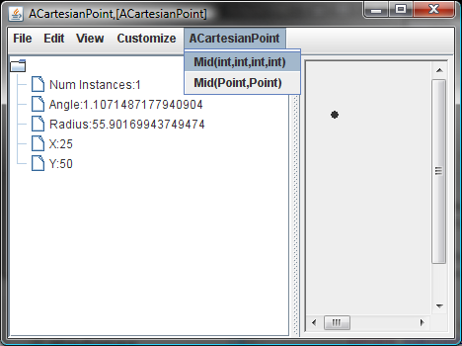
Object Parameters

Slide 90
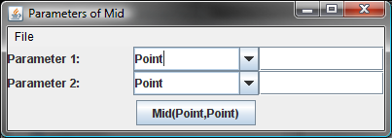
Object Parameters

Slide 91
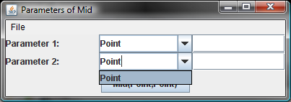
Object Parameters
Cannot instantiate interface!
Java does not know all implementations of an interface!

Slide 92
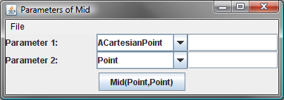
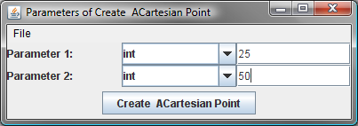
Specifying Parameter Class
Edit interface name and hit return
Constructor of specified class

Slide 93
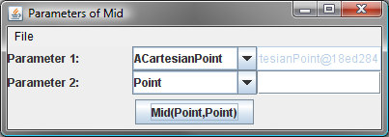
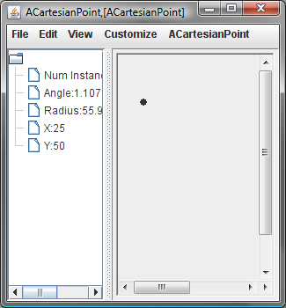
Specifying Parameter Class
Object address
Constructed object becomes value of first mid parameter
Constructed object displayed and can be edited

Slide 94
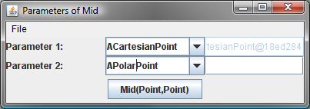
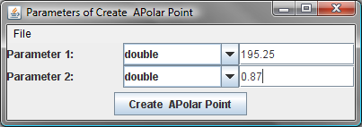
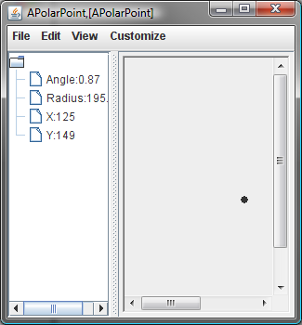
Specifying Second Parameter
Constructor of specified class with its parameters

Slide 95
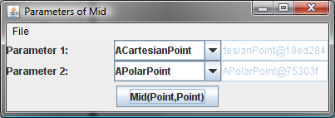
Second Parameter
Object address

Slide 96
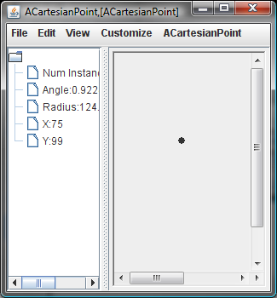
Result of Executing Mid
Object returned by mid

Slide 97
Equivalent Code
Point point1 = new
ACartesianPoint (25, 50);
Point point2 = new
APolarPoint (195.25, 087);
Point mid = mid (point1, point2);

Slide 98
Typing Objects
ACartesianPoint
APolarPoint
Point

Slide 99
Kinds of Types
types
Object types
Classes
Primitive types
ABMICalculator
ABMISpreadsheet
double
int
AnotherBMISpreadsheet
Interfaces
BMISpreadsheet
Point
type = set of operations

Slide 100
Interfaces as Types
public static Point mid (Point p1, Point p2 ) {
return mid (p1.getX(), p1.getY(), p2.getX(), p2.getY());
}

Slide 101
Classes as Types
public static Point mid (ACartesianPoint p1, Point p2 ) {
return mid (p1.getX(), p1.getY(), p2.getX(), p2.getY());
}

Slide 102
Typing an Object
Use interface rather than class to type object variables
=> Define interfaces for all classes that include headers of all public method

Slide 103
Programmer-defined vs. Predefined Types
Programmer-defined interface/class (Point/ACartesianPoint) is programmer-defined type
Programmer-defined types in Java must be object types
Some object types are predefined (String)
All primitive types are predefined

Slide 104
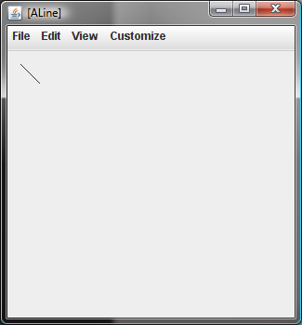
Line?

Slide 105
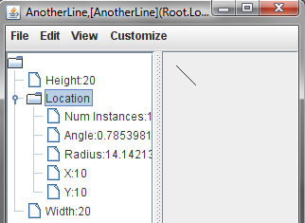
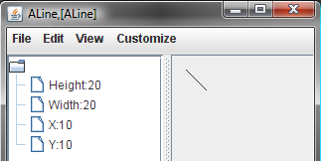
Describing Lines
Point
h2
w2
Bounding Rectangle
x2, y2
h2
w2

Slide 106
Line Interface
public interface Line {
public int getX();
public void setX(int newX);
public int getY();
public void setY(int newY);
public int getWidth();
public void setWidth(int newVal);
public int getHeight();
public void setHeight(int newHeight);
}

Slide 107
Line Implementation
public class ALine implements Line{
int x, y, width, height;
public ALine (int initX, int initY, int initWidth, int initHeight) {
x = initX;
y = initY;
width = initWidth;
height = initHeight;
}
public int getX() {return x;}
public void setX(int newX) {x = newX;}
public int getY() {return y;}
public void setY(int newY) {y = newY;}
public int getWidth() {return width;}
public void setWidth(int newVal) {width = newVal;}
public int getHeight() {return height;}
public void setHeight(int newHeight) {height = newHeight;}
}

Slide 108
AnotherLine Interface
public interface AnotherLine {
public Point getLocation();
public void setLocation(Point newLocation);
public int getWidth();
public void setWidth(int newVal);
public int getHeight();
public void setHeight(int newHeight);
}

Slide 109
Alternative Implementation with Two Different Kinds of Properties
public class AnAnotherLine implements AnotherLine {
int width, height;
Point location;
public AnAnotherLine (Point initLocation, int initWidth, int initHeight) {
location = initLocation;
width = initWidth;
height = initHeight;
}
public Point getLocation() {return location;}
public void setLocation(Point newVal) {location = newVal;}
public int getWidth() {return width;}
public void setWidth(int newVal) {width = newVal;}
public int getHeight() {return height;}
public void setHeight(int newHeight) {height = newHeight;}
}

Slide 110
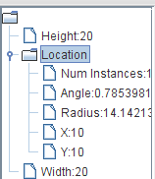
Predefined, Primitive vs. Programmer-Defined, Object
Point
Programmer-defined
Object
int
Predefined
Primitive

Slide 111
Programmer-defined vs. Predefined Types
Programmer-defined interface/class (Point/ACartesianPoint) is programmer-defined type
Programmer-defined types in Java must be object types
Some object types are predefined (String)
All primitive types are predefined

Slide 112
Structured vs. Atomic Properties
Angle
Radius
…

Slide 113
Structure vs. Atomic Types
types
Structured Types
Classes
Primitive types
ABMICalculator
ABMISpreadsheet
double
int
AnotherBMISpreadsheet
Interfaces
BMISpreadsheet
Point
Instances of structure type decomposed into one or more smaller values

Slide 114
Decomposing AnAnotherLine Instance
public class AnAnotherLine implements AnotherLine {
int width, height;
Point location;
public AnAnotherLine (Point intLocation, int initWidth, int initHeight) {
location = initLocation;
width = initWidth;
height = initHeight;
}
public Point getLocation() {return location;}
public void setLocation(Point newVal) {location = newVal;}
public int getWidth() {return width;}
public void setWidth(int newVal) {width = newVal;}
public int getHeight() {return height;}
public void setHeight(int newHeight) {height = newHeight;}
}
new AnAnotherLine(new ACartesianPoint (10, 10), 20, 20)

Slide 115
Physical Structure
int
x
int
ACartesianPoint
y
Variable name
location
width
AnAnotherLine
int
Class or primitive type of value stored in variable
height
int
new AnAnotherLine(new ACartesianPoint (10, 10), 20, 20)

Slide 116
Logical Structure
int
int
Property name
X
Y
Point
double
Location
Angle
Width
Radius
AnAnotherLine
int
double
Class or primitive type of property value
Height
int
new AnAnotherLine(new ACartesianPoint (10, 10), 20, 20)

Slide 117
Structure Shown by ObjectEditor
Angle
Radius
…
ObjectEditor cannot see instance variables

Slide 118

Structure Shown by Debugger

Slide 119
Two Ways to Decompose Objects
Physical Decomposition
  components of objects are its instance variables
    x, y, location, width, size
  the component can be further decomposed
    location into x, y
  difference instances of same class may have different physical structure
Logical Decomposition
  components of object are its properties
    Location, X, Y, Radius, Angle, Width, Height
  each of these can be further decomposed
    Location can be decomposed into X, Y, Angle, Radius
  all instances of class have same logical structure
  class properties not considered part of instance

Slide 120
Drawing the Physical Structure of a Value of Some Type
Start with the name of the type of value
  type can be class or primitive type
  cannot be interface because no associated physical representation
For each instance variable of the value
  draw an edge
  end point of edge is primitive type/class of value assigned to variable if value is non-null and null otherwise
  label of edge is variable name
Follow the same algorithm to physically decompose value of each instance variable
Stop at atomic type or a type already drawn in the figure

Slide 121
Drawing the Logical Structure of a Value of Some Type
Start with the name of the class/primitive type of value
For each property defined by the type
  draw an edge
  end point of edge is primitive type/class of property value if not null and null otherwise
  label of edge is property name
Follow the same algorithm to logically decompose value of each property
Stop at atomic type or a type already drawn in the figure

Slide 122
Instance-Specific Structure
double
angle
double
APolarPoint
radius
location
width
AnAnotherLine
int
height
int
new AnAnotherLine(new APolarPoint (14.01, 0.78), 20, 20)
Structures of instances of same class can be different!

Slide 123
Instance-Specific Structure
int
x
int
ACartesianPoint
y
location
width
AnAnotherLine
int
height
int
new AnAnotherLine(new ACartesianPoint (10, 10), 20, 20)

Slide 124
Atomic vs. Structure Types
All primitive types are atomic
Object types with >= 1 properties are logically structured
Object types with >= 1 instance variables are physically structured
Some object types may be physically or logically atomic

Slide 125


ObjectEditor Shape Rules

Slide 126
ObjectEditor Shape Rules
Rectangle
Line
X, Y
X, Y
Height
Height
Width
Width
Oval
TextBox
X, Y
Label
X, Y
X, Y
Eiffel
Height
Height
hello
Height
Width
Width
Width

Slide 127
ObjectEditor Shape Rules
Rectangle
Line
Location
Location
Height
Height
Width
Width
Oval
TextBox
Location
Label
Location
Location
Height
Eiffel
Height
hello
Height
Width
Width
Width
The type of Location is any type following point rules given earlier

Slide 128
ObjectEditor Bounding Box Rules
An object describes the bounding box of a shape if it:
  represents the size of the bounding box using int (read-only or editable) properties, Height, and Width
  describes the location of the upper left corner of the bounding box using either:
    X, Y properties of type int
    A Location (read-only or editable) property whose type follows the ObjectEditor rules for a Point

Slide 129
ObjectEditor Shape Rules
An object is recognized as a rectangle/line/oval if:
  Its interface or class has the string “Rectangle”/”Oval”/”Line” in its name
  It has properties describing the bounding box of the shape
  Can have additional properties
public interface Line {
public int getX();
public void setX(int newVal);
public int getY();
public void setY(int newVal);
public int getWidth();
public void setWidth(int newVal);
public int getHeight() ;
public void setHeight(
int newVal);
}
public interface AnotherLine {
public Point getLocation();
public void setLocation(
Point newVal);
public int getWidth();
public void setWidth(int newVal);
public int getHeight() ;
public void setHeight(int newVal);
}

Slide 130
ObjectEditor TextBox Rules
An object is recognized as a textbox if:
  Its interface or class has the string “Text” in its name
  It has properties described the bounding box of the text-box
  It has String property Text representing contents of the text-box
  Can have additional properties
public interface TextBox {
public int getX();
public void setX(int newVal);
public int getY();
public void setY(int newVal);
public int getWidth();
public void setWidth(int newVal);
public int getHeight() ;
public void setHeight(int newVal);
public String getText();
public void setText(String newVal);
}

Slide 131
ObjectEditor Label Rules
An object is recognized as a label if:
  Its interface or class has the string “Label” or “Icon” in its name
  It has properties described the bounding box of the label.
  It either has String property
    Text giving the label text.
    ImageFileName describing the name of a graphics file describing the label icon.
  Can have additional properties
public interface Label {
public Point getLocation();
public void setLocation(Point newVal);
public int getWidth();
public void setWidth(int newVal);
public int getHeight() ;
public void setHeight(int newHeight);
public String getText();
public void setText(String newString);
public String getImageFileName();
public void setImageFileName(
String newVal);
}
public interface AnotherLabel {
public Point getLocation();
public void setLocation(Point newVal);
public int getWidth();
public void setWidth(int newVal);
public int getHeight() ;
public void setHeight(int newVal);
public String getImageFileName();
public void setImageFileName(
String newVal);
}

Slide 132
Label Implementation
public class ALabel implements Label {
int width, height;
String text, imageFile;
Point location;
public ALabel (
int initX, int initY, int initWidth, int initHeight,
String initText, String theImageFile) {
location = new ACartesianPoint(initX, initY);
width = initWidth; height = initHeight;
text = initText; imageFile = theImageFile;
}
public Point getLocation() {return location;}
public void setLocation(Point newVal) {location = newVal;}
public int getWidth() { return width;}
public void setWidth(int newVal) {width = newVal;}
public int getHeight() {return height;}
public void setHeight(int newHeight) {height = newHeight;}
public String getText() {return text;}
public void setText(String newVal) {text = newVal;}
public String getImageFileName() {return imageFile;}
public void setImageFileName(String newVal) {imageFile = newVal;}
}

Slide 133


Using ALabel
The label icon and image are offset 0, height/2 from upper left corner
Text follows the label in a left-to-right order.

Slide 134
Creating Other Geometric Objects
Compose the existing geometric objects
  Point, Line, Rectangle, Oval, TextBox, Icon
Any graphical image can be created from triangles!

Slide 135

ACartesianPlane

Slide 136

ACartesianPlane

Slide 137
ACartesianPlane Properties
Axes Length (int)

Slide 138
ACartesianPlane Properties (Edit)
Axes Length (int)

Slide 139
ACartesianPlane Properties
Axes Length (int)
XAxis (Line)
YAxis (Line)
XLabel (Label)
YLabel (Label)

Slide 140
ACartesianPlane Implementation
public class ACartesianPlane implements CartesianPlane {
int axesLength ;
Line xAxis;
Line yAxis;
Label xLabel;
Label yLabel;
final int LABEL_BOUNDS_SIDE_LENGTH = 10;
public ACartesianPlane (int theAxesLength,
int theOriginX, int theOriginY ) {
}
public Line getXAxis() {return xAxis;}
public Line getYAxis() {return yAxis;}
public int getAxesLength() {return axesLength;}
public void setAxesLength(int newVal) {
}
public Label getXLabel() {return xLabel;}
public Label getYLabel() {return yLabel;}
}

Slide 141
ACartesianPlane Implementation (Edit)
public class ACartesianPlane implements CartesianPlane {
int axesLength ;
Line xAxis;
Line yAxis;
Label xLabel;
Label yLabel;
final int LABEL_BOUNDS_SIDE_LENGTH = 10;
public ACartesianPlane (int theAxesLength,
int theOriginX, int theOriginY ) {
}
public Line getXAxis() {return xAxis;}
public Line getYAxis() {return yAxis;}
public int getAxesLength() {return axesLength;}
public void setAxesLength(int newVal) {
}
public Label getXLabel() {return xLabel;}
public Label getYLabel() {return yLabel;}
}

Slide 142
ACartesianPlane Implementation
public class ACartesianPlane implements CartesianPlane {
int axesLength ;
Line xAxis, yAxis;
Label xLabel, yLabel;
final int LABEL_BOUNDS_SIDE_LENGTH = 10;
public ACartesianPlane (int theAxesLength, int theOriginX, int theOriginY ) {
axesLength = theAxesLength;
xAxis = new ALine(
theOriginX - theAxesLength/2, theOriginY, theAxesLength, 0);
yAxis = new ALine(
theOriginX, theOriginY - theAxesLength/2, 0, theAxesLength);
xLabel = new ALabel(
theOriginX + theAxesLength/2,
theOriginY - LABEL_BOUNDS_SIDE_LENGTH/2,
LABEL_BOUNDS_SIDE_LENGTH,
LABEL_BOUNDS_SIDE_LENGTH, "X", null);
yLabel = new ALabel(
theOriginX,
theOriginY - theAxesLength/2 - LABEL_BOUNDS_SIDE_LENGTH,
LABEL_BOUNDS_SIDE_LENGTH,
LABEL_BOUNDS_SIDE_LENGTH, "Y", null);
}

Slide 143
ACartesianPlane Implementation
public Line getXAxis() {return xAxis;}
public Line getYAxis() {return yAxis;}
public int getAxesLength() {return axesLength;}
public void setAxesLength(int newVal) {
int lengthIncrease = newVal - axesLength;
xAxis.setX(xAxis.getX() - lengthIncrease/2);
yAxis.setY(yAxis.getY() - lengthIncrease/2);
xLabel.setLocation(new ACartesianPoint(
xLabel.getLocation().getX() + lengthIncrease/2,
xLabel.getLocation().getY()));
yLabel.setLocation(new ACartesianPoint(
yLabel.getLocation().getX(),
yLabel.getLocation().getY() - lengthIncrease/2));
axesLength = newVal;
xAxis.setWidth(axesLength);
yAxis.setHeight(axesLength);
}
public Label getXLabel() {return xLabel;}
public Label getYLabel() {return yLabel;}
}
Cannot change instance of Point since Point is immutable!
We must create new instances of Point instead.

Slide 144
ACartesianPlane Implementation
public Line getXAxis() {return xAxis;}
public Line getYAxis() {return yAxis;}
public int getAxesLength() {return axesLength;}
public void setAxesLength(int newVal) {
int lengthIncrease = newVal - axesLength;
xAxis.setX(xAxis.getX() - lengthIncrease/2);
yAxis.setY(yAxis.getY() - lengthIncrease/2);
xLabel.setLocation(new ACartesianPoint(
xLabel.getLocation().getX() + lengthIncrease/2,
xLabel.getLocation().getY()));
yLabel.setLocation(new ACartesianPoint(
yLabel.getLocation().getX(),
yLabel.getLocation().getY() - lengthIncrease/2));
axesLength = newVal;
xAxis.setWidth(axesLength);
yAxis.setHeight(axesLength);
}
public Label getXLabel() {return xLabel;}
public Label getYLabel() {return yLabel;}
}
Can we refactor the code?

Slide 145
Refactoring Label Code
public Line getXAxis() {return xAxis;}
public Line getYAxis() {return yAxis;}
public int getAxesLength() {return axesLength;}
public void setAxesLength(int newVal) {
int lengthIncrease = newVal - axesLength;
xAxis.setX(xAxis.getX() - lengthIncrease/2);
yAxis.setY(yAxis.getY() - lengthIncrease/2);
updateXOfLabel(xLabel, xLabel.getLocation().getX() + lengthIncrease/2);
updateYOfLabel(yLabel, yLabel.getLocation().getY() - lengthIncrease/2);
axesLength = newVal;
xAxis.setWidth(axesLength);
yAxis.setHeight(axesLength);
}
public Label getXLabel() {return xLabel;}
public Label getYLabel() {return yLabel;}
}

Slide 146
Refactoring Label Code (Edit)
public Line getXAxis() {return xAxis;}
public Line getYAxis() {return yAxis;}
public int getAxesLength() {return axesLength;}
public void setAxesLength(int newVal) {
…
updateXOfLabel(xLabel, xLabel.getLocation().getX() + lengthIncrease/2);
updateYOfLabel(yLabel, yLabel.getLocation().getY() - lengthIncrease/2);
…
}
// v1
/*private Label updateXofLabel(Label label, int newX) {
Label newLabel = new ALabel( newX, label.getLocation().getY(), label.getWidth(), label.getHeight(), label.getText(), label.getImageFileName());
return newLabel;
}*/
//v2
private static void updateXofLabel(Label label, int newX) {
label.setLocation(new ACartesianPoint(newX, label.getLocation().getY()));
}
public Label getXLabel() {return xLabel;}
public Label getYLabel() {return yLabel;}
}

Slide 147
Refactoring Label Code
…
public void setAxesLength(int newVal) {
…
updateXOfLabel(xLabel, xLabel.getLocation().getX() + lengthIncrease/2);
updateYOfLabel(yLabel, yLabel.getLocation().getY() - lengthIncrease/2);
…
}
public static void updateXOfLabel(Label label, int newX) {
label.setLocation(new ACartesianPoint(
newX, label.getLocation().getY());
}
public static void updateYOfLabel(Label label, int newY) {
label.setLocation(new ACartesianPoint(
label.getLocation().getX(), newY));
}
…
}
New methods do not interact with instance variables
So make them class methods!

Slide 149


ACartesianPlane

Slide 150

Shuttle Location

Slide 151

Shuttle Location

Slide 152

Shuttle Location

Slide 153
ShuttleLocation Properties
ShuttleX (int)

Slide 154
ShuttleLocation Properties (edit)
ShuttleX (int)

Slide 155
ShuttleLocation Properties (edit)
ShuttleX (int)
ShuttleY (int)
ShuttleLabel (Label)
CartesianPlane
(CartesianPlane)

Slide 156
AShuttleLocation Implementation
public class AShuttleLocation implements ShuttleLocation {
public final int SHUTTLE_WIDTH = 80;
public final int SHUTTLE_HEIGHT = 30;
public final int CP_ORIGIN_X = 200;
public final int CP_ORIGIN_Y = 200;
public final int CP_INIT_AXES_LENGTH = 300;
public final String SHUTTLE_IMAGE = “shuttle2.jpg”;
public final String SHUTTLE_TEXT = “”;
int shuttleX, shuttleY;
CartesianPlane plane = new ACartesianPlane(CP_ORIGIN_X, CP_ORIGIN_Y, CP_INIT_AXES_LENGTH);
Label shuttleLabel = new ALabel(getShuttleX(), getShuttleY(), SHUTTLE_WIDHT, SHUTLTE_HEIGHT, SHUTTLE_TEXT, SHUTTLE_IMAGE);
private int getShuttleX(){
return CP_ORIGIN_X + shuttleX;
}
private int getShuttleY() {
return CP _ORIGIN_Y– shuttleY – SHUTTLE_HEIGHT;
}

Slide 157
AShuttleLocation Implementation (Edit)
public CartesianPlane cartesianPlane() {
return plane;
}
public Label shuttleLabel() {
return shuttleLabel;
}
public void setShuttleX(int newShuttleX) {
shuttleX = newShuttleX;
shuttleX.setLocation(new ACartesianPoint(getShuttleX(), shuttleLabel.getLocation().getY());
}
public int getShuttleX() { return shuttleX; }
public void setShuttleY(int newShuttleY) {
shuttleY = newShuttleY;
shuttleLabel.setLocation(new ACartesinaPoint(shuttleLabel.getLocation().getX(), getSHuttleY());
}
public int getShuttleY() { return shuttleY; }
}

Slide 158
AShuttleLocation Implementation
public class AShuttleLocation implements ShuttleLocation {
static final int ORIGIN_X = 200, ORIGIN_Y = 200;
static final int AXES_LENGTH = 300;
static final String SHUTTLE_IMAGE = "shuttle2.jpg";
static final String SHUTTLE_TEXT = "";
static final int SHUTTLE_WIDTH = 80;
static final int SHUTTLE_HEIGHT = 25;
int shuttleX = 0, shuttleY = 0;
ACartesianPlane cartesianPlane = new ACartesianPlane (
AXES_LENGTH, ORIGIN_X, ORIGIN_Y);
ALabel shuttleLabel = new ALabel(
labelX(), labelY(),
SHUTTLE_WIDTH, SHUTTLE_HEIGHT,
SHUTTLE_TEXT, SHUTTLE_IMAGE);

Slide 159
AShuttleLocation Implementation
public ACartesianPlane getCartesianPlane() {return cartesianPlane;}
public ALabel getShuttleLabel() {return shuttleLabel;}
public int getShuttleX() {return shuttleX;}
public void setShuttleX(int newVal) {
shuttleX = newVal;
shuttleLabel.setLocation(new ACartesianPoint(labelX(), labelY()));
}
public int getShuttleY() {return shuttleY;}
public void setShuttleY(int newVal) {
shuttleY = newVal;
shuttleLabel.setLocation(new ACartesianPoint(labelX(), labelY()));
}
int labelX() {return ORIGIN_X + shuttleX;}
int labelY() {return ORIGIN_Y - shuttleY - SHUTTLE_HEIGHT;}
}

Slide 160

Alternate Views of Logical Structure
Logical Structure Without Graphical Properties
Graphical Properties
Complete Logical Structure

Slide 161

Lines of Composition
Lines can be composed into triangles
Triangles can be composed to create arbitrary computer graphics

